Slide 1

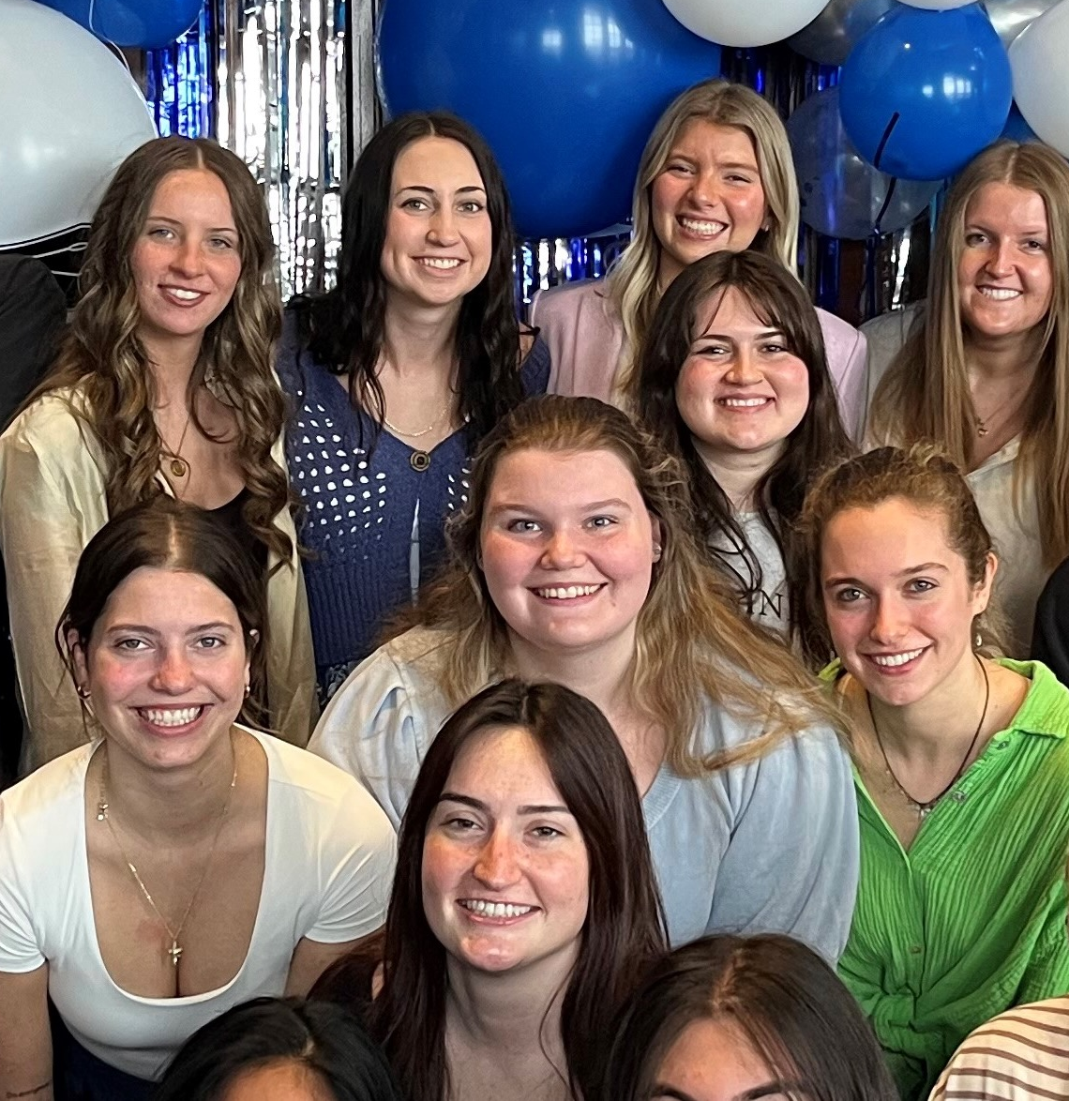
1. RECENT JOB/INTERNSHP OPENINGS | New week, new opportunities to learn and grow as an HTM professional. Check out the listings for jobs and internships!
2 . WINTER CAREER & INTERNSHIP FAIR | This semester’s career & internship fair is on February 19th from 1-5 pm at the Devos Convention Center in downtown Grand Rapids. Find out more information through the Career Center website.
3. INTERNSHIP OPPORTUNITY | Applications for Scenic Stays is now open! Learn about the vacation rental industry while interning on the beach during the summer.
4. AHLA HOSPITALITY SCHOLARSHIP | The AHLA Foundation Scholarship application cycle is now open for the 2026-2027 academic year. Applications are being accepted until March 23, 2026.
5. INTERNSHIP OPPORTUNITY | Kandle Dining Services is currently seeking talented and dedicated candidates for a Hospitality Internship positions for the summer of 2026,. Competitive wages, travel reimbursement, and housing and meals provided
6.. EXTERNSHIP OPPORTUNITY | Spend spring break week at one of AHC Hospitality’s Grand Rapids properties learning about hotel housekeeping during an immersive hands-on externship
2.2.2026

Slide 2
New Internship and Employment Opportunities
Front Desk Agent - Airport
Paws Up Montana - Greenough, Montana
Application Deadline: March 31, 2026 (will continue to repost position until filled) Posted: 1/29/26
Administrative Operations Intern
Blackthorn Productions - Ann Arbor , Michigan
Application Deadline: 4/28/26 Posted: 1/28/26
Event Assistant
All Buttoned Up Events - Grand Rapids, Michigan
Application Deadline: 3/1/2026 Posted: 1/26/26
Hospitality Housekeeping Externship
AHC Hospitality - Grand Rapids, Michigan
Application Deadline: 2/13/26 Posted: 1/23/26
1

Slide 3

GVSU WINTER CAREER & INTERNSHIP FAIR
2
The Career & Internship Fair is an excellent place to kick off your job or internship search, or to begin networking with organizations looking to hire Grand Valley students and alumni of all majors! 230 employers with THOUSANDS of immediate openings are expected to attend. Attend the Career Fair to:
Meet with employers to discuss full-time positions
Learn about available internships and co-ops
Build your professional network and expand your job search
Register Here!

Slide 4
INTERNSHIP OPPORTUNITY
Some highlights of this paid internship include:
A summer on the BEACH working and learning the Hospitality Industry firsthand
A dedicated mentor to guide you through the summer
Weekly Information Sessions about each aspect of the industry: Owner Relations, Guest Experiences, HOA and COA exposure, and Real Estate!
Bi-weekly (every two weeks) shifts at the Front Desk and Housekeeping Inspection, giving you a broad look at everything that goes into the hospitality
Two shadowing opportunities for any positions the student is interested in, can shadow anyone up to and including our CEO!
Did we mention it's paid?
If this internship interests you, please fill out our application at https://myscenicstays.com/internships/
3

Slide 5

HOSPITALITY SCHOLARSHIP
Each year, the AHLA Foundation administers a competitive scholarship process that awards more than 300 students with scholarships ranging from $2,000 to $7,000. Both school-allocated scholarship funds and general self-nominated scholarship funds, depending on eligibility, are available.
Application Deadline
Monday March 23, 2026
Apply through the QR code or at this link
4

Slide 6


INTERNSHIP OPPORTUNITY
5
Kandle Dining Services is recruiting interns for the Summer 2026 season.
Positions include:
Director of Dining Services
Front of House Team Lead
Kitchen Team Member
Benefits
Meals Provided
Room and Board Provided
Travel Reimbursement

Slide 7
EXTERNSHIP OPPORTUNITY
AHC Hospitality is once again offering a Housekeeping Externship during spring break at one of their downtown Grand Rapids properties.
The externship offers a chance for an immersive experience in gaining valuable, hands-on housekeeping knowledge.
6
More information at ahcjobs.com

Slide 8



IMPORTANT STUDENT RESOURCES
Join Replenish for a hands-on cooking demo exploring Halal food as culture. Learn how to make Halal Chicken Shawarma Bowls and Wraps and take home a care bag with ingredients to recreate the meal.
WEDNESDAY FEBRUARY 4 2026.
5:00 p.m. - 8:00 p.m.
Niemeyer Multipurpose Room
Allendale Campus

