Slide 1

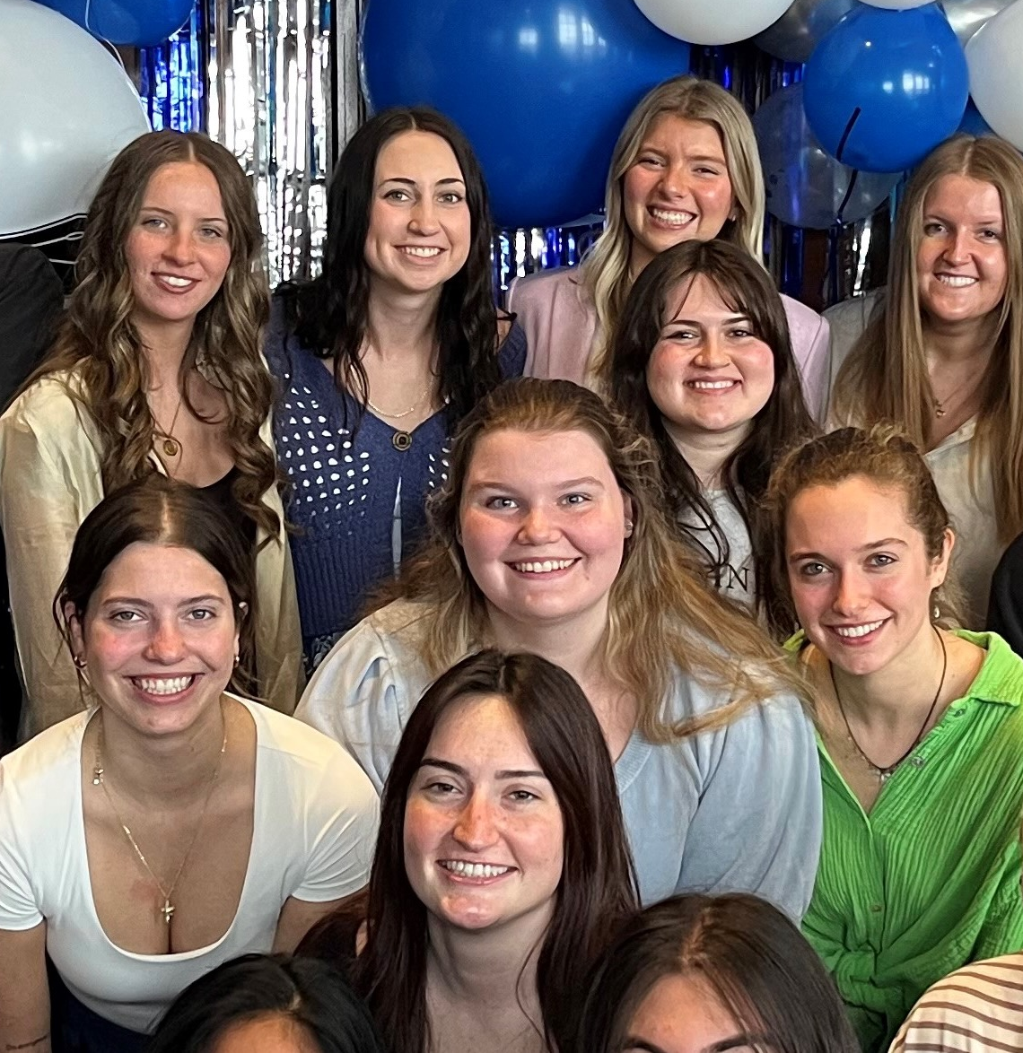
1. RECENT JOB/INTERNSHP OPENINGS | New week, new opportunities to learn and grow as an HTM professional. Check out the listings for jobs and internships!
2 . EXAM JAM WEEK | Stress management resources, events, brain breaks, study tips, and more! You've got this, Lakers! Let's exam JAM!.
3. NAMIBIA STUDY ABROAD | Join us on this adventure through Namibia! Explore the fascinating diversity of Africa’s ecosystems, wildlife, cultures and complex history through field trips, desert camping, lectures and discussion. Deadline February 1, 2026.
4. FOOD FOR FINES | University Libraries will be forgiving library fines until December 2 with the donation of 5 food items to the Replenish Basic Needs Center. Drop off at any library location.
5. INTERNSHIP OPPORTUNITY | Kandle Dining Services is currently seeking talented and dedicated candidates for a Hospitality Internship positions for the summer of 2026,. Competitive wages, travel reimbursement, and housing and meals provided
12.1.2025

Slide 2
New Internship and Employment Opportunities
Assistant Rentals Manager
John Ball Zoo - Grand Rapids, Michigan
Application Deadline: 01/01/2026 Posted: 11/14/25
Barista
Sheraton Grand Rapids - Grand Rapids, Michigan
Application Deadline: None Posted: 11/13/25
Maintenance Tech II
Sheraton Grand Rapids - Grand Rapids, Michigan
Application Deadline: None Posted: 11/13/25
Assistant Chief Engineer
Sheraton Grand Rapids - Grand Rapids, Michigan
Application Deadline: None Posted: 11/13/25
1

Slide 3
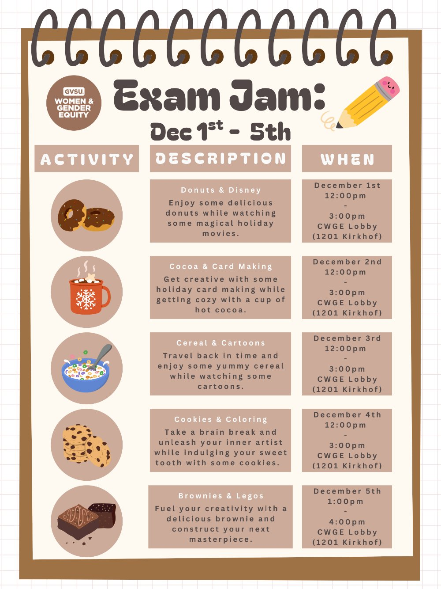
EXAM JAM WEEK
December 1st -5th
Allendale Campus
Stress management resources, events, brain breaks, study tips, and more! You've got this, Lakers! Let's exam JAM!
More information: https://www.gvsu.edu/studentaffairs/exam-jam-107.htm#events
2

Slide 4
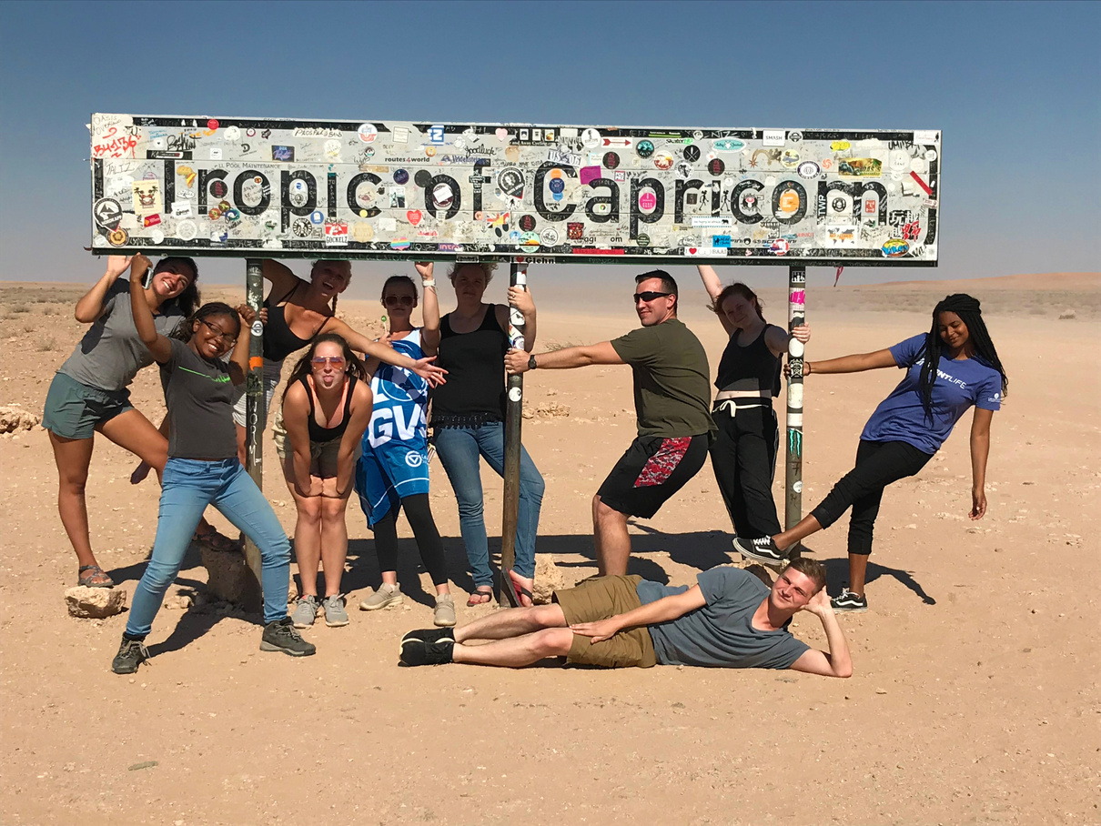
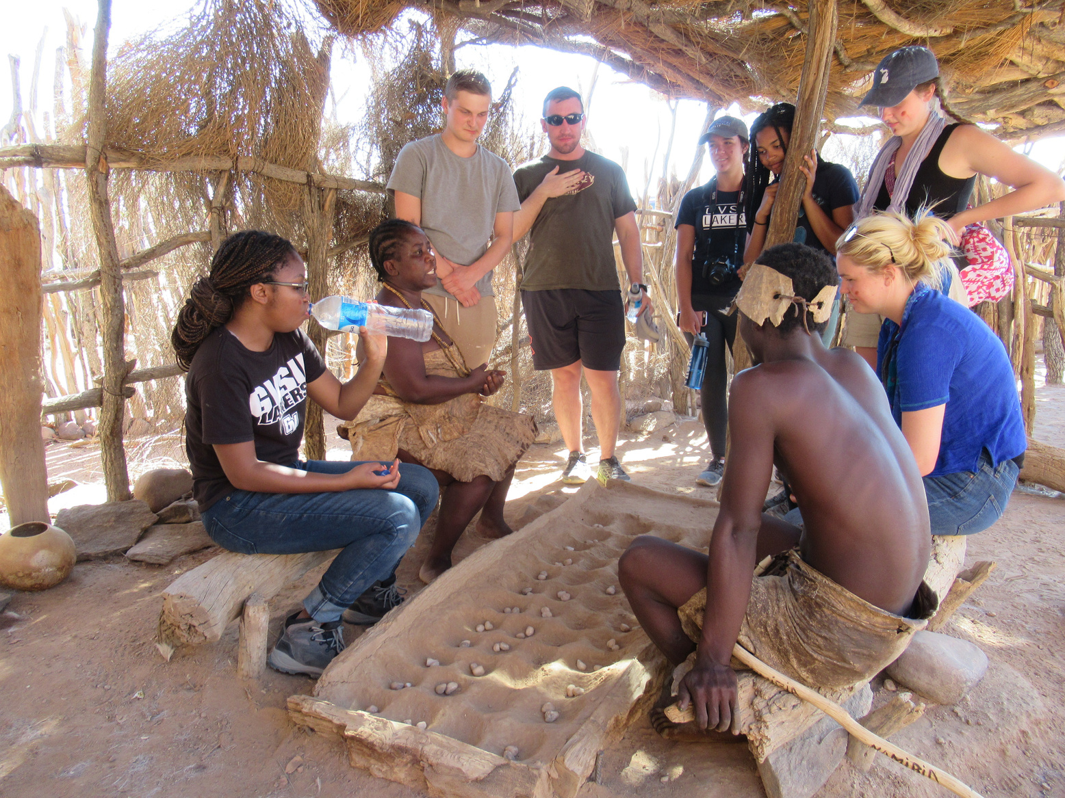
NAMIBIA STUDY ABROAD
3
Windhoek, Namibia: Join us on this adventure through Namibia! Explore the fascinating diversity of Africa’s ecosystems, wildlife, cultures and complex history through field trips, desert camping, lectures and discussion.
Questions? Steeve Buckridge 616-331-8550 buckrids@gvsu.edu
P R I O R I T Y A P P L I C A T I O N D E A D L I N E : D E C E M B E R 1, 2025
Final Deadline: February 1, 2026

Slide 5

FOOD FOR FINES
November 4 – December 2
University Libraries will be forgiving library fines until December 2 with the donation of 5 food items to the Replenish Basic Needs Center.
Donations can be dropped off at the following library locations. Swing by the front desk to drop off your items and have your book fines forgiven!
Valley Campus: Mary Idema Pew Library
City Campus: Steelcase Library
City Campus: Frey Foundation Library
Donations can include:
Shelf-stable pantry items
Personal hygiene
Household goods
4
F

Slide 6
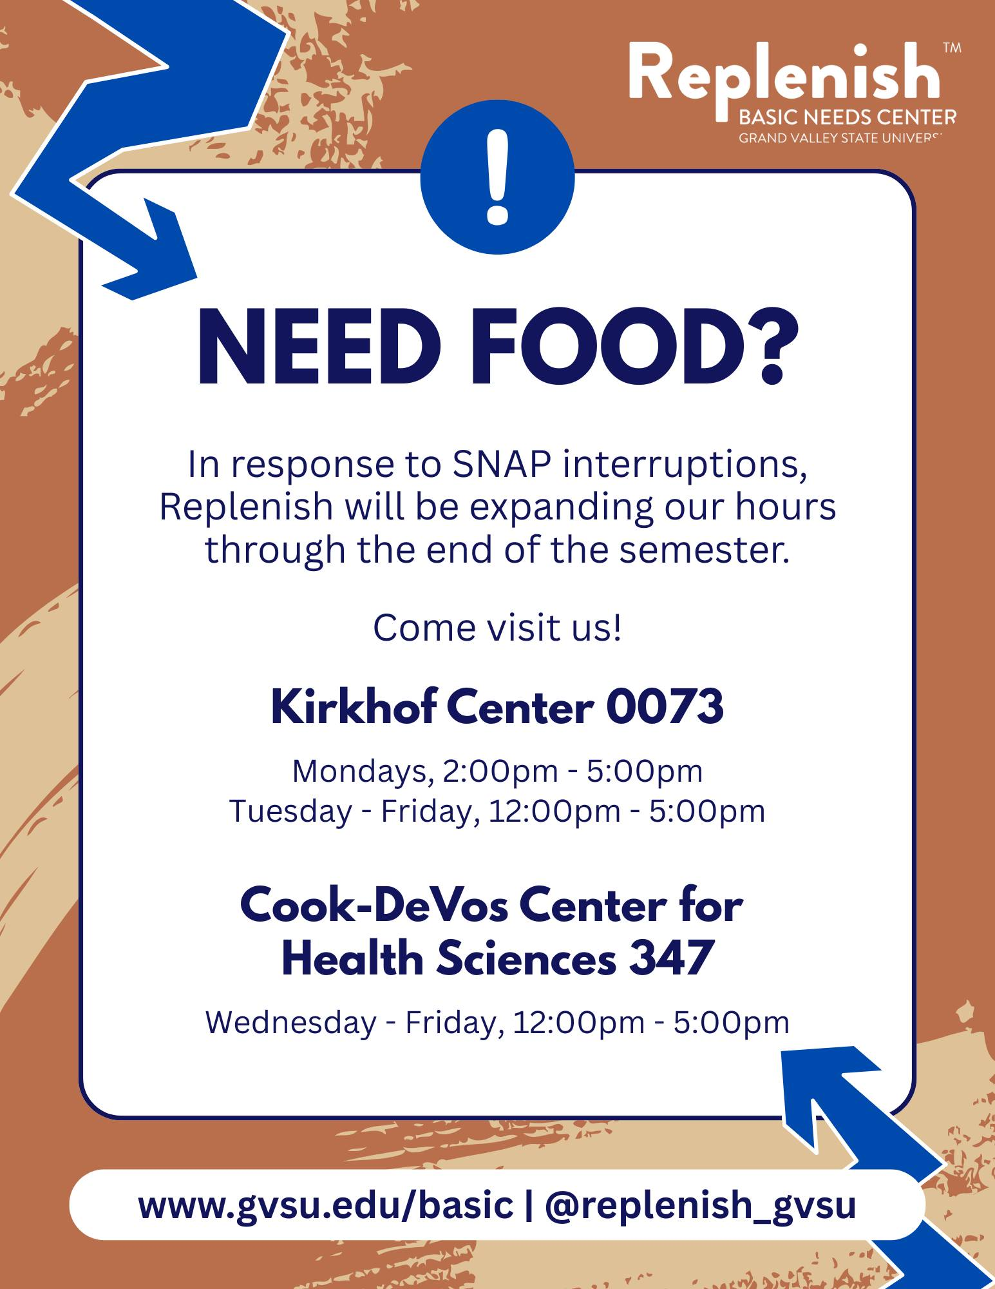


IMPORTANT STUDENT RESOURCES
It is important that all students are given the resources they need to thrive here at GVSU. Learn more about the resources available to you on campus, many of which are available to students at NO COST.
Available Resources Include: Academics, Academic Support, Belonging and Campus Climate, Campus Safety, Finances, and Wellness

Slide 7

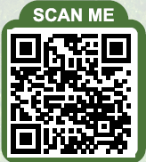
INTERNSHIP OPPORTUNITY
5
Kandle Dining Services is recruiting interns for the Summer 2026 season.
Positions include:
Director of Dining Services
Front of House Team Lead
Kitchen Team Member
Benefits
Meals Provided
Room and Board Provided
Travel Reimbursement

