Slide 1

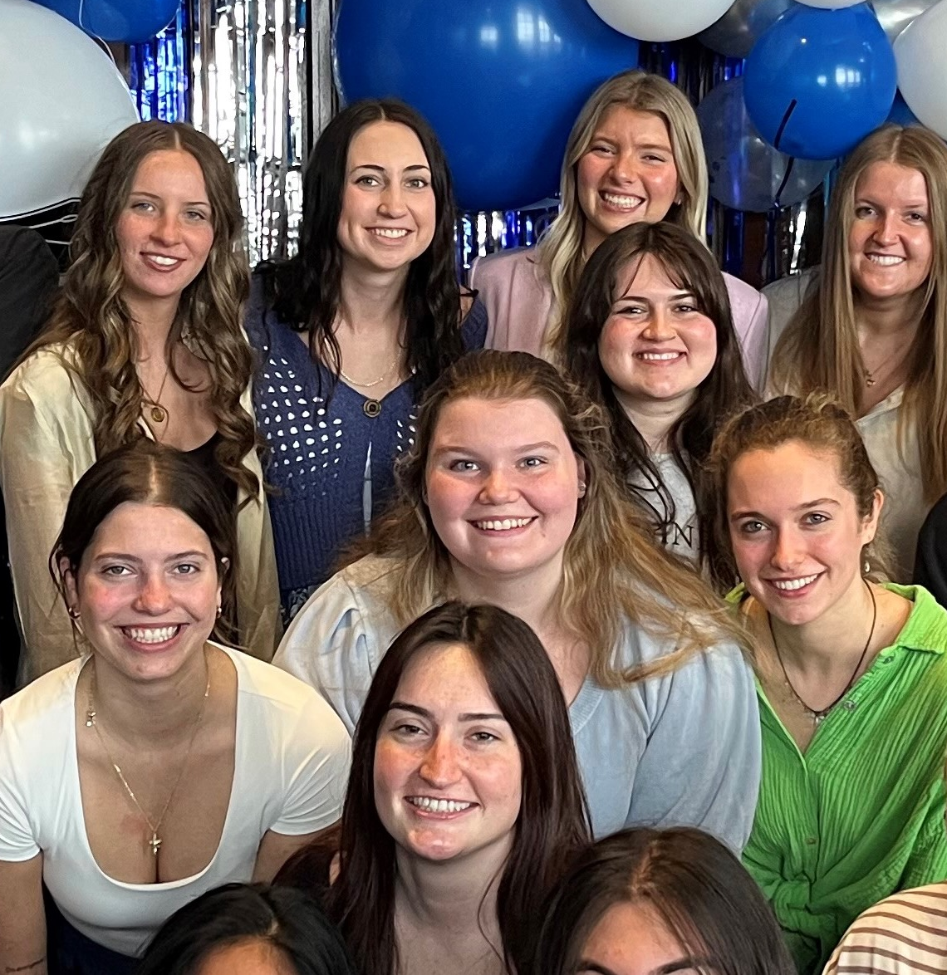
1. RECENT JOB/INTERNSHP OPENINGS | New week, new opportunities to learn and grow as an HTM professional. Check out the listings for jobs and internships!
2 . WINTER CAREER & INTERNSHIP FAIR | This semester’s career & internship fair is on February 19th from 1-5 pm at the Devos Convention Center in downtown Grand Rapids. Find out more information through the Career Center website.
3. NAMIBIA STUDY ABROAD | Join us on this adventure through Namibia! Explore the fascinating diversity of Africa’s ecosystems, wildlife, cultures and complex history through field trips, desert camping, lectures and discussion. Deadline February 1, 2026.
4. INTERNSHIP OPPORTUNITY | Applications for Scenic Stays is now open! Learn about the vacation rental industry while interning on the beach during the summer.
5. AHLA HOSPITALITY SCHOLARSHIP | The AHLA Foundation Scholarship application cycle is now open for the 2026-2027 academic year. Applications are being accepted until March 23, 2026.
6. INTERNSHIP OPPORTUNITY | Kandle Dining Services is currently seeking talented and dedicated candidates for a Hospitality Internship positions for the summer of 2026,. Competitive wages, travel reimbursement, and housing and meals provided
7. EXTERNSHIP OPPORTUNITY | Spend spring break week at one of AHC Hospitality’s Grand Rapids properties learning about hotel housekeeping during an immersive hands-on extenship
1.26.2026

Slide 2
New Internship and Employment Opportunities
Wedding & Floral Intern
Ludemas Floral & Garden - Grand Rapids , Michigan
Application Deadline: Friday, March 20th Posted: 1/22/26
VAGTC Student Event Support
GVSU's Van Andel Global Trade Center - Grand rapids, Michigan
Application Deadline: 4/22/26 Posted: 1/22/26
Guest Services/Front Desk Agent
Staybridge Suites Grand Rapids South - Grand Rapids, Michigan
Application Deadline: 2/2/26 Posted: 1/13/26
Housekeeping Externship
AHC - Grand Rapids, Michigan
Application Deadline: Until filled Posted: 12/12/25
1

Slide 3

GVSU WINTER CAREER & INTERNSHIP FAIR
2
The Career & Internship Fair is an excellent place to kick off your job or internship search, or to begin networking with organizations looking to hire Grand Valley students and alumni of all majors! 230 employers with THOUSANDS of immediate openings are expected to attend. Attend the Career Fair to:
Meet with employers to discuss full-time positions
Learn about available internships and co-ops
Build your professional network and expand your job search
Register Here!

Slide 4
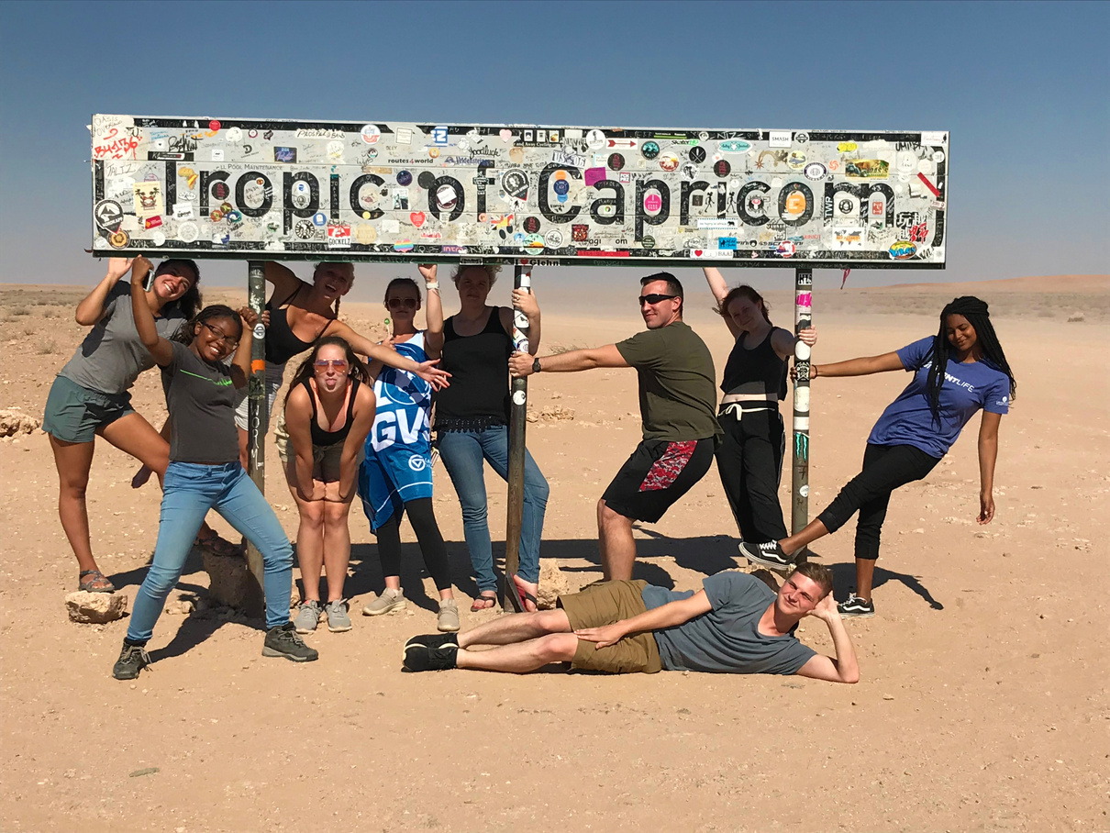
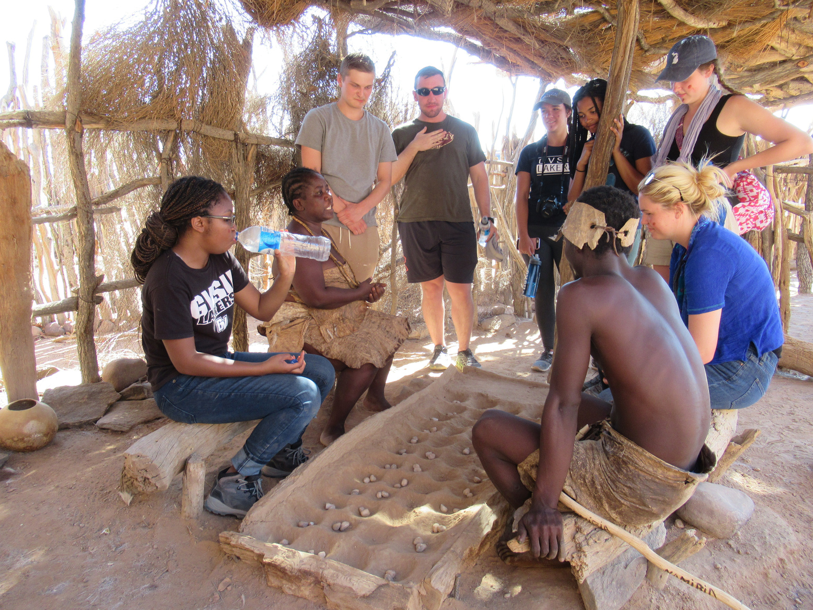
NAMIBIA STUDY ABROAD
3
Windhoek, Namibia: Join us on this adventure through Namibia! Explore the fascinating diversity of Africa’s ecosystems, wildlife, cultures and complex history through field trips, desert camping, lectures and discussion.
Questions? Steeve Buckridge 616-331-8550 buckrids@gvsu.edu
P R I O R I T Y A P P L I C A T I O N D E A D L I N E : D E C E M B E R 1, 2025
Final Deadline: February 1, 2026

Slide 5
INTERNSHIP OPPORTUNITY
Some highlights of this paid internship include:
A summer on the BEACH working and learning the Hospitality Industry firsthand
A dedicated mentor to guide you through the summer
Weekly Information Sessions about each aspect of the industry: Owner Relations, Guest Experiences, HOA and COA exposure, and Real Estate!
Bi-weekly (every two weeks) shifts at the Front Desk and Housekeeping Inspection, giving you a broad look at everything that goes into the hospitality
Two shadowing opportunities for any positions the student is interested in, can shadow anyone up to and including our CEO!
Did we mention it's paid?
If this internship interests you, please fill out our application at https://myscenicstays.com/internships/
4
F

Slide 6

HOSPITALITY SCHOLARSHIP
Each year, the AHLA Foundation administers a competitive scholarship process that awards more than 300 students with scholarships ranging from $2,000 to $7,000. Both school-allocated scholarship funds and general self-nominated scholarship funds, depending on eligibility, are available.
Application Deadline
Monday March 23, 2026
Apply through the QR code or at this link
5

Slide 7

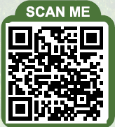
INTERNSHIP OPPORTUNITY
6
Kandle Dining Services is recruiting interns for the Summer 2026 season.
Positions include:
Director of Dining Services
Front of House Team Lead
Kitchen Team Member
Benefits
Meals Provided
Room and Board Provided
Travel Reimbursement

Slide 8
EXTERNSHIP OPPORTUNITY
AHC Hospitality is once again offering a Housekeeping Externship during spring break at one of their downtown Grand Rapids properties.
The externship offers a chance for an immersive experience in gaining valuable, hands-on housekeeping knowledge.
7
More information at ahcjobs.com

