Slide 1
COVID-19 Student Survival Advice
How to make it through trying times!
Report by: Dr. Christine Yalda, GVSU School of Criminal Justice

Slide 2
Reminders:
This slideshow reflects student advice about dealing with the COVID 19 crisis. In addition:
Remember that we are all in this together. See GVSU Lakers Together for up-to-date information about campus health and safety.
Make sure that you use necessary precautions
Wear a mask
Wash your hands
Watch your (social) distance
If you are sick, take care of yourself and take care of others, by isolating if necessary.
The GVSU Care Team supports student concerns, including financial, basic needs, physical and mental health, campus climate concerns, off campus housing, concerns for well-being, and disturbing behavior. For help or more information, see the CARE website.

Slide 3
The COVID-19 crisis and how students are surviving…in their own words:
In mid-March 2020, GVSU moved its face-to-face classes online, closed residential housing, and limited access to campus in response to the COVID-19 crisis. These necessary changes significantly disrupted students’ everyday lives: an abrupt shift to virtual learning, revised schedules/assignments; employment changes (lost jobs, reduced hours, increased hours (essential workers), etc.); and housing changes (many moved in with friends or back home, where family responsibilities often became more critical). Yet, when asked, students shared remarkable insights and resilience in terms of how to survive these challenges.
Here is their advice, in their own words…

Slide 4
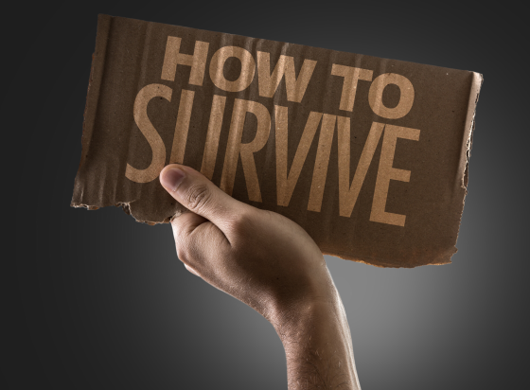
Five Elements of Survival:
Do the Work
Ask for Help (It’s Okay!)
Be Kind to Yourself and Others
Be Balanced
Be Adaptable

Slide 5
Do the Work:
Make and plan and stick to it – Organization is key!
Use a planner or calendar
Be proactive about due dates
Never miss a deadline!

Slide 6
Do the Work:
Schedule and manage your time – Stay focused, meet deadlines!
Create a routine with a weekly schedule
Designate time for reading, discussion work, studying.
Write down ALL due dates as soon as you know them
Cross them off as you finish them – One less thing to do!
Don’t try to do everything in one day
Pace yourself!

Slide 7
Do the Work:
Keep up with the work – Procrastination = Stress!
Check e-mail and blackboard regularly Don’t miss course changes/assignment reminders!
Don’t procrastinate Stay on top of your assignments – they can build up quickly!
Read course materials – Don’t skim! When you know the materials, it’s easier to participate!

Slide 8
Do the Work:
Communication is key!
Keep communication open with instructor
Your situation may be different than others – Communicate that!
Talk to classmates
Good communication is essential when working in groups!

Slide 9
Do the Work:
Stay Focused and Persist!
Focus and keep things in perspective
Take it one day at a time!
Stay on track to achieve goals
Work hard and keep going!
Don’t. Quit.
Persevere – You can do it!

Slide 10
Ask for Help (It’s Okay!):
Talk with friends, classmates, faculty/staff
During difficult times, many people experience similar feelings/fears – talk about it, you’re not alone!
Utilize available resources
Tutoring, counseling, advising, etc. – all FREE for GVSU students!
It’s okay to seek help/support
GVSU faculty/staff are here to assist you!

Slide 11
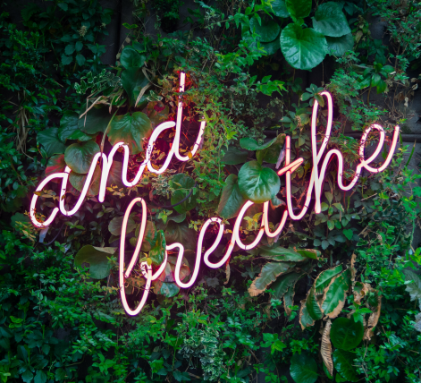
Be Kind to Yourself and Others:
Be safe, make good choices.
Remember to BREATHE!
Take your time, collect your thoughts, stay safe.
Think before you react – Don’t panic!
Keep a level head – choose rational over irrational, use logic and reasoning.

Slide 12
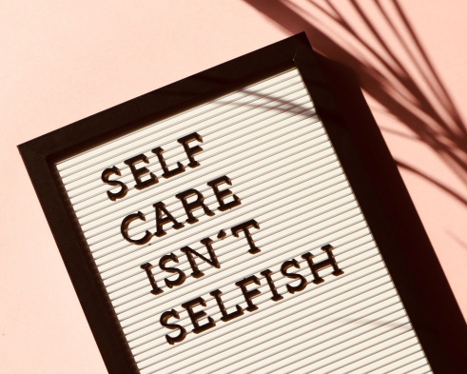
Be Kind to Yourself and Others:
Practice self-care – Maintain physical, emotional, mental health!
Self-care, exercise, maintain relationships
Take care of your body and mind, keep in touch with family/friends. Isolation isn’t healthy.
Limit exposure to news and social media
Constant negativity can be overwhelming and may worsen mental health.

Slide 13
Be Kind to Yourself and Others:
Take a break from school if needed – Reset and Recharge!
Don’t overwork yourself – Make time for you!
Schedule breaks into your daily agenda and TAKE THEM! Clear your mind before tackling the next item on your list.
It’s okay to step away
College is stressful! If you need a break from school, take it. Come back when you have a fresh mindset and are ready.

Slide 14
Be Kind to Yourself and Others:
Give grace – Show compassion to yourself and others!
Be gentle with yourself
School is important, but not more important than your health and sanity.
Give yourself grace and understanding for your feelings and needs
It’s okay to do nothing or spend time with those you love, instead of being productive. The COVID-19 crisis is scary and unknown – if you need to take time away from school and work to care for yourself, DO IT!
Be kind and mindful
Observe your surroundings, and don’t be too hard on yourself. By keeping our wits about us, maintaining order, and exhibiting grace under pressure, we can persevere!

Slide 15
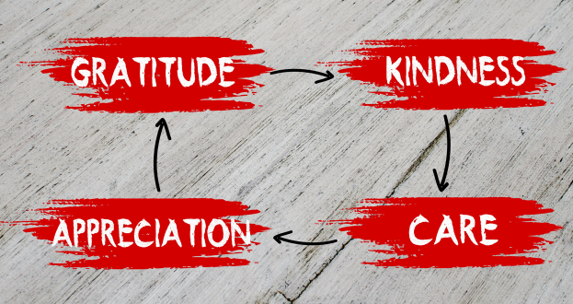
Be Kind to Yourself and Others:
Do what you love!
Invest your time wisely
Do what you love, and don’t take anything for granted.
Care for yourself and others
Kindness and selflessness can go a long way in the world – don’t lose sight of that, even when struggling yourself.

Slide 16
Be Balanced:
School is not everything!
Devote certain hours each day to online classes
Designated hours for classwork will make it feel less like your entire day belongs to school.
Priorities may change, and that’s okay
Responsibilities may shift during a crisis. Family or work may become your primary focus for a while, but that doesn’t make you any less of a student.

Slide 17
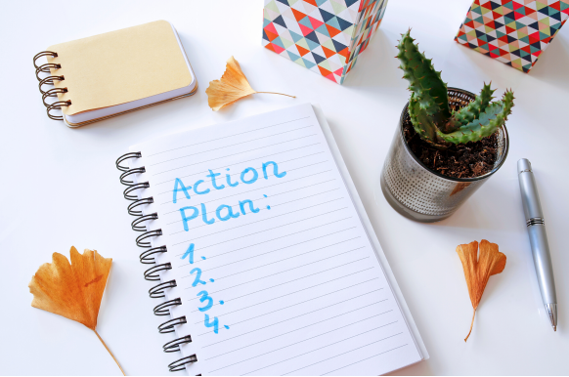
Be Adaptable:
Keep Calm and Carry On!
Be flexible – This is new for everyone!
You may have to adopt a new routine or learning style as circumstances change.
Prepare for multiple scenarios
Have a plan for different situations – hope for the best, but plan for the worst.

Slide 18
Be Adaptable:
Figure out the “new normal” together!
Be supportive
Everyone is in a similar situation, don’t face the struggle alone.
Faculty, staff, and students are in this together – communicate, listen, and take it one step at a time.

Slide 19
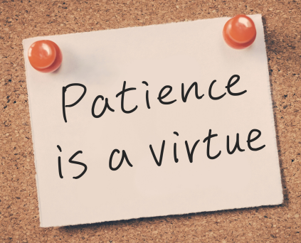
Be Adaptable:
Take time to grow.
Have patience
There’s an adjustment period after sudden change, don’t rush it.
Know that things will get better – they may not go back to the way they originally were, but you will have grown and learned through this experience, and you’ll be stronger for it.

Slide 20
About This Presentation:
This presentation summarizes student survival advice collected in two General Education courses at the end of Winter 2020 semester. Students were asked:
You are completing this semester at a unique time in history. If you could offer some “survival advice” to future students, what would you want them to know?
Combined, these classes included students from 25 different majors. Eighty-percent (80%) of the students (n=56) answered the question.
For more information about this project, please contact Dr. Christine Yalda, Grand Valley State University, 616-331-7135, yaldac@gvsu.edu.
Images Source: Canva Pro. PowerPoint Created by: Victoria A. Stubbs ‘10, GVSU Hospitality and Tourism Management, June 2020.

