Slide 1
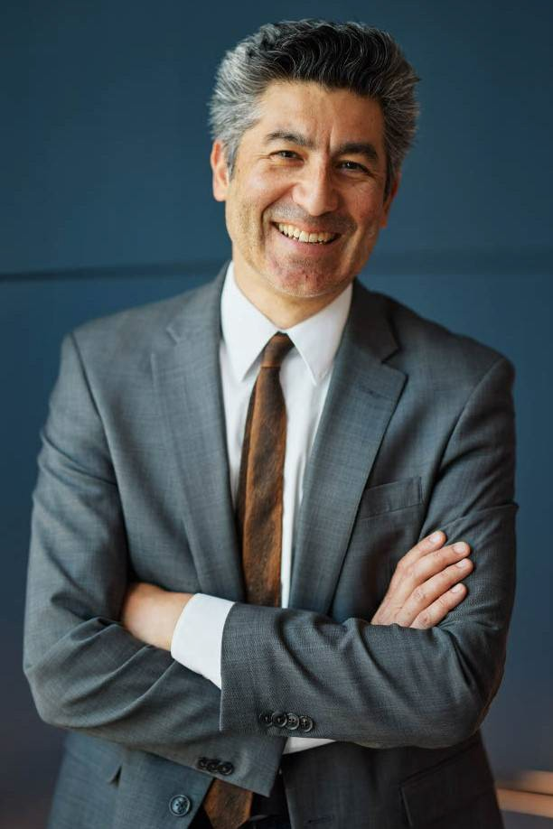
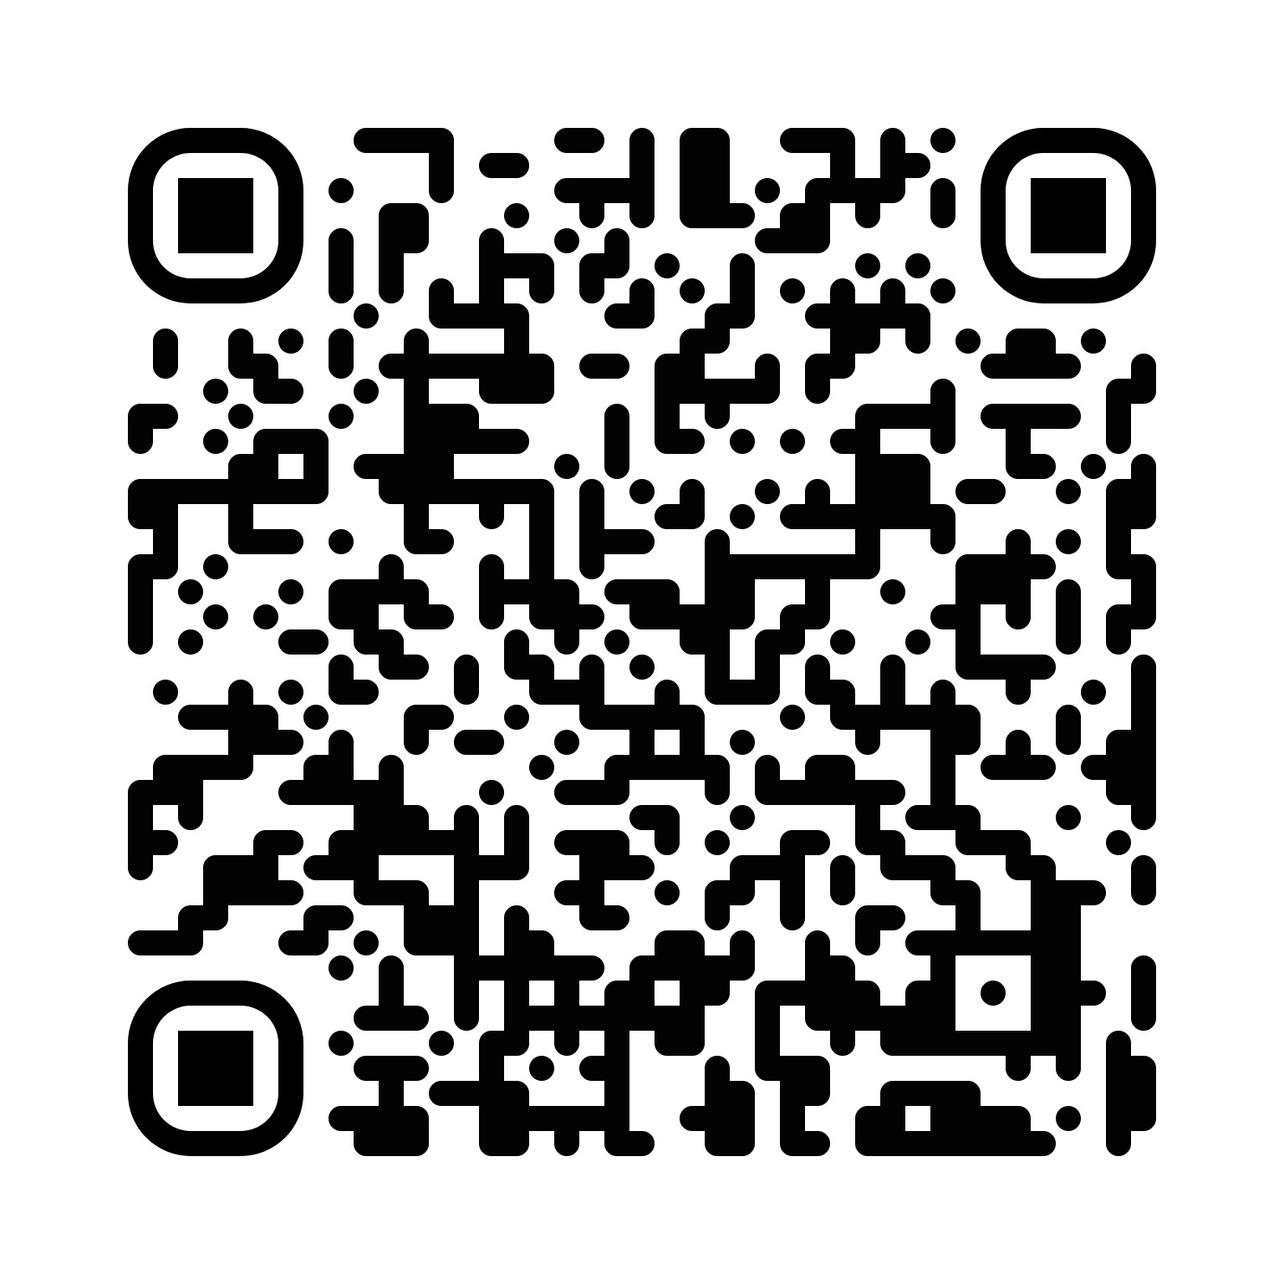
SSD Keynote Speaker
Keivan G. Stassun, Ph.D.
The Neurodiversity Revolution: Tapping the Human Diversity of Mind to Accelerate Scientific Discovery
Tuesday, April 7, 2026, 4:00-5:30 p.m. 2204 Kirkhof Center, Pere Marquette Room, GVSU Allendale Campus
Scan here for more information gvsu.edu/ssd

