Slide 1


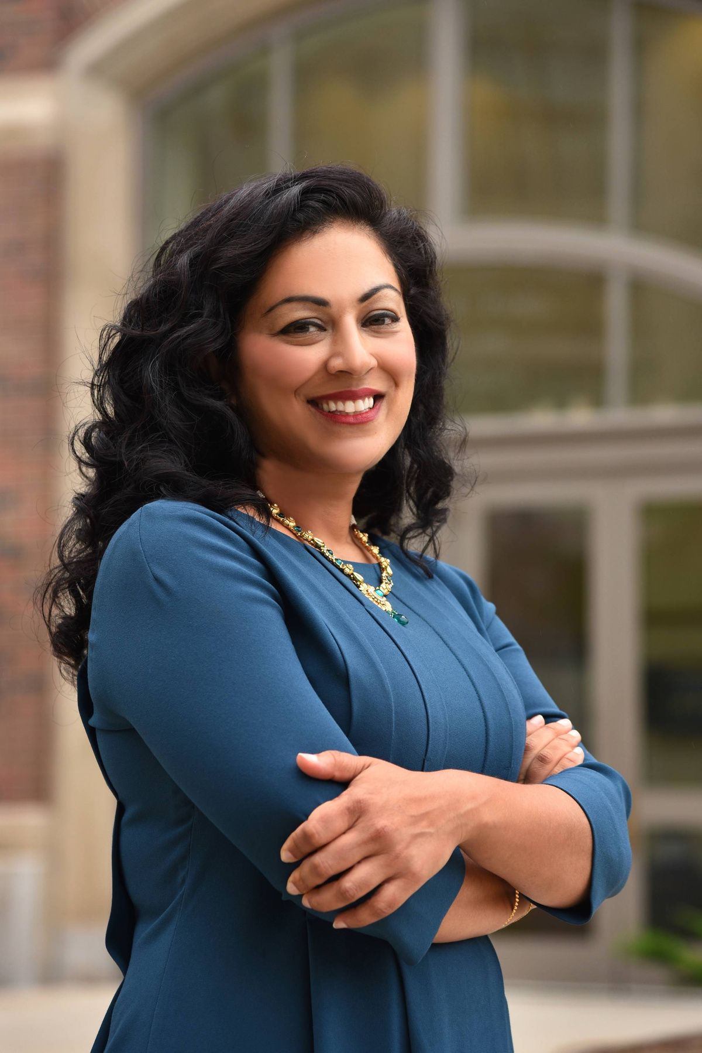



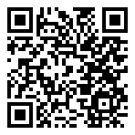

Student Scholars Day Keynote Speaker
Keynote Address: To Achieve Social Equity, We Must Rethink Innovation Systems
Join Us
Tuesday, April 8, 2025
4:00-5:30 p.m.
Alumni House
Dr. Shobita Parthasarathy is a Professor of Public Policy and Women’s and Gender Studies, and Director of the Science, Technology, and Public Policy Program at the University of Michigan. Lecture followed by reception.
Co-sponsored by Digital Studies.
Dr. Shobita Parthasarathy
RSVP HERE
Contact ours@gvsu.edu with any questions

