Slide 1
Distribution Game
Version 2015

Slide 2
Introduction To The Game

Slide 3

ERP Simulation Games: Objectives
To show how the ERP system supports business strategies
To develop a hands-on understanding of the concepts underlying enterprise systems
To experience the tangible benefits of enterprise integration firsthand

Slide 4
Distribution Game
In groups of 4 participants, each team operates a water bottle distribution company
Using standard business reports, participants have to make business decisions to ensure the profitability of their operation

Slide 5

German Market
North
45 retailers
3 areas with distinct marketing accounts
Market size of about 6,000 per company
per day
One distribution channel : 18 – Selling To Convenience Stores
West
40 retailers
South
38 retailers

Slide 6

6 Products
Product Code | Product Description | Units in box | Cost of boxes
$$-B01 | 1L Clear Pure | 12 bottles | 11.99
$$-B02 | 1L Spritz | 12 bottles | 14.99
$$-B03 | 1L Lemon Spritz | 12 bottles | 16.99
$$-B04 | 500mL Clear Pure | 24 bottles | 16.99
$$-B05 | 500mL Spritz | 24 bottles | 19.99
$$-B06 | 500mL Lemon Spritz | 24 bottles | 22.99

Slide 7
Rules Of The Game
Each round will be of 20 days (1 min per day) We will play 3 Rounds
End-of-round inventory is carried over to the next round
You can sell a product only if you have it in stock
You compete against the other teams and importers (bot)
Your objective is to maximize profit

Slide 8
The Roles And Responsibilities In The Game

Slide 9
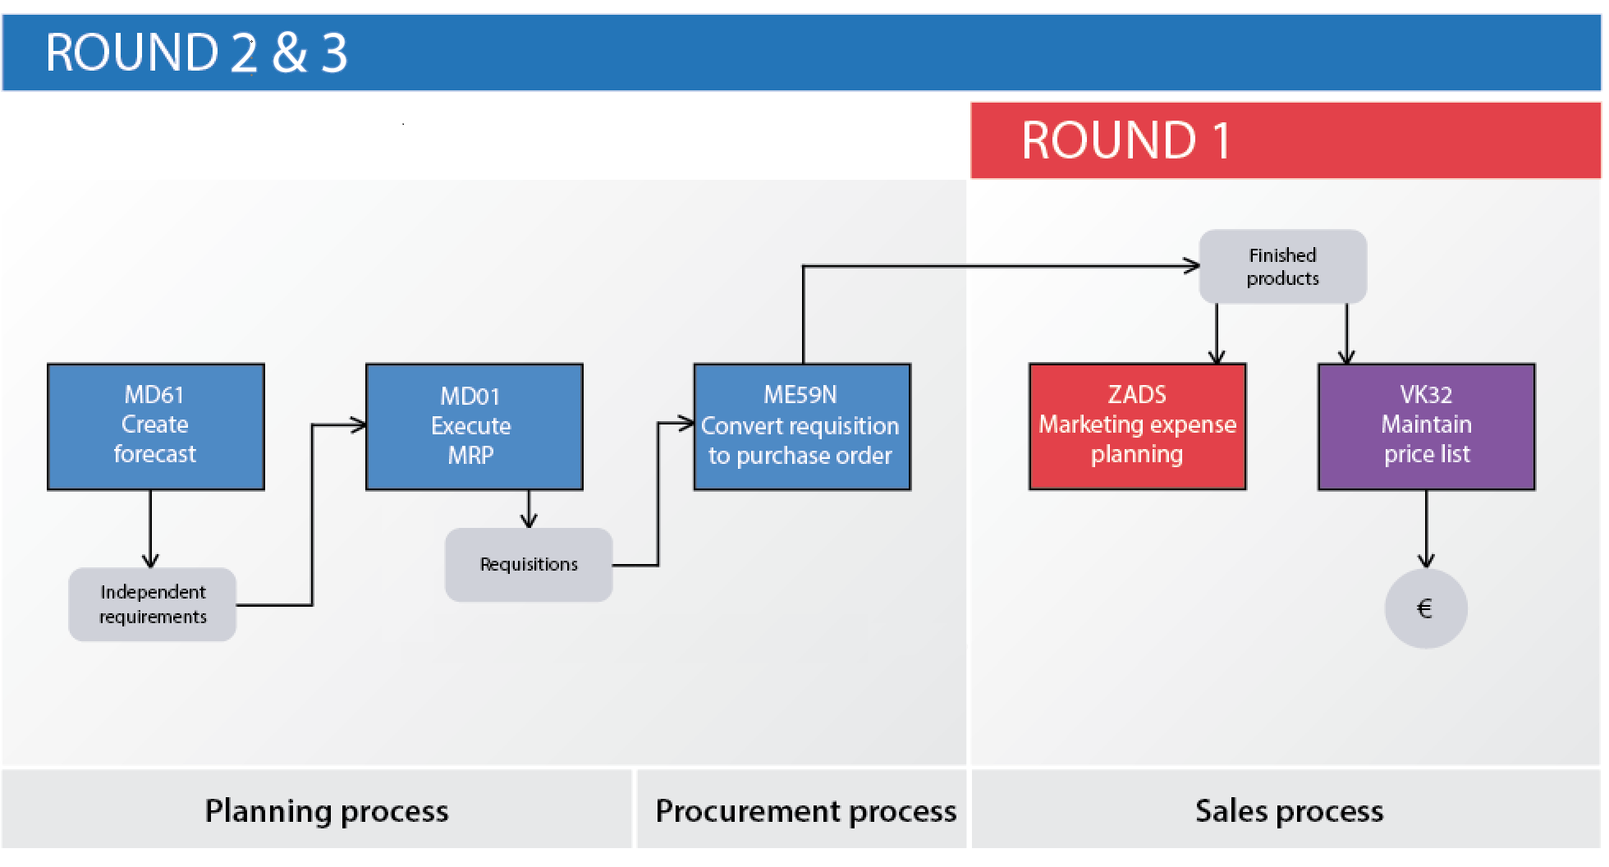
Business Process

Slide 10
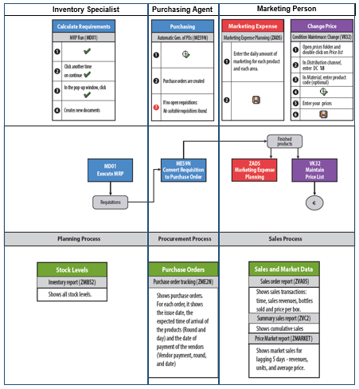
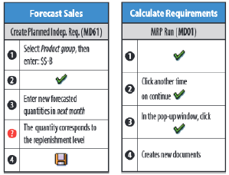
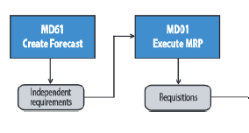
Participant’s Job Aid
Job Position
Activities/Transactions
Business Process
Business Reports

Slide 11
Set Up Team Roles
Set up team roles:
Purchasing Agent
Marketing Person
Inventory Specialist
Communications Coordinator

Slide 12

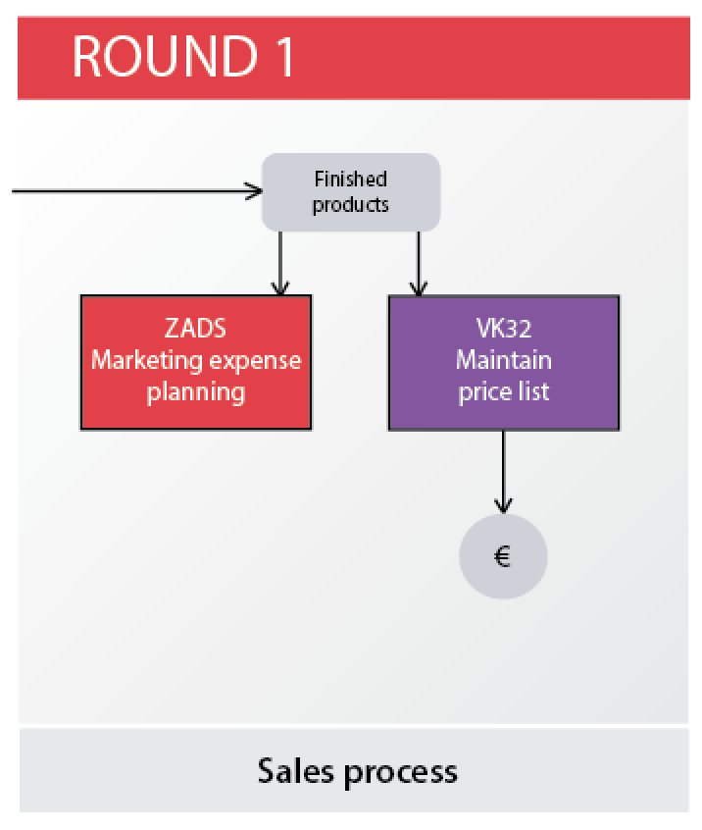
Distribution Game: Round 1
20 min
20 days

Slide 13
Cost, Inventory & Initial Pricing
Material | $$-B01 | $$-B02 | $$-B03 |  | $$-B04 | $$-B05 | $$-B06
Name | 1L ClearPure | 1L Spritz | 1L Lemon Spritz |  | 500mL ClearPure | 500mL Spritz | 500mL Lemon Spritz
Size | 1L | 1L | 1L |  | 500mL | 500mL | 500mL
Number of bottles in package | 12 | 12 | 12 |  | 24 | 24 | 24
Cost | 11.99 | 14.99 | 16.99 |  | 16.99 | 19.99 | 22.99
Initial price | 14.99 | 17.99 | 19.99 |  | 19.99 | 22.99 | 25.99
Initial stock | 1,000 | 1,000 | 1,000 |  | 1,000 | 1,000 | 1,000

Slide 14
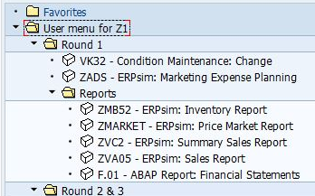
Marketing Person’s Job Aid & Menu

Slide 15
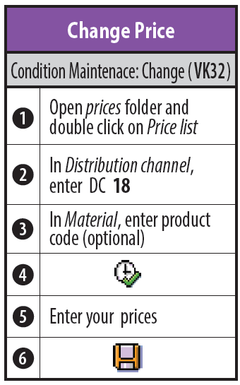
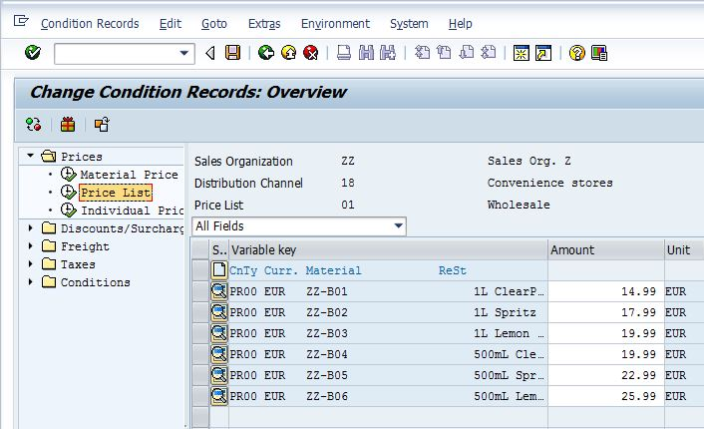
Maintain Prices for DC 18

Slide 16
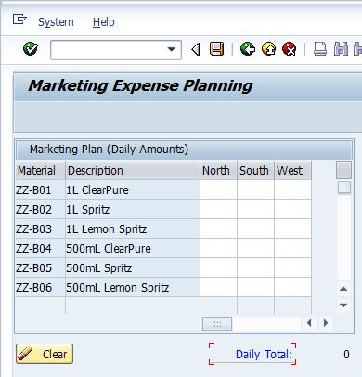
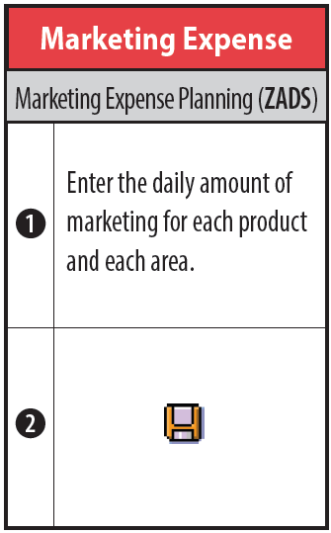
Marketing Expenses

Slide 17
Marketing Person’s & Inventory Specialist Reports

Slide 18
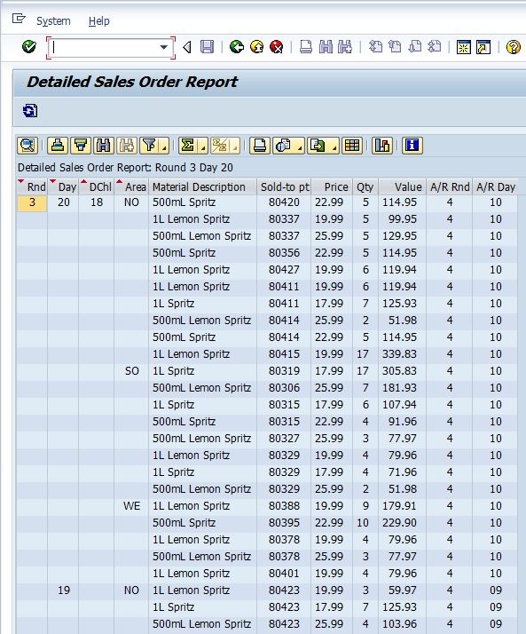
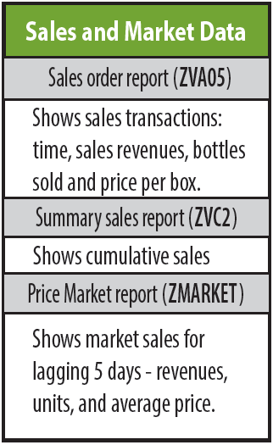
Marketing Manager Report: Check Sales Order Report
Monitor Sales Orders

Slide 19
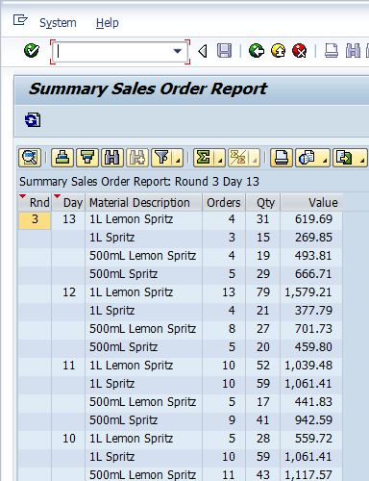
Marketing Manager Report: Check Summary Sales Report
Monitor How Well Sales Are Going

Slide 20
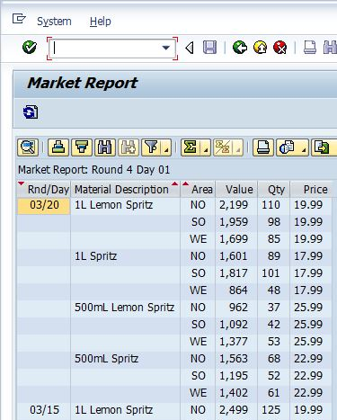
Marketing Manager Report: Check Market Report
Monitor Competitors

Slide 21
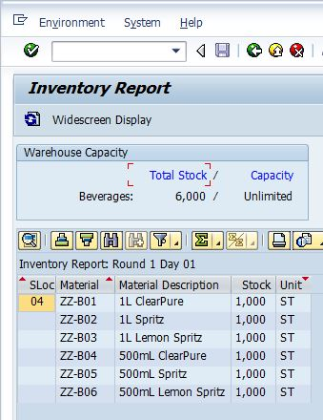
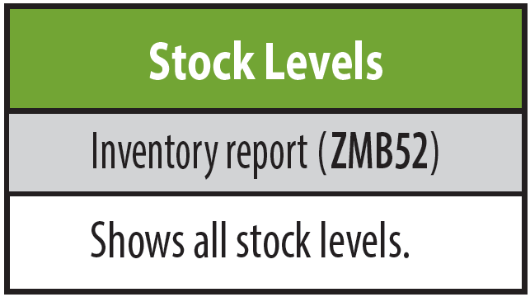
Inventory Specialist Report: Stock In Material Overview
See Available Stock

Slide 22
The Distribution Game: Round 1
Strategize with Team
Snack Break

Slide 23
The Distribution Game: Round 1
Start Round 1

Slide 24
The Distribution Game: Round 1
Stop For Evaluation
Notes:
Stop at day 7

Slide 25
The Distribution Game: Round 1
End Round 1

Slide 26
The Distribution Game: Round 1
How Did Your Team Do?

Slide 27
Results

Slide 28
Round 1: Debriefing
How did your team communication work?
Did your marketing work?
Did your pricing work?
Did you run out of supply?
Did your strategy work?
What do you want to do in the next round?
How do you want to change your marketing?
How do you want to change your pricing?
How do you feel about your supply levels?
How do we prepare so we don’t run out of supply?
What is our overall strategy going to be?

Slide 29
Distribution Game: Round 2 & 3
20 min
20 days

Slide 30
It’s Time To Replenish !
Replenishment will allow you to purchase the same quantity that you have sold.
Material | $$-B01 | $$-B02 | $$-B03 |  | $$-B04 | $$-B05 | $$-B06
Name | 1L ClearPure | 1L Spritz | 1L Lemon Spritz |  | 500mL ClearPure | 500mL Spritz | 500mL Lemon Spritz
Forecast | 1,000 | 1,000 | 1,000 |  | 1,000 | 1,000 | 1,000
Replenishment lead time | Up to 3 days | Up to 3 days | Up to 3 days |  | Up to 3 days | Up to 3 days | Up to 3 days

Slide 31
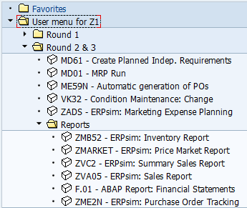
Inventory Specialist’s Job Aid & Menu

Slide 32
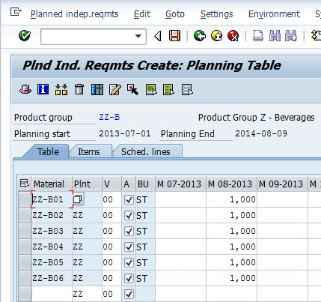
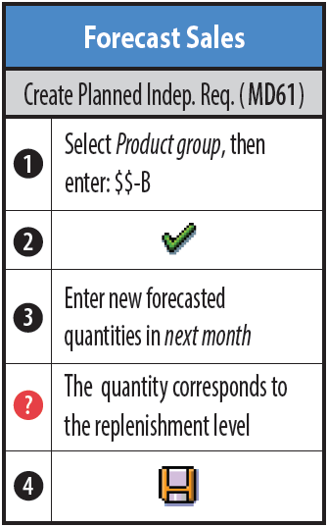
Forecasting

Slide 33
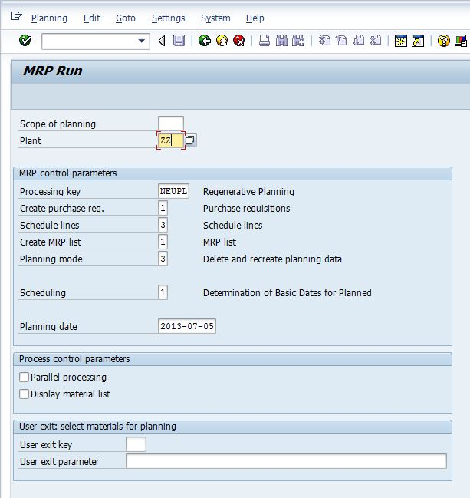
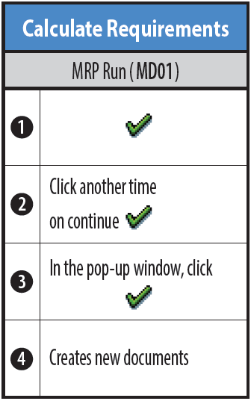
Execute MRP

Slide 34
Purchasing Agent’s Job Aid & Menu

Slide 35
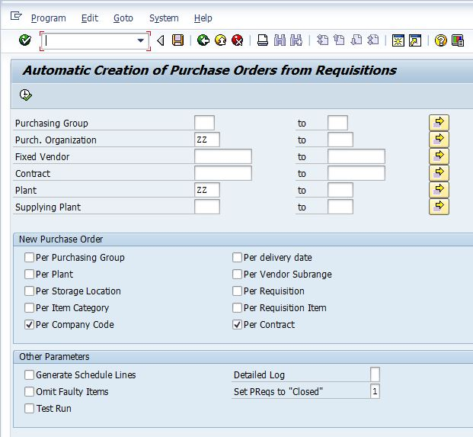
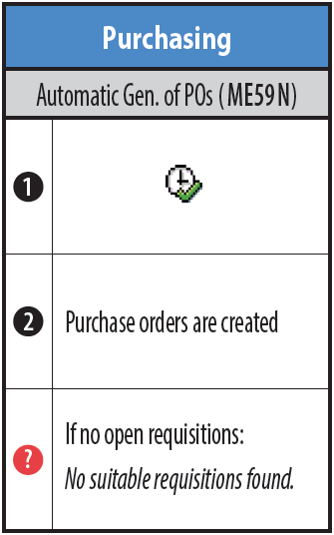
Convert Requisitions to Purchase Order

Slide 36
Purchasing Agent Reports

Slide 37
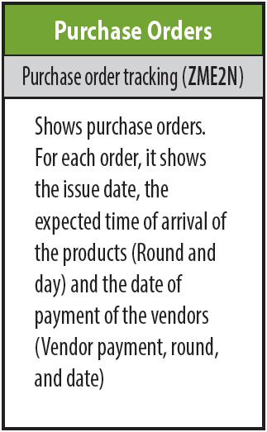
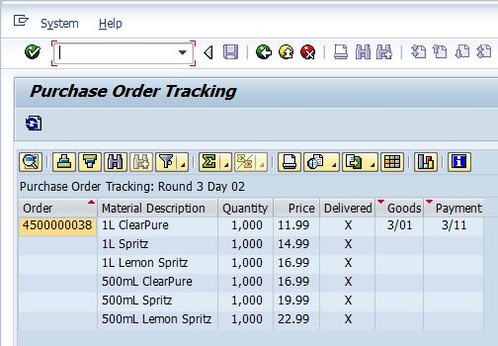
Purchasing Agent’s Report: Track Purchase Orders
Monitor Purchase Orders

Slide 38
The Distribution Game: Round 2 (20 days)
Start Round 2

Slide 39
The Distribution Game: Round 2 (20 days)
End Round 2

Slide 40
Round 2: Debriefing
How did your team communication work?
Did your marketing work?
Did your pricing work?
Did you run out of supply?
Did your strategy work?
What do you want to do in the next round?
How do you want to change your marketing?
How do you want to change your pricing?
How do you feel about your supply levels?
How do we prepare so we don’t run out of supply?
What is our overall strategy going to be?

Slide 41
Results

Slide 42
The Distribution Game:
Team Lunch

Slide 43
The Distribution Game:
Welcome Back

Slide 44
The Distribution Game: Round 3 (20 days)
Start Round 3

Slide 45
The Distribution Game: Round 3 (20 days)
End Round 3

Slide 46
Round 3: Debriefing
Explain the process that took place?
What are the steps that took place?
Why do you have to do one before the other?
What were your strategies?
Why do you think your group didn’t or did win?

Slide 47
Announce The Winners

Slide 48
Results

