Slide 1
Frankenstein: A warning for Artificial Intelligence
Rex Curtis
2018

Slide 2
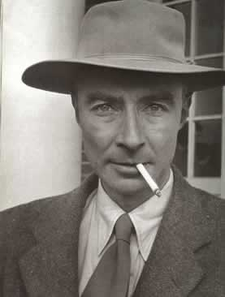

Slide 3
Justification
Victor Frankenstein
“I was encouraged to hope that my present attempts would at least lay the foundations of future success.” (Shelley 57)
“pour a torrent of light into our dark world.” (57)
“Natural philosophy is the genius that has regulated my fate;” (45)
Robert Oppenheimer
Putting and end to World War 2
The Baghadvad Gita
“Krishna, not Arjuna, will decide who lives and who dies, and Arjuna should neither mourn nor rejoice over what fate has in store but should be sublimely attached to such results.” (Hijiya 131)

Slide 4
“Because of the long-standing connection between artificial intelligence research and military, it’s already too late to forgo an AI arms race. One is well under way. Today, we face a choice between a well-managed AI arms race that reinforces mutual security and a poorly managed one that could lead to disastrous outcomes.” (Geist 2016)

Slide 6
Problems
"The Bureau of Investigative Journalism estimates that the 415 drone strikes launched in Pakistan since 2004 have killed between 2,449 and 3,949 people. Of these, between 400 and 1,000 have been civilians.” (Schiavenza 2015)
“Civilian casualties are inevitable, and the U.S. appears willing to accept them”

Slide 7
Connections
“I would sacrifice my fortune, my existence, my every hope, to the furtherance of my enterprise. One man’s life or death were but a small price to pay for the acquirement of knowledge which I sought; for the dominion I should acquire and transmit over the elemental foes of our race.” – Robert Walton (Shelley 37)

Slide 8
COnclusions
What are we willing to sacrifice?

