Slide 1
Target Inquiry: Incorporate More Inquiry in Your Classroom
Deborah Herrington
Department of Chemistry
Grand Valley State University
Supported by: NSF (ESI-0553215) and (DRL-1118658), the Camille and Henry Dreyfus Foundation, and GVSU
Opinions, findings, conclusions or recommendations expressed in these materials are those of the TI project and do not necessarily reflect the views of the National Science Foundation.

Slide 2
Teaching standards
“Teachers of science guide and facilitate learning. In doing this, teachers encourage and model the skills of scientific inquiry, as well as the curiosity, openness to new ideas and data, and skepticism that characterize science.”
NRC (1996) National Science Education Standards, p. 32
“Students will understand the nature of science and demonstrate an ability to practice scientific reasoning by applying it to the design, execution, and evaluation of scientific investigations.”
MDE HSSCE (2006)
“Engaging in the full range of scientific practices helps students understand how scientific knowledge develops and gives them an appreciation of the wide range of approaches that are used to investigate, model, and explain the world.”
NRC (2011) A Framework for K-12 Science Education

Slide 3
Problem
Complete references available on TI web site
 | Best Practices from Research | Reality
High School Chemistry Instruction | Primarily inquiry-based (National Research Council, 1996 & 2011) | Traditional lecture/discussion Occasional verification lab activities (Smith, 2002)
High School Teacher Professional Development | Sustained Coherent Promote active learning Content-focused Pedagogy-focused (Garet, Porter, Desimone, Birman, & Yoon, 2001; NRC, 1996) | Short-term Patchy Has little influence on instruction Does not affect student learning Not supported by schools (American Association of Colleges & Universities, 2001)
Notes:
One way to overcome many of the barriers is PD, but many PD programs fall short of their expectations…

Slide 4
Why is Inquiry Instruction so Hard?
Multiple definitions of inquiry
Students designing procedures (Deters, 2005)
Data to concepts (Cracolice, 2006)
Hands-on (Bonnstetter, 1998)
Student research (Bonnstetter, 1998)
How scientists investigate phenomena (NSES, 1996)
Lack of experience with authentic science inquiry and inquiry instruction

Slide 5
Why is inquiry instruction so hard?
“…even though I believe in inquiry based learning, adopting it in the Chemistry classroom has been difficult for me….I was never taught how to teach chemistry in an inquiry based atmosphere.”
- 1st cohort TI teacher pre-program

Slide 6
What is Inquiry?
National Science Education Standards | Framework for K-12 Education
Students will: Ask questions Construct explanations Test those explanations against current scientific knowledge Engage in critical and logical thinking Consider alternative explanations Identify their assumptions Describe objects and events Communicate their ideas to others | Students should be involved in: Asking questions & defining problems Constructing explanations Developing and using models Engaging in argument from evidence Planning and carrying out investigations Analyzing and interpreting data Using mathematics, information and computer technology, and computational thinking
Engage in the activities of scientists

Slide 7
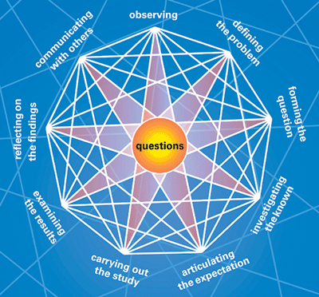
A different model of inquiry
Harwood, B. (2004). A new model for inquiry. Journal of College Science Teaching, 3(7), 29-33.

Slide 8
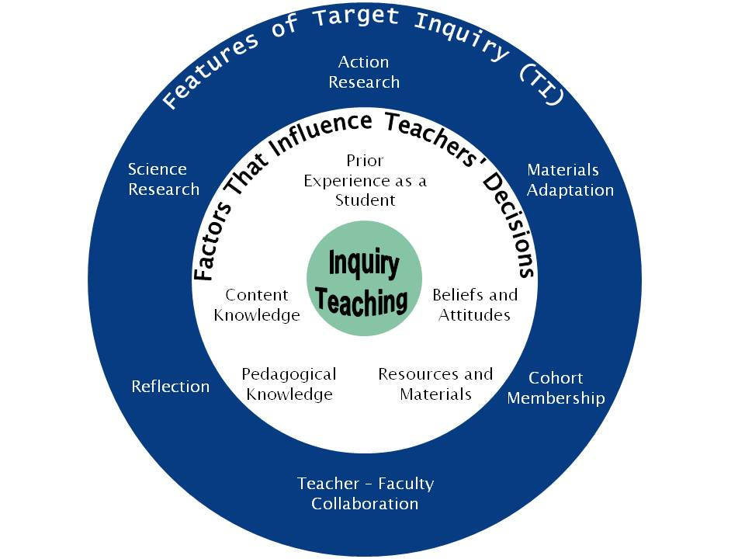
Target Inquiry program
Program Goal:
Improve the quality
and frequency of
inquiry instruction in
the MS and HS science
classroom.
Program Description:
2.5 years
15 credits/33 in M.Ed.
15 teachers/cohort

Slide 9
Target Inquiry Program
Research Experience
Materials Development
Action Research
SCI 610
Preparation to do research
SCI 611
Science research for teachers
SCI 612
Applications of research to teaching
SCI 621
Education research in science
SCI 631
Inquiry curriculum development
SCI 632
Inquiry colloquium
SCI 633
Applications of science education

Slide 10
Program timeline
2012-13 |  |  | 2013-14 |  |  | 2014-15
Fall | Winter | Summer | Fall | Winter | Summer | Fall | Winter | Summer
 | Jan-April | June-Aug |  | Jan-April | June-Aug | Aug-Dec | Jan-April | June-Aug
 | SCI 610 Graduate Research Seminar (2) | SCI 611 Research Exp. for Teachers (3) SCI 612 Applic. of Research Teaching (1) |  | SCI 621 Ed. Research in Sci. (3) | SCI 631 Inquiry Curric. Dev. and Adapt. (4) | SCI 632 Inquiry Colloq. (.5) | SCI 632 Inquiry Colloq. (.5) | CHM 633 Applic. of Sci. Ed. (1)
Materials Action
Adaptation Research
RET

Slide 11
Teacher support
Each TI teacher will receive approximately $13,000 to work toward 15 graduate chemistry credits at GVSU. Support includes:
Tuition waivers (tuition for 15 graduate credits valued over $7,500);
Fellowships ($3,500 over 4 years);
A classroom award ($500 to use at the teacher’s discretion); and
Travel to two conferences (up to $1,750)
Funding provided by NSF grant and GVSU

Slide 12
Study requirements
Administering tests and surveys to students twice each academic year
Teachers will receive student test data to contribute to classroom assessment measures to be used as his/her discretion
Inviting researchers to observe your class 1-2 times each year
Participating in one interview and round of teacher surveys each year
Completing all class requirements
Teachers not interested in enrolling in the TI program may wish to participate in the comparison group in the TI study. Each comparison cohort teacher will receive a $200 annual stipend for up to four years for participating in the study tasks with the exception of completing class requirements

Slide 13
What TI teachers say about TI
“There is a purpose to everything that is being done in this program and even if it doesn’t feel like it at the moment, later you’re like, oh, that was why I had to do this. You [TI developers] have actually thought through all the things that we’re doing.”
“The resources I’m going to walk away with are incredible too. Leaning how to go to the website and look at articles, the instructors here at Grand Valley, stuff to use in the classroom, and fellow teachers. Knowing that if I get into a bind I know that I can call or email and I will get responses back in a constructive way. I think we’ve got so close together that we’re not afraid to tell it like it is.”
“But what TI did for me is bridge the gap between what I think and believe and what I practice…And it also not only started to bridge that gap, it’s given me the tools that I can see one of these days, they may actually meet each other, and that’s exciting to me.”

Slide 14
What TI teachers say about their teaching
“I realized I can just really let the kids do it….cause I think that’s kind of a scary concept for me. I always think, “No, they need to know this first.” “No, they really don’t need to know this first.”
“…[inquiry] is doable. It’s not impossible. And when I saw the breadth of the activities that we looked at, that just about anything can be done in an inquiry manner.”
“I think part of the issue we had with content coverage was that most of the inquiry labs we had seen before were about the process of science and not content learning. And we really made a focus, through your [the instructors’] direction, that this had to be about the content not just about the inquiry process.
“I’d say that motivating students is almost a non-issue now. I don’t want to say it’s a non-issue, but definitely in my chemistry classes, it’s not like ‘why do we have to do this’ or ‘this is dumb.’ I don’t have those questions anymore, and I remember way back to the beginning when we were talking about all our barriers. Now the students just jump right into the labs and they enjoy them.”

Slide 15
What students say
"I also enjoyed doing the experiment where I had to figure out which mining site had the higher concentration of copper so as to make mining worth it at that location. I was a little confused at the beginning but having to figure out things for myself put me into a situation where I was actually independent.”
Teacher response to student comment: “This is a student who could do a chemistry math problem after watching one example and then breeze through a worksheet. Thanks for the way that TI has changed the education for my students!”

Slide 16
Starting the Transition to Inquiry
Audience Participation is Required!

Slide 17
From cookbook to inquiry
Start by picking an activity that you already do
You don’t have to do it all at once – small changes can make a big difference
Pick one skill you want your students to focus on
forming questions, observing, examining results, conducting the investigation, communicating with others, etc.

Slide 18
From cookbook to inquiry: How thick is aluminum foil?
Procedure
Obtain a square piece of Al foil approximately 12 cm x 12 cm.
Measure and record the length and width of the foil to the nearest 0.1 cm.
Find the mass of the foil. Return the foil to the proper place.
Calculations: Copy the table below. Show your work for calculations and record the answers in the table.
Density of Al___________ Mass of Al foil _________
Volume of foil (cm³) _________ Height of foil (cm) _________
Atoms thick of the foil _________ Moles of Al in foil _________
Atoms of Al in foil _________
Use the density and the mass to find the volume.
To find the thickness (H), you know that V= L x W x H. Using other information in your data table, find H.
One aluminum atom is 2.5 x 10⁻⁸ cm thick. Find the thickness in atoms using the height.
Knowing the mass of your foil, find the moles of Al.
Knowing the moles of Al, find the total number of atoms in the foil.

Slide 19
From cookbook to inquiry: How thick is aluminum foil?
I want students to focus on defining the problem and developing a procedure to answer a question.
What information do they need to solve the problem?
Mass of foil
Area of foil
Formula for volume of a 3D cube
Density of Al
Diameter of Al atom

Slide 20
From cookbook to inquiry: How thick is aluminum foil?
Procedure
You have been given a piece of aluminum foil.
The density of aluminum is 2.70 g/cm³
The diameter of an aluminum atom is 2.5 x 10⁻⁸ cm
Using your textbook and making any other measurements you need, determine the thickness of the piece of aluminum foil in cm.
How many atoms thick is the aluminum foil?
Alternative question – How much does 1 aluminum atom cost in a roll of aluminum foil?

Slide 21
What kind of changes should I make?
An inquiry activity should start with a question or problem for students to investigate/solve
This gives students a framework for the activity so that they are not just blindly following a procedure
For more student control, remove the starter question, start with a discrepant event, have students generate questions
Do the lab first
Refer to it throughout the unit
Revise the materials section
Have students pick appropriate materials out of a longer list so that they have to think more about what they are doing and why they are doing it

Slide 22
What kind of changes should I make?
Revise the procedure section
Cut the individual steps into strips and have students put them in the proper order
Give an incomplete list of steps and have students fill in the rest
Have students develop procedure
Take away the data table or chart
Have students decide how to collect and report data

Slide 23
What kind of changes should I make?
Redesign the results section
Have students predict what would happen if a given variable was changed
Add a “Going Further” section
Allow students to pose their own questions at the end of the lab. For example, “What if we changed this variable?”
Encourage students to think of ways they could test their questions.
Ask students to research “real world” applications of what they have been investigating or pose some additional problems with “real world” contexts
Llewellyn, D. (2005). Teaching high school science through inquiry. Corwin Press, Thousand Oaks, CA

Slide 24
Your turn
Determine what skills/processes you want students to focus on.
Identify ways you could modify the activity you have been given to address those skills

Slide 25
Group discussion
What did your group decide you wanted students to focus on?
Questions, data analysis, procedure, other?
How did you choose to modify the lab?
What concerns might you have about these types of modifications?

Slide 26
For more information about Target Inquiry, visit www.gvsu.edu/targetinquiry
Thank you coming!

