Slide 1
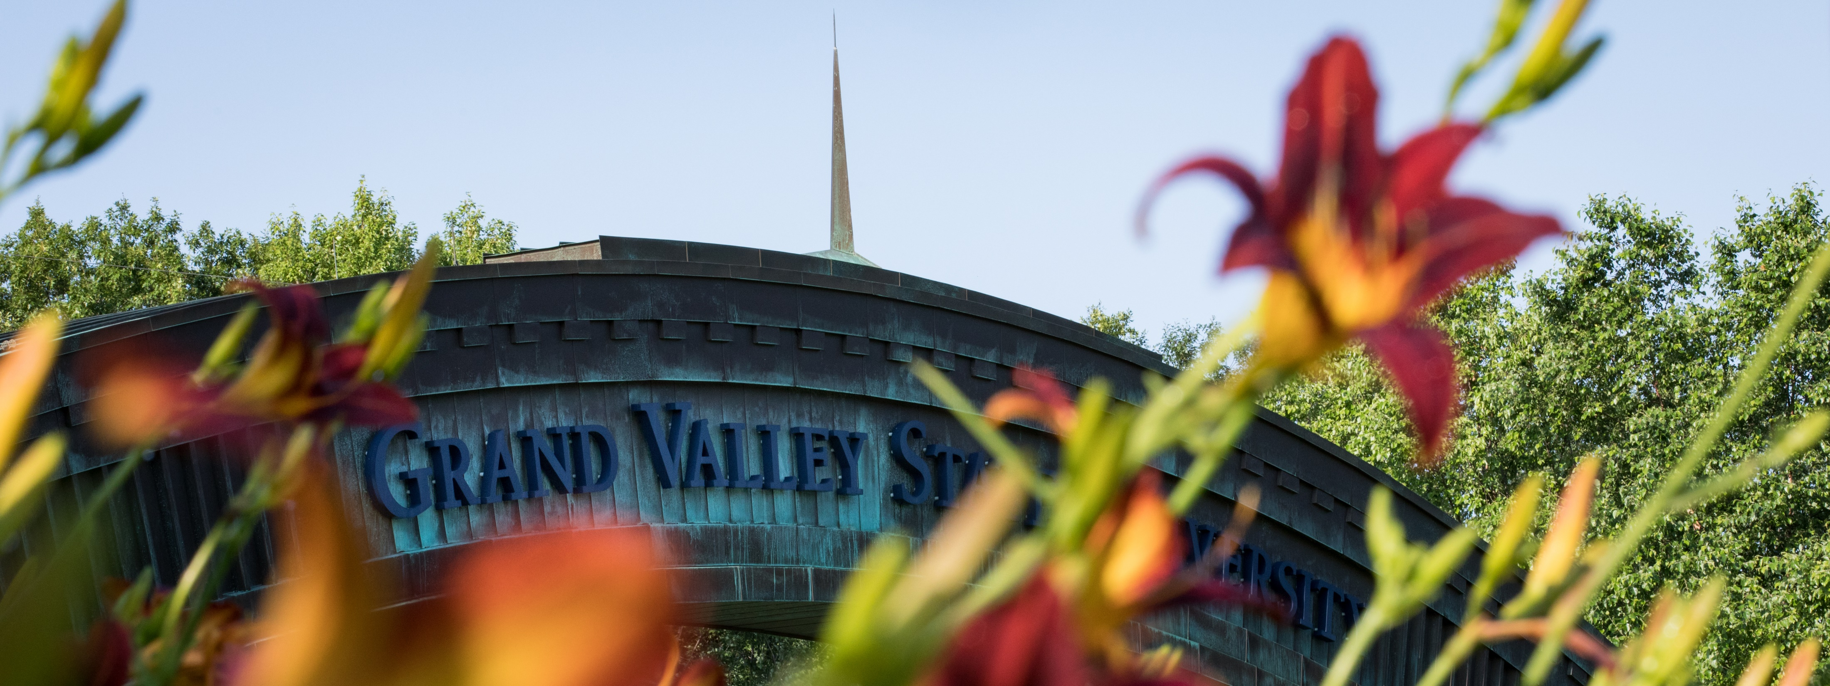
GVSU New International Student Zoom Meeting
November 5, 2021
Topic: Visa Preparation

Slide 2
Agenda
Introductions of GVSU Staff
Blackboard Overview
Zoom Instructions
Visa Process Presentation
Questions and Answers

Slide 3
GVSU International Student Support Staff
Chris Hendree
Libby Jawish
Noelia Siriamphone
Kate Stoetzner

Slide 4
Blackboard

Slide 5
Zoom

Slide 6
Visa Process
Receive I20/DS 2019
Pay SEVIS Fee at fmjfee.com ($350 USD for F1/$290 USD for J1)
Complete DS 160 at US Embassy Website in your home country
Pay Visa Fee ($160 USD for F1 and J1)
Schedule Visa Appointment

Slide 7
Visa Interview Advice
Be Prepared
Know why you are choosing GVSU
Must answer academic, financial, family, intention questions
Must PROVE intent to return to home country

Slide 8
Visa Problems
If you are unable to book an appointment- keep trying! GVSU can help request an emergency appointment 30 days before school begins. Please work with both Chris Hendree and Kate Stoetzner if you need this.
Even if you can book an appointment for after school begins, and you need our help moving the appointment forward, that is helpful. We still won’t be able to do anything with an emergency appointment until 30 days prior to the beginning of classes

Slide 9
Visa Denial
If you are denied a visa, please keep the notice on WHY your visa was denied. The reason why your visa is denied will make a big difference on the kind of support you need to re-apply. The most common reason for denial is failure to prove intent to return home after the degree. You can avoid this by preparing your answer ahead of time.

Slide 10
Communication
It is most helpful if you continue to communicate with Chris Hendree and Kate Stoetzner during the visa process so we know whether or not your visa has been approved, delayed, denied, etc.

Slide 11
Questions?

Slide 12
Reminders
Upcoming Zoom meetings and topics
Nov 19– Registration Process
Dec 3– Housing
Dec 17– Arrivals and Orientation Overview

