Slide 1
The General Education Program prepares students for
informed citizenship, leading to responsible participation in local, national, and global communities.
2022-2023

Slide 2
OVERVIEW
General Education Program
How it is laid out
“Double-dipping”
Prerequisites
Choosing a GE category for your course
SAIL

Slide 3
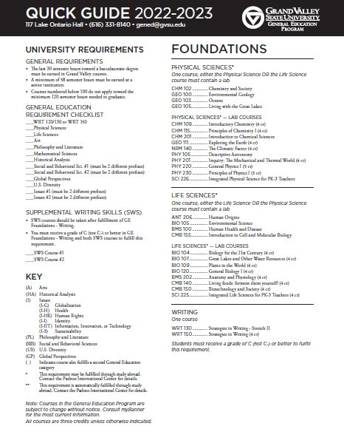
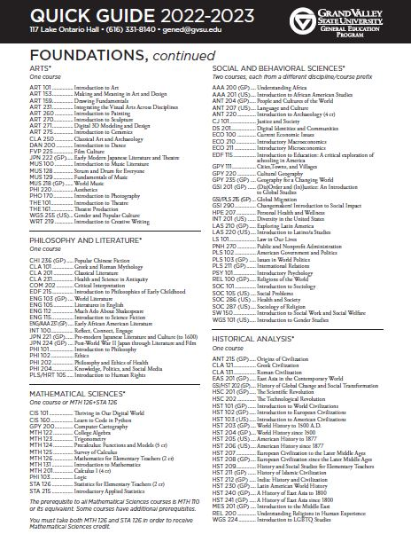
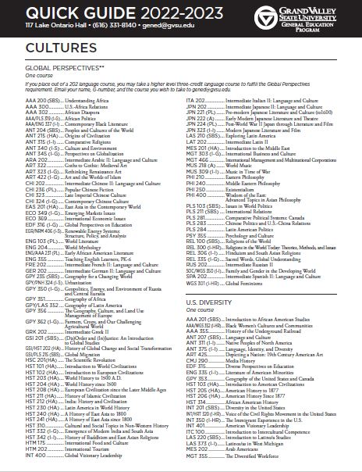
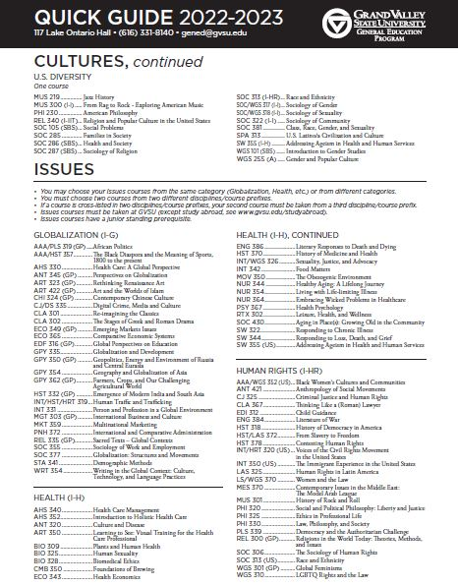
Each GE Category has 1-3 Knowledge outcomes
Each GE Category has 2-3 Skills outcomes

Slide 4
FOUNDATIONS [100-200 Level]
…the major areas of human thought and endeavor. These courses present the academic disciplines as different ways of looking at the world, introduce you to the varied methods used to create knowledge, and acquaint you with major questions and principles of the field.
Arts
Historical Analysis
Mathematical Sciences
Physical Sciences
Life Sciences
Philosophy and Literature
Social and Behavioral Sciences (2 courses from 2 different prefixes)
Writing
Faculty must teach 2-3 Knowledge and 2 Skills outcomes

Slide 5
CULTURES [100-400 level]
…recognize yourself as a cultural being, and to understand the diverse ways in which people organize life and perceive the world. It enhances your ability to live and work intelligently, responsibly, and cooperatively in a multicultural nation and an interdependent world.
Global Perspectives
U.S. Diversity
Faculty must teach 2-3 Knowledge and 2 Skills outcomes

Slide 6
ISSUES [300-400 level]
…integrate learning and co-curricular experiences to build connections between prior understanding and new learning. Issues courses are problem-solving courses that encourage cross-disciplinary collaboration within each class. They also develop your understanding of some of the most compelling issues of our time: globalization, health, human rights, identity, sustainability, and the connected topics of information, innovation, or technology.
2 Issues courses
Faculty must teach 1 Knowledge and 3 Skills outcomes
Issues are the unique aspect of our GE Program – a critical aspect of the course is teaching the skills of collaboration, problem solving and integration – at the upper division level

Slide 7
“Double-dipping”
Courses can “double-dip” – be in 2 GE categories
Foundations + Cultures
Issues + Cultures
Courses cannot
Be in 2 GE Foundations
Double-dip between Foundations and Issues
You will be responsible to TEACH and ASSESS Knowledge and Skills outcomes in BOTH categories if your course “double-dips”

Slide 8
Prerequisites
Foundations provide foundational knowledge so they have few prerequisites
Occasionally WRT 150 is a prerequisite.
All Issues courses must have Junior standing
You can have few other prerequisites.
You can have “completion of X GE Foundation” but most students have completed every Foundation before Issues.
You cannot restrict the course to a major or minor.

Slide 9
CHOOSING A GE CATEGORY

Slide 10
1. Look at the level of your course
If you are teaching at the
100 or 200 level - it is a Foundation course
300 or 400 level - it is an Issues course
100-400 level - it is a Cultures course

Slide 11
2. Read the category description in the GE Handbook
Foundations - Philosophy and Literature
Literary and philosophical works represent an ongoing conversation about the fundamental ideas and values that shape cultures and civilization. To participate fully in this conversation requires knowledge, both of those works that are recognized as defining the history of the conversation and of works that offer original or critical additions to it in the present. Through the study of great works of philosophy and literature, you will come to understand more clearly your own response to the world and to the ideas that give it form and comprehensibility.
Courses in this category introduce you to the interpretation of a significant body of literary or philosophical work and assist you in the careful reading, discussion, and analysis of primary texts.

Slide 12
3. Read the Knowledge outcomes
Explain principles and questions that define philosophy or literature and its contributions to human knowledge and civilization.
Explain the relationship between the works discussed, the cultures in which they were created, and the human concerns they illuminate.
Analyze and interpret one or more primary texts as a major portion of course content.
You have to teach ALL of the Knowledge outcomes

Slide 13
4. Choose the Skills outcomes associated with your category
Read the definition of the Skill and the objectives associated with it.
You have to teach ALL of the objectives.
All of the Skills must be taught and assessed regardless of the course modality (online, hybrid, face to face).
You don’t have to worry about online if you aren’t proposing it for online or hybrid delivery.

Slide 14
Oral Communication: Effectively prepare and deliver a formal oral presentation. Students must give individual formal presentations; group presentations are acceptable if every student presents. Presentations must be at least 5 minutes in length.
Objectives
States a thesis that is compelling, precisely stated, appropriately repeated, and strongly linked to the supporting material.
Organizes the presentation in a clear, consistent, and cohesive manner.
Uses language that is imaginative, memorable, compelling, appropriate for the audience, and enhances the effectiveness of the presentation.
Uses delivery techniques that make the presentation compelling and the speaker appears polished and confident.
Uses a variety of supporting materials that significantly enhances the presentation.

Slide 15
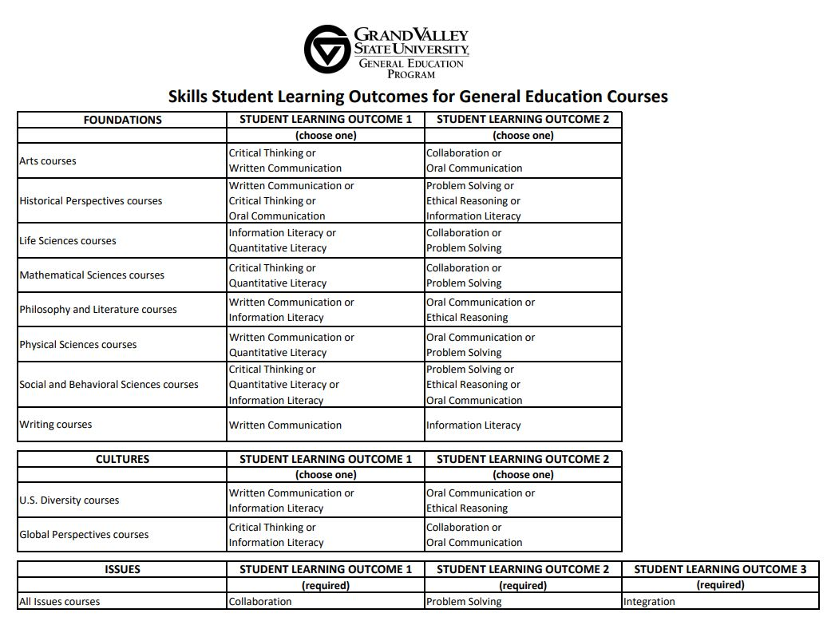

Slide 16
SAIL

Slide 17
The SAIL Process
You
Unit Head
Library/IT – fast
If it is online/hybrid – it goes to the Online Education Council
College Curriculum Committee
Dean - fast
GE
UCC
Provost

Slide 18
Why is the SAIL process slow?
Backlog – sometimes at the College level
You don’t respond quickly to amendments!
Tip – reviewing bodies try to “stay in their lane” (most College Curriculum Committees say nothing about the contents of the GE form).
Tip – most reviewing bodies ask for amendments.

Slide 19
Deadlines for submission
There really aren’t any…
But, your unit can’t schedule a new course until it is approved!
If you want the course to be in the GE Handbook you need to be through the GE Committee by Feb. 1. This is particularly important for Foundations.

Slide 20
SAIL 101
New Course proposal
Why you are proposing it
SOR
GE Form
Course Change Proposal
What you are changing
SOR
GE Form

Slide 22
GE FORM
Knowledge Outcomes
Describe how will you teach
Describe how you will assess
Skills Outcomes
Describe how will you teach
Describe how you will assess

Slide 23
TIP: Write for your audience
The College CC, GEC, and UCC are NOT in your discipline.
What is self-evident to you, is not to us
Examples can help us understand what you mean

Slide 24
TIP: Teaching vs. Assessing
Teaching is what YOU do.
Assessing is a product that the STUDENTS produce (report, presentation, answer a test question).

Slide 25
TIP: Teaching the Skills
It is NOT enough to have students give an oral presentation, write a paper, do problem solving, or work in a group. You have to TEACH them how to do it.
Go over the GE Skill Rubric in class.
Have them brainstorm good/bad examples.
Show a good/bad YouTube video examples.
Show/describe an example in class.

Slide 26
TIP: Assessing student learning
You have to use the GE Rubrics
You have to be able to assess students individually – which means you can’t really use a group written paper to assess written communication
You can’t use grades
For an overview to assessment check out the Assessment PowerPoint on the GE Website

Slide 27
SPECIAL TOPICS COURSES
Special Topics courses are designed to let you “test drive” a course before you propose it for a permanent course number in SAIL.
You can propose a Special Topics course (180, 280, 380, 480) for GE
You can only offer the course twice before it must go to SAIL
GE approval is for one semester
The Special Topics Form happens outside of SAIL (it is a streamlined version of SAIL)
All the GE “rules” apply to the Special Topics course

