Slide 1
Kirkhof Center & Event Services

Slide 2
Mission of the Kirkhof Center
is to provide students with inclusive space to gather, create, and engage. Our quality facilities, programs, and services will enrich student lives, complement, and enhance their academic experience.
It is our vision to create an environment that encourages collaboration among campus groups while building a strong sense of community.
Notes:
How many have seen this?

Slide 3
Learning Objectives
You will learn what Event Services does.
How to make a reservation
Your responsibility when reserving space
Information needed to insure a successful event
We will have time for Q&A at the end
Please feel free to ask questions throughout the session!

Slide 4
Event Services Responsibilities
Oversee all space in the Kirkhof and Cook-DeWitt Centers
Oversee outdoor space south of STU, east of Campus Drive
Provide audiovisual support for events taking place in our areas of responsibility
We manage over 8,000 reservations and 19,000 equipment requests per year!
Notes:
Even a 2-hour shift would be helpful. Please let Nick know by Tuesday.

Slide 5
How to make a reservation
WebApp → https://ems.gvsu.edu/emswebApp
Email → events@gvsu.edu
In-person → 1110 Kirkhof Center
Make an appointment with the Event Services Assistant, Shyceka Armstrong by emailing armstrsh@gvsu.edu
Don’t forget about the Event Services website! Great resource for info on the fly! www.gvsu.edu/eventservices
Notes:
Here is my thought: your perceived value of your role is too low!

Slide 6
What is my responsibility if I’ve reserved the room?
If your name is on the reservation, you are ultimately responsible for the following:
Room reservation and setup
Behavior of your student organization members in the space
All modifications must be made by the person who made the reservation. This includes
Setup changes or additions
Equipment changes or additions
Event date change
Canceling the reservation
Notes:
Communication: EMS, 7PointOps, Info Desk, Building Managers, Event Services – YOU!

Slide 7
Provide Information!
Event date
Actual event start and end times
Guest count – guesstimates are fine
Share if you need extra time before to decorate (may be limited based on availability)
Using Grand River or Pere Marquette Room?
Event Services can create a diagram—work with us one-on-one
By providing Event Services with accurate information, we are better able to serve your student organization

Slide 8
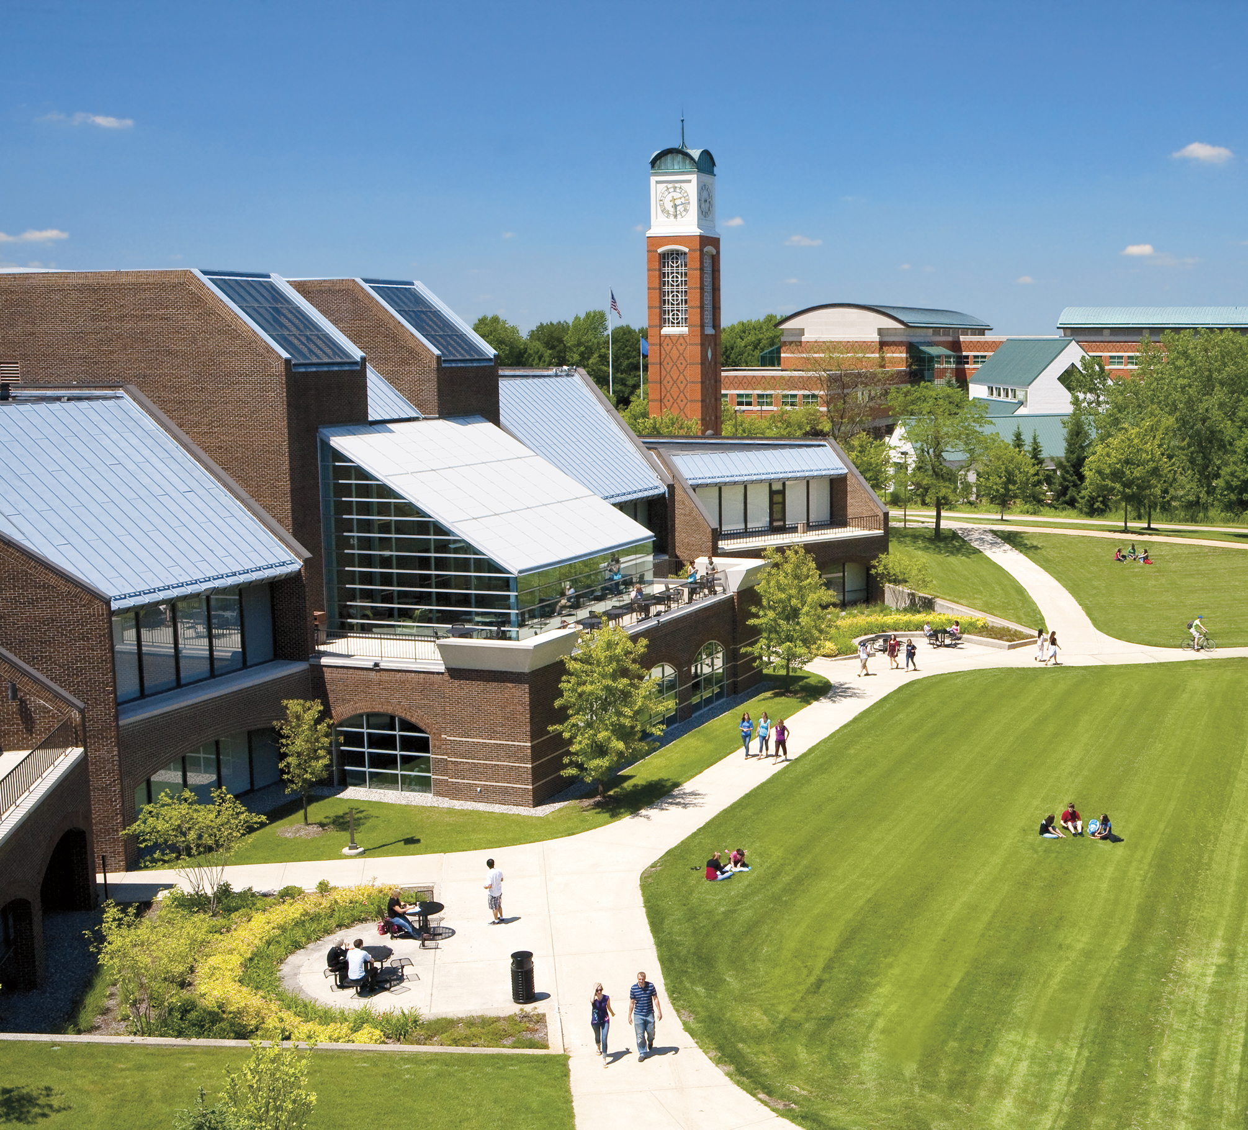
Questions?
Notes:
Excellent customer service includes responsiveness, empathy, reliability.

