Slide 1
Michelle LaJoye-Young, Undersheriff
Kent County Sheriff’s Department

Slide 2
Opioid Crisis – A Local Perspective
12.2.2016

Slide 3
Overview
2016 Statistics
2016 in Comparison
Why Heroin?
Challenges Facing Law Enforcement
The Crime Scene
Effect on First Responders
Effect on Corrections
Investigations
What Action is Being Taken?

Slide 4
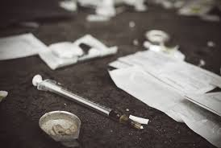
2016 Statistics
Heroin related overdoses: 37
Heroin related deaths: 14 (confirmed)
Narcan saves: 12 (No Narcan prior to 2016)
Heroin seized: 1076 grams (as of 9/30/16)

Slide 5
2016 in Comparison
Notes:
2014 anamoly had a single seizure of 1000 grams.

Slide 6
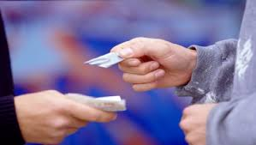
Why Heroin?
It’s relatively cheap
Marijuana and cocaine costs have significantly increased
Heroin street value has stayed relatively flat over the last several years
Most often starts with prescription pain medication addiction
Readily available and easier to obtain than prescription pain killers
Heroin has become more socially acceptable
Notes:
Marijuana went from $800 per pound to $2000-$4000 per pound
Ivie: “Heroin has become the drug of all classes”

Slide 7
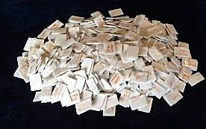
Why Heroin? Approximate Street Value in Kent County
.25 grams of heroin: $40
.50 grams of heroin: $80
1 gram of heroin: $140-$200
A single dose of heroin varies from user to user
Notes:
No standard amount for a “single hit” of heroin. All depends on what the heroin is cut with and what the user’s tolerance is. “Safe” to say it is down in the .2 gram range for the “average” user
“Average” dose might be .1g-.2g? So single hit might be between $20-$40

Slide 8
Challenges Facing Law Enforcement: The Crime Scene
Often multiple users present who tamper with crime scene and are unwilling to cooperate with investigation
Destruction of evidence is common. Other users often “clean house” prior to calling 911 for someone experiencing an overdose
Witnesses who are cooperative during the medical emergency commonly try to kick investigators out of their house once the person is revived from overdose
Not uncommon for parents to be completely unaware their child is using
Notes:
Multiple users present
No cooperation
Lack of evidence recently. They use all the heroin. Or they have the users or dealers who clean house before police arrive
Destruction of evidence.
As soon as the person recovers they shut down completely. Investigators get kicked out of the house after the person has been revivied. “Get out, as a matter of fact go get a search warrant”

Slide 9
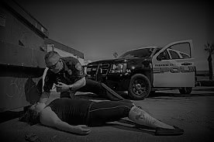
Challenges Facing Law Enforcement: The First Responder
Some first responders in heavier hit areas have experienced PTSD from being exposed to so many deaths
Officers put at greater risk having to respond to locations that identify with the drug trade
Increased exposure to dangerous substances
Drug teams/K9s/SWAT teams have been injured during response
Increased workload (Patrol/Forensics/Investigations)
Related offenses tend to (property crimes increase)
Notes:
Connection between heroin use and property crimes difficult to quantify but worth noting
Hartford Connecticut 11 SWAT officers exposed during raid when Fentanyl became airborne. Entire team taken to hospital for treatment. All were released
Coral Springs Florida 3 Police K9s hospitalized after drug search warrant, inhaled Fentanyl. ***Narcan worked on the K9s

Slide 10
Challenges Facing Law Enforcement: Corrections
Methadone is administered if inmate is pregnant
Suboxone administered in 3 day taper to inmates going through withdrawal
If inmate is in methadone program, bus pass given upon release
Red Project educates inmates about available resources in re-entry program
Significant increase in withdrawal alerts in last 3 years
Inmate being placed on withdrawal alert is largely dependent upon inmate disclosing opioid use
An inmate experiencing opioid withdrawal is one of the highest risk inmates for suicide
Notes:
Potential questions to be prepared for relating to “ethical and public health concerns for not offering a formal detox program”
Nationally approx. 15% of inmates addicted to heroin?
Other meds given to combat withdrawal symptoms
If person is identified as a southside clinic goer they get bus pass to go back there when released
Medical monitors all withdrawls
Much more painful than other withdrawals. Neuman researched the leg pain that was described and said it can lead to suicide attempt. We had one inmate try for this reason, he lived.
Screening process is where withdrawl alerts are identified
Suboxone used to be used but changed cert standards. In 2-3 weeks doc will be re administering. 3 day taper. Did it till June but then changed cert. Doc now recertified waiting on his certification

Slide 11
Challenges Facing Law Enforcement: Investigations
Physical dependency on opioids/heroin makes it difficult for person to quit long enough to work with police
Person must be clean to work with our VICE Unit
Heroin users are more difficult to work with than other drug users because the addiction is so strong and they are afraid of getting sick so they don’t show make their appointments
More concerned with getting high again than giving up source
No more field testing of powder results in delayed arrest
Notes:
Always “chasing their first high.” Keep upping doses.
Had one user in Alpine Twp od 3 times in one day.
Discovered through interivews when they find out there is a hot load out there they seek it out. They don’t stay away from it they seek it out.
Recently 3 people in under 2 months under 22 y/o that have died could be considered upper class families

Slide 12
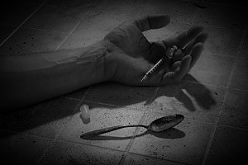
What Action is Being Taken?
Expansion of the Good Samaritan law now includes protection from prosecution for people of all ages seeking medical attention for an overdose
Narcan in every patrol vehicle with personnel trained to administer
No more field testing of powdered substances
Social media push of educational materials
Working with Red Project Grand Rapids to develop a “Quick Response Team”
Notes:
Previously it was only people under 21 who were protected
Ohio is resorting to a 3 prong approach using a Quick Response Team. 1. packet 2. LE, Paramedic, Counselor visits person within 10 days 3. Person given resource info for all agencies that help them develop life skills
Fairfield Fire Department: The numbers show it is working, Mueller said. Comparing the first six months of 2015 to 2016, of the 109 follow up visits by the QRT, 79 percent are in recovery. Over that same time opiate response calls are down 40 percent, and cardiac arrest calls are down 75 percent — and evidence shows they’re not going to other communities and overdosing, Mueller said.
Colerain paid $30,000 to purchase and equip a vehicle for the QRT. The other costs are through reallocating existing resources.
https://www.ems1.com/community-paramedicine/articles/109830048-Heroin-opiate-spike-prompts-Ohio-first-responders-to-reach-out-to-addicts/
EJ meeting with RED project tomorrow

