Slide 1
Health Forum MiHIN Overview
VIRTUAL HEALTH & EMERGING TECHNOLOGIES
Tim Pletcher
Executive Director
Michigan Health Information Network Shared Services
tim.pletcher@mihin.org

Slide 2


Creating Statewide Infrastructure
BETTER

Slide 3
What we are doing at MiHIN
Improving healthcare experience for consumers & providers
Improving quality
Decreasing cost
Enabling statewide exchange of health information
Making valuable data available at the point of care
For the people of Michigan

Slide 4












































Network of Networks:
Federal
PIHPs (10)
Health
Plan QOs
Other Data Sharing Organizations
MI
Syndromic Surveillance
System
MSSS
MiHIN
Statewide
Shared Services
Immunizations
Consumer QOs (more coming)
MDHHS Data Hub
MyHealthPortalMyHealthButton
MI Disease Surveillance
System
HIE
Qualified Organizations (QOs)
State Labs
Data
Warehouse
Chronic Diseases
Virtual QOs
Medicaid
Single point of entry/exit for state
Providers &
Health Systems
Pharmacies
(more coming)
Sponsored Organizations

Slide 5


Chain of Trust to Reduce Risk
Covered Entity
Covered Entity
Trusted Data Sharing Organization
Trusted Data Sharing Organization
Business
Associate
Business
Associate
Business
Associate
Covered Entity

Slide 6
Legal Infrastructure for Trusted Data Sharing Organizations (TDSOs)
ORGANIZATION AGREEMENT
(QDSOA, SDSOA)
Definitions
HIPAA Business Associate Terms
Basic Connection Terms
Service Level Agreement
Data Sharing Agreement
Cyber Liability Insurance
Indemnification & Liability
Master Use Case Agreement
Contracting & Payment
Use Case
#1
Use Case
#2
Use Case
#3
Use Case
#N
Dispute Resolution
Exhibit
Exhibit
Exhibit
Exhibit
Term & Termination

Slide 7
Use Case Factory
Anyone can submit ideas for use cases:
http://mihin.org/about-mihin/resources/use-case-submission-form/

Slide 8
MiHIN Statewide Use Case and Scenario Status
Conceptual
Planning & Development
Implementation (Operational Adoption)
Mature Production (>65% Utilization)
Health Risk Assessments
Patient Record Service
Advance Directives
Admission, Discharge, Transfer Notifications (Senders)
Health Information For State:
Newborn Screening - Hearing Test Results
Health Information for State: Birth Notifications,
Chronic Disease Notifications
Care Plan-ICBR
Lab Orders-Results
State Bureau Lab Orders-Results,
Cancer Pathology,
Cancer Notifications-Registry, Statewide Lab Orders-Results
Immunization History-Forecast
Health Information For State:
Immunizations
Syndromic Surveillance
Organ Donor Notifications
Single Sign-On
Prescription Information: Prescription Status,
Prescription Stop Order, Prescription Monitoring Program
Information for Veterans
Consumer Consent
Social Security Determination
Discharge Medication Reconciliation (Senders)
Consumer Preference Management
Lab Orders-Results:
Disease Surveillance
Information for Consumer
Death Notifications
Clinical Quality Measures
Active Care Relationship Service
Lab Orders-Results:
Newborn Screening - CCHD
Health Provider Directory
Common Key Service
Admission, Discharge, Transfer Notifications (Receivers)
Notes:
NBS – pulse ox
MU participating providers to meet attestation based on “use cases being in production”
Define Mature Production (>65% utilization) versus Production – may need to define ‘utilization’ this as part of Use Case
Beginning in June, started meeting 2x per month to address use cases & process
MCIR being piloted
ICBR & Bureau of Labs Use Case Summaries tomorrow

Slide 9
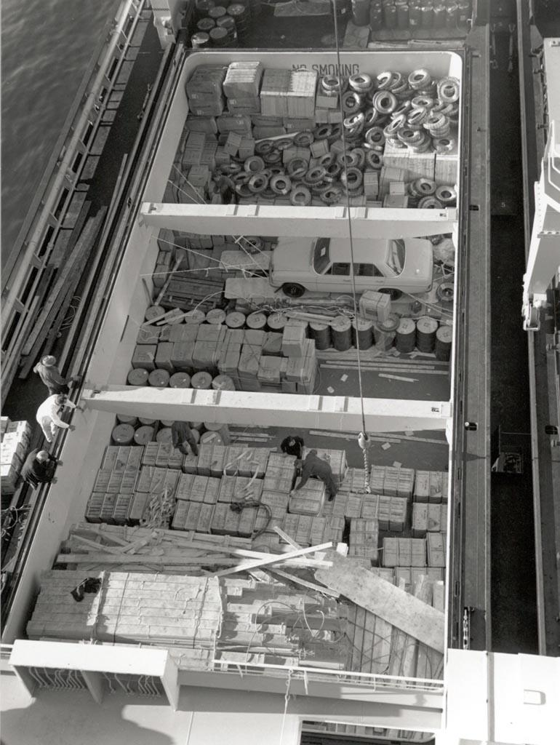


Break-Bulk Shipping

Slide 10



Container Shipping

Slide 11
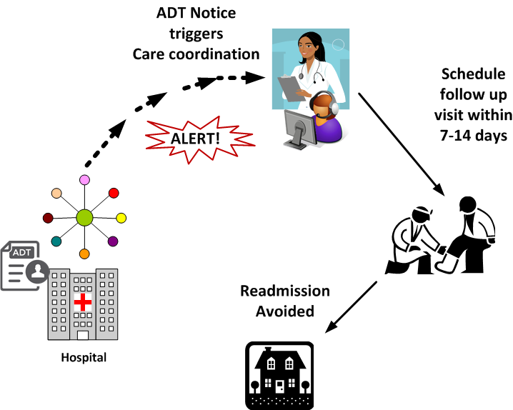
Care Coordination Opportunity

Slide 12




Statewide ADT Use Case Example
+
+
Statewide Health Provider
Directory (HPD)
Active Care
Relationship Service (ACRS)
Statewide ADT Notification Service

Slide 13


Active Care Relationships
Linkage
Primary Care Provider
Patient

Slide 14

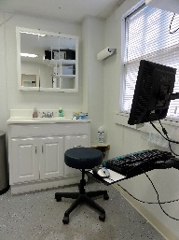



Active Care Relationship Service™ (ACRS™)
Primary Care Provider
Direct Address or
ESI
Practice
Unit
Practice
Physician Group
Patient
Used for the Health
Provider Directory

Slide 15
July 2016 ACRS Volumes
ACRS: 10,069,244
Providers: 11,717

Slide 16







Supports Seamless Exchange
Alerting Disconnected Entities
Trusted Data Sharing Organization
(TDSO)
Trusted Data Sharing Organization
(TDSO)
Specialist
Health Provider Directory
Primary Care
Active Care Relationships
Patient
1) Patient goes to hospital which sends message to TDSO then to MiHIN
Care
Coordinator
2) MiHIN checks Active Care Relationship Service and identifies providers
3) MiHIN retrieves contact and delivery preference for each provider from HPD
4) Notifications routed to providers based on electronic addresses and preferences

Slide 17
Other Use Case Combinations
MED REC
+
+
Statewide Health Provider
Directory
Active Care
Relationships
CarePlan
+
+
Statewide Health Provider
Directory
Active Care
Relationships

Slide 18

Scarcity of Data
Energy goes into finding data
Minimal thought on quality
Strategy for going without info

Slide 19
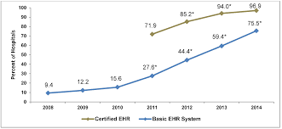
Electronic Health Record Adoption

Slide 20

Scarcity vs. Abundance
Energy goes into prioritizing what you want
Lots of thought about quality & editing
Strategy for effective use

Slide 21

A Simplified Model for Send
HPD
ADT’s
STANDARDIZED
ACRS
Hospital & SNF
CKS
Care Summaries
CCD
Problems
Allergies
MEDs
CCD
CCD
+Care Plan
“pain plan”
CCD
Diagnostics
+Advance Directives
????

Slide 22


Medication Reconciliation
HIE
Data Sharing Organization
Hospital
Direct
Med Rec Service
Direct
Data Sharing Organization
API
Active Care
Relationships
HTTPS Endpoint
MIDIGATE®
inbox@direct.mihin.org
Statewide Health Provider Directory (HPD)
“Catch, Detach, Dispatch”

Slide 23



Everyone begins sending
Community Based Services
HPD
STANDARDIZED
ACRS
Primary Care
Provider
Specialist
CKS
Care Summaries
CCD
Problems
Allergies
MEDs
Pharmacy
????

Slide 24

Reducing Provider Burdens

Slide 25
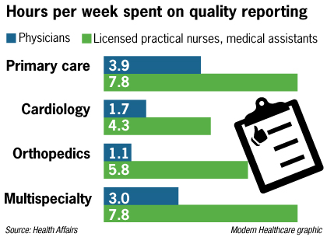
Health Affairs Article on Quality Reporting
In total, we spend $15.4 billion in salary annually dealing with quality reporting
81% reported that they spent more effort dealing with external quality measures than 3 years ago
Conclusion: “Greater effort is needed to standardize measures and make them easier to report”
Notes:
Time taken to:
enter the data into the EHR
Track newly introduced measures
create protocols to track / report them

Slide 26
Quality measures overlap
Measure Set | # of Unique Measures
PQRS | 281
eCQM | 93
HEDIS | 89
AHIP - CMS | 88
Medicaid | 51
QRS | 45
CPC+ | 22
PPQC | 27
Overlap | 3
(EH)
(EP)
AHIP-CMS
eCQM
Medicaid
PPQC
CPC+
QRS
PQRS
HEDIS

Slide 27
There is hope!
(EH)
Measure Set | # of Unique Measures
eCQM | 93
HEDIS | 89
CPC+ | 22
Overlap | 10
(EP)
eCQM
CPC+
HEDIS

Slide 28






Supplemental Data – Status Quo
NCQA
Allscripts
PO 1
HL7 Format
NextGen
PO 2
NCQA
HEDIS®
eCW
Meridian Format
PO 3
NCQA
Wellcentive
PO 4
“Group to BCN” Format
Notes:
Once the QRDA data starts flowing from EHRs and POs, we can assist the payers to receive additional supplemental clinical data

Slide 29





Simplifying Quality Data Collection
BCN
NCQA
MIDIGATE®
inbox@direct.mihin.org
“Group to BCN” Format
“Catch, Detach, Dispatch”
NCQA
HEDIS
PO
Supplemental Clinical Data File
Meridian Format
HL7
NCQA
Epic
HL7 Format
Cerner
Allscripts
Notes:
Once the QRDA data starts flowing from EHRs and POs, we can assist the payers to receive additional supplemental clinical data

Slide 30


Quality Measure Data Flow
NPO
MiHIN
Combined Quality Measure Reporting and Recovery
WSUPG
UP
OSP
Physician Organizations
One format and one location for:
POs to submit quality measures
Payers to submit Gaps in Care
POs to close Gaps in Care
Discussing FHIR resources for Gaps in Care with HL7, FHIR leadership
Health
Plans & State
Notes:
Once the QRDA data starts flowing from EHRs and POs, we can assist the payers to receive additional supplemental clinical data

Slide 31



Closing Gaps In Care
Close Gaps in Care
Supplemental Data
Physician Organizations
Payers
MiHIN
ACRS
Physician Organizations
Gaps in Care Feedback
CKS
Notes:
Once the QRDA data starts flowing from EHRs and POs, we can assist the payers to receive additional supplemental clinical data

Slide 32
THANK YOU!
Follow Up Questions:
Tim Pletcher
Executive Director
Michigan Health Information Network Shared Services
tim.pletcher@mihin.org
Phone: 989.621.7221

