Slide 1



Joseph Brennan Sr. Director, MedNow

Slide 2







What is MedNow?
On Demand Care
Save time & Money
Easy Access
24/7
Specialty Care
Opening up access
Keeping
care local

Slide 3
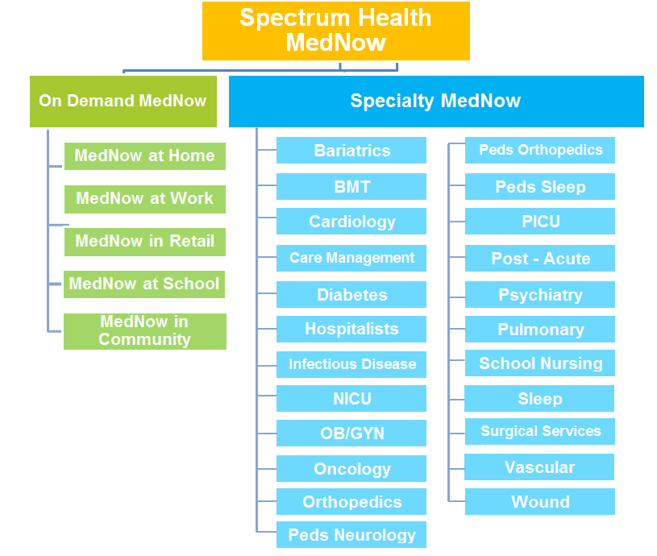

Slide 4


On Demand Primary Care Symptoms
Allergies
Back Pain
Bites & stings
Cough, cold & flu
Diarrhea
Ear ache
Fever
Headache
Heart burn
Pink eye
Rash/hives
Sinus infection
Sore throat
Sprains & Strains
Smoking cessation
Urinary problems
Treating patient 3 years and older

Slide 5
Specialty MedNow
Behavioral Health
Cardiology
Infectious Disease
Oncology
Pediatrics
Pulmonary
Sleep
Vascular
Wound Care
90+ Use Cases
Care Settings
ED
Inpatient
Outpatient
Home

Slide 6
Why?
Volume
Transitioning from Volume based to Value
Value

Slide 7
80%
of patients report being
comfortable communicating with physicians via text, email or video

Slide 8


68%
of Americans own
a smartphone
http://www.pcworld.com/article/2999631/phones/pew-survey-shows-68-percent-of-americans-now-own-a-smartphone.html

Slide 9

90%
of
the world’s
population will have a smartphone
by 2020
http://thenextweb.com/insider/2014/11/18/2020-90-worlds-population-aged-6-will-mobile-phone-report/#gref.

Slide 10
Driving Exceptional Value

Slide 11
Patient Lives in Marquette, MI
Patient's Appointment is with Specialist in Grand Rapids, MI
Patient Must Take Time Off of Work to Attend Appointment
6 Hours & 34 Minutes-Patient travels to Grand Rapids (if traffic, construction, or weather allow)
Patient's Household Income is $37,355
Patient Locates Correct Parking Ramp of Specialist's Facility
10 Minutes-Patient Parks and Locates Building Elevator
10 Minutes-Patient Walks to Specialist's Office
20 Minutes-Patient Waits in Waiting Room
15 Minutes-Patient Waits in Exam Room
15 Minutes-Patient Meets with Specialist
10 Minutes-Patient Leaves Office and Returns to Vehicle
6 Hours & 34 Minutes-Patient Travels to Ludington (if traffic, construction, or weather allow)
Total Time:
14.5 Hours
Current State
Patient Costs
Food Expense: $16.00
Total Gas Expense: $434.16
Wages Lost: $161.64
Total Patient Costs Excluding Any Medical Expenses:
$611.80

Slide 12
Patient Lives in Marquette, MI
Patient's Household Income is $37,355
IRS Mileage Rate of .54 a Mile
Patient's Appointment in Marquette
Patient Must Take Time Off Work to Attend Appointment
5 Minutes-Patient Travels to Marquette Location
5 Minutes-Patient Parks and Locates Specialist's Office
5 Minutes-Patient Waits in Waiting Room
2 Minutes-Patient Waits in Exam Room
15 Minutes-Specialist Meets with Patient via Telehealth
5 Minutes-Patient Leaves Office and Returns to Vehicle
5 Minutes-Patient Travels Home
Total Time: 0.7 Hours
Future State
Patient Costs
Food Expense: N/A
Total Gas Expense: $1.43
Wages Lost: $12.57
Total Patient Costs Excluding Any Medical Expenses:
$14.00

Slide 13
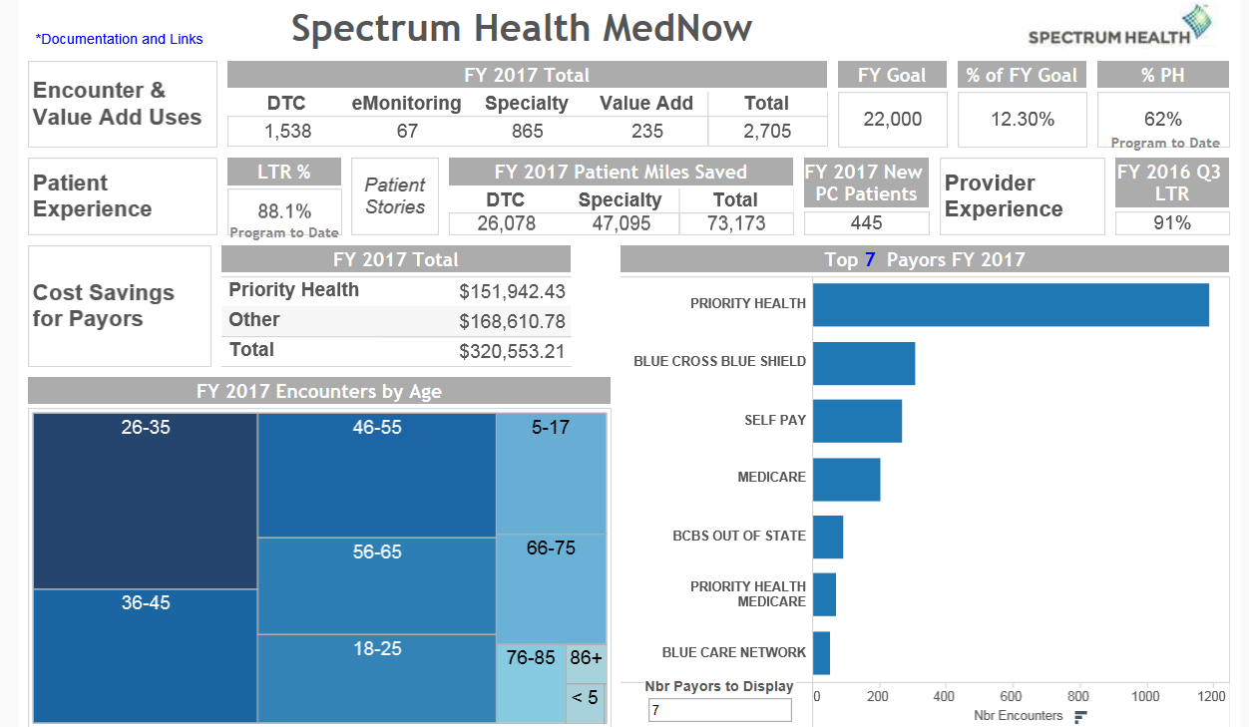
Dashboard

Slide 14

MedNow Numbers
5,244 DTC Encounters
3,622 Specialty Encounters
47 Avoided Inpatient Transfers
1,831 Avoided UC & ED Visits
1,297 New Patients to Primary Care
MedNow is in:
29 Specialty Areas 90+ Use Cases 12 Hospitals

Slide 15


Impact
Changing the way care is delivered
Decreasing Cost of Care
      Decreased ED/UC utilization
      Avoidable transfers
Improved Access to care
Provider and Patient Satisfaction

