Slide 1
Addressing Opioid Use and Public Health Outcomes through a Harm Reduction Approach
Steve Alsum
The Grand Rapids Red Project

Slide 2
Red Project Basics
A 501c3 non-profit founded in 1998
Mission: Improve Health, Reduce Risk, Prevent HIV
We utilize a Harm Reduction philosophy
  The space in between prevention & treatment
  Meeting people where they are at
  Providing a range of options
  Client centered
  Low threshold approach
  Pre-recovery supports
Health Issues: HIV, Hepatitis C, and Overdose

Slide 3
A Continuum of Service Modalities around Substance Use
-Weighted according to historic funding levels
Prevention
Enforcement
Harm Reduction
Treatment

Slide 4
Evidence Based Treatment
Medication Assisted Treatment
  the use of medications, in combination with counseling and behavioral therapies, to provide a whole-patient approach to the treatment of substance use disorders.
  Key Factors in Effectiveness
    Dosage
    Length of Treatment
    Provider responsiveness/client centered/holistic
  Options
    Methadone
    Buprenorphine
    Naltrexone

Slide 5
Overdose & Naloxone Rescue Kits: National Model Programming
CDC MMWR, June 18, 2015
Nationally there were 136 local overdose prevention programs that distribute Naloxone
  From 1996-2014
    Trained 152,283 people
    26,463 reported reversals
Multiple Models For Successful Programming
  Syringe Access/Harm Reduction-Chicago Recovery Alliance, etc
  Point of Prescription/Medical Model-Project Lazarus
  State Health Department- Massachusetts, etc
The Take Away:
  Finding ways to put tools in hands to save lives…

Slide 6
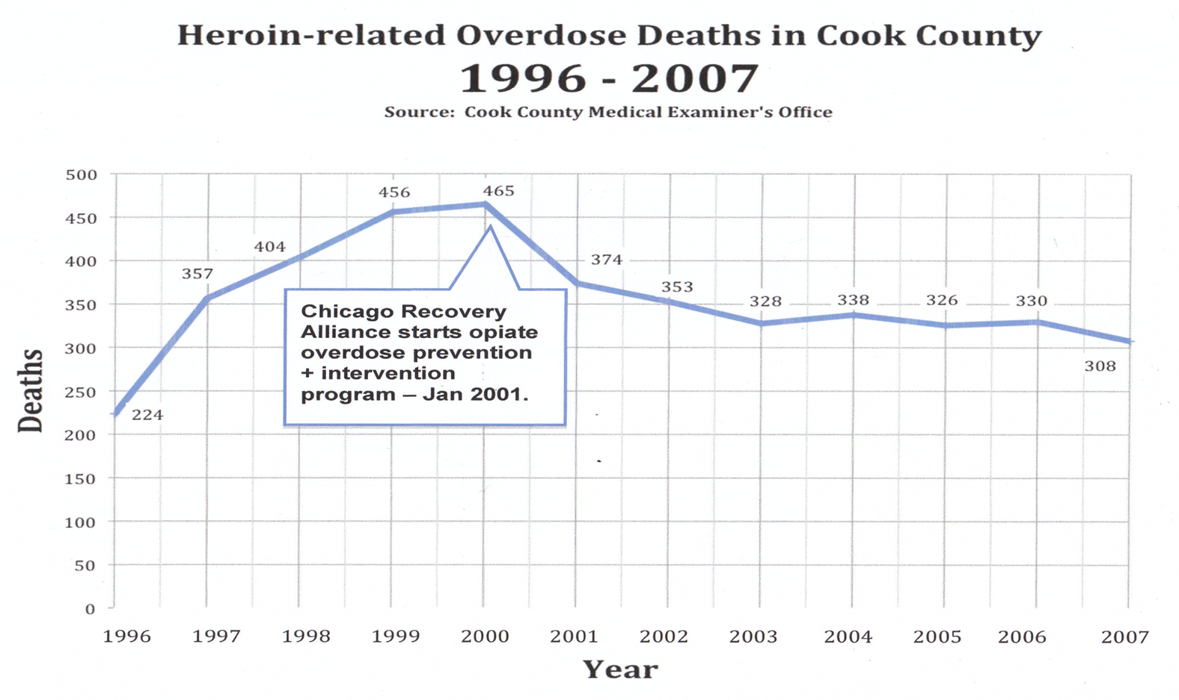
The Chicago Recovery Alliance

Slide 7
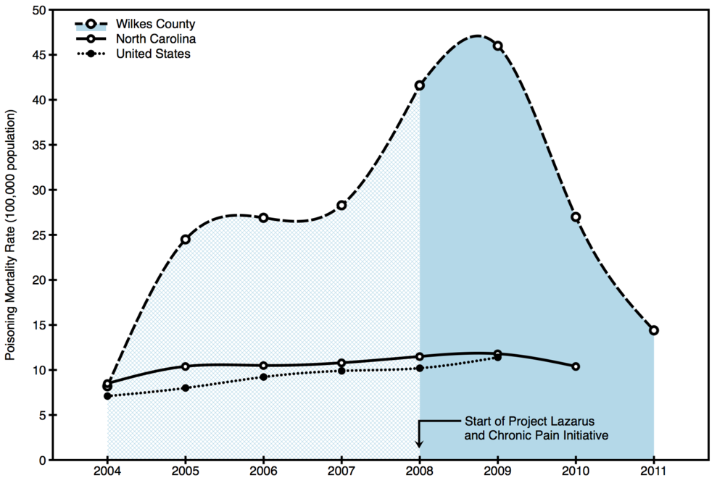
Project Lazarus

Slide 8
GR Area Programming
Clean Works Program- October 2008
Cherry St Health Methadone Clinic- 2012
Network 180 and SUD Treatment- 2013
  SA Turning Point, Arbor Circle IOP, Our Hope, Jellema House, Freedom House, Cherry St Health Methadone Clinic, Degage Open Door Women’s Shelter, Network 180 Access Center, etc
Results (as of 6/30/2016)
  3,150 individuals trained which has led to 345+ reported reversals

Slide 9
2016/17 Expansions
Direct Client Service Delivery
  Allegan, Ottawa, Muskegon, Lake, Mason, and Oceana counties
Technical Assistance/Program Start-Up
  Region 10 PIHP- 4 County Region Flint to Port Huron
  SWMBH- Kalamazoo and 8 Counties in SW MI
  Lansing and Montcalm Counties
Law Enforcement Training
  Over 50 departments and 1,000 officers equipped
Local Task Force Creation targeting the Medical Community

Slide 10
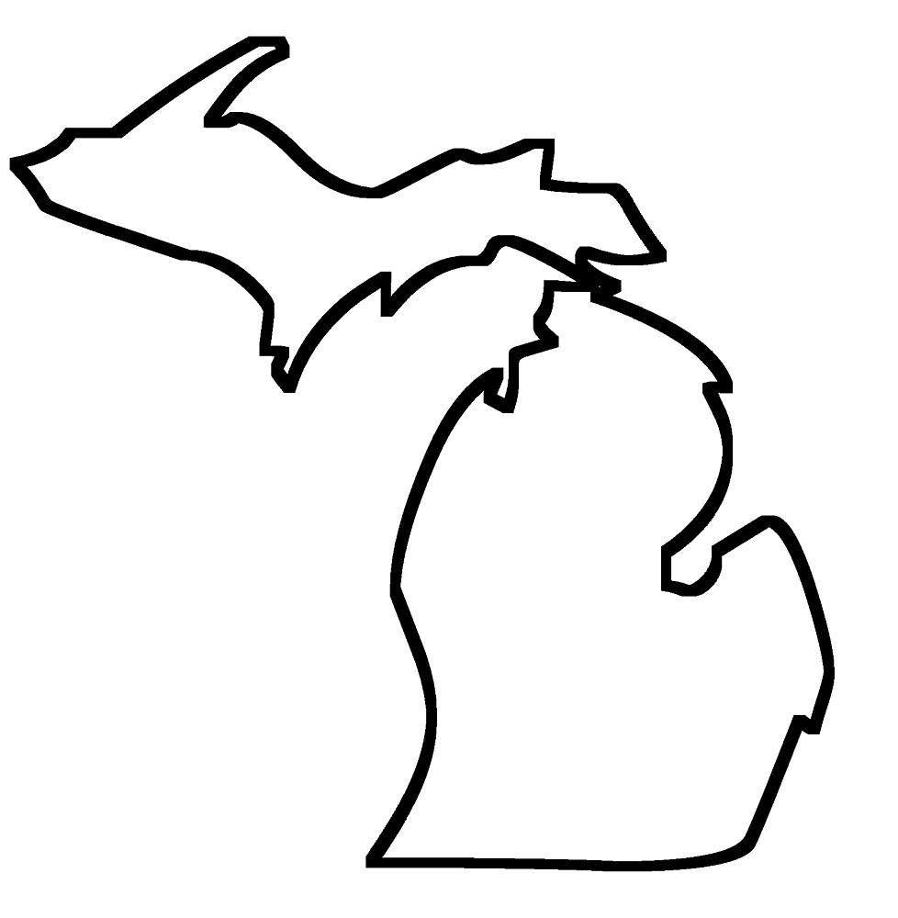
Naloxone In MI: 2016

Slide 11
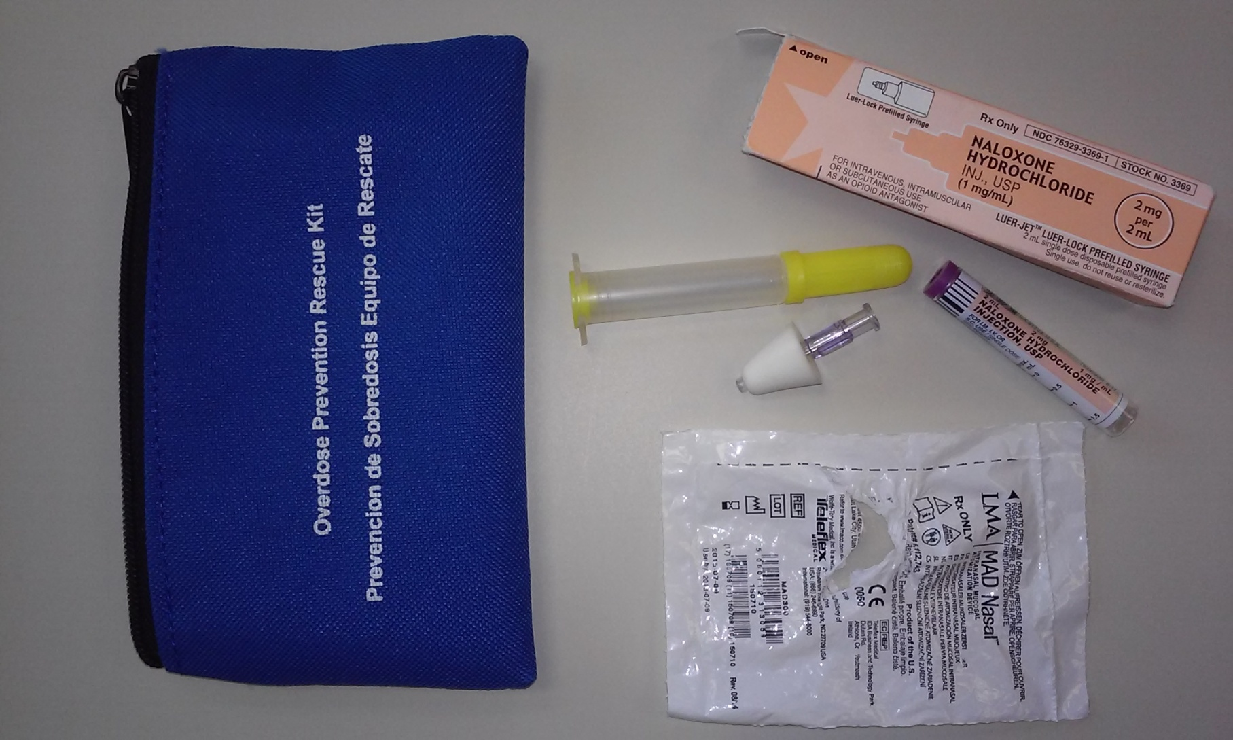
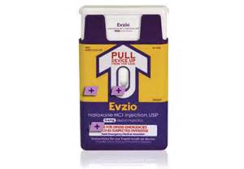
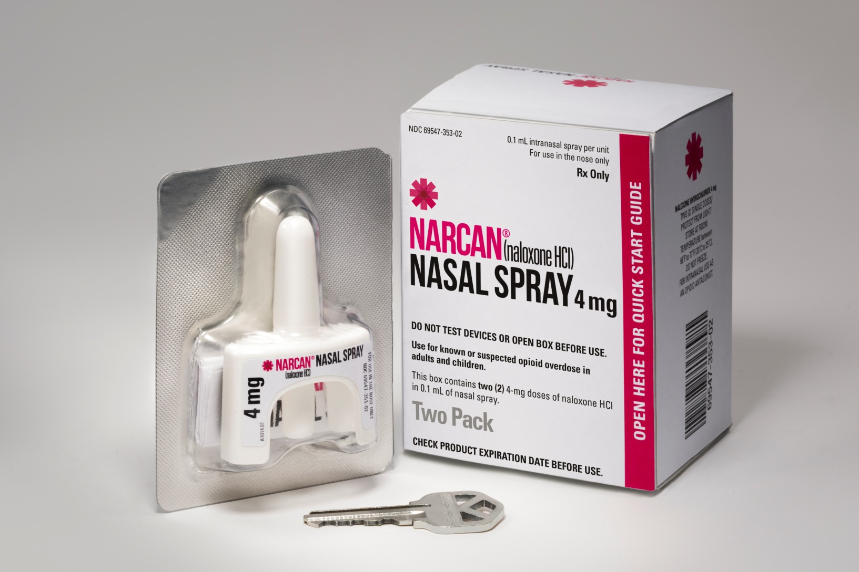
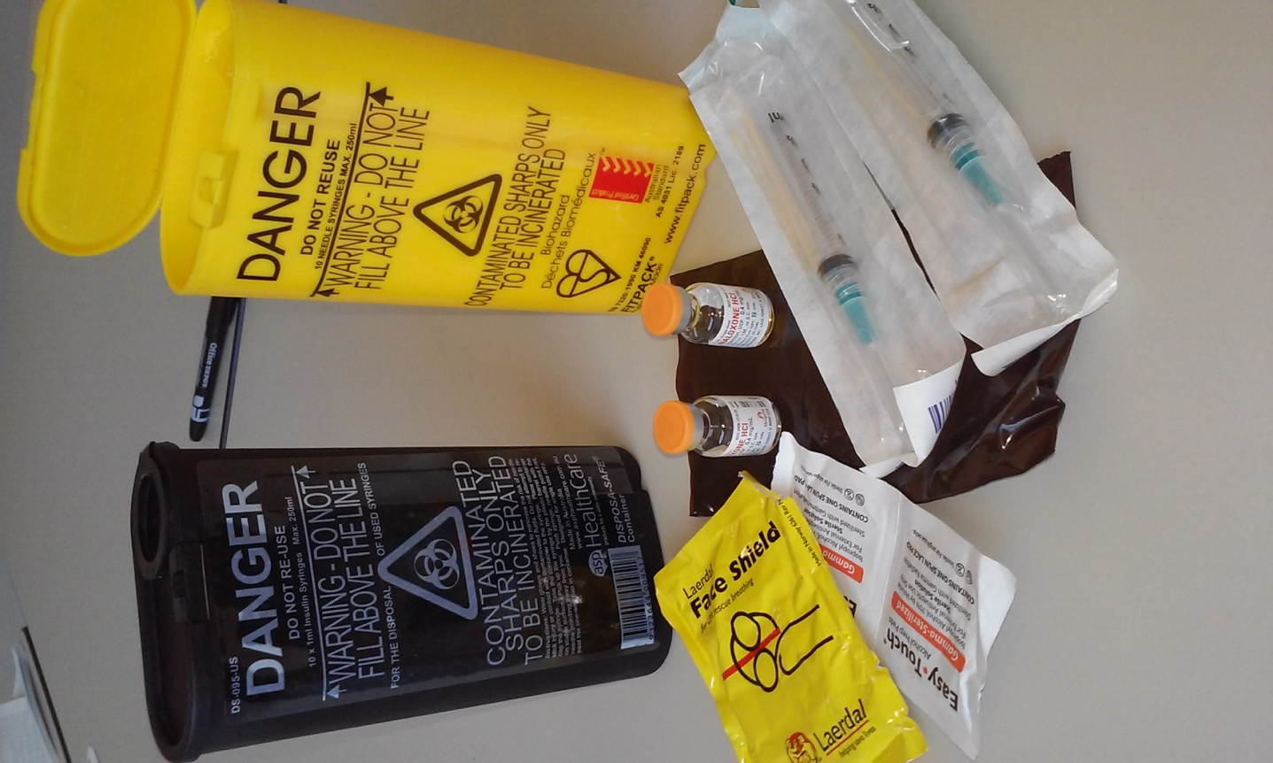
Naloxone

Slide 12
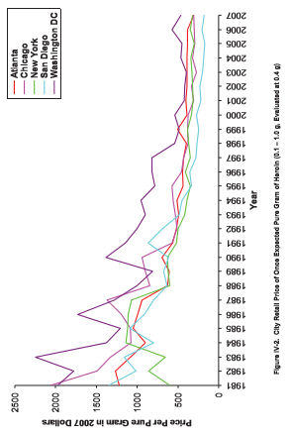
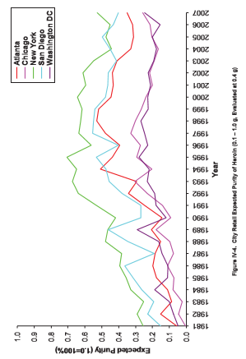
A Story of Data Points
Opioid Use in the United States has more than more than doubled in the last 15 years

Slide 13
Reassessing Priorities
It should be apparent:
  Enforcement & Prevention alone have not been effective
  Underfunded Treatment & Unfunded Harm Reduction alone have not been effective
Recommendations
  1. Funding for evidence based (medication assisted) treatment and harm reduction is a necessity
  2. We must work more collaboratively between all points in our system, with equal-weight on all modalities

Slide 14
Sources
CDC MMWR
Chicago Recovery Alliance
Project Lazarus
Red Project
Price and Purity of Illicit Drugs: 1981-2007; Office of National Drug Control Policy
National Survey on Drug Use and Health

