Slide 1
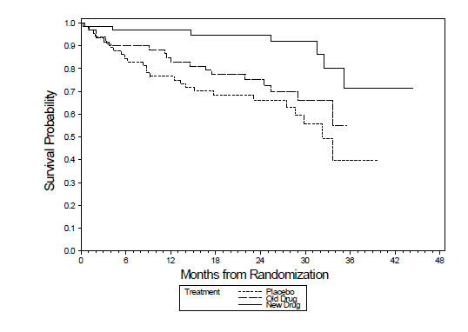
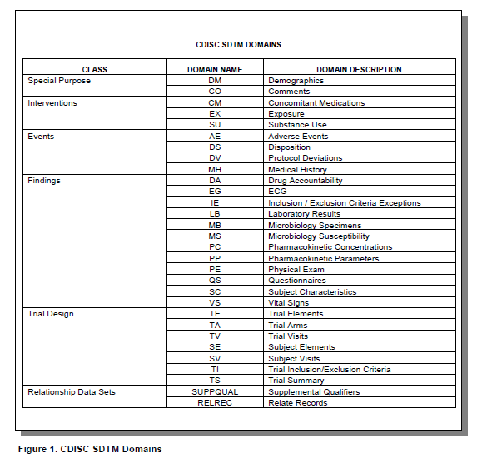
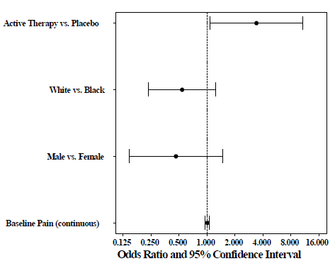
CLINICAL DATA ANALYST INTERNSHIP, AT DATAPLUS PHARMA SERVICES
Sai Krishna. Kotha
Medical and Bioinformatics Graduate Program, School of Computing and Information Systems,
Grand Valley State University, Allendale, MI, USA
Purpose and Background
Description of Work
Clinical trial graphs
Dataplus pharma is a leading service provider for pharmaceutical and Biotech companies. They are specialized in providing services and developing software products for CDISC implementation, Statistical reporting and Data Management. Some of the products they have developed are:
DataDefine - a user friendly software application to generate CDISC compliant Define.xml for regulatory submissions
CRF annotator – to reduce manual effort of creating PDF annotations
Datacompare – to compare metadata templates
DataMap – to convert raw data into SDTM standards
Datacheck - to check the data for CDISC standards conformance
Importing data:
From relational database and clinical database management system: Using SAS/ACCESS SQL pass through facility.
2) Importing ASC11 Text: using PROC IMPORT and SAS Data step
Standardising the data as per CDISC SDTM regulations
Converting the CDISC SDTM datasets ADAM datasets
Transforming data and creating Analysis datasets
Creating tables and listings
Creating graphs
Objectives
Objectives
The objectives that I could achieve during my internship are:
Provide clinical data analysis support for data management, data validation and statistical report generation
Assist Biostatisticians, Data Managers and Clinicians with developing tools techniques for improving process efficiencies
Generate analysis datasets, statistical tables, listings and graphs
Support regulatory electronic submissions to FDA
Workflow
Overall Experience
My Internship experience has given me the realistic preview of my field of interest. As a result of my internship, I have a better understanding of the concepts, theories in my study.
The internship provided an opportunity to learn about Clinical trial data standardization and analysis.
Acknowledgements
Dr. Guenter Tusch, PSM Medical and Bioinformatics Program and Director.
Dr. Tim Born, PSM Coordinator.
GVSU Medical and Bioinformatics Dept.
Sridhar Dodlapati, Manager at Dataplus pharma services
Mahipal Vannam , Manager at Dataplus pharma services
Contact
References
SAI KRISHNA KOTHA
GRAND VALLEY STATE UNIVERSITY
Email: kothasa@mail.gvsu.edu
Phone:845-518-1087
https://www.cdisc.org/standards/foundational/sdtm
https://www.cdisc.org/standards/foundational/adam

