Slide 1
Orchestrating Mathematical Discussion
Session 3
October 21, 2015

Slide 2
Overview
Lesson Sharing
Connecting Discussion
Problem Solving
LUNCH
SAT
Globe Activity
Rigor Discussion

Slide 3
Paperwork
We need:
SCECH Forms
Substitute Reimbursement Form

Slide 4
Share Protocol
Describe the strategy and implementation (3 minutes)
Group asks clarifying questions and presenting teacher may respond
(2 minutes)
Provide warm and cool feedback
(2 minutes)
Reflect based on feedback
(1 minutes)

Slide 5
Reflection
What was the most meaningful/beneficial thing your group learned from this experience?
Would you use this with students?
If so, how would you adjust the questions?

Slide 6
Connecting Discussion
5th Practice for Orchestrating Mathematical Discussions
Most Challenging
Dependent on questioning to reveal student thinking
Link between mathematical ideas and representations to critically consider a mathematical concept.

Slide 7
Connecting
UNIT
Sequence Topics and Build Connections
Intradisciplinary
Interdisciplinary
Lesson
Sequence
Connecting

Slide 8
5 Practices Rubric
Review the 5 Practices Rubric
In your group, please discuss the following:
Strengths and weaknesses of the rubric
Uses of the rubric

Slide 9
5 Practices Rubric
Use your rubric to rate the following classroom
After the clip is done, discuss with your ratings and logic behind the ratings

Slide 10
BREAK

Slide 11
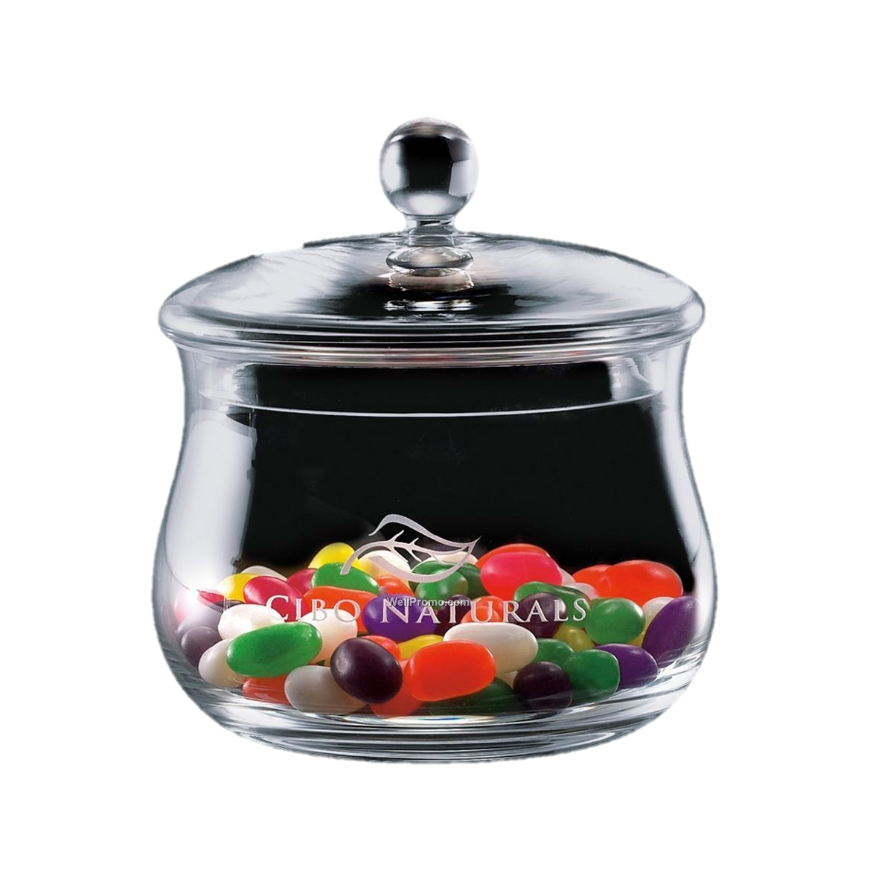
Candy problem solving
Work in groups to solve your assigned method
Fraction
Percent
Ratio (Unit Rate)
Ratio (Scaling Up)
Additive
** When ready, place your solution method on a poster paper

Slide 12
Candy problem solving
Selecting, Sequencing, and Connecting
How would you select and sequence?
Would you use them all?
Why or why not?

Slide 13
lunch

Slide 14
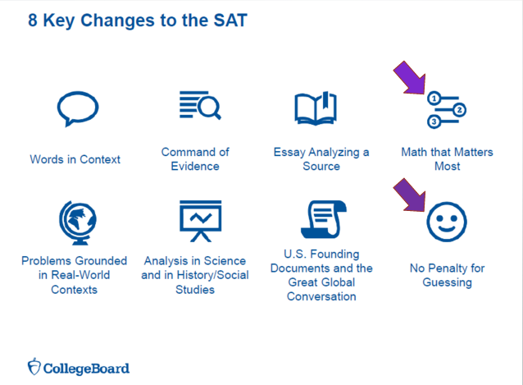
SAT

Slide 15
SAT Research
Current research shows that three key areas most contribute to readiness for college and career training:
Heart of Algebra (mastery of linear equations)
Problem Solving and Data Analysis (quantitative literacy)
Passport to Advanced Math (familiarity with more complex equations)

Slide 18
SAT Math
The overall aim of the SAT Math Test is to assess fluency with, understanding of, and ability to apply the mathematical concepts that are most strongly prerequisite for and useful across a wide range of college majors and careers.
The Math Test has two portions:
Calculator Portion (38 questions) 55 minutes
No-Calculator Portion (20 questions) 25 minutes
Total Questions on the Math Test: 58 questions
Multiple Choice (45 questions)
Student-Produced Response (13 questions)

Slide 20
SAT Math Topic Areas
Heart of Algebra
Linear equations
Fluency
Problem Solving and Data Analysis
Ratios, rates, proportions
Interpreting and synthesizing data
Passport to Advanced Math
Quadratic, exponential functions
Procedural skill and fluency
Additional Topics in Math
Essential geometric and trigonometric concepts

Slide 21
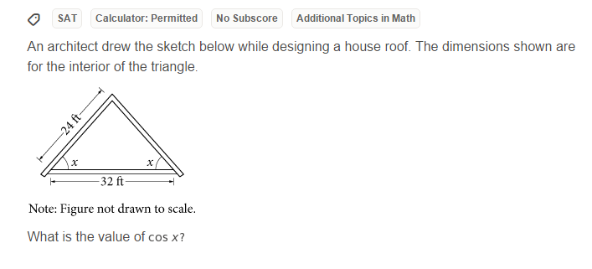
SAT Practice
Try on your own.

Slide 22
SAT Practice
Use the student work provided as if it is your own classroom.
What would you do to address your class and their needs?

Slide 23
SAT Practice
Please take some time to go online and look at the various resources available.
www.gvsu.edu/s/Jk

Slide 24
Globe activity
Use the first sheet to make a quick, independent estimation.

Slide 25
Globe activity
Please take the next 15 – 20 minutes to solve the problem in as many ways as you can find.
Please feel free to work with your peers.
Thought Provokers by Doug Rohrer, published by Key Curriculum Press ($3)

Slide 26
Circling the Earth
By Mikayla and Audrey A.

Slide 27
PLEASE NOTE
That the following presentation is given under the assumption that the earth is perfectly spherical.

Slide 28
A Visual Representation
The Earth
The circumference of the Earth and the Earth’s circumference with the thread.
The radius of the Earth and the Earth’s radius with the thread.

Slide 29
A Birds Eye View / Let Statements
Let r₁ be the radius of the earth
Let r₂ be the radius of the earth with the 100 extra feet of string accounted for
Let c be the circumference of the earth
EARTH
GAP
Let c + 100 be the circumference of the earth with the 100 extra feet of string.

Slide 30
Some Simple Formulas
To solve this problem, one needs to know ONLY this formula:
c = 2πr
circumference = (2) (π) (radius)

Slide 31
And the Computation Begins...
gap = r₂ - r₁
gap = c + 100 - c
2π 2π
gap = c + 100 - c
2π 2π 2π
gap = 100 = 50
2π π
C = 2πr
r₁ = c/2π
r₂ = c + 100
2π

Slide 32
The following slide tests our predicted conclusion

Slide 33
Proposed value for c
c + 100
2π
c
2π
c + 100 - c
2π 2π
(solution)
30
20.69014260
4.77648293
15.915494307
15.91549438
15. 9154943
250
55.6281864
39.7887357
1,192
205.6281864
189.7126921

Slide 34
THANK YOU FOR VIEWING OUR PRESENTATION!

Slide 35
break

Slide 36
Understanding rigor
Definition of Rigor as related to the Mathematics Classroom
Frayer Model
Individually, complete the Frayer Definition Model for the word “rigor”
Once completed, discuss your definition with an elbow partner

Slide 37
Defining Mathematical Rigor
Two aspects of mathematical rigor
CONTENT: Mathematical rigor is the depth of interconnecting concepts and the breadth of supporting skills students are expected to know and understand.
INSTRUCTION: Mathematical rigor is the effective, ongoing interaction between teacher instruction and student reasoning and thinking about concepts, skills, and challenging tasks that results in a conscious connected, and transferable body of valuable knowledge for every student.

Slide 38
DEFINING Mathematical Rigor
As a table group, discuss your definitions of rigor with the definitions presented by Hull, Balka, and Harbin-Miles.
Where do you agree? Disagree?
(Be prepared to share one or two thoughts with the whole group)

Slide 39
Rigor expectations “shift”
Mathematical rigor requires a shift in beliefs and actions.
In the column in the middle of the chart below, rate where you and/or your students are in thinking related to the shifts required for increased rigor in the classroom. Items in the “Current Tendencies” column would be rated “1”; items in “Future Opportunities” would be a “5”.
Once you are done rating each item, select one or two to discuss with a partner or trio.

Slide 40
evaluation
Please complete the Evaluation
THANK YOU!

