Slide 1
Formative Assessment in the Secondary Classroom
Chelsea Ridge, Grand Valley State University
Regional Math & Science Center

Slide 2
Introduction and Overview
Defining formative assessment
Overview of research supporting formative assessment
Exploring various formative assessment techniques
Best Practices
Reflection

Slide 3
Prior Knowledge
Commit and Toss & Sticky Bars

Slide 4
Commit and Toss & Sticky Bars
1. On the sticky note: Place the letter of your answer to the following question:
Assessment is most productive when it is considered
a. primarily as accountability for students on grade reports
b. an ongoing process that supports student learning
c. objective through multiple choice only assessments
d. to inform teaching and learning
e. through multiple data sources
2. On your half sheet of paper: Write your own definition of Formative Assessment.

Slide 5
Commit and Toss & Sticky Bars
Commit and Toss
Great opportunity to share various thought processes in class
Remind students to maintain anonymity if they get their own or they recognize handwriting
Variations: Fold and Pass OR put in a hat and draw back out
Sticky Bars
Works best when followed by an experience that challenges student thinking (Prompt could be overgeneralized or target a common misconception)
Variations: different color for each class to make a combined histogram OR different color sticky notes for mid unit/end of unit to highlight changes

Slide 6
What is formative assessment?
Formative assessment is any assessment strategy that promotes learning rather than measure and report learning. Assessment for learning.
Learning
Instruction
Assessment
What is the purpose?
“To inform instruction and provide feedback to students on their learning”
Threefold: motivation, support and improve teaching and learning
“When viewed as a process that is indistinguishable from effective instruction, assessment serves as a means to achieve productive teaching and learning for all.” (Principles)

Slide 7
Formative Assessment Research
Mathematics Formative Assessment highlights 3 main principles:
1. Accessing prior knowledge: If students initial understanding is not engaged, they may fail to grasp new content or learn for a test but revert back to their preconceptions.
2. Deep conceptual knowledge has to have a deep foundation of factual knowledge, understand it in the context of a conceptual framework, organize the knowledge in ways that facilitate retrieval and application.
3. A metacognitive approach to instruction helps students take control of their own learning by defining learning goals and monitoring their progress. Best when taught in content areas.
Research shows that incorporating these three principles into instruction improves student achievement.
The use of formative assessment with particulary low attainers improves learning and raises achievement.

Slide 8
Formative Assessment Research
Principles to Actions: Ensuring Mathematical Success For All
Making formative assessment an integral part of student learning is associated with improved student learning (3 independent studies)
Effective instruction, including formative assessment, is arguably the most effective test prep strategy as it promotes retention, reflection, generalization, and transfer of knowledge
NCTM calls us to focus on the importance of assessment to guide instruction and assess programming

Slide 9
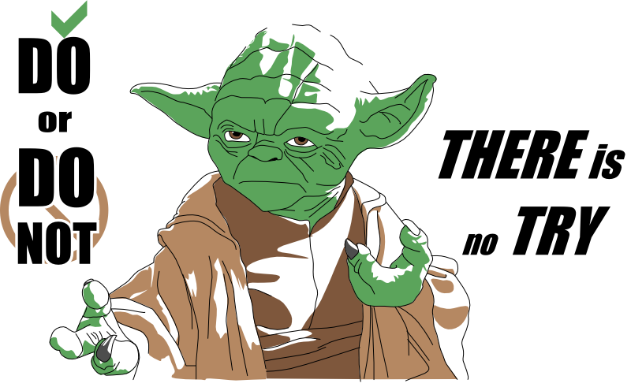
Try it on your own
Try it on your own (2 minutes)
Discuss your solution pathway as if you were a student. Make sure to refine your thinking (3 minutes)
Discuss the formative assessment as teachers (3 minutes)
Pros vs. Cons
Uses in your classroom
Variations you could make
Assessment for Learning
Learning
Instruction
Assessment

Slide 10
Whiteboard It
As a teacher group…
Name It
Summarize your formative assessment
When would be a could time to use in your classroom?
Advantages and disadvantages
Assessment for Learning
Learning
Instruction
Assessment

Slide 11
Switch
Take 2 sticky notes
Write “I like…” and “I wonder…”
Switch tables and review their formative assessments and white boards
Provide feedback

Slide 12
Share It
Each group has 2 minutes to explain their formative assessment to the group.

Slide 13
¾ | 15/20 | 8/9 | 33/44
2/3 | 2/5 | 3/8 | 7/15
½ | 1/3 | ¼ | 1/5
Which one is the odd one out?
Why?

Slide 14
Yellow
The quotient of two fractions is 3. What could those two fractions be? Can you name another set?
How many possible whole number bases and heights of a triangle with an area of 30 in² can you find?

Slide 15
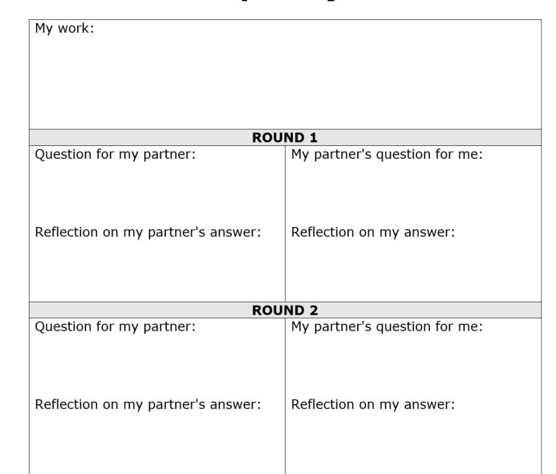
Blue
A string is wrapped around the Earth’s equator and the two ends of the string just exactly touch. Now suppose that another string is tied to the original string so that it is 100 feet longer.
If this new string is placed around the equator and pulled tight so it it is suspended in the air, evenly, how high will the string be above the ground?

Slide 16
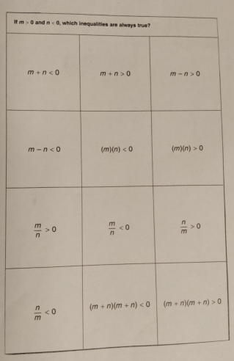
Green
Card Sort

Slide 17
Summarize
Odd One Out (Pink: B p. 137)
Analyzes relationships
Prompts discussion
Conjecture Cards (Green: Y p. 41)
Encourages productive talk
Helps students identify misconceptions
Always, sometimes, never true
Flipped Question (Yellow: Y p. 86)
Multiple answers
Prompts for discussion and a broad understanding of student learning
Partner Strategy Rounds (Blue: Y p. 142)
All students have the opportunity to articulate their learning
Whiteboarding (p. 218 B)
Teachers can circulate and give feedback/probe for deeper thinking
Students come to a group consensus
Researchers have found that when students use whiteboards their discussions are more animated and on task and draw upon higher level thinking.
Use larger whiteboards for easier group think
First time, model effective white board solutions: size, colors, diagrams, bullets etc.

Slide 18
Formative Assessment Best Practices: Preparation
Teachers must consider HOW, WHEN, and for what PURPOSE to use formative assessment.
Questions to consider:
Used to access prior knowledge or assess knowledge or practice skills or self-assess?
Is it helpful to highlight misconceptions?
Individually, small group, or large group?
How will this connect to the learning goal?
How will students receive feedback to move them forward?
Effective formative assessment involves using tasks that elicit evidence of students’ learning and that all students can have an answer (Low floor - High Ceiling Tasks)

Slide 19
Formative Assessment Best Practices: Discussion
Work to build a classroom culture where it is safe to discuss and evaluate peer ideas
Start anonymous
Build a mathematics community with the goal to consider ideas of others to gain new information in order to construct mathematical explanations
Refrain from giving the right answer or passing judgment on student thinking
Students can narrow down their ideas to their ‘best thinking so far’
Don’t underestimate the importance of acknowledging student ideas

Slide 20
Formative Assessment: Addressing Misconceptions
Misunderstandings are a normal part of learning mathematics, but research shows that misconceptions can be held by students even when they recognize a misconception impacts their learning.
Students don’t let it go because they are emotionally and intellectually invested in it
Rather than immediately correcting misconceptions, teachers should learn more about them to reveal how a misconception could be a starting point for instruction

Slide 21
Formative Assessment Best Practices: Metacognition
Part of the role as teacher is to help students to learn strategies to help understand how well they are learning.
Learning has to be done by them; it can’t be done for them
An important goal of assessment should be to make students effective self assessors. When students assume responsibilities, teachers and students can be partners in the learning process with teachers giving students advice on how to improve.
An exclusive emphasis on end of unit assessment carries a serious risk as it serves only to sort students and to convince those who score lower that they can’t ‘do math’ defeating the aim of mathematical success for all

Slide 22
Reflection
PLUS – DELTA Slip
Upon reflection of the session, please complete the following slip:
+ This helped me learn
∆This could be changed to help me learn

Slide 23
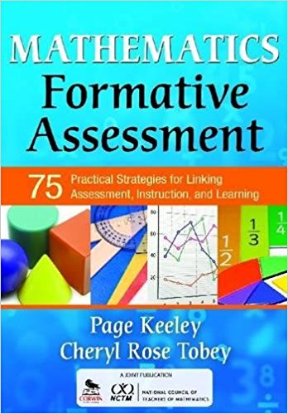
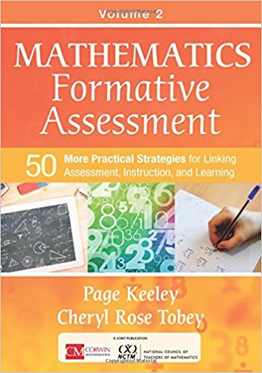
Resources
Keeley, P., & Tobey, C. R. (2017). Mathematics formative assessment. Thousand Oaks, CA: Corwin Mathematics.
Keeley, P., & Tobey, C. R. (2011). Mathematics formative assessment: 75 practical strategies for linking assessment, instruction, and learning. Thoudand Oaks, CA: A joint publication Corwin / National Council of Teachers of Mathematics.
Principles to actions: Ensuring mathematical success for all. (2014). Reston, VA: NCTM, National Council of Teachers of Mathematics.

Slide 24
Contact Me Handouts
Chelsea Ridge
ridgec@gvsu.edu
www.gvsu.edu/rmsc
@GVSURMSC
www.gvsu.edu/rmsc/mctm
www.uncoveringstudentideas.org/templates

