Slide 1
Graduate Record Exam (GRE)
Revised General Test
Information Session
Brian Eikenhout, Heather Chafin, and Gwen Higgins
Academic Advisors
College of Liberal Arts and Sciences Academic Advising Center
C-1-140 MAK
616 331-8585
www.gvsu.edu/clasadvising
PowerPoint: Left menu – Past Presentations

Slide 2

Co-Sponsors for Tonight:
PSI CHI
The International Honor Society in Psychology
www.gvsu/edu/psychology
Thanks for the Snacks!

Slide 3
Agenda
Graduate Records Exam overview
Preparing to take the GRE
What is on the exam
  Analytical Writing
  Verbal Reasoning
  Quantitative Reasoning
Sample Questions
Success Strategies/Resources
Subject Test Overview

Slide 4
Graduate Record Exams
-Evaluating readiness for graduate study -
Revised General Test - $195
Started Aug. 1, 2011 – New format, content & question types
  Assesses analytical reasoning
  Verbal, Quantitative, Analytical Writing Skills
Subject Tests - $150
  (Assesses achievement in a particular subject area)
  (7 Subject Areas)
Educational Testing Services Web Site: www.ets.org/gre
www.takethegre.com

Slide 5
Fee Reduction Program
A Fee Reduction Certificate may be used for one GRE revised General Test and/or one GRE Subject Test. Eligibility for participation in the Fee Reduction Program is limited to one time only
A 50% reduction in fees is possible if you are:
  Receiving Financial Aid
  Unemployed and Receiving Unemployment Compensation
Special Programs
  McNair Scholars
  Gates Millenium
  Project 1000
  GEM

Slide 6
Fee Reduction Program Cont.
Contact your financial aid office to see if you qualify
Once your eligibility is established, the Financial Aid Office front desk in STU will issue you a Fee Reduction Certificate and a copy of your ISIR. Follow the instructions on the voucher. Allow up to three weeks for processing and mail delivery
  http://www.ets.org/gre/revised_general/about/fees/reductions/

Slide 7
Pre-Planning
Check with each target school:
  Is the GRE required for admissions OR for fellowships, grants, or other forms of financial aid?
  What scores are competitive for each program?
  What is the application deadline?
      Determine when you need to take the test(s)
Notes:
Graduate School Timeline and Tasklist

Slide 8
Revised General Test
  Assesses analytical reasoning in verbal, quantitative and written contexts
  Given year round
  Testing sites
    Prometrics in GR on Burton
  Register for test on-line (credit card, PayPal, etc.), by phone or by mail
    Please note: accommodations for test takers with disabilities need to register by mail
  Computer administered
Notes:
Accommodations for Test Takers with Disabilities
Must register by mail with ETS Disability Services
Can take up to six weeks to process, additional six weeks if more documentation is needed
Cannot register using the online registration system
Look at the Bulletin Supplement for more info

Slide 9
Revised General Test, cont.
  Official score reports in 10-15 days-email notification
  Can retake up to once every 30 days for a total of 5 times in a 12 month period (e.g., May – May)
  Unofficial Verbal & Quantitative scored given immediately
  At testing, designate up to 4 institutions to receive scores
  Sending later: $25 per institution
  At testing, designate scores to be sent to your undergraduate institution - free

Slide 10
New Score Report Options
On test day, when viewing your scores at the test center, you can select:
  ScoreSelectSM Most Recent option — send scores from their current test administration (FREE)
  ScoreSelectSM All option — send scores from all administrations in the last five years (FREE)
After test day, test takers can send Additional Score Reports for a fee and select:
  ScoreSelectSM Most Recent option — send scores from their most recent test administration
  ScoreSelectSM All option — send scores from all administrations in the last five years
  ScoreSelectSM Any option — send scores from one OR many test administrations in the last five years
Scores for a test administration must be reported in their entirety

Slide 11
New Score Report Options, cont.
Keep in Mind:
  You will select by specific test dates, so your scores are all from the same testing session.
  The schools you designate will only see the scores that you selected to send them. There will be no special indication if you have taken additional GRE tests.

Slide 12
Preparation Tasks
Become familiar with basic format and structure of the tests
Take full-length practice test in a test-like setting
Assess areas of strength and weakness
Practice with typical questions
Work through problems out loud so you can hear what you are doing
Develop effective pacing – last 4 weeks
Hone writing skills
Review relevant math concepts

Slide 13
Preparation
Typically take the tests in late summer before, or early fall of, your senior year
Test is designed assuming you will study for the exam
How much should you study?
  Regular study period each week – 3 hrs
  Think months, rather than weeks or days
  Expect that progress will be irregular
  Should you take an actual test for practice?
Notes:
2-6 months depending on starting point and need for improvement, or time to acquire vocabulary

Slide 14
General Test
Preparation Materials
www.ets.org/gre - Test Taker Test Preparation
  GRE Information and Registration Bulletin -Information about the tests/testing centers, policies, scores, etc.
  PowerPrep II Program – Two full-length practice tests and additional practice questions – NOT compatible with Mac or some browsers other than Microsoft Explorer 8 and above
      Available in all GVSU computers labs in applications folder under Psychology
  Math Review
  Tips for Analytical Writing, Verbal & Quantitative Sections
  The Official Guide to the GRE, 2nd Ed. - $35- 2 additional practice tests
  All Analytical Writing Topics
  Math Conventions
  For-fee services: Score It Now! $13 Online Writing Practice, etc.
  GRE App- $4.99
Notes:
ScoreItNow!TM is $13.

Slide 15
Preparation Materials, cont.
Commercial preparation books and CD’s
Commercial Test Prep Courses
Additional Information:
  Make sure you read all the information about identification, name, etc. given online and in the bulletin BEFORE you register for the tests
  Read carefully all information about what you must, can or cannot bring to the testing

Slide 16
On Test Day
ID requirements are strictly enforced
  Name on ID must match registration info
The following items are not allowed in the testing room:
  Food, drinks and tobacco
  Cell phones, smartphones, and other electronic devices including cameras
  Personal items other than identification documents
Photograph taken
Handwriting sample collected
Test takers receive a copy of scratch paper
Testing rooms has proctors and electronic surveillance
Policy and Procedures will be covered
  Two educational background information questions

Slide 17
Revised General Test Format
Approx. 3 hrs 45 minutes
Section | Number of Questions | Time | Scaled Score Range
Analytical Writing -1 Section | 1 Analyze an Issue Task 1 Analyze an Argument Task | 30 minutes per task | 0-6 pts.
Verbal Reasoning -2 Sections | Approx. 20 per section | 30 minutes per section | 130-170 pts.
Quantitative Reasoning -2 Sections | Approx. 20 per section | 35 minutes per section | 130-170 pts.
Unscored Section -unidentified | Varies | Varies | No score
Research Section - identified | Varies | Varies | No score
Breaks:
  There is a 10-minute break following the third section, and a 1-minute break between the other test sections.

Slide 18
Revised General Test Changes
Scoring system for Verbal and Quantitative sections:
  New score range of 130-170 with one point increments (Previously 200-800 with 10 point increments)
Eliminated Analogies & Antonyms in Verbal Section
  Vocabulary still very important
Can move around within sections to revisit questions, change answers, etc. Can mark questions to return to. Can skip questions
On-screen basic calculator provided – learn how to use it!
Use this information to ensure that you are using the right study materials
Notes:
If look at last years entering class scores for a graduate program, remember that they are based on the old scale.

Slide 19
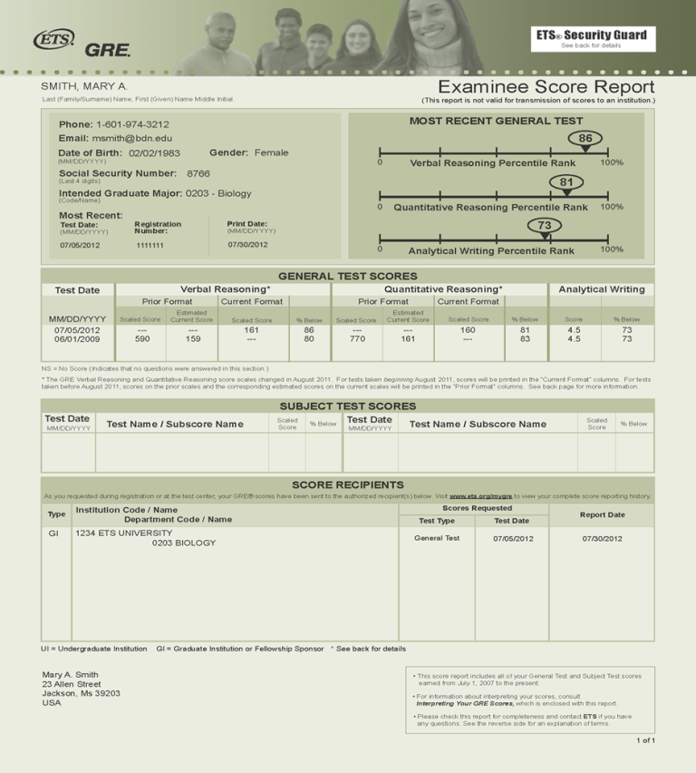
Score Report

Slide 20
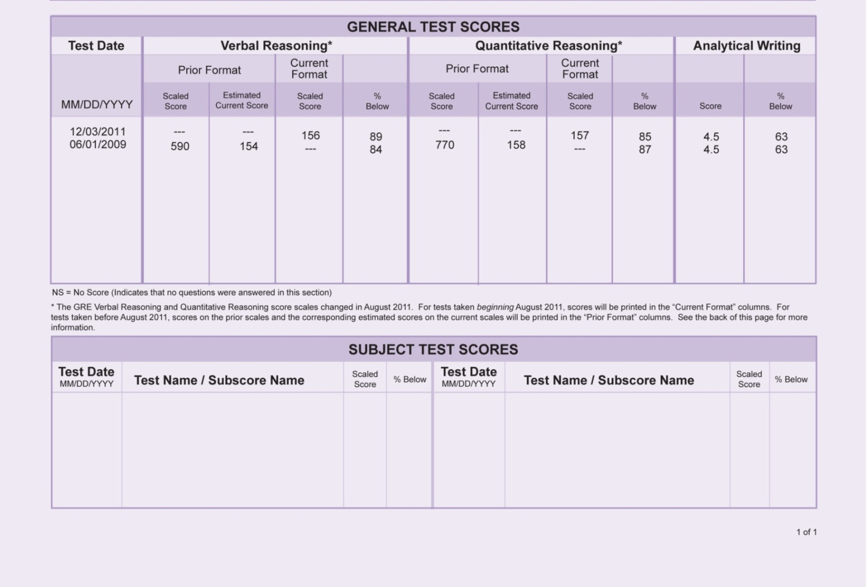
Score Report

Slide 21
Some Computer Adaptive Testing Rules
Your score on the first section determines difficulty of second section for verbal and quantitative portions of the test
Don’t spend too much time on one question. Mark and return.
Learn to guess effectively/eliminate some options
It is normal to answer several questions incorrectly, even for high scorers.
Scores are not based solely on the number of questions answered correctly, but rather on the level of difficulty. Questions within specific sections are all worth the same points.
No penalty for guessing – so guess!
Notes:
Explain Mark and Review features
“Mark” button
Allows test takers to mark questions they would like to come back to later during the time provided to work on that section
“Review” button
Allows test takers to view a list of the test questions in the section. The list contains each question number in the section, whether the test taker has answered the question, and whether the test taker has marked the question for review

Slide 22
Analytical Writing

Slide 23
Analytical Writing: Analyze an Issue Task
You will be presented with a brief issue statement
Your task is to present a compelling case for your own position on the issue
Your STANCE on the issue doesn’t effect your score: Agree, Disagree, Both- Depending
Looking for complexity of thought and understanding and articulate expression of ideas
Stick to the perspective in your topic sentence
Give clear examples and explain their meaning –don’t assume that the reader understands

Slide 24
Analytical Writing: Analyze an Issue Task
You will be instructed to do one of the following:
Write a response in which you discuss the extent to which you agree or disagree with the statement and explain your reasoning for the position you take. In developing and supporting your position,
  you should consider ways in which the statement might or might not hold true and explain how these considerations shape your position.
  describe specific circumstances in which adopting the recommendation would or would not be advantageous and explain how these examples shape your position.
  be sure to address the most compelling reasons and/or examples that could be used to challenge your position.
  you should address both of the views presented.
  you should consider the possible consequences of implementing the policy and explain how these consequences shape your position.
Write a response in which you discuss the extent to which you agree or disagree with the claim and the reason on which that claim is based.
Notes:
The "Analyze an Issue" task assesses your ability to think critically about a topic of general interest and to clearly express your thoughts about it in writing. Each Issue topic makes a claim that can be discussed from various perspectives and applied to many different situations or conditions. Your task is to present a compelling case for your own position on the issue. Before beginning your written response, be sure to read the issue and the instructions that follow the Issue statement. Think about the issue from several points of view, considering the complexity of ideas associated with those views. Then, make notes about the position you want to develop and list the main reasons and examples you could use to support that position.

Slide 25
Issue Task Examples:
  As people rely more and more on technology to solve problems, the ability of humans to think for themselves will surely deteriorate.
    Discuss the extent to which you agree or disagree with the statement and explain your reasoning for the position you take. In developing and supporting your position, you should consider ways in which the statement might or might not hold true and explain how these considerations shape your position.
  All parents should be required to volunteer time to their children's schools.
  Write a response in which you discuss the extent to which you agree or disagree with the recommendation and explain your reasoning for the position you take. In developing and supporting your position, describe specific circumstances in which adopting the recommendation would or would not be advantageous and explain how these examples shape your position.

Slide 26
Analytical Writing:
Analyze an Argument Task
Given a brief passage in which the author makes a case for some course of action or interpretation of events by presenting claims backed by reasons and evidence
Discuss the logical soundness of the author's case by critically examining the line of reasoning and the use of evidence
The instructions will narrow your focus and will be different for each tester

Slide 27
What to consider in formulating your response
    Alternative explanations
    Soundness of the Argument
    Assumptions
    Conclusions
    Counterexamples
    Evaluation
    Evidence
    Examples
    Reasons

Slide 28
Analyze an Argument
Examples of possible instructions:
Write a response in which you discuss what specific evidence is needed to evaluate the argument and explain how the evidence would weaken or strengthen the argument.
Write a response in which you discuss what questions would need to be answered in order to decide whether the recommendation and the argument on which it is based are reasonable. Be sure to explain how the answers to these questions would help to evaluate the recommendation.
Write a response in which you discuss one or more alternative explanations that could rival the proposed explanation and explain how your explanation(s) can plausibly account for the facts presented in the argument.
ETC.

Slide 29
Argument Task
Sample
The following is a recommendation from the Board of Directors of Monarch Books:
"We recommend that Monarch Books open a café in its store. Monarch, having been in business at the same location for more than twenty years, has a large customer base because it is known for its wide selection of books on all subjects. Clearly, opening the café would attract more customers. Space could be made for the café by discontinuing the children's book section, which will probably become less popular given that the most recent national census indicated a significant decline in the percentage of the population under age ten. Opening a café will allow Monarch to attract more customers and better compete with Regal Books, which recently opened its own café."
Write a response in which you discuss what questions would need to be answered in order to decide whether the recommendation is likely to have the predicted result. Be sure to explain how the answers to these questions would help to evaluate the recommendation.

Slide 30
Argument Task, cont.
What matters is not the form your response takes, but how insightfully you evaluate the argument and how articulately you communicate your evaluation to academic readers within the context of the task
Include all the arguments you can make
Not necessary to write a conclusion if you run out of time
Avoid excessive irony or humor that can be misinterpreted by readers

Slide 31
Verbal Reasoning

Slide 32
Verbal Reasoning Section
Three type of questions
  Text Completion
    Fill in blanks in 2-3 sentence passage
  Sentence Equivalency
    Select the two answer choices that, when used to complete the sentence, fit the meaning of the sentence as a whole and produce completed sentences that are alike in meaning
  Reading Comprehension
    Each Reading Comprehension question is based on a passage that may range in length from one paragraph to several paragraphs
Notes:
20 questions in each section

Slide 33
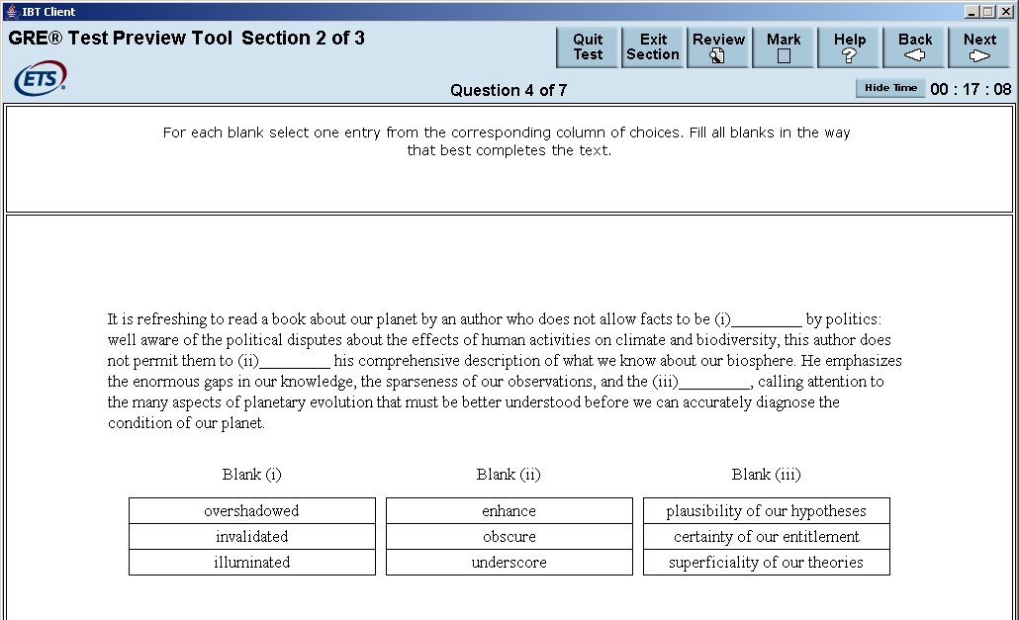
Text Completion Sample Question
The narrative that vanquished peoples have created of their defeat have, according to Schivelbusch, fallen into several identifiable types. In one of these, the vanquished manage to ___i___ the victor’s triumph as the result of some spurious advantage, the victors being truly inferior where it counts. Often the winners ___ii___ this interpretation, worrying about the cultural or moral costs of their triumph, and so giving some credence to the losers story.
Answers for each blank are independent. Must have both right to get credit for a correct answer.
Blank i | Blank ii
anoint | take issue with
construe | disregard
acknowledge | collude in

Slide 34
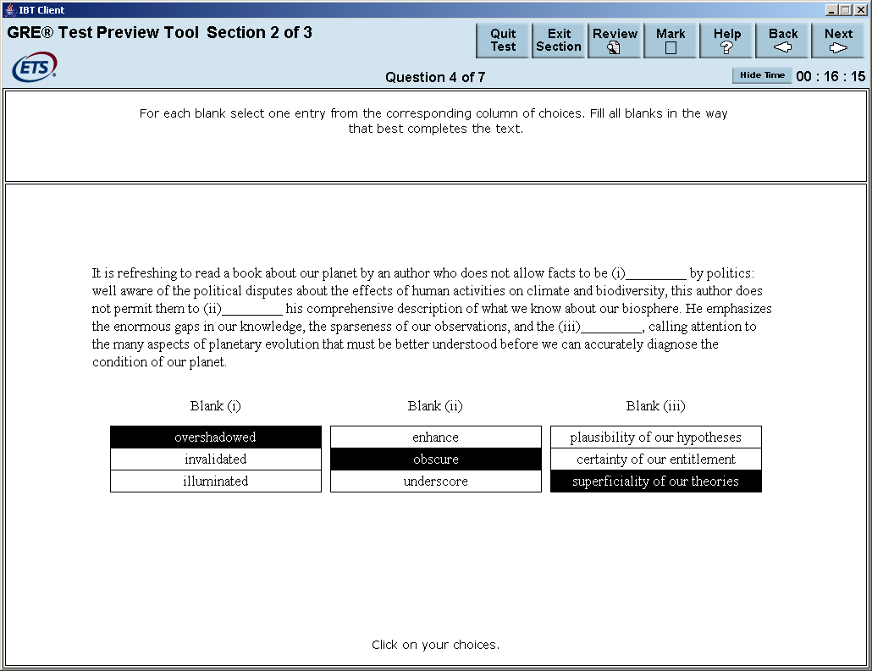
Text Completion Answer

Slide 35
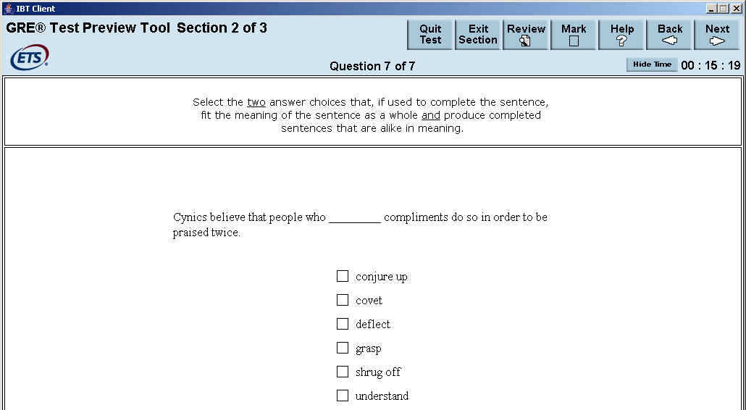
Sentence Equivalence Sample Question
Select the two answer choices that, when used to complete the sentence, fit the meaning of the sentence as a whole and produce completed sentences that are alike in meaning.
2. It was her view that the country's problems had been _______ by foreign technocrats, so that to ask for such assistance again would be counterproductive.
  ameliorated
  ascertained
  diagnosed Note: Square boxes denote that
  exacerbated more than one answer is possible
  overlooked or, in this case, needed
  worsened
Notes:
Answers: Deflect and shrug off

Slide 36

Sentence Equivalence Answer

Slide 37
Reading Comprehension
The test contains approximately 10 passages, with 1-6 questions/passage.
  Most - one paragraph, and only one or two - several paragraphs
Drawn from: physical sciences, biological sciences, social sciences, business, arts and humanities and everyday topics. Based on material in books and periodicals, - academic and nonacademic
No special knowledge needed of the field
These questions make up about 1/2 of the questions in the verbal section
Questions focus on deciphering main ideas, authors purpose, what is specifically stated, what is implied or suggested, and deciding what might come next, etc. Be careful not to pick an answer choice simply because it is a true statement
Mix of standard one answer M/C questions, questions where you choose all answers that are correct and questions where you choose an exemplar sentence. Shape of check boxes tells you whether more than one answer may be needed
Notes:
Oval = One answer
Box = Multiple answers

Slide 38
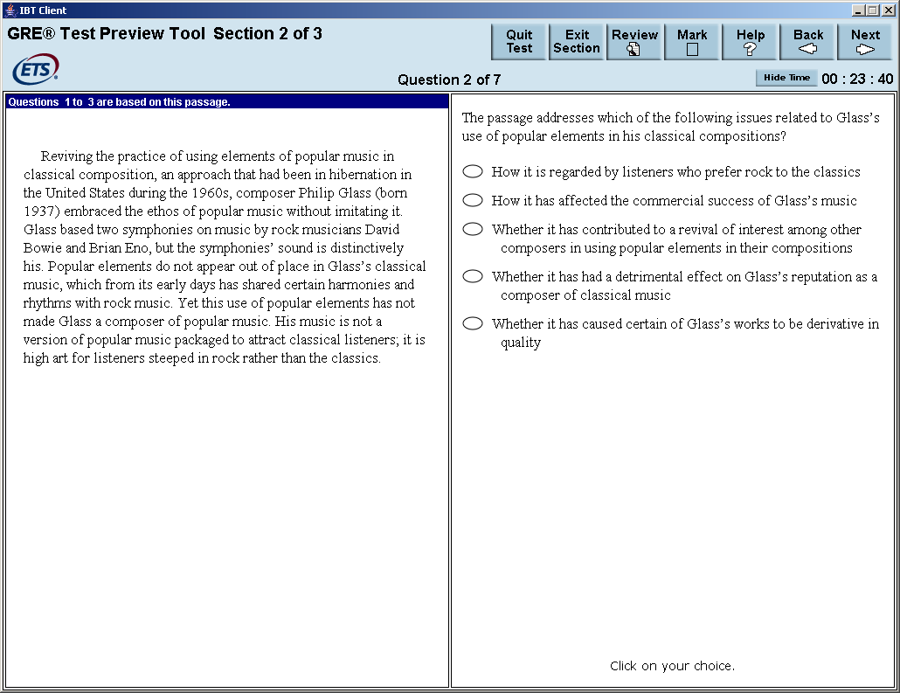
Reading Comprehension Example #1
Notes:
Answer - Last

Slide 39
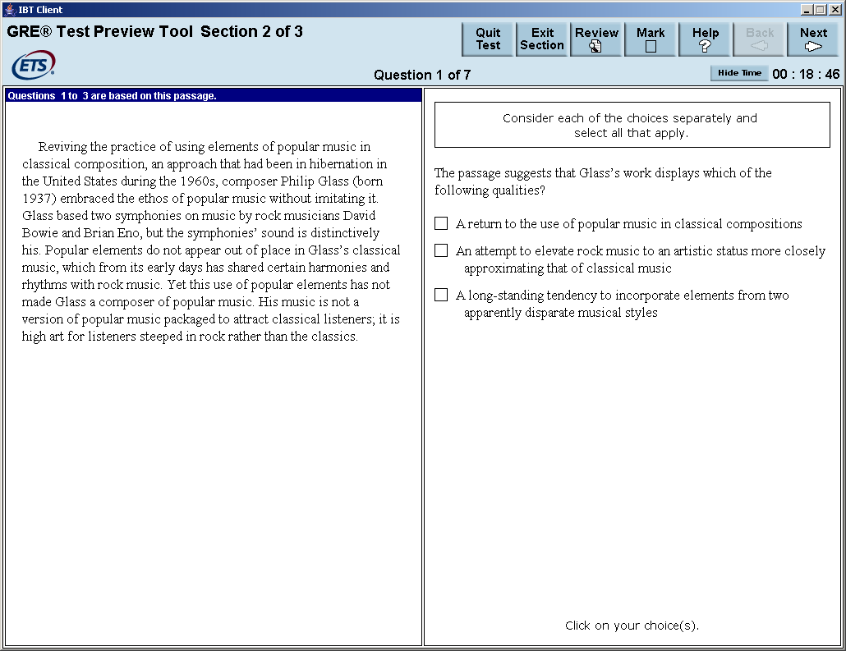
Reading Comprehension
Example #2
Notes:
Answers: 1st and 3rd

Slide 40
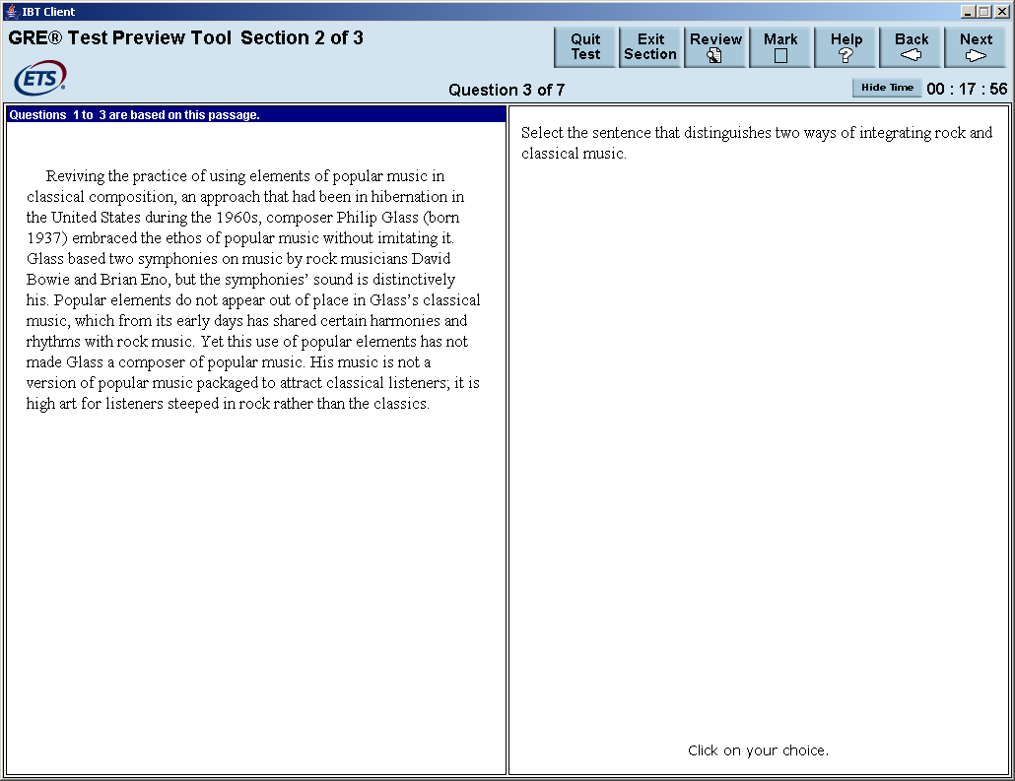
Reading Comprehension
Example #3
Notes:
Last Sentence: His music is not a version of popular music packaged to attract classical listeners; it is high art for listeners steeped in rock rather than the classics.

Slide 41
Reading Comprehension, cont.
When practicing to take the test, try to determine which method is best for you:
  Whether to read the passage thoroughly first
  Whether to skim the passage first
  Whether to look at each question before reading the passage
When answering reading comprehension questions
  Make sure you understand what the question is asking
  Answer strictly on the basis of what the passage says — do not rely on outside knowledge
  Do not select an answer simply because it is a true statement
  Do not select an answer that is only partially correct

Slide 42
Quantitative Reasoning

Slide 43
Quantitative Reasoning
Covers:
  Arithmetic, algebra, geometry, and data analysis
Excludes:
  Trigonometry, calculus, and higher college-level math
Question formats:
  Multiple choice – one answer
  Multiple choice – one or more answers
  Numeric entry – type correct answer in box
  Quantitative Analysis – compare two quantities.
  Data Interpretation – 2 or more sets of questions concerning a display of data.

Slide 44
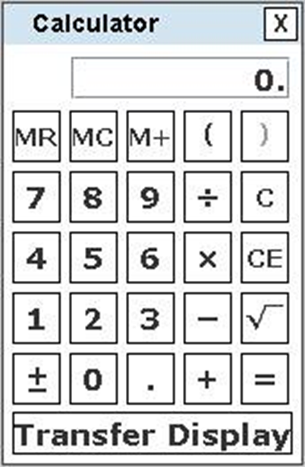
On-Screen Calculator
Operated with the keyboard or mouse
Has four arithmetic functions, square root, memory and parentheses
Has a Transfer Display button to transfer a number to a Numeric Entry question (with a single answer box)
Respects order of operations (e.g., the result of 1 + 2 x 3 is 7, not 9)
Most questions do not require difficult computations, so the calculator should be used only when needed (e.g., larger numbers, long divisions or multiplications, square root, etc.)

Slide 45
Quantitative Reasoning, cont.
Things to keep in mind:
  Read the section in math review or PowerPrep II concerning math conventions used!
  Figures are NOT drawn to scale unless the question indicates this, or involves graphs and charts
  There are short cuts to finding answers in some cases. See strategy guides
  Pay attention to UNITS for answer as well as INSTRUCTIONS for ROUNDING

Slide 46
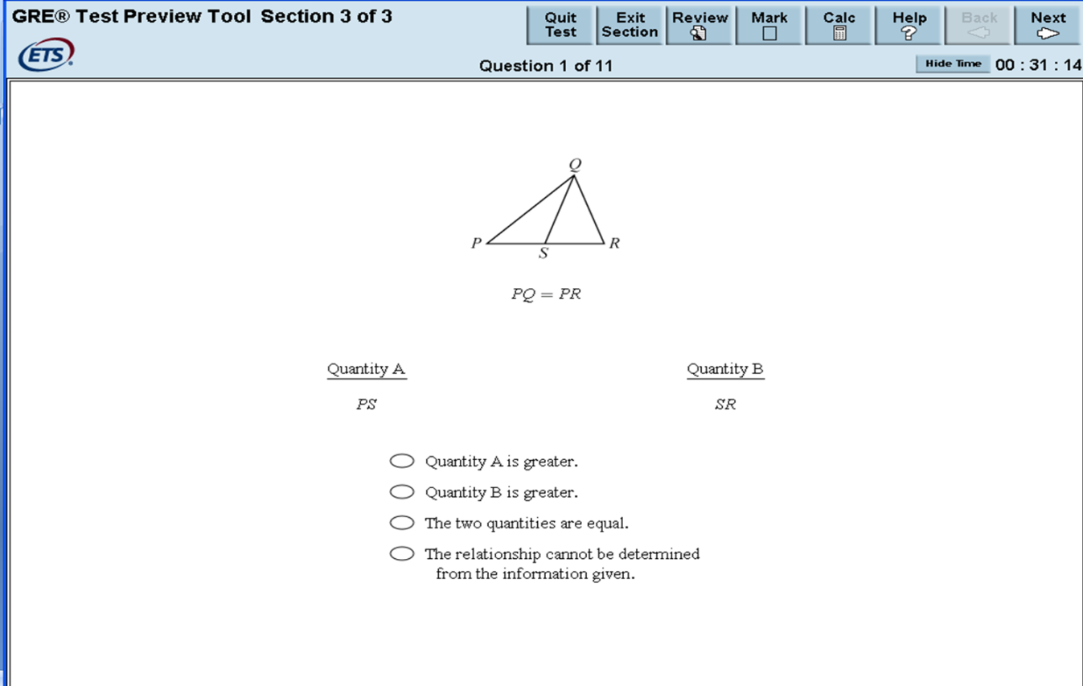
Quantitative Comparison
Example
Notes:
Answer: Cannot be determined

Slide 47
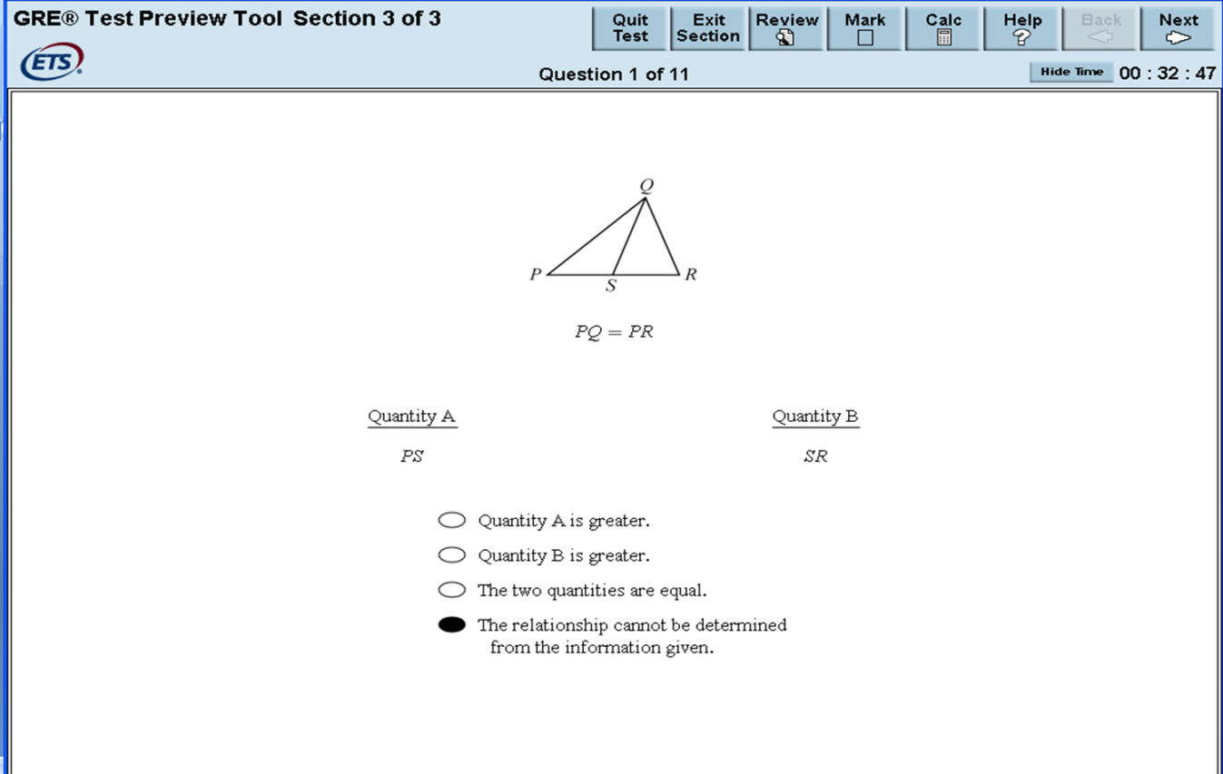
Quantitative Comparison Example Answer

Slide 48
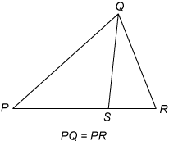
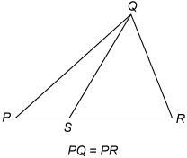
Quantitative Comparison Explanation
Explanation:
The figure is not necessarily drawn to scale!
Notes:
Furthermore, because the figure is not necessarily drawn to scale, you cannot determine the relative sizes of PS and SR visually from the figure, though they may appear to be equal. The position of S can vary along side PR anywhere between P and R. Below are two possible variations of Figure 1, each of which is drawn consistent with the information
The answer is therefore that the relationship cannot be determined.

Slide 49
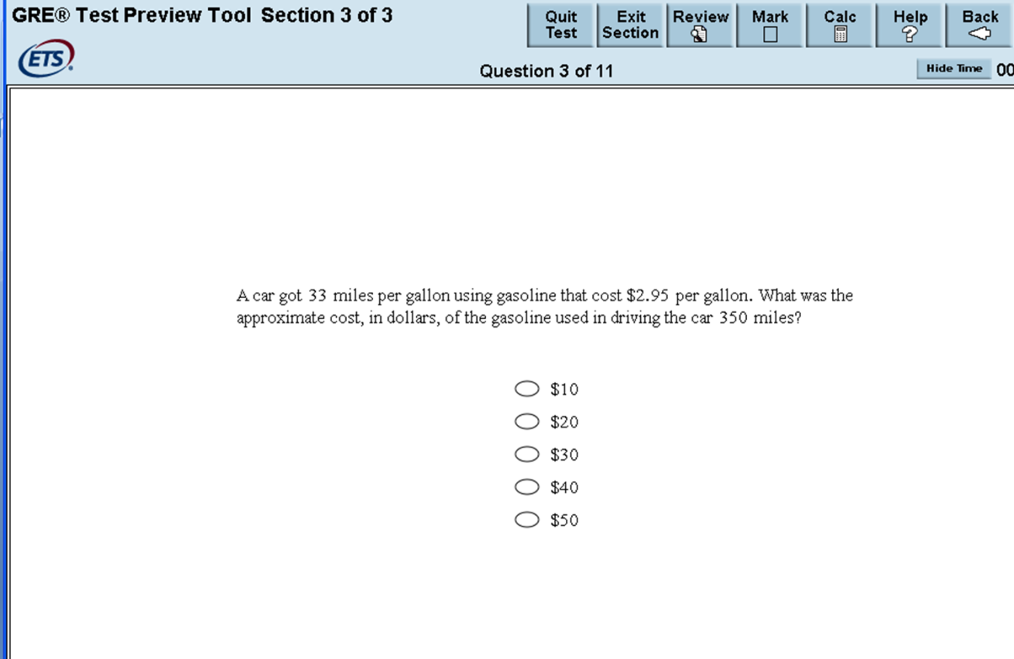
Multiple Choice – Single Answer Example

Slide 50
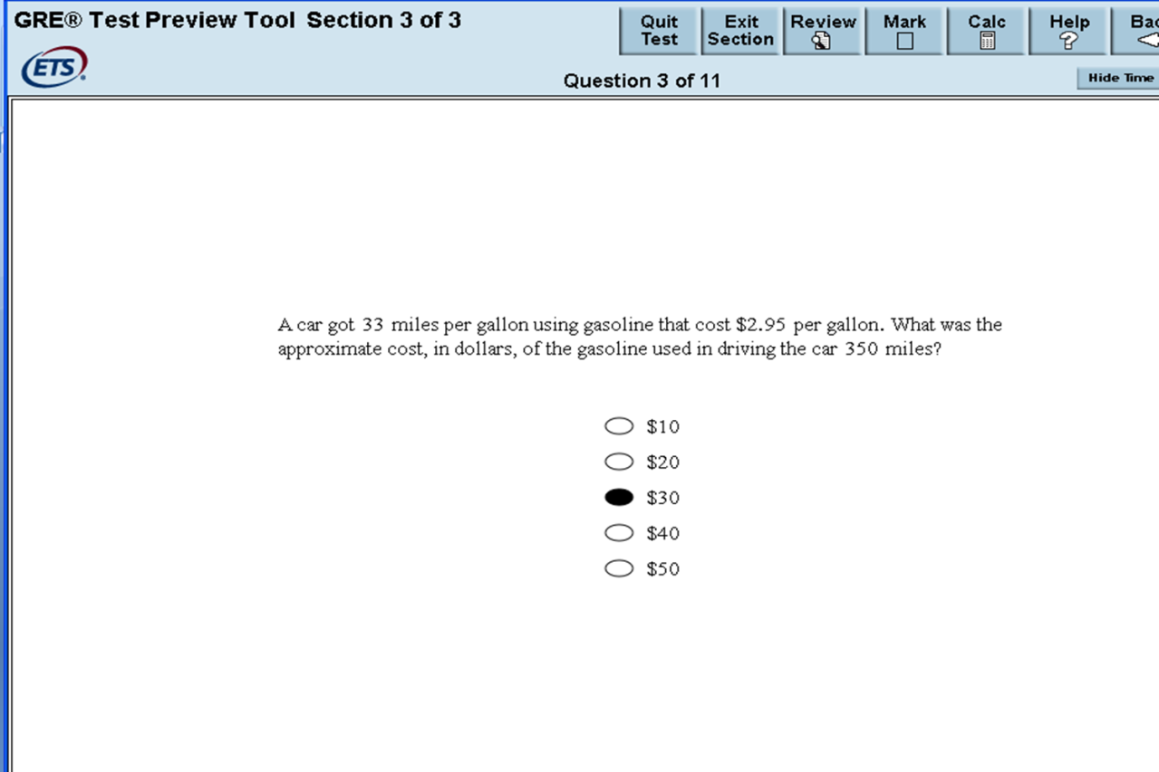
Multiple Choice - Single Answer

Slide 51
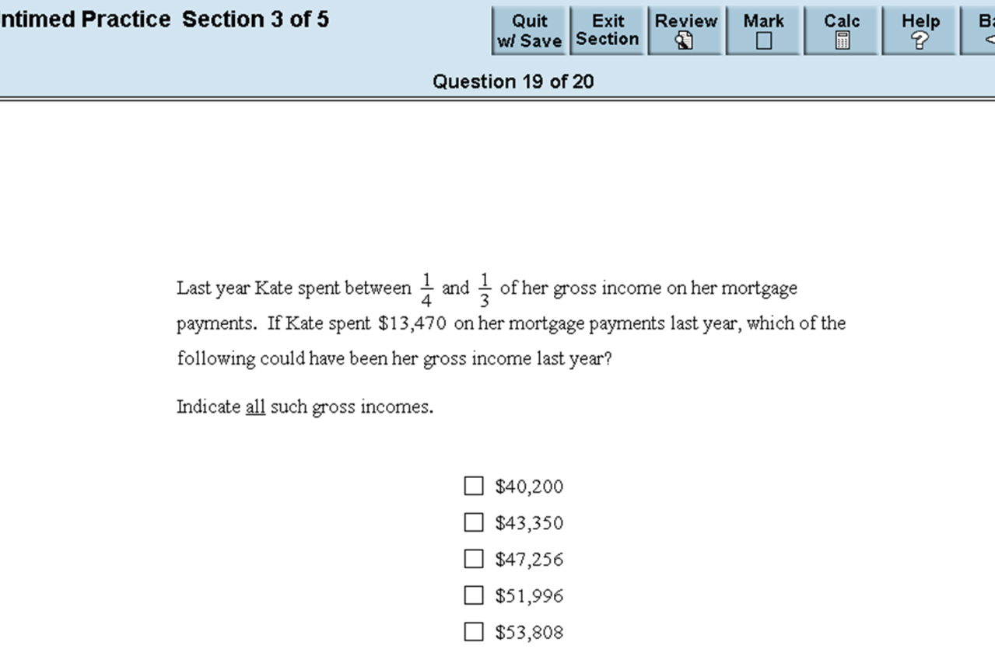
Multiple Choice - Select One or More Answer Choices

Slide 52
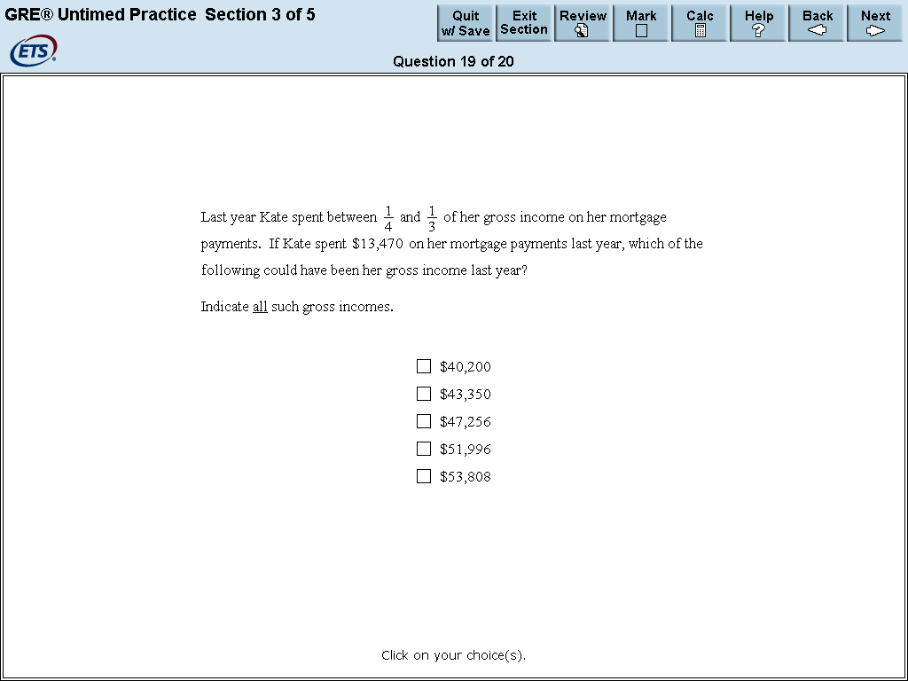
Multiple Choice - Select One or More Answer Options
X
X
X
X

Slide 53
Numeric Entry
Enter your answer as an integer or a decimal if there is a single answer box
Enter it as a fraction if there are two separate boxes—one for the numerator and one for the denominator.
Use the computer mouse and keyboard to enter your answer
For a single answer box, a number can be transferred to the box from the on-screen calculator
Enter the exact answer unless the question requires you to round your answer

Slide 54
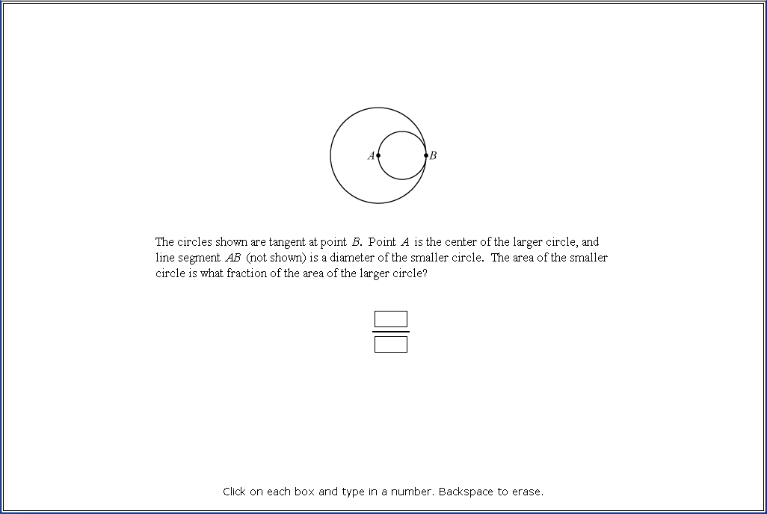
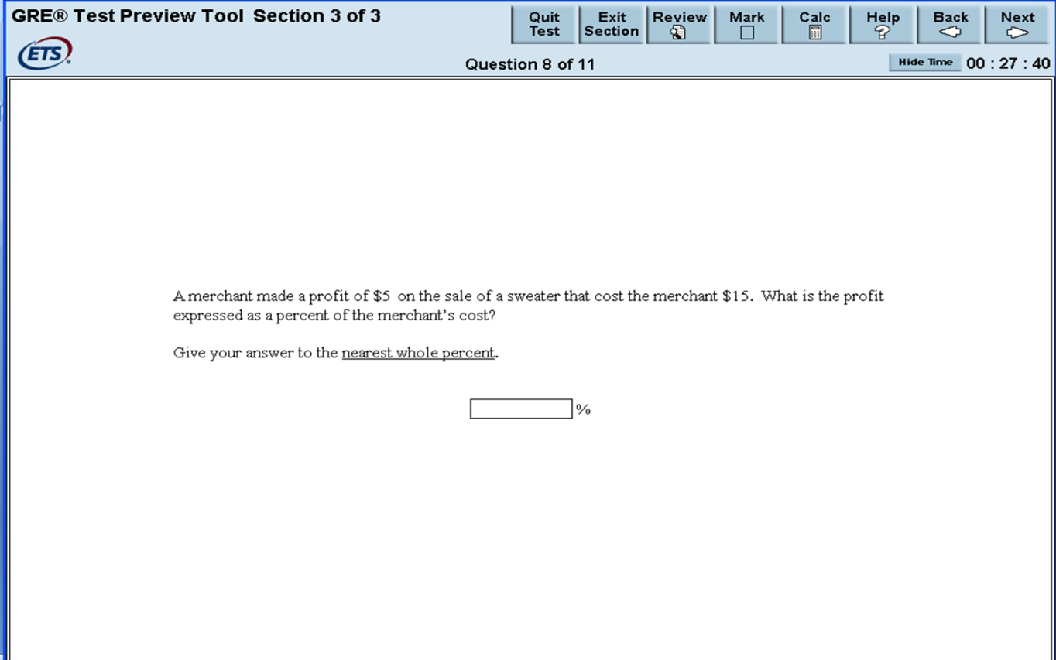
Numeric Entry Example

Slide 55
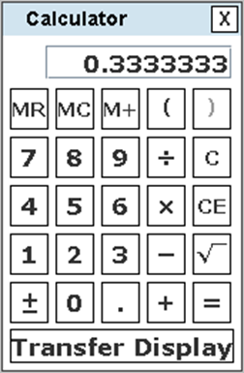
Numeric Entry Example Answer
1
4

Slide 56
Data Interpretation
Data Interpretation questions are grouped together and refer to the same table, graph or other data presentation
These questions ask you to interpret or analyze the given data
The types of questions may be Multiple Choice (both types) or Numeric Entry

Slide 57
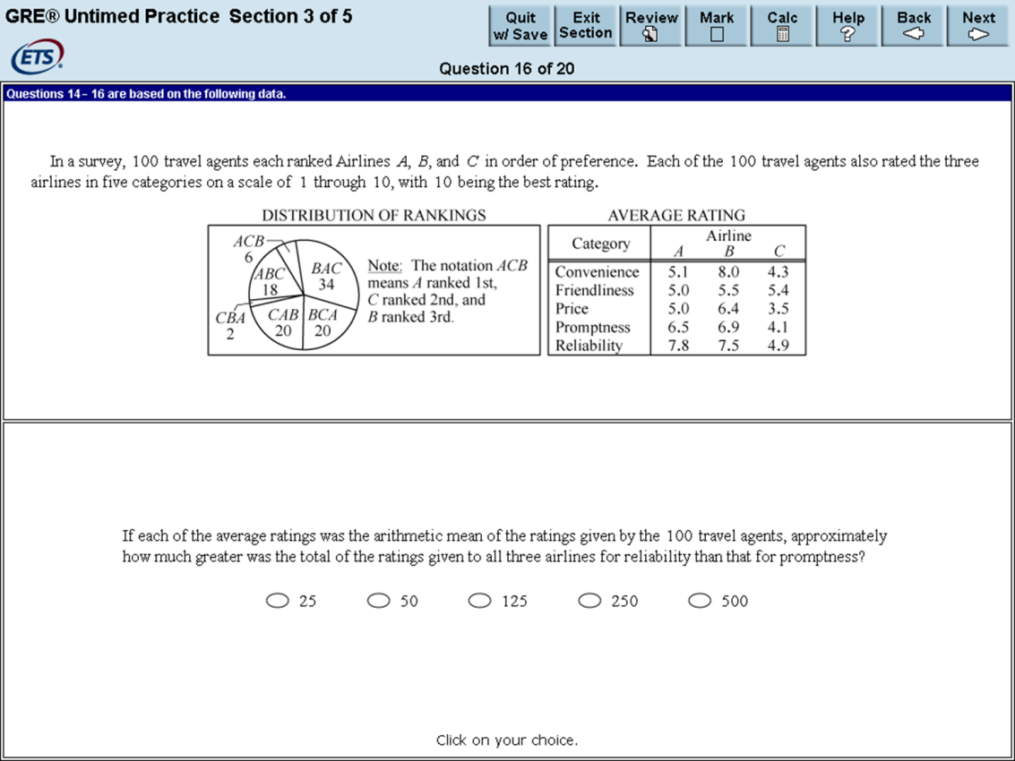
Data Interpretation Example

Slide 58
Data Interpretation Example Answer
Notes:
Answer is 250

Slide 59
What if you don’t do well?
Do something in response!
  Repeat test if time, but study intensely first
  Can you compensate for your scores in other ways?
    Talk with faculty about possible strategies
    Can your recommenders state that the scores don’t reflect your knowledge, etc.?
      Might they call someone in the dept. that they know?
    Make sure the other materials you submit are very strong –
      GPA, personal statement, letters of rec., research experience/presentations, relevant experience, etc.
      Ace the interview.
    Would submitting an excellent paper you’ve written help? --- Check to see if this is allowed.
  In worst case, take a year to improve your credentials and study for retake, and reapply.

Slide 60
ETS® Personal Potential Index (ETS® PPI)
Looks at six areas that graduate schools have identified as important for graduate study success:
  Knowledge and Creativity
  Teamwork
  Planning and Organization
  Communication Skills
  Resilience
  Ethics and Integrity
Individual evaluator ratings

Slide 61
Resources
Freerice.com
Khan Academy
Math Review on GRE website
Writing Center
Relevant courses to build skills
Student Academic Success Center
Math Lab, Stats Lab
Youtube: GVSU Math Department
GRE Search Service
Career Services
CLAS Advising Resource Room (C-1-140 MAK)

Slide 62
Subject Tests
Subjects:
    Biochemistry, Cell and Molecular Biology
    Biology
    Chemistry
    Literature in English
    Mathematics
    Physics
    Psychology

Slide 63
Subject Tests, cont.
Paper-based
Offered September, October, and April
Cost: $150
Duration: 2 hours, 50 minutes
Late registration is available for online registration only for a fee of US$25. Late registration closes one week after the regular registration deadline.

Slide 64
GRE Workshop
Coming Winter 2015…
Stay tuned!

Slide 65
Questions?

