Slide 1

EGR- 106
Honor Concept
Laboratory Support & Information
Access Card Policies & Procedures
Safety & Qualifications
Computer Software & Lab Information

Slide 2
HONOR CONCEPT
MORE THAN AN HONOR CODE…
While knowledge and skill are certainly important to engineering practice, an engineer’s integrity is even more important. You must establish this integrity as a student. The professional engineering community monitors itself to establish trustworthiness or integrity. For that reason:
An engineering student will not lie, cheat, or steal, or tolerate those who do.

Slide 3
HONOR CONCEPT
MORE THAN AN HONOR CODE…
Rules of thumb:
Does this action attempt to deceive anyone or allow anyone to be deceived? Handing in or using someone else’s work in electronic or any other form is deceiving my instructor. Grades are assigned to assess my grasp of a concept or skill for future use. If I choose to evade the evaluation or grading process in this way I will deceive my instructor, but I will also deceive my future employer, the clients who will depend on my engineering expertise, and the general public.
Does this action result in an undue advantage to which I would otherwise not be entitled?
Would I be satisfied by the outcome if I were on the receiving end of this action?

Slide 4
Reasons for Submission of Student Work
(Why homework is required and is handed in to be graded)
Students master knowledge and concepts
Students develop problem-solving skills
Students develop good study habits
Students receive feedback on progress
Note student focus in REASONS

Slide 5
Levels of Collaboration - Categories
Category A: Independent Work
Category B: Individual Work
Category C: Group Work

Slide 6
Why the Honor Concept for the Engineering School at GVSU?
To increase Professionalism
To assure that you have the BEST POSSIBLE preparation to become an engineer

Slide 7
Consequences for Violation
First offense: may be a 0 for submission and notification to student, copy to student file
Second offense: may lead to a course grade of F, letter posted to student record
WE REALLY HOPE THAT WE WILL NOT NEED TO INVOKE OFFENSE CONSEQUENCES !

Slide 8
Ryan Aldridge
KEN217 – aldridry@gvsu.edu - 331-6766
Kennedy Hall of Engineering Supervisor
Technical Support Lab (KEN234) EE & CE Support
  Laboratory Equipment
  Check-out System (KEN234)
  Lockers in KEN 2nd & 3rd can be registered for a semester
  Report damaged equipment or facilities

Slide 9

Access Cards
Access Cards
For safety purposes, all students utilizing an Engineering Building during any non-business hours (Daily after 5 PM, plus Weekends and Holidays) are required to use the "buddy system" while in the rooms of any building. This means there must be a minimum of two (2) students within any occupied room within any School of Engineering building.
A “Buddy” can be anyone over the age of 13.

Slide 10
Access Cards
Report lost or stolen cards immediately.
Do not allow other people to use your access card.
You will be held responsible for any damages or theft in the labs. Every time you swipe an access card, the room number, your name, date, and time are recorded in our database.

Slide 11
Access Cards
Unapproved entry into any space (i.e. locked store rooms, conference room, labs, faculty/staff offices, etc.) will result in revocation of your access card privileges for the remainder of the current semester.
Building Hours for Fall/Winter:
  7:00 a.m. – 9:00 p.m. Monday-Thursday
  7:30 a.m. - 5:00 p.m. Friday
  Weekends & Holiday breaks – Key card access only
Key card access only outside of building hours

Slide 12
Access Cards
Failure to follow the policies & procedures will result in revocation of access privileges
$25 security deposit for access cards
Get your security deposit back by returning it to the lab supervisor after graduation or if you leave engineering
Lost or broken card – $5
Destroy it – $25

Slide 13
Access Cards
Examples of Ways to lose your access card privileges
Letting someone else use your access card
Entering rooms that have a class in session
Removing equipment from labs
Not following the buddy system
Leaving doors propped open
Unapproved entry into any space
Using equipment you are not certified to use
Any other violation of the access card policies and procedures

Slide 14
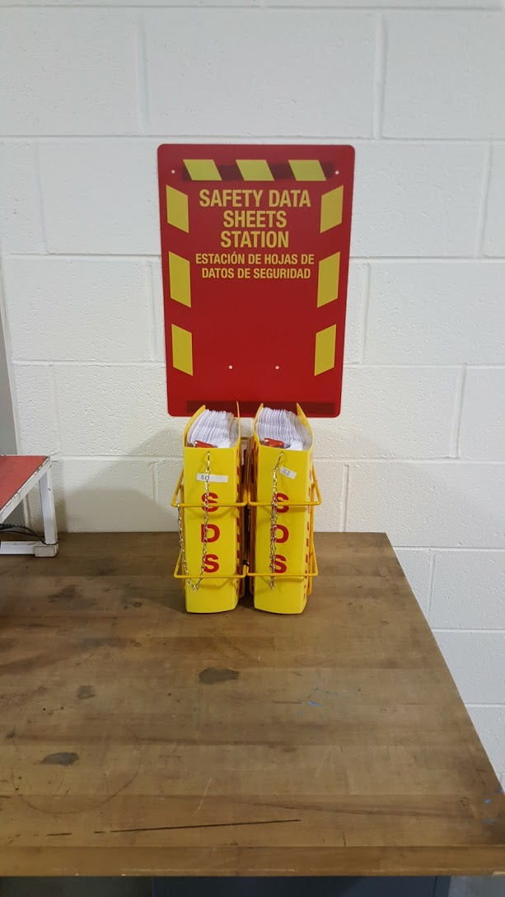
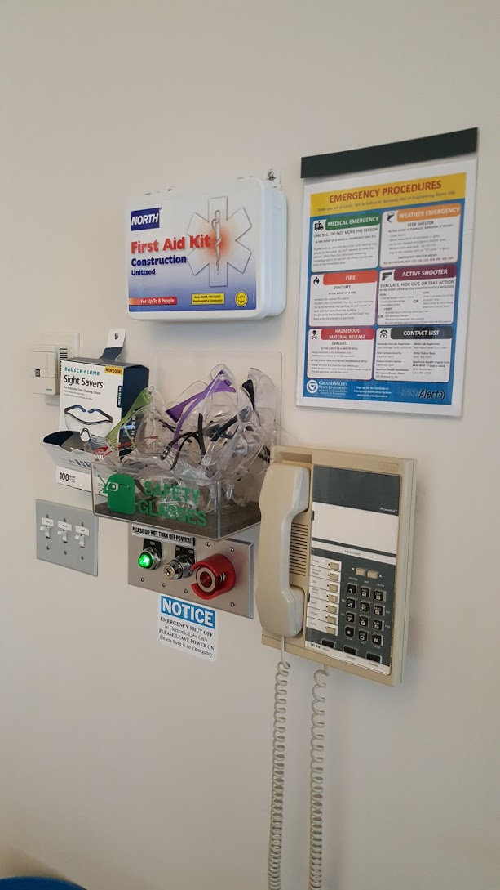
Lab Safety
Emergency contact list
Telephone
Emergency power cutoff
Safety glasses
First Aid
SDS (Safety Data Sheets)
  1st Floor Keller Labs

Slide 15

Doors
All Doors are locked! If the door has a keycard access you will have to swipe your card and pull on the door to open it up!
DO NOT PROP OPEN THE DOORS

Slide 16
Respect
DO NOT enter a lab/classroom in progress that is not your own
Please respect our labs and equipment
  It is a privilege to have “open” labs
Clean up after yourself
Do not remove equipment or tools from the labs
  Checkout equipment from KEN234
Keep doors closed at all times

Slide 17

Roy Visser
KEB 105 – visserro@gvsu - 331-7269
Urban Campus
Entry doors open during the day
Public has access
Classroom/Lab doors kept locked
Personal Belongings
Homeless people
Fire safety protocol
Stairways not elevators
Exit the building and assemble in front of Kennedy Hall
Weather Safety
Designated storm shelters

Slide 18
Hands-on Program
GVSU Safe environment
  Up to you to be safe
  Safety is nothing more than prevention
  Don’t be afraid to ask questions
  Think before you act/don’t take chances
  Powers of observation
Proper Safety apparel
  Eye protection
  Clothing/Jewelry
  Hearing protection
  Shoes
Signage
  Safety Glasses must be warn in this lab

Slide 19
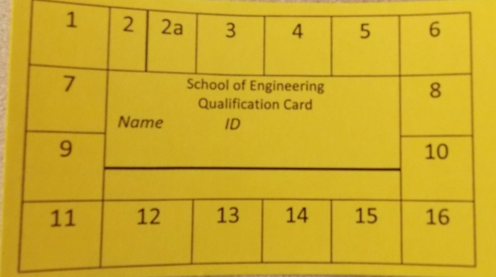
Qualifications
Qualifications/Qualification Cards
Keep your cards with you in case you are asked to show it
The more qualifications you get, the more privileges you achieve
You get #12 for attending this class

Slide 20
Carl Strebel / Adrian Mora
Computer Software
  Licensing
  Distribution
  Installation
Computer Hardware
  Computers
  Printers
Contact
  Carl Strebel 219 KEN strebelc@gvsu.edu
  Adrian Mora 315C EC moraadr@gvsu.edu

Slide 21
Computer Labs
Current Access:
    KEB
      KEB 202 and 211
        Open labs
        No schedule classes in these rooms
        KEB 202 is a quiet lab…no talking, no music, no ear buds….
  KEN
    KEN244, 258, 322, 330, 342 and 358
    You may use any lab as long as there is no class in session

Slide 22
Computer Labs
The Lab computers run windows 8.1
  Login is required (twice)
    Remember to Sign Out! Sign Out!! Sign Out!!!(Twice)
  You have 25Gb of storage
    Avoid saving to your desktop, My Documents, downloads
    Quota
    Save all your work to the W: drive!!!

Slide 23
Computer Software
Solid Works/Solid Cam, Ansys, Matlab, Mentor Graphics, etc…
Most licensed software can be downloaded and run on your own computer
  Downloading and installing is at your own risk!
    No support is offered
    All the software you need is already installed on the Engineering server
  Access to the software
    www.egr.gvsu.edu/egrSoftware
    User id: egr Password: student
  Warning the downloads are HUGE
    Make sure you have enough room on you hard drive for the download, uncompressed software and the installed software.

Slide 24
Computer Software
Most licensed software can be downloaded and run on your own computer
  Follow the directions for installing…do not skip any steps!
  If you are using the software from off campus, you MUST use the VPN connection
    https://vpn.student.gvsu.edu
    Login with your university id and password.
    Click the pulse secure button and install the required software
An easier way to run the software is on the Engineering servers (known as the blade server or gateway)
    See the hand out we gave you in class

Slide 25
Printing on Windows
Printer Setup
  For Windows
    Click the lower left icon, then type “Devices and Printers”
    Select “Devices and Printers”
    Add printer -> Printer isn’t listed -> select a shared printer
    Enter the generic address of the printer you want
      http://egr.gvsu.edu:631/printers/Room_Number
      Example: http://egr.gvsu.edu:631/printers/ken258
    Most of the printers are Xerox Phaser 5550
      Select the correct driver for the printer

Slide 26
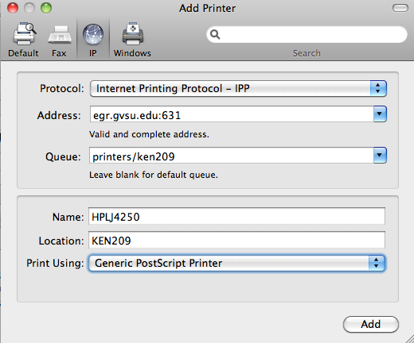
Printing on a Mac
Printer Setup
  For Mac
    Go to System Preferences
    Printers & Scanners
    Click Add (+) to setup a printer
    Select IP
      See picture ->

Slide 27
Printing Etiquette
Where did my print job go?
Don’t print the “Digikey Catalog”!
Don’t print to a room where a class is going on!
Always pick-up your print job!

Slide 28
Computer Etiquette
Do not enter a lab if a class is in session
  Go to another lab
If a lab is has a sign saying “CLOSED” or a computer is labeled “DO NOT USE”, do not use them!

Slide 29
Computer Etiquette
If the labs are full, please give up your seat if you are not doing school work.
Do not steal mice or keyboards or damage the computers in any way.
Do not put mice on keyboard when closing the desktop.

Slide 30
Questions
Ryan Aldridge Kennedy Hall Supervisor Email: aldridry@gvsu.edu Location: 217 KEN Phone: 616-331-6766 | Roy Visser Keller Labs Supervisor Email: visserro@gvsu.edu Location: 105 KEB Phone: 616-331-7269
Carl Strebel Network Systems Supervisor Email: strebelc@gvsu.edu Location: 219 KEN Phone: 616-331-2441 | Adrian Mora Systems Administrator Email: moraadr@gvsu.edu Location: 315c Eberhard Center Phone: 616-331-6260

