Slide 1
Grantsmanship for Graduate Students
PACES Professional Development Program
1/17/15
Salvatore Alaimo, PhD - Assistant Professor

Slide 2
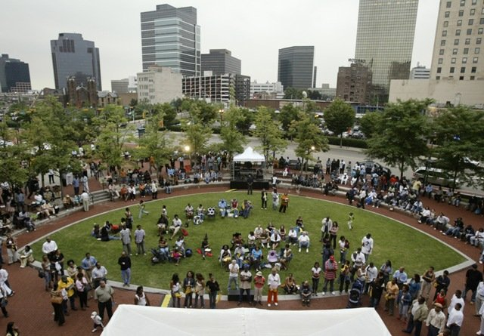
Why are grants important?
Improve lives and communities

Slide 3
Why are grants important?
Build capacity
Organizational
Individual

Slide 4
Why are grants important?
Contribute to sustainability

Slide 5
Why are grants important?
Increasing competitive environment
 |  | 1999 |  | 2009
 |  | Number of Orgs. | Percent of All Orgs. | Number of Orgs. | Percent of All Orgs. | Pct. Change
All Nonprofit Organizations |  | 1,202,573 | 100.0% | 1,581,111 | 100.0% | 31.5%
 | 501(c)(3) Public Charities | 631,902 | 52.5% | 1,006,670 | 63.7% | 59.3%
 | 501(c)(3) Private Foundations | 77,978 | 6.5% | 120,617 | 7.6% | 54.7%
 | Other 501(c) Nonprofit Organizations | 492,693 | 41.0% | 453,824 | 28.7% | -7.9%
 | Small community groups and partnerships, etc. | Unknown | NA | Unknown | NA | NA
National Center on Charitable Statistics - 2010

Slide 6
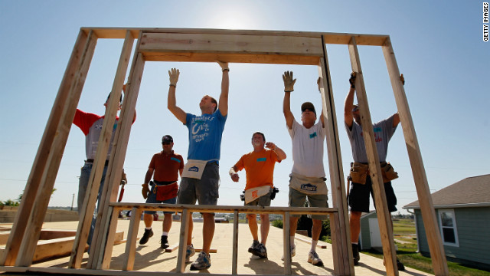
Why are grants important?
Applicable to nonprofit, health and government

Slide 7
Case Statement
Rationale for acquiring resources or other forms of support for your cause, program and/or organization

Slide 8
Case Statement
“There is a need for the Kent Intermediate School District to reduce teenage pregnancy. This application focuses on the priority of developing and disseminating knowledge at the services delivery level by creating an on-site counseling center within the district. Counseling will be provided to Kent ISD students for prevention and for guiding pregnant female students and their partners through family planning.”

Slide 9
Case Statement
Steps
Convey the compelling need
Demonstrate how your organization is uniquely qualified to address the need
Connect how your organization’s mission fits with what you plan to do to address the need
Give the funding source documentation for how your mission, the program/project and their concerns and values are a perfect match.

Slide 10
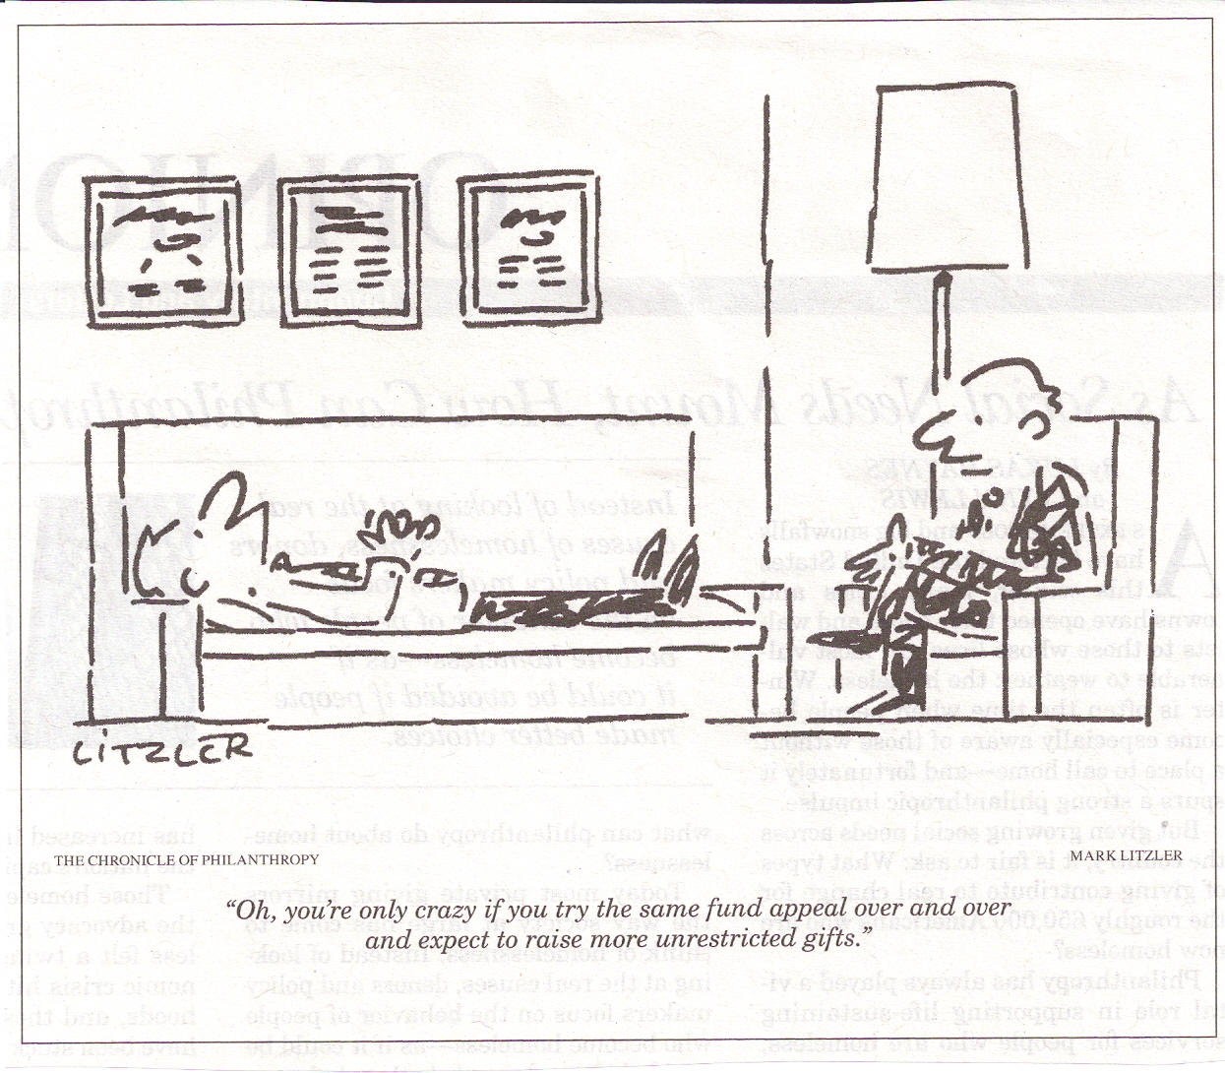
Case Statement

Slide 11
Case Statement
Tips
Logic
Reasonable / feasible
Sensible
Desirable

Slide 12
Case Statement

Slide 13
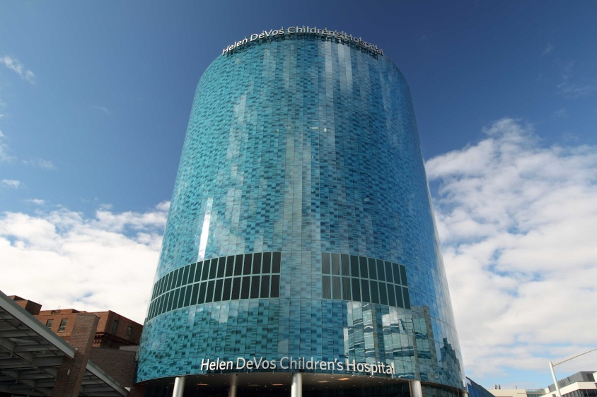
Types of grants
Capital – endowments, buildings, equipment
General operating – everyday operations

Slide 14
Types of grants
Program/project grants – specific activity or plan hat is time limited
Start-up – costs of a new project or organization

Slide 15
Types of grants
Technical assistance – training, development or infrastructure needs
Planning – the planning stages of a project

Slide 16
Types of grants
Matching – to another grant or #volunteers hours
Scholarships – financial assistance for students

Slide 17
Sources of grants
Government

Slide 18
Sources of grants
Foundations

Slide 19
Sources of grants
Corporations

Slide 20
Sources of grants
Local organizations

Slide 21
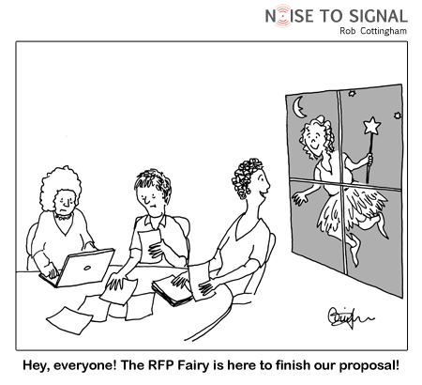

Slide 22
Basic grant proposal components
Identify the problem/issue/need
Objectives –
your intent to address the problem/issue/need
measures of success
Activities – steps to be reach objectives
Personnel – who will carry out activities
Evaluation - measuring success in meeting objectives
Budget – estimation of funding needed to complete project

Slide 23
Basic grant proposal components
Objectives
What the project will achieve
Time required

Slide 24
Basic grant proposal components
Objectives
Strategic, specific
Measurable
Attainable
Relevant
Timely

Slide 25
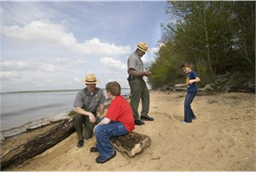
Basic grant proposal components
Activities
How the project will reach its objectives
Focus on the aspects of the project that will help resolve or prevent the problem/issue/need
Describe completely in detail

Slide 26
Basic grant proposal components
Activities
Program description
Management plan
Use of resources
Training
Facilities

Slide 27
Basic grant proposal components
Personnel
Show that the people implementing project activities have the necessary skills and experience

Slide 28
Basic grant proposal components
Personnel
Summarize project director’s qualifications
“JoAnn Szabynski will be project director. Ms. Szabynski earned her B.A. in Psychology from Arizona State University and her MSW from Grand Valley State University. She is also certified in addictions counseling (CAC). JoAnn has taught for 16 years in the Kent Intermediate School District and has been a counselor at City High School for the past four years. She has vast experience directing successful counseling programs including pilot testing many techniques used in this program.”

Slide 29
Basic grant proposal components
Personnel
Outline the job descriptions for any personnel that need to be hired

Slide 30
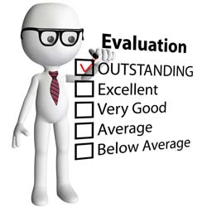
Basic grant proposal components
Evaluation
Involve the evaluator in the application process
Alignment of outcomes
Evaluation plan
Formative, summative and/or process evaluation
Methods
Tools
Data collection
Data analysis

Slide 31
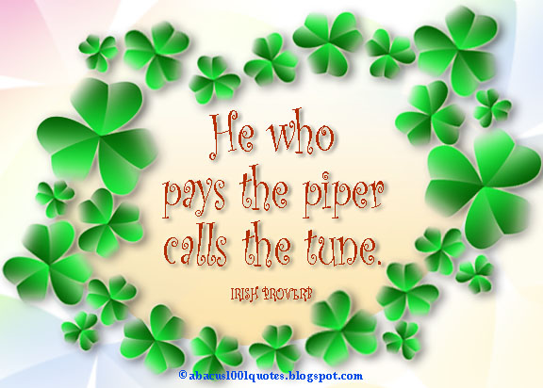
Basic grant proposal components
Evaluation
Who pays the cost?
Standards
Utility
Feasibility
Propriety
Accuracy
Guiding Principles according to American Evaluation Association

Slide 32
Basic grant proposal components
Budget
MUST REFLECT THE COSTS OF THE ITEMS AND ACTIVITIES IN THE PROJECT DESCRIPTION!!!
Brief explanations of each item
Basis for each cost
Salary
Vendor
Bidding process
Average cost
Contract
Quantity

Slide 33
Basic grant proposal components
Budget
Personnel
Travel
Supplies
Contracted services
Equipment

Slide 34
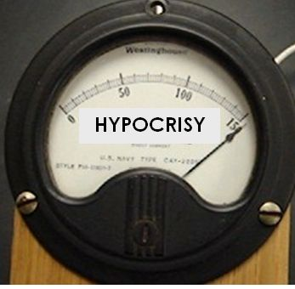
Politics and dark side of grants
Do as I say, not as I do
5% - maximum or minimum
Innovation, creativity, impact or relationships

Slide 35
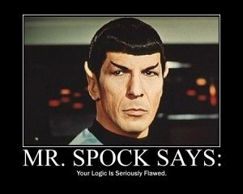
Politics and dark side of grants
“Creating reason from someone else’s nonsense is as much a political exercise as an intellectual one.”
– (Ward, 2012)

Slide 36
Politics and dark side of grants
Personalities
Conflicting values
Traditions
Protocols
Prestige
Self-interest
Corrupt review processes

Slide 37
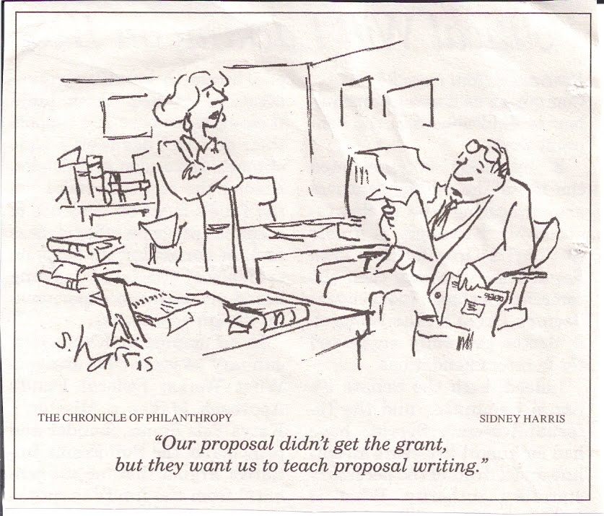
Politics and dark side of grants

Slide 38
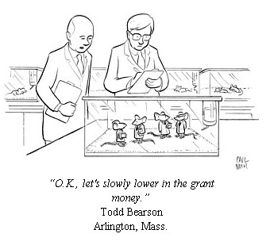
Politics and dark side of grants
Resource Dependency

Slide 39
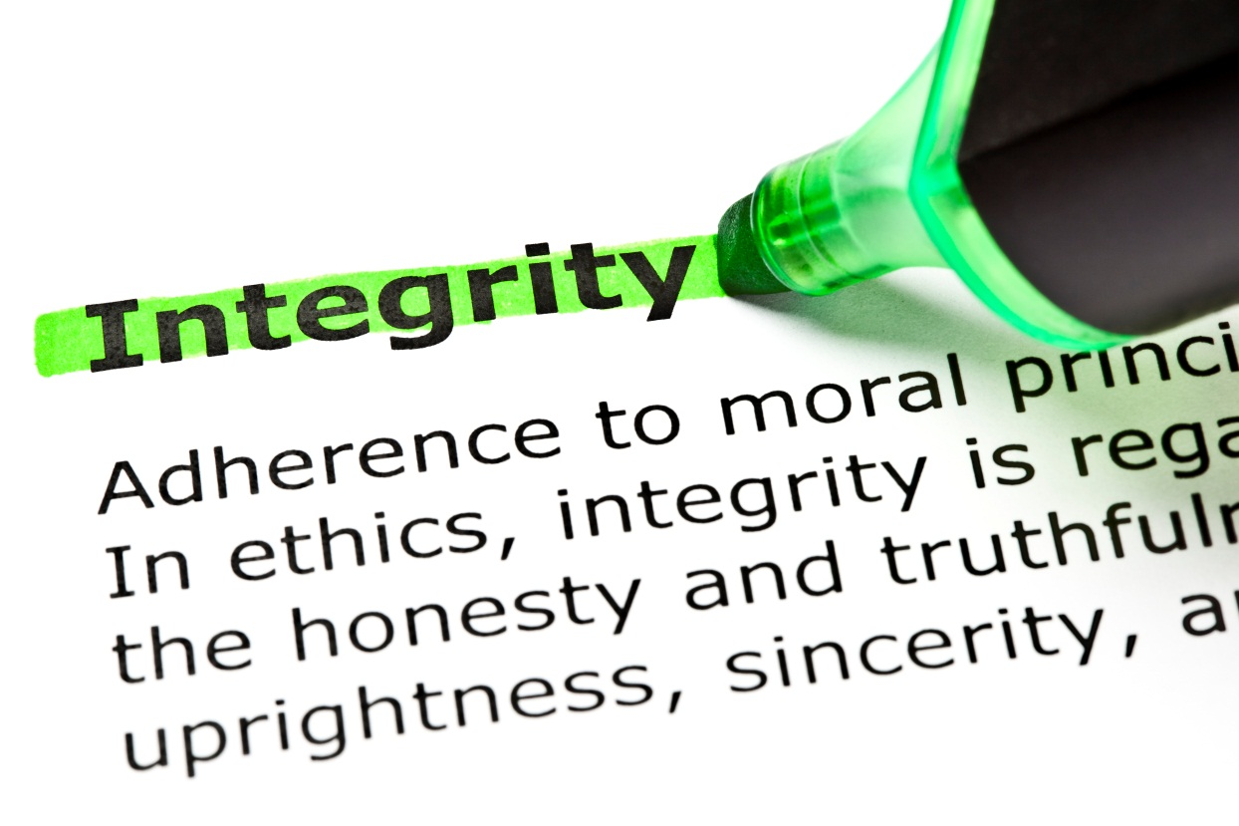
Politics and dark side of grants
Tips
Stick to your mission
Know when to say NO
Assess risks
Be accountable
Maintain integrity

Slide 40
Politics and dark side of grants
Tips
Don’t go it alone
Use color, visuals
Take advantage of technology
Serve on grant review panels
Communicate regularly, clearly and consistently
Balance numbers with stories
Research, research, research

Slide 41
THANK YOU!!
Salvatore Alaimo, PhD - Assistant Professor

