Slide 1
Thesis and Dissertation: Selecting a Topic and Getting Started
Jeffrey A. Potteiger, Ph.D., FACSM
Dean, Office of Graduate Studies
Grand Valley State University

Slide 2
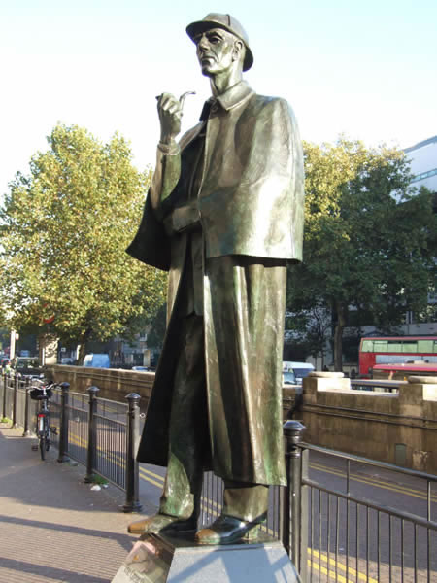
Why do a thesis or a dissertation?
Degree program requirement
Preparation for future graduate work
Interested in research/scholarship
Advance your career
Want to answer a question
Personal satisfaction and accomplishment

Slide 3
Getting started with 5 questions and some advice
What topic am I interested in?
Who can advise me in my topic?
Do I have the skill set to complete my project?
Is my project doable?
Does my project have meaning?
Outline for thesis/dissertation project

Slide 4
What topic am I interested in?

Slide 5
Who can advise me in my topic?

Slide 6
Do I have the skill set to complete my project?

Slide 7
Is my project doable?

Slide 8
Does my project have meaning?

Slide 9
Outline for thesis/dissertation project
Background Information
Provide a cursory overview of the "why" you need to conduct this investigation
Purpose
What specific question are you trying to answer
Hypothesis
Establish hypothesis or hypotheses
Importance
Why is it necessary to perform this investigation

Slide 10
Outline for thesis/dissertation project
Subjects
What group (people, animals, cells, bacteria) will participate in your investigation
Variables
What variables are you going to control or manipulate and what variables are you going to measure (independent and dependant)
Design and methods
Describe exactly (in short form) what you plan to do

Slide 11
Outline for thesis/dissertation project
Equipment
What is the equipment you plan to use
Budget
Is there any cost to performing this project
Previous experience
Do you have the necessary skills to conduct this research
Collaboration
Will other individuals help with the project

Slide 12
Outline for thesis/dissertation project
Data collection
Provide an outline of your data collection procedures
Data analysis
Provide information on the most appropriate data analysis

Slide 13
Tips for getting started
Talk with a professor for whom you have written a paper (presumably a good one) to see if the paper could be expanded into a thesis
Look at Dissertation Abstracts, which sometimes includes lists of masters theses
View masters theses that are catalogued (ScholarWorks) in the library: http://scholarworks.gvsu.edu/
Examine articles on topics that interest you--you may find something that you can explore further

Slide 14
Mechanics of getting started
Know the program requirements for thesis or dissertation
Identify a committee chairperson and then the committee members
Establish a reasonable and workable timeline
Use the GVSU resources: http://www.gvsu.edu/gs/

Slide 15
Potteiger’s tips
Read, read, read…and then read some more
Select a topic in which you are highly interested
Read, read, read…and then read some more
Identify a thesis/dissertation advisor that you can work with and that can help you complete your thesis in an exemplary manner
Read, read, read…and then read some more

Slide 16
Questions not answered
?

