Slide 1
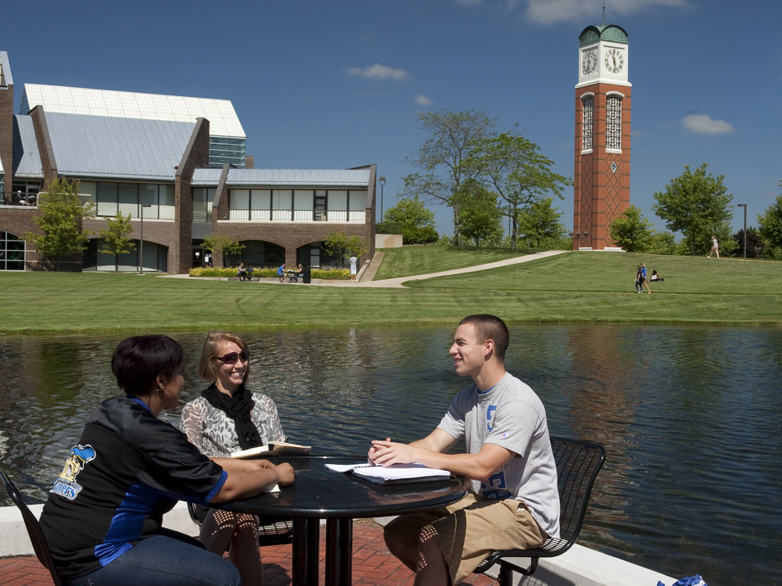
Seminar Title Slide
LEADING
HIGH-PERFORMANCE
TEAMS

Slide 2
CAPITALIZING ON
INDIVIDUAL DIFFERENCES
I I I I I

Slide 3
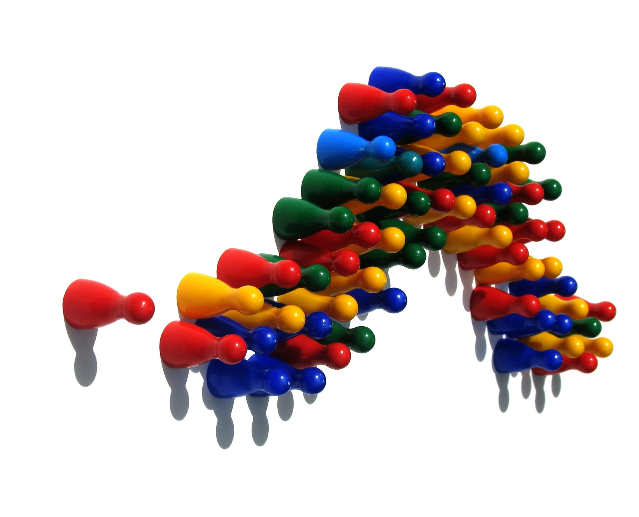
“The great leaders not only accommodate the fact that each person is different…
…they capitalize on
these differences.”

Slide 4
The Leadership Squeeze

Slide 5
BUILDING
RELATIONSHIPS

Slide 6
Constructive
Conflict

Slide 7
YOUR EMOTIONAL
BANK ACCOUNT

Slide 8
Getting Results

Slide 9
Strength Based
Delegation

Slide 10
Your Leadership Development Plan
Your Leadership Strengths and Struggles
Four ways to Improve Relationships
Four Ways to Get Results
Your First Action Step
Your Leadership Legacy

