Slide 1
Seminar Title Slide
LEADING
HIGH-PERFORMANCE
TEAMS

Slide 2
UNDERSTANDING &
APPRECIATING
INDIVIDUAL DIFFERENCES
I I I I I

Slide 3
How Do
People
Differ?

Slide 4
Are We Objective?

Slide 5
Value of Knowing Talents

Slide 6
Your ProScan Strengths Report

Slide 7
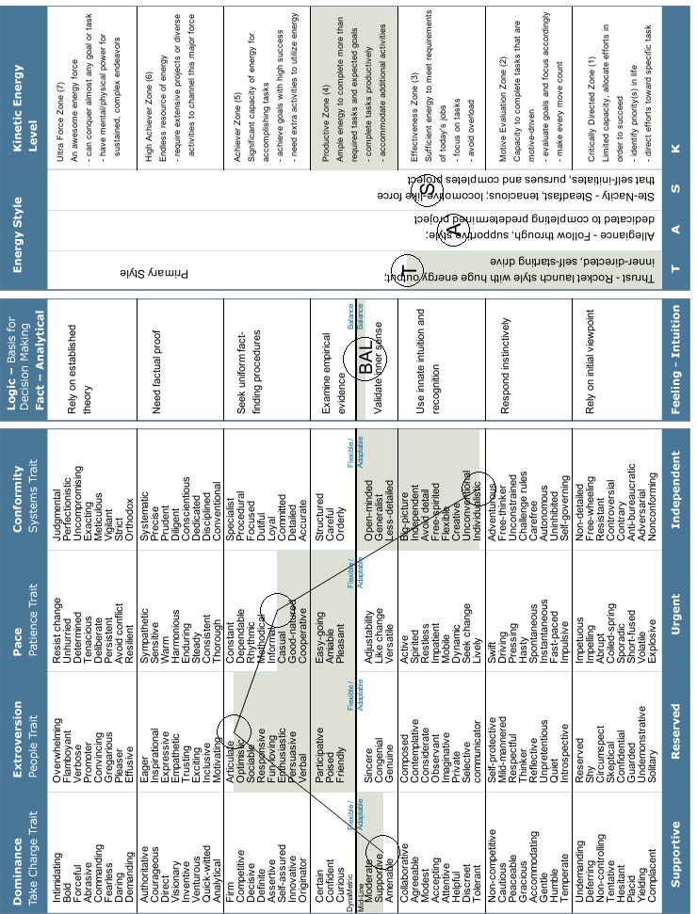
Trait Intensity Chart

Slide 8
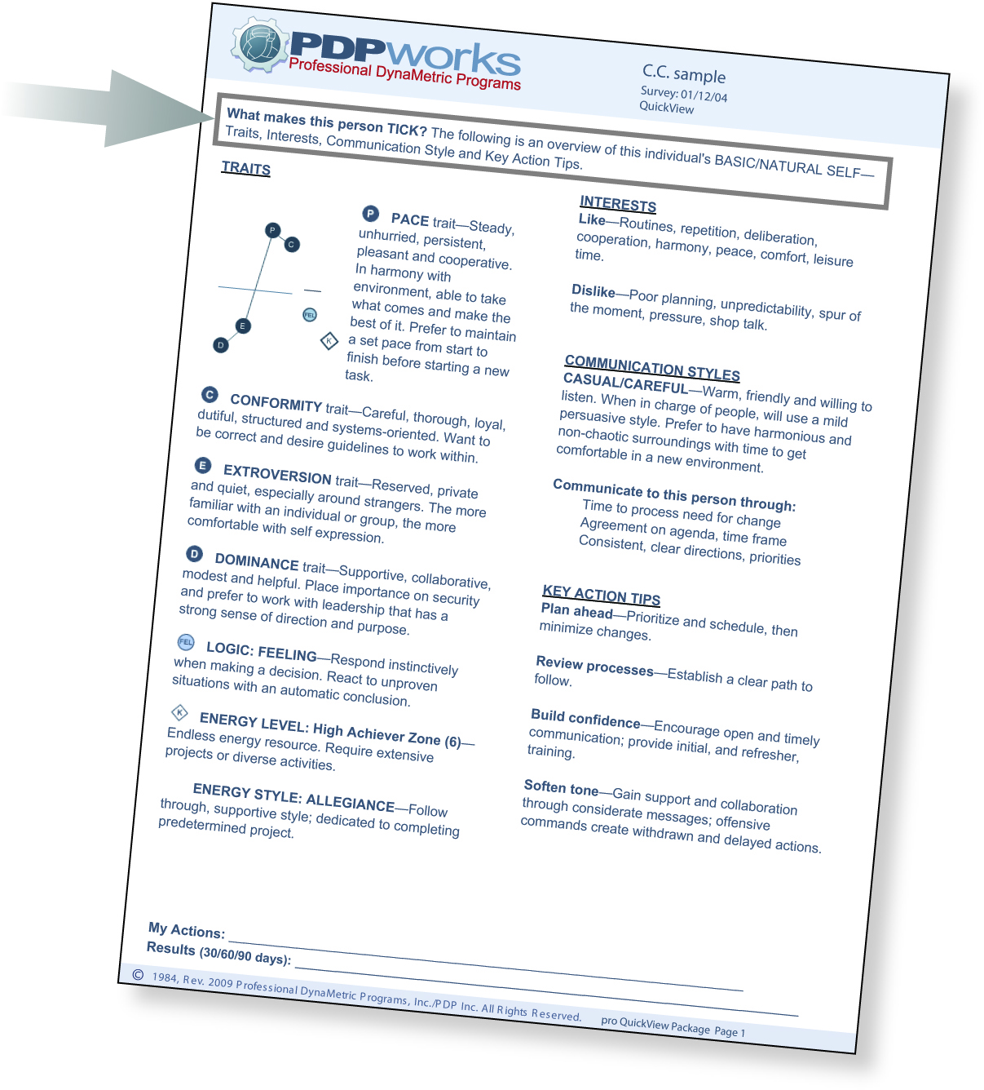
Your QuickView Report

Slide 9
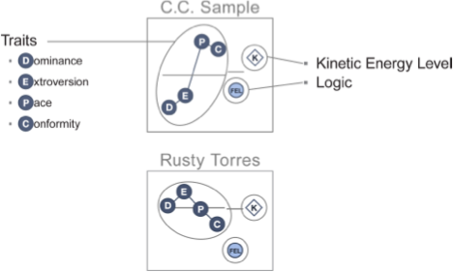
Profile Picture

Slide 10
What Are Your Traits?

Slide 12
How would you describe yourself?

Slide 13
LOGIC: Decision Style
Fact
Feeling
Balance
FAC
FEL
BAL

Slide 14
Team Members Conversation
Tom: My initial reaction is to do it in the spring. Besides, other companies do it at that time.
Pat: I feel the same way, but we should also check with those companies to see how successful they were at that time of year.
Nicki: I don’t think we should decide this so quickly. Let’s first identify the types of people that are most likely to come at different times of year.
John: I’ve already been doing the research to find out. Here’s a list of several options that will fit our schedule.
Tom: I know what you are saying, but my initial read on the situation will be right.

Slide 15
How do you make decisions?

Slide 16
The Power Inside
Kinetic Energy Level
Energy Style
K

Slide 17
How do you get things done?

Slide 18
Interests
Likes
Dislikes

Slide 19
What environmental elements are important to you?

Slide 20
Communication Styles
Teller/authoritative
D
Seller/persuasive
E
Casual/careful
P
Guarded/cautious
C

Slide 21
What is your communication style?

Slide 22
Back-Up Styles

Slide 23
Leadership Styles

Slide 24
Key Action
Tips

Slide 25
What can I do with this information?

