Slide 1
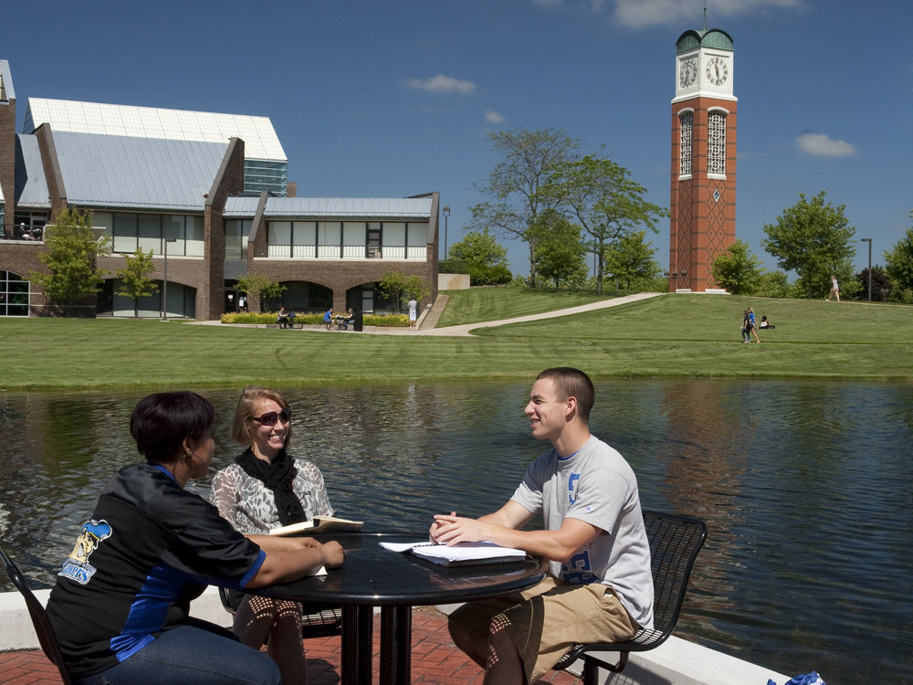
Seminar Title Slide
LEADING
HIGH-PERFORMANCE
TEAMS

Slide 2
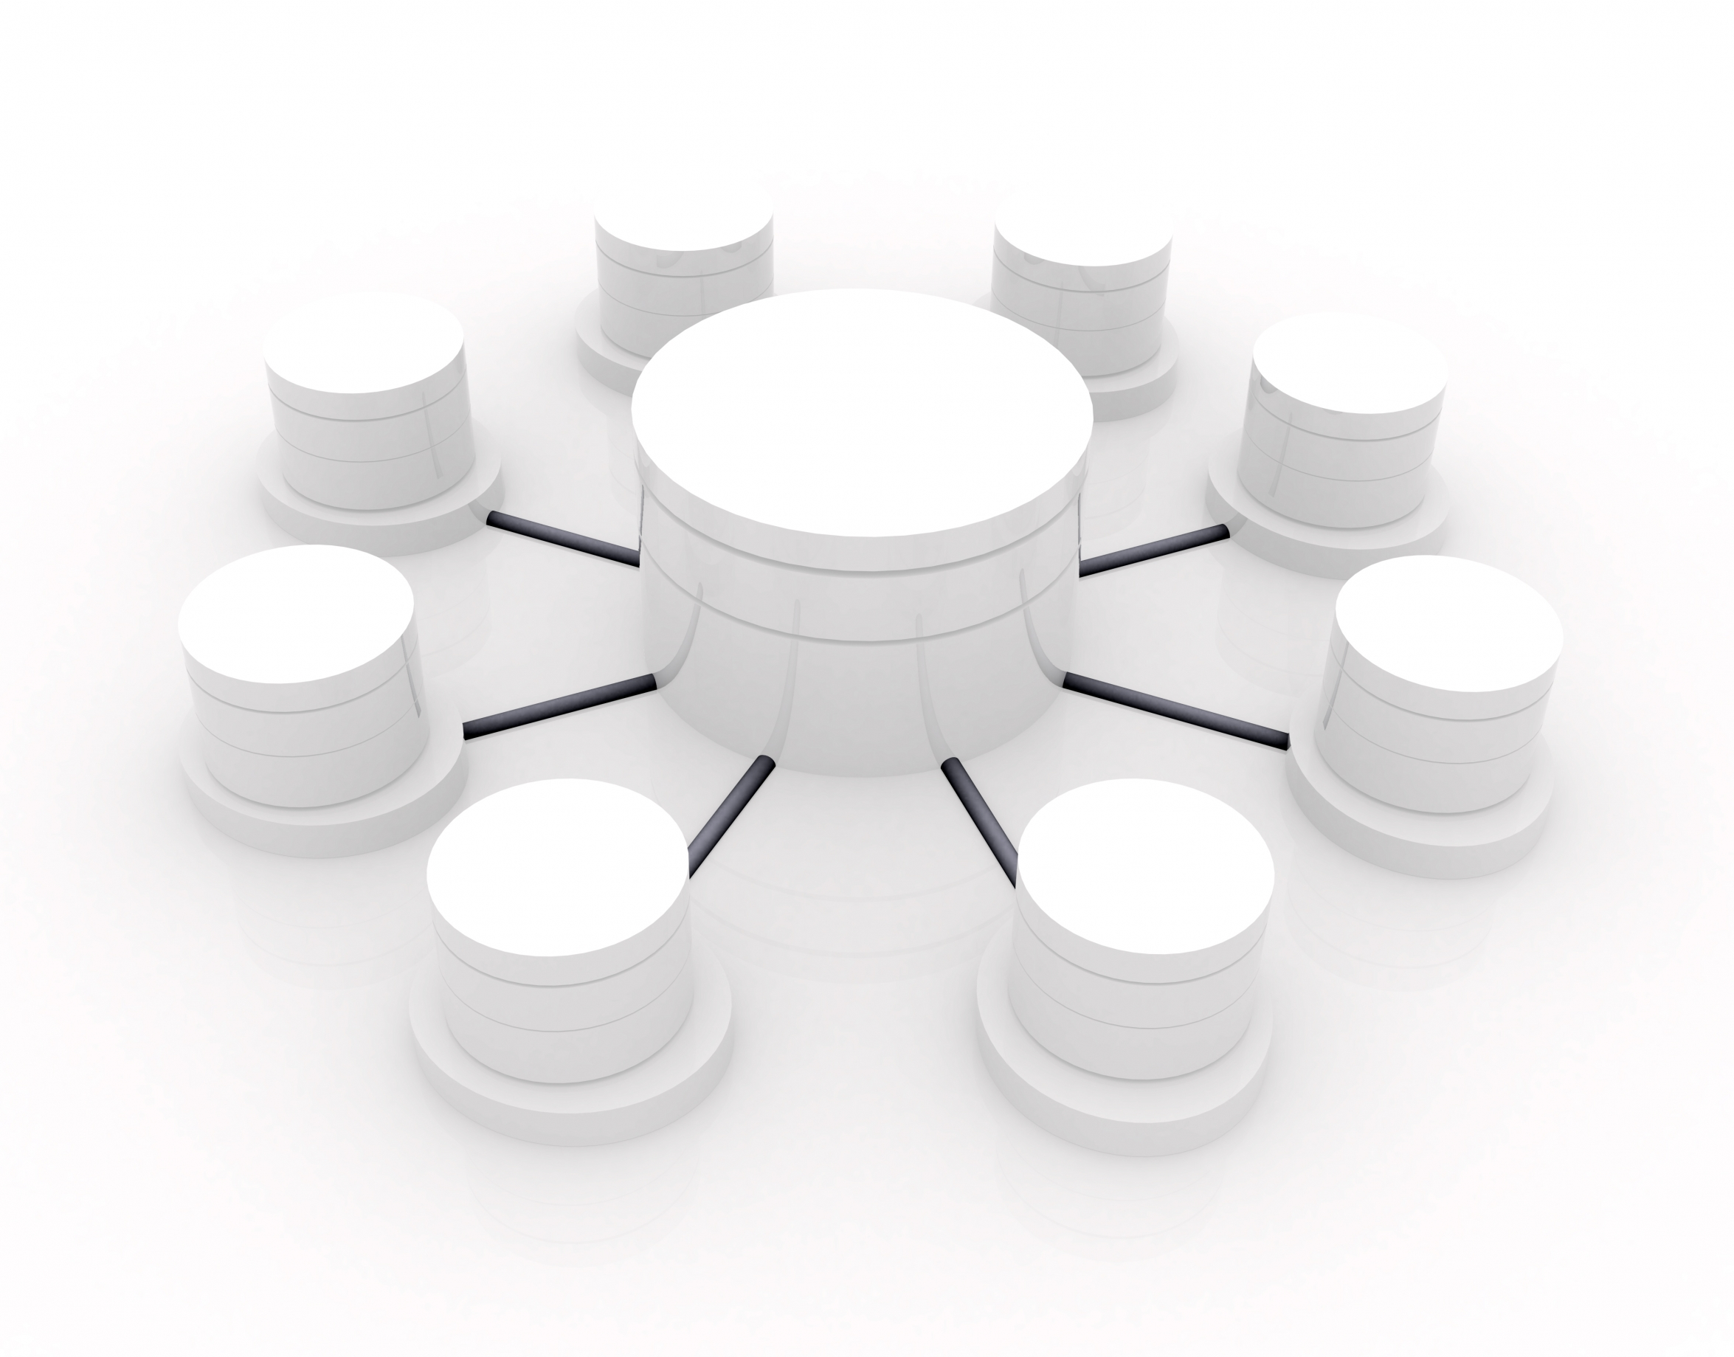
UNDERSTANDING
HIGH-PERFORMANCE
T E A M S

Slide 3
WHAT IS LEADERSHIP?

Slide 4
DESCRIBE A TEAM YOU WERE ON THAT SUCCESSFULLY TURNED PRESSURE INTO HIGH PERFORMANCE.
WHAT DID YOU DO?

Slide 5
THE WHAT, HOW, WHY, AND WIN OF HIGH-PERFORMANCE TEAMS

Slide 6
The What: Vision Directed
They have a clear understanding of where they are going and why.

Slide 7
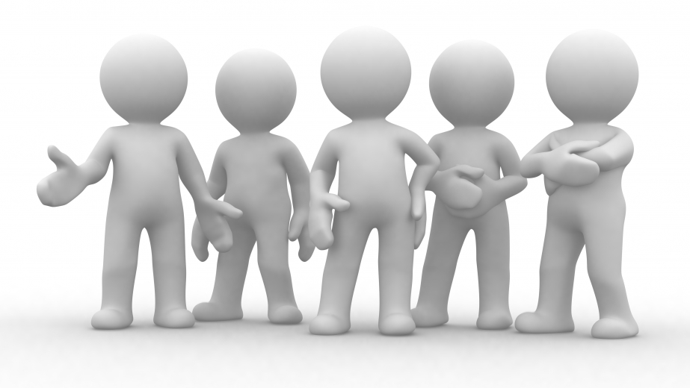
The Why: Values Driven
They exhibit congruence between team values, goals and individual behaviors.

Slide 8
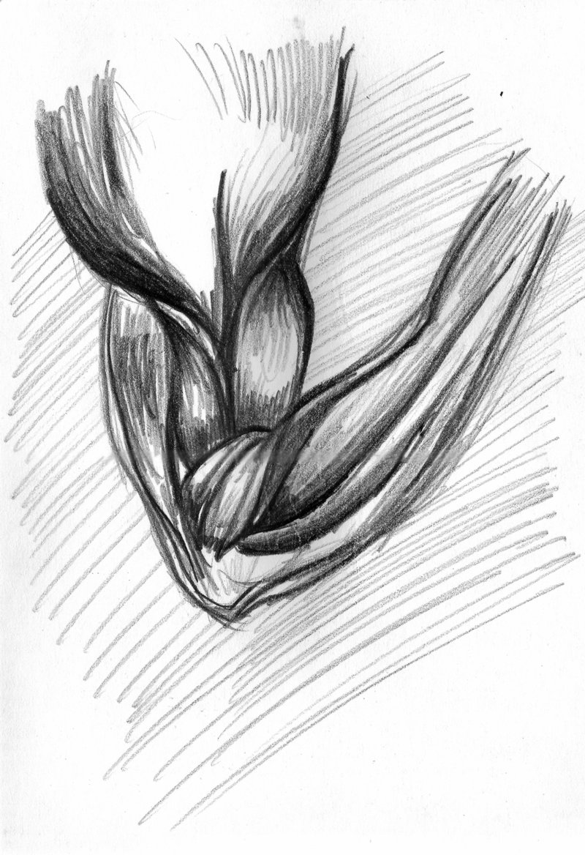
The How: Strengths Based
They understand, appreciate and capitalize on individual talents.

Slide 9
The Win: Performance Focused
They use performance challenges to create passion, not the desire to get along.

Slide 10
WHAT ARE THE LEADERSHIP PRACTICES THAT BRING OUT THE BEST IN YOU?

Slide 11
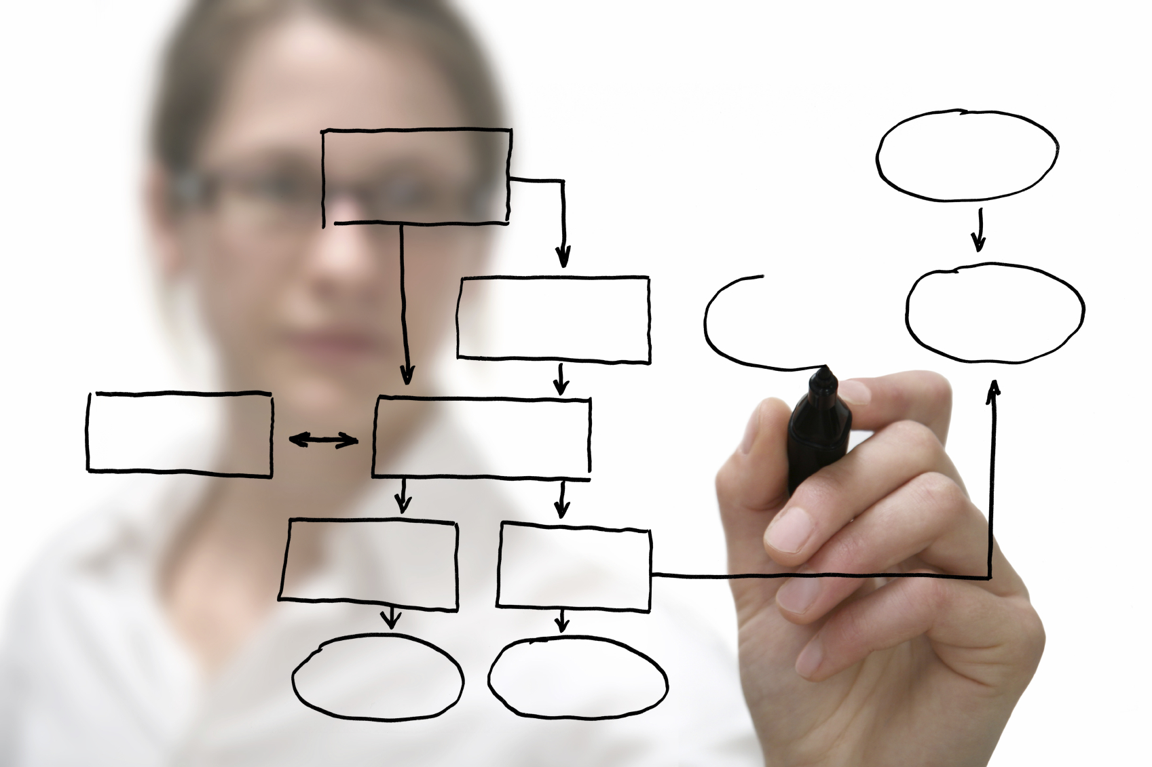
The Role of the
LEADER
Mobilize People Toward a Vision
Build Emotional Bonds
Model High Standards of Performance
Develop People for the Future

Slide 12
WHAT ARE SOME OF THE BEHAVIORS THAT EITHER PREVENTED YOUR TEAM FROM COMING TOGETHER OR CAUSED YOUR TEAM TO PULL APART?

Slide 13
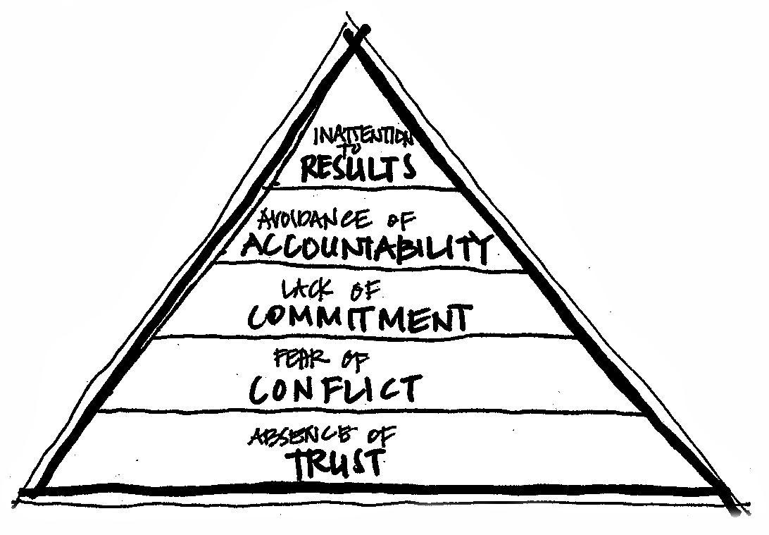
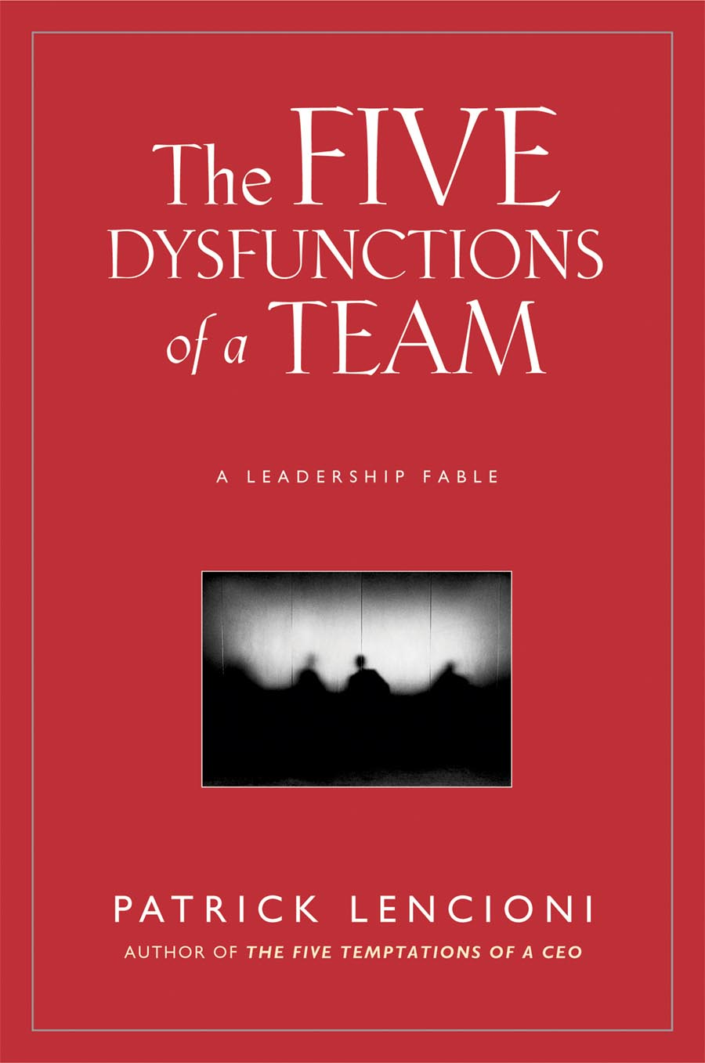
The Five Dysfunctions of a Team
Patrick Lencioni

Slide 14
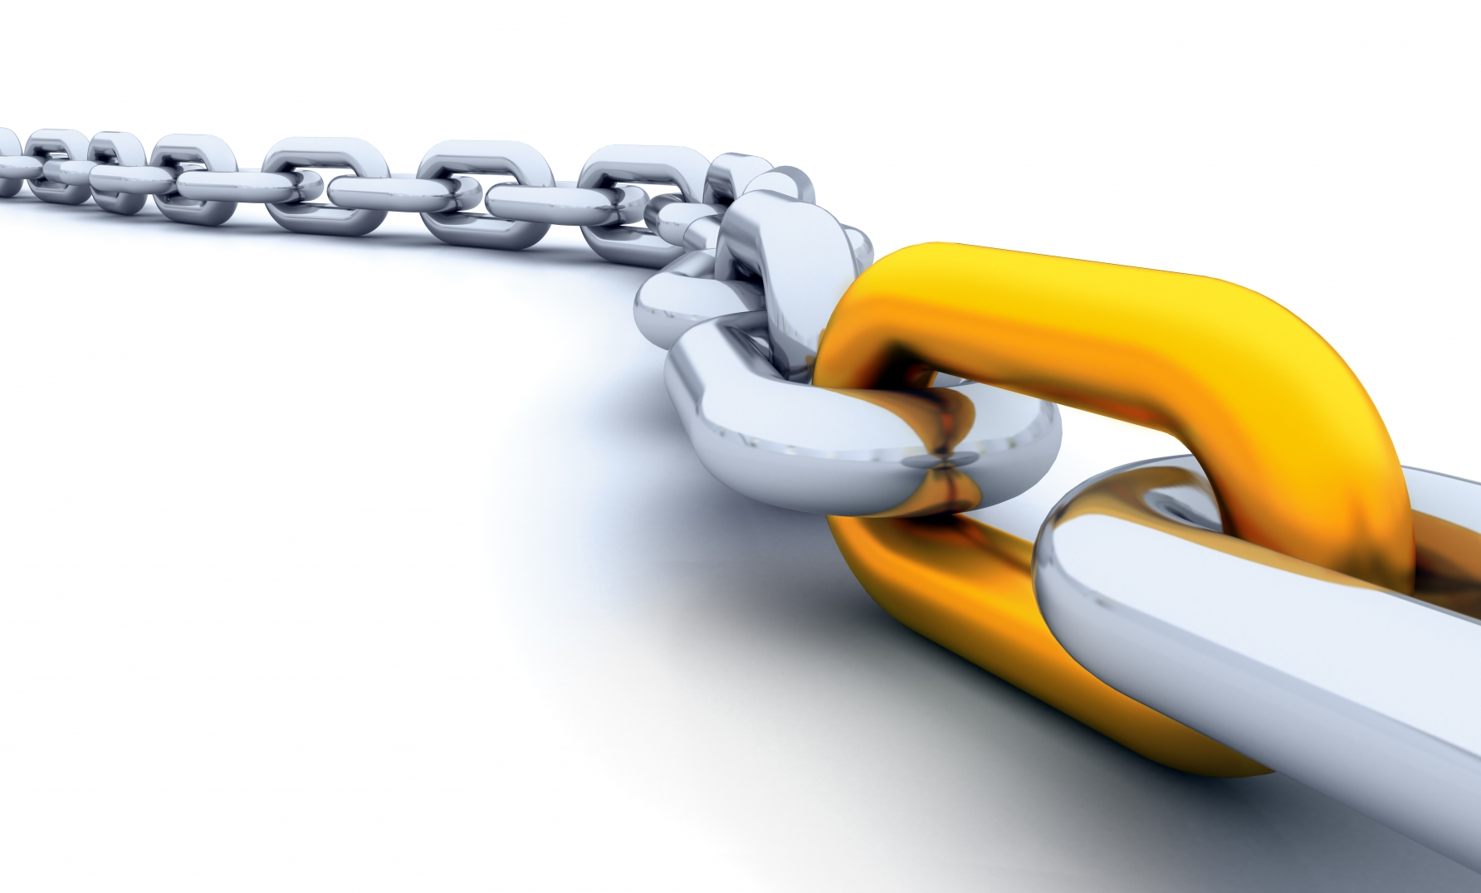
PERFORMANCE
MYTHS

Slide 15
MYTH…
As you grow your personality changes.
TRUTH…
As you grow you become more of who you are.

Slide 16
WHAT POSITIVE PATTERNS OF BEHAVIOR HAVE STAYED WITH YOU AS FAR BACK AS YOU CAN REMEMBER?
HOW DO YOU APPLY THESE STRENGTHS TODAY?

Slide 17
MYTH…
You grow the most in your areas of greatest weakness.
TRUTH…
You will grow most in your areas of greatest strength.

Slide 18
ARE THERE ANY ACTIVITIES AT WHICH YOU CONSTANTLY EXCEL?
HOW DID YOU GET SO GOOD?

Slide 19
MYTH…
A great team member does whatever it takes to help the team.
TRUTH…
A great team member deliberately volunteers his strengths to the team most of the time.

Slide 20
WHEN YOUR TEAM IS IN A CRUNCH AND NEEDS A GREAT PERFORMANCE, WHAT IS THE PLAY EVERYONE KNOWS YOU CAN RUN?

Slide 21
MYTH…
Great leaders perfect one leadership style.
TRUTH…
Great leaders adjust their style to fit the demands of the situation.

Slide 22
MYTH…
Great teams consist of members who are alike.
TRUTH…
Team members have a genuine, mutual concern for each other’s personal well being but have many individual differences.

Slide 23
Big
TAKE-AWAYS
LEADERSHIP IS INFLUENCE. WITHOUT TRUST YOU HAVE NO INFLUENCE
STRENGTHS HAVE A GREATER IMPACT ON PERFORMANCE OUTCOMES THAN DO WEAKNESSES
GREAT LEADERS WIN THROUGH RELATIONSHIPS
GREAT TEAMS WIN BY CAPITALIZING ON TALENTS

