Slide 1
Literacy & ASD

Slide 2
Literacy - Definition
Reading
Writing
Speaking
Listening
Pragmatics
Critical Thinking
Engagement in Literacy Experience
Carnahan & Williamson (Eds), 2010

Slide 3
Engagement in Literacy Experiences

Slide 4
Reading – National & State Attention National Assessment of Education Progress (NAEP) 2015
http://www.michigan.gov/mde/0,4615,7-140-22709_32669---,00.html
29% of Michigan students score at or above proficient in reading at the beginning of 4th grade (Rank 3-16th).
AUTISM?
National Data:
 | PERCENTAGE OF STUDENTS AT OR ABOVE Proficient
 | Grade 4 | Grade 8 | Grade 12
READING | 36% 2015 | 34% 2015 | 37% 2015
http://www.nationsreportcard.gov/
http://www.michigan.gov/documents/mde/snapshot_RED2015MI_4_530245_7.pdf

Slide 5
Reading and ASD
Limited solid data;
Evidence that decoding & word recognition develop with same processes as typically developing students and often at a faster rate but that comprehension skills do not develop alongside word recognition skills;
More than 65% of students with ASD with measurable reading skills demonstrate comprehension difficulties.
Randi, Newman & Grigorenko, 2010

Slide 6
HOW TO TEACH STUDENTS WITH ASD TO READ
Meaningful Access to Authentic Curriculum

Slide 7
The Dynamic Relationship Between Content, Curriculum and Student Learning: Three Primary Findings
The amount, type, and quality of interactions between students with extensive support needs and their typical peers were better in general education contexts.
Services in general education contexts could be superior to those in self-contained settings with respect to:
The quality of student Individualized Education Programs, the aspects of instruction and the overall program provided
The amount of time that teachers provided instruction
The amount of time students were engaged in instruction and social interactions with general education classmates
When these student received services in inclusive general education contexts, their learning outcomes could be better across skills areas and activities including:
Social competence
Language Development and Use
Literacy
General education content areas
The Dynamic Relationship Between Context, Curriculum, and Student Learning: A Case for Inclusive Education as a Research-based Practice. Jackson, Ryndak, & Wehmeyer, (2010).

Slide 8
Rationale for Segregated Programming Simply Not Supported
Study: 7 years; 6 self-contained; 5 districts; 3 states
Rationale:
Community (i.e. more protective environment)
Not purposefully created or given much attention
Evidence that it, in fact, was the opposite
Less Distractions: SC more frequent; more severe
Curriculum and Instruction: (structure; individualized)
Less structure than gen ed
Context-Free / Meaningless Curriculum (i.e. little inquire-based / cooperative learning; often “seat work;” no connection to gen ed)
No Specially Trained Instructor – mostly parapros
Behavior Supports: Confrontational staff; Few attempts to understand or respond to function; Contingent removal; Use of time out / restraints
Does Self-Contained Special Education Deliver on Its Promises? A Critical Inquiry Into Research and Practice. Causton-Theoharis, Theoharis, Orsati, Cosier, (2011)

Slide 9
LRE=General Education
There is STRONG Evidence that
Student with “Extensive Support Needs”
Acquire skills and content knowledge (including literacy) in general education with rigorous instruction and UDL-based adaptations (e.g. differentiated instruction; universal supports, literacy supports (Kluth))
Are BEST served by educational teams that approach their education with the intent of finding solutions to access and learning barriers rather than alternative placements.
Involvement and Progress in the General Education Curriculum for Students With Extensive Support Needs:
K-12 Inclusive-Education Research and Implications for the Future. Ryndak, Lewis & White, (2013).

Slide 10
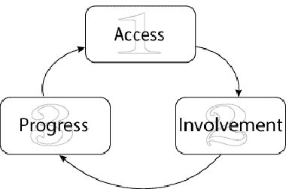
Kurth & Mastergeorge, 2010
15 Ss w/ ASD (not AS) – 12 males
7-9th grade; 12-15 years old
7 spent >80% day in GenEd; math and reading instruction in GenEd
8 self-contained spent >50% in SpEd; math and reading instruction in SpEd
Measures:
Cognitive GenEd mean 64.9; SpEd mean 60.0
Adaptive GenEd mean 44.4; SpEd mean 42.3
Academic—WJ 3
Broad Reading: GenEd mean 67.6; SpEd mean 13.1
Broad Writing: GenEd mean 83.6; SpEd mean 14.1
Broad Math: GenEd mean 77.4; SpEd mean 8.5
Academic and Cognitive Profiles of Student with Autism: Implications for Classroom Practice and Placement. International Journal of Special Education, 25 (2), 8-14.

Slide 11
Guiding Principle
“All students, regardless of their perceived functioning level, should have access to quality literacy instruction.”
Carnahan & Williamson, 2010

Slide 12
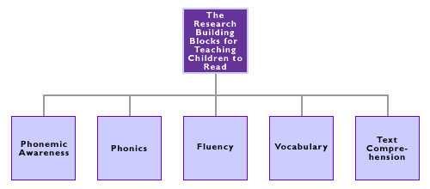
Programs with High Reading Proficiency
(National Reading Panel, 2000)

Slide 13
Principles for Promoting Inclusive Literacy Practices
Maintain High Expectations
Provide Models of Literate Behavior (Peer to Peer)
Elicit Students’ Perspectives (Use Preferred Interests)
Promote Diversity as a Positive Resource -- LRE
Adopt “Elastic” Instructional Approaches (e.g. Pacing)
Use Flexible Grouping Strategies
Differentiate Instruction

Slide 14
Methods to Enhance Literacy “Elastic” Procedures
Visual supports, maps, and supplemental materials / instruction
Priming for background knowledge
Peer – mediated instruction
Use of high interest materials
Engaging learners before, during and after reading
Use of Interactive books and PPT
Carnahan & Williams, 2010;
Carnahan, Williams & Haydon, 2009; Brown, Oram-Cardy & Johnson, 2013

Slide 15
Reading Instruction and Assessment within a Multi-Tiered System of Support (MTSS)
Intensive Individualized
Interventions
Few
Micro-Level
Sensitive to Small
Changes Over Time
Targeted Interventions
Meta-Level (2-3X per mo)
Progress Monitoring
(e.g. CBM)
Some
Universal Interventions
Macro-Level
Annual Assessment
(e.g. M-STEP; NWEA)
All
UNIVERSAL DESIGN FOR LEARNING
(Johnson & Street, 2013)

Slide 16
The DANGER of in Relying on Macro Assessment for Students with ASD

Slide 18
“Because assumptions, rather than proper assessment and screening, are frequently made about their (i.e. Students w/ ASD) cognitive and communication functioning, they are often excluded from literacy experiences.”
(Quality Literacy Instruction for Students with ASD;
Carnahan & Williamson, Eds., 2010)

Slide 20
Formal vs. Informal Literacy Assessments
Formal Literacy Assessments
Standardized Administration
Standardized Norms (criterion; norm-referenced)
Typically administered by non-familiar person in non-familiar setting.
Informal Literacy Assessments
Designed to be used by teachers
Used in learning context
Sensitive and Recent
Observation
Analysis of Student Work Samples
Student Interview
Presentations / Performances
IEP Goal Checklists
Portfolio
Literacy Assessments that Contain BOTH
DIBELS / CBM
Informal Reading Inventories
Unit and/or Chapter Tests

Slide 21
Challenges with Formal Reading Assessments for Students with ASD
Lack of Sensitivity (ability to detect small changes)
Lack of Specificity (areas of ASD impacting reading)
Assessment & Social Context
Restricted Interests = Lack of Motivation
Output Differences (Theory of Mind)
PRINCIPLE: Use more than one way to assess for reading skills and include informal measures!!
Iland, E., 2011
Kluth & Chandler-Olcott, K., 2008.

Slide 22
Creative Uses of Standardized Tools “Breaking Standardization”
Observe performance under various conditions (e.g. with and without use of visuals supports; preferred interest)
Administer subscales or items within subscales in a different order so highly preferred tasks can follow less preferred ones to increase motivation;
Start at the beginning of a particular subscale (easiest item) rather than the age-suggested starting point to create behavioral momentum;
NOTE: Such expansions can be beneficial in capturing rich information on the student’s learning needs, strengths, and challenges, but invalidates obtained scores. Avoid by first administering under standardized conditions.

Slide 23
Creative Uses of Standardized Tools “Breaking Standardization” (cont.)
Take frequent breaks; Use tangible reinforcers;
Use a multiple-choice or fill-in-the-blank formats rather than an open-ended;
Paraphrase instructions and/or simplify language to match child’s level;
Use terms and phrases that are familiar to the child (e.g., “match” vs. “find me another one just like this”)
NOTE: Such expansions can be beneficial in capturing rich information on the student’s learning needs, strengths, and challenges, but invalidates obtained scores. Avoid by first administering under standardized conditions.

Slide 24
Is the Student Taking State / District Reading Assessment(s)
Yes
No
Proficient?
Decision-Making Process
Enhanced Assessment
Proficient?
Yes
No
Carry On
Yes
No
Teaching Strategies

Slide 25
Reading Difficulties Fall in 3 Categories Reading problem is defined as “cannot understand classroom / grade-level materials”
Print Skills
Ability to translate printed symbols efficiently into spoken language for meaning (e.g. phonics, sight words)
Assessment: Read Aloud, CBM
Vocabulary Knowledge (Understanding of Terms)
Knowledge of key words contained in particular reading selections & concepts being conveyed; meaning related through context.
Assessment: questions to elicit understanding of terms
Comprehension Strategies
Integrating information across text and fix it strategies
Assessment: Retell, think aloud during reading, comprehension questions, maze procedures
Barr, R. & Blachowicz, C. (2013). Reading Diagnosis for Teachers: An Instructional Approach. Pearson.

Slide 26
ENHANCED ASSESSMENT

Slide 27
Look for Word Recognition FIRST Many students with ASD learn whole word. If you find they already have word recognition skills, no need to go back to letter skills. (Kluth, P. & Chandler-Olcott, 2008).

Slide 28
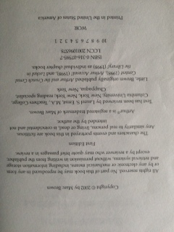
Look for ANY Evidence of Print Knowledge

Slide 29
Investigate…Investigate…Investigate
Consider speaking vs. non-speaking
Individualize (e.g. use preferred interests)
Use Interest Areas
Get Parental Input

Slide 30
Katie and Disney

Slide 31
Russell and Fast Food

Slide 33
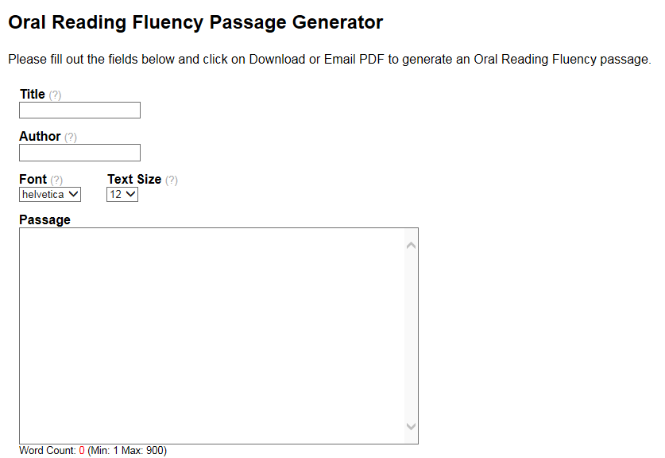
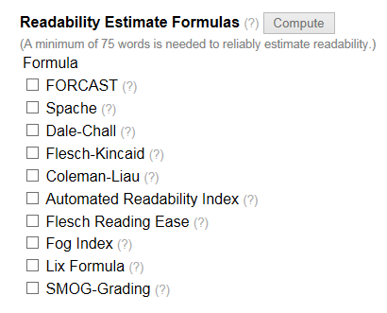
Match Evidence with READABILITY http://www.interventioncentral.org/teacher-resources/oral-reading-fluency-passages-generator

Slide 34
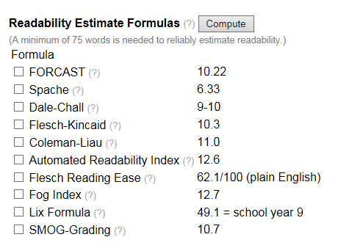
Women’s Health

Slide 35
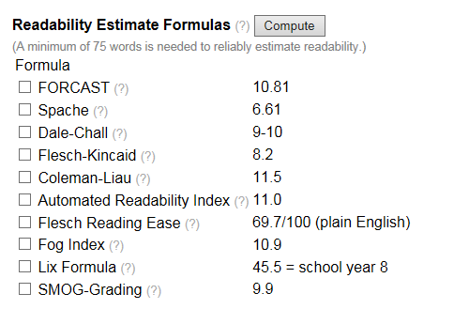
Better Homes and Gardens

Slide 36
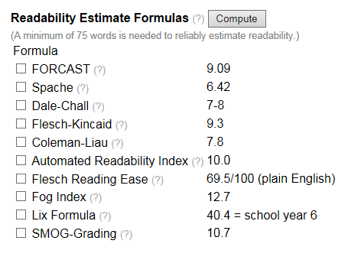
Fitness

Slide 37
Enhanced Assessment Dynamic Indicators of Basic Early Literacy Skills (DIBELS) (2015) https://dibels.uoregon.edu/assessment/index/materialdownload/?agree=true#dibels CORE Assessment (2009) https://www.amazon.com/Assessing-Reading-Multiple-Measures-2nd/dp/1571284648
Early Literacy Assessment | Enhanced Assessment Options—Verbal / Non
Letter Identification (upper / lower) Letter Sound Identification (Phonics) | What letter is this vs. Show me / Point to What sound does “c” make vs. “this letter” vs. which letter makes a /k/ sound? Use Preferred Interests (PI)
Phoneme Deletion Say “cat” – now without the /K/ | Initial, Ending, Embedded Sound(s) Deletion – Use PI; Recognition vs. Response
Phoneme Segmentation What are the 3 sounds in /sh/ /o/ /p/ | How many sounds are in the word /sh/ /o/ /p/ (point to response) – Use PI
Nonsense Word Fluency | Unlikely Successful
Oral Reading Fluency (ORF) (3 1-minute probes – take median) | Verbal w/ Reading Skill: Use Preferred Interests Can’t measure if non-speaking
MAZE Procedure for Comprehension (3 minute probe w/ 7th word choice) | Use Preferred Interests Make Choice Obvious vs. Difficult

Slide 41
Comprehension Assessment Fluency & Maze Procedures Using Movie Scripts / Closed Captioning for Preferred Interests

Slide 42
How to Create a ORF and MAZE Probes First, select a passage (at least 300 words)
Example:
Movie Script
Closed – Caption

Slide 43
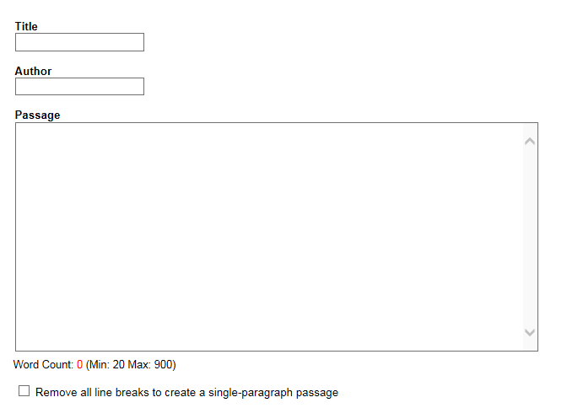
How to Create a Maze Probe
Go to Intervention Central’s Maze Passage Generator
Enter your Passage
http://www.interventioncentral.org/teacher-resources/test-of-reading-comprehension
Three Steps
Distractor Source
Sources for Readability
Download Student Copy

Slide 44
Computer-Generated Distractors
Students’ Copy
He’s done. He must have finished it while (we, funny, space) were sleeping. Good riddance. He’s gone? (enthusiastic, Well, excuse), we wouldn’t, want him to miss (enter, group, that) race of his. Oh, dude, are (you, taste, gotten) crying? No! I’m happy! I don’t (infamous, have, awake) to watch him every second of (rice, the, fluffy) day anymore! I’m glad he’s gone! (mute, What’s, won) wrong with Red? Oh, he’s just (sad, afraid, brick) because you left town and went (fresh, to, steel) your big race to win the (speak, Piston, broken) Cup that you’ve always dreamed about (your, became, educate) whole life and get that big (old, blush, bought) sponsor and that fancy helicopter you (were, inquisitively, introduce) talking about. Wait a minue! I (learned, skirt, knew) you wouldn’t leave without saying goodbye. (What, Tendency, Secretary) are you doing here? You’re gonna (that, flag, miss) your race. Don’t worry. I’ll give (eerie, you, steep) a police escort, and we’ll make (up, wing, follow) time. Thank you, Sheriff. But you (rapidly, person, know) I can’t go just yet. Well, (rhythm, why, safe) not? I’m not sure these tires (gun, distance, can) get me to California. Yeah, does (anybody, oil, grip) know what time Luigi’s opens? I (can’t, mourn, medium) believe it! Four new tires! Would (you, know, petite) look at that! Our first customer (button, strange, in) years! I am filled with tears (sheep, of, kept) ecstasy, for this is the most (glorious, invention, root) day of my life! All right, (Luigi, island, huge), give me the best set of (blackwalls, quick, breezy) you’ve got.

Slide 45
Personally-Generated Distractors
Cars-Close Caption – Scene Selection 41:19-42:16
Let me get this straight. I can go when this road (is, has, will) done. That’s the deal, right? That’s what (we, they, them) done did said. Ok. Outta my (house, bus, way). I got a road to finish. He’s (starting, done, sick). Done. Uh-huh. It’s only been an (hour, 6 months, year). Ah, I’m done. Look, I’m (starting, over, finished). Say thanks, and I’ll be on (your, my, someone) way. That’s all you gotta say. Whee-hoo! (We, I, Them) am the first one on the new (train, bus, road). Oh! It rides pretty smooth. It looks (great, simple, awful)! Well, it matches the rest of the (road, town, country). Who do you think you are? Look, (Doc, Sally, Mater) said when I finish, I could (stay, go, swim). That was the deal. The deal was you (wreck, fix, drive) the road, not make it worse. Now, (scrape, piece, jump) it off and start over again. Hey, (walk, look, cry) grandpa, I’m not a bulldozer. I’m a (balloon, racecar, lamp). Oh-ho-ho-ho! Is that (right, wrong, silly)? Then why don’t we just have a (colorful, little, square) race? Me and you. What? Me (then, later, and) you. That a joke? If you (swim, walk, win), you go and I fix the (computer, chair, road). If I win, you do the (hamburger, road, table) my way. Doc, what are you (going, doing, sleeping)? I don’t mean to be rude here (Sally, Mater, Doc), but you probably go zero to (one, sixty, backwards) in, like, what? Three-point-five (times, clocks, years)? Then I reckon you ain’t got (everything, apple, nothing) to worry about. You know what, old (dog, chair, timer)? That’s a wonderful idea. Let’s race!

Slide 46
Creating a Reading Profile Controlling for Interest Area, Vocabulary & Background Knowledge

Slide 47
Example: History
Designed for a 7th grade student who demonstrated reading skills but not performing at proficiency on state or district reading assessments.
Concerns he was not reading at “grade level”
Reports indicated reading skills were highly variable and dependent on:
interest level in the text
understanding of vocabulary
level of engagement on any particular day.
The profile data was designed to determine the student’s reading level across interest and vocabulary, understanding the output challenges of individuals with Autism Spectrum Disorder (ASD).

Slide 48
Reading Profile Example
Student Information
Student Name:
Current Grad Level Placement:
Birth Date:
Special Education Eligibility:
Year | Grade | Reading RT Score | Reading District GRADE Norm | Percentile
F2013 |  |  | ---/216 | 7
S2013 |  |  | 219/216 | 4
F2012 |  |  | 213/212 | 2
S2012 |  |  | 217/212 | 9
F2011 |  |  | 210/207 | 6
S2008 |  |  | 189/199 | 1
Understanding Reading and ASD
Phonemic awareness and phonics skills require adequate auditory processing skills. Most students with ASD struggle with auditory processing (brain’s ability to recognize and interpret sounds). (Henry, K.A., 2010)
Difficulties in reading comprehension for students with ASD are strongly linked to receptive and receptive language comprehension deficits, difficulty creating abstract connections, difficulty making predictions and drawing conclusions (executive functioning), limited background knowledge, difficulty with perspective-taking (theory of mind), over-selective attention, too much attention to details or to specific words or phrases rather than the situation or context that gives meaning, lack of reciprocity, and lack of motivation for non-preferred topics. (Carnahan, C. & Williamson, P., 2010 and Iland, E. 2011).
Literacy Strategies: Create print-rich environments, utilize a balanced, meaning – centered literacy approach (e.g. consider interest and motivation, connect to personal experiences, model comprehension processes by thinking aloud (e.g. verbalize the questions a good reader is running in their head when reading for comprehension), build background knowledge, help related content to personal experiences, and start with concrete and literal reading selections like nonfiction that are often easier than fiction. (Carnahan, C. & Williamson, P., 2010 and Iland, E. 2011, Kluth, P., 2013).
MEAP Reading:
 | Scaled Score | Average Score
5th Grade |  |  | Not Proficient
6th Grade |  |  | Not proficient
*Note:
Core Reading Assessment
Fall Spring Notes & Scoring Scales
CORE Phoneme Deletion Test
Part A: Initial Sound (Late Kindergarten) | 5/5 | 5/5 | For the CORE Reading Assessment, the following color codes are used
Part B: Final Sound (Grade 1) | 5/5 | 5/5
Part C: First sound of a Consonant Blend (Grade 2) | 0/5 | 4/5 | Green = Independent Level = At Benchmark
Part D: Embedded Sound of a Consonant Blend (Grade 3) | 5/5 | 5/5 | Yellow = Instructional Level = Strategic Intervention (grade-level)
CORE Phoneme Segmentation Test | 11/15 | 14/15 | Red = Frustration Level = Intensive intervention needed

Slide 52
Steps to Create a Similar Profile Document
The CORE Reading Assessments
Steps to the CBM Assessments:
Get copy of the full year reading curriculum (ex. science, social studies, lit, etc.)
Segment out student high interest text (e.g. topics or material (i.e. Scholastic)).
Randomly select passages from both the full year and the high interest text.
Type selected passages into the Intervention Central CBM calculator to determine readability: http://www.interventioncentral.org/curriculum-based-measurement-reading-math-assesment-tests.
Create probes of the selected text for both Oral Reading Fluency (ORF) – 1 minute probes -- and Maze Passages (comprehension) –3 minute probes–
Assess student periodically over the course of 2-3 weeks using the CBM probes.
For some of the full reading curriculum passages, assess following pre-teaching of vocabulary and concepts (create background knowledge).
Compare results with the CBM norms provided by Hasbrouck & Tindal (2005) or your own state or local norms.
Summarize results and behaviors that may have impacted these results.

Slide 53
Creating a Reading Profile Template
CORE Reading Assessment
 | Fall |  | Spring |  | Notes & Scoring Scales
CORE Phoneme Deletion test
Part A: Initial Sound (Late Kindergarten) |  |  |  | For the CORE Reading assessment, the following color codes are used:
Part B: Final Sound (Grade 1)
Part C: First sound of a consonant Blend (Grade 2) |  |  |  | Green = independent Level = At Benchmark
Part D: Embedded Sound of a Consonant Blend (Grade 3) |  |  |  | Yellow = Instructional Level = Strategic Intervention (grade-level)
CORE Phoneme Segmentation Test |  |  |  | Red = Frustration Level = Intensive Intervention needed
CORE Phonological Segmentation Test
Part A: Sentences into Words
Part B: Words into Syllables
Part C: Words into Phonemes
Alphabet Skills and Letter Sounds
O. Letter Names – Upper Case
P. Letter names – Lower Case
Q. Consonant Sounds
R. Long Vowel Sounds
S. Short Vowel Sounds
Core Phonics Survey: Reading & Decoding (Mastery Test)
T. Short Vowels in CVC words
U. Consonant Blends with Short Vowels
V. Short vowels. Digraphs and Trigraphs

Slide 54
The Top 10: Characteristics of ASD that Impact LITERACY
Theory of Mind / Emotional Reciprocity
Restricted Interests & Motivation
Joint Attention & Social Engagement
Executive Function
Central Coherence
Literal Thinking
Repetitive Patterns of Behavior
Pragmatics
Language & Communication
Prior Knowledge

Slide 55
Interrelatedness of Characteristics Selection of Top Examples

Slide 56
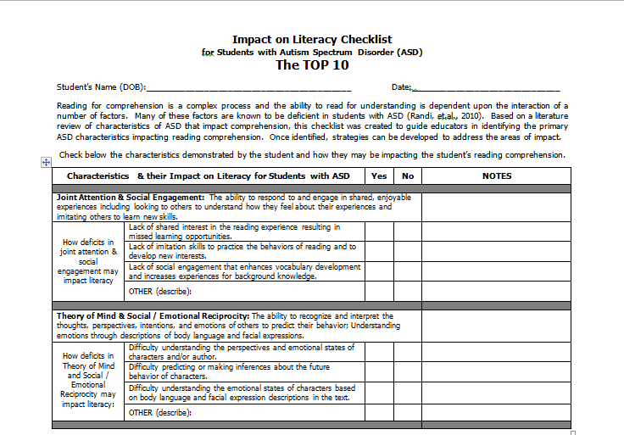
ASD Impact on Literacy Checklist The TOP 10

Slide 57
Characteristics of ASD that Impact Literacy Joint Attention & Social Engagement
Joint Attention & Social Engagement: The ability to respond to and engage in shared, enjoyable experiences including looking to others to understand how they feel about their experiences and imitation others to learn new skills.
How deficits in joint attention & social engagement may impact literacy | Lack of shared interest in the reading experience resulting in missed learning opportunities.
 | Lack of imitation skills to practice the behaviors of reading and to develop new interests.
 | Lack of social engagement that enhances vocabulary development and increases experiences for background knowledge.
 | OTHER (describe):

Slide 58
Characteristics of ASD that Impact Literacy Theory of Mind & Social Emotional Reciprocity
Theory of Mind & Social / Emotional Reciprocity: The ability to recognize and interpret the thoughts, perspectives, intentions, and emotions of others to predict their behavior; Understanding emotions through descriptions of body language and facial expressions.
How deficits in Theory of Mind and Social / Emotional Reciprocity may impact literacy: | Difficulty understanding the perspectives and emotional states of characters and/or author.
 | Difficulty predicting or making inferences about the future behavior of characters.
 | Difficulty understanding the emotional states of characters based on body language and facial expression descriptions in the text.
 | OTHER (describe):

Slide 59
Characteristics of ASD that Impact Literacy Central Coherence
Central Coherence: Understanding the central tenets of a passage and creating meaning from text details; the ability to integrate details in order to understand the “big picture” of a passage.
How deficits in central coherence may impact literacy | Over-focus on minor, irrelevant or concrete details in the passage thus missing the main idea(s) or overall purpose of the text.
 | Comprehending all the rote facts in the passage but not blending
 | Difficulty connecting information at the paragraph or chapter level.
 | OTHER (describe):

Slide 60
When asked to tell about the picture, the fourth grader replied, "deer." Do you see it?

Slide 61
Characteristics of ASD that Impact Literacy Executive Function
Executive Function: The ability to organize information and thoughts for coherency, self-monitor for comprehension, and execute plans of action.
How deficits in executive functioning may impact literacy | Difficulty suppressing irrelevant background knowledge and shifting meaning to different contexts.
 | Making irrelevant connections between contexts, concepts, or relationships.
 | Difficulty organizing and planning the reading experience (e.g. timelines for reading long texts) and self-monitoring for understanding (meta-cognition).
 | OTHER (describe):

Slide 62
Characteristics of ASD that Impact Literacy Restricted Interests and Motivation
Restricted Interests & Motivation: Abnormally intense preoccupation with specific interest areas or activities which impact motivation to read non-preferred text or results in getting stuck on words or phrases.
How intense interests and motivation can impact literacy | Intense focus on specific preferred interest areas so does not engage in reading in non-preferred text or results in getting stuck on words or phrases.
 | Gets stuck reading only certain words, phrases, or sections in text.
 | Fails to monitor for comprehension (meta-cognition) due to focus on preferred interests and topics.
 | OTHER (describe):

Slide 63
Characteristics of ASD that Impact Literacy Prior Knowledge
Prior Knowledge: The ability to apply relevant background knowledge to make global and abstract connections in text.
How deficits in applying prior knowledge can impact literacy | Difficulty accessing and applying relevant background knowledge in order to understand the context or situation in text.
 | Difficulty with word meanings (semantics) in context of the text.
 | Difficulty with comprehension of text requiring a lot of background social knowledge and social experiences (e.g. novels) versus those that require limited social understanding (e.g. technical text).
 | OTHER (describe):

Slide 64
Characteristics of ASD that Impact Literacy Literal (vs. Abstract) Thinking
Literal (vs. Abstract) Thinking: Focus on factual information such as events and actual objects or people in the text and an absence of focus on concepts and generalizations often confused by a lack of understanding idioms, irony, figures of speech, innuendo, and sarcasm.
How literal vs. abstract thinking can impact literacy | Difficulty understanding figurative language (e.g. metaphors) and use of idioms, irony, innuendo, sarcasm.
 | Difficulty ignoring irrelevant factual information in text and missing context cues and information that enhances understanding.
 | Applying only one meaning to a word and failure to use context cues to recognize a different meaning is necessary.
 | OTHER (describe):

Slide 65
Characteristics of ASD that Impact Literacy Pragmatics
Pragmatics: The ability to understand language and communication in social contexts and this predict character intentions and behaviors.
How deficits in pragmatics can impact literacy | Difficulty understanding perspectives or intentions based on the narration of characters and context cues.
 | Focus on concrete details in narrative text (e.g., what a character said specifically) rather than focus on conversation and context cues to gain an understanding of plot and character development.
 | Difficulty making inferences about characters’ emotions and perspectives based on subtle cues or context in text.
 | OTHER (describe):

Slide 66
Characteristics of ASD that Impact Literacy Language, Communication & Vocabulary
Language, Communication & Vocabulary: The ability to understand the complexities of language, communication, and vocabulary to comprehend text.
How deficits in language, communication & vocabulary can impact literacy | Difficulty with communication skills that impact ability to answer questions or demonstrate knowledge
 | Difficulty understanding vocabulary nuances (e.g. homographs (words spelled the same with more than one meaning) or homophones (words pronounced the same but with different meanings)).
 | Difficulty understanding pronouns used to represent previously identified persons, objects, or groups.
 | OTHER (describe):

Slide 67
STRATEGIES
Characteristics & their Impact on Literacy for Students with ASD |  | Yes | No | If yes, reference comprehension strategies listed for each characteristic.
Joint attention & Social Engagement: The ability to respond to and engage in shared, enjoyable experiences including looking to others to understand how they feel about their experiences and imitating others to learn new skills.
How deficits in joint attention & social engagement may impact literacy | Lack of shared interest in the reading experience resulting in missed learning opportunities. |  |  | Shared Storybook Reading: Building Young Children’s Language and Emergent Literacy Skills (Ezell & Justice, 2005) Attending Strategy: Determine current attending baseline behavior by observing how long the child attends in two separated shared-reading sessions. Establish an attending goal measured in either length of time or number of pages Select an attractive book with limited print on a topic that may be preferred interest and incorporates flaps, moveable parts or textures. During shared reading session, the adult should read the book with enthusiasm and animation. When the target time or page has been reached, verbal praise should be provided to the child (e.g. “You did a great job listening to the story!” and then the session should be ended. A record of the child’s attending time (measured in either minutes or number of pages read) should be maintained. The use of this strategy can be continued until the child is able to attend to the entire reading of one brief storybook.

Slide 68
Next Steps
Use Profile and give feedback
Use of the checklist and get feedback
Understanding of the areas (i.e. characteristics)
Ease of use of the tool
Covers all or most relevant areas
Ideas for improvement
Match strategies to Characteristics

Slide 69
PRIMARY SOURCES
Barr, Blachowicz, C. Bates, A. Katz, C. Kaufman, B. (2013). Reading Diagnosis for Teachers: An Instructional Approach (6th Ed.). Pearson.
Brown, H., Oram-Cardy, J. & Johnson, A. (2013). A Meta-Analysis of the Reading Comprehension Skills of Individuas on the Autism Spectrum. Journal of Autism and Developmental Disorders, 43, 932-955.
Carnahan, C. & Williamson, P. (Eds) (2010). Quality Literacy Instruction for Students with Autism Spectrum Disorders. AAPC.
Carnahan, C. Williamson, P. & Haydon, T. (2009). Matching Literacy Profiles with Instruction for Students on the Spectrum: Making Reading Instruction Meaningful. Beyond Behavior, 19, 10-16.
Consortium on Reading Exellence (2008). Assessing Reading: Multiple Measures. Arena Press.
Honig, B. Diamond, L. & Gutlohn. L, (2013). Teaching Reading Sourcebook. Arena Press.
Iland, E. (2011). Drawing a Blank: Improving Comprehension for Readings of the Autism Spectrum. AAPC

Slide 70
PRIMARY SOURCES
Intervention Central (2015) Curriculum-Based Measurement Warehouse.
http://www.interventioncentral.org/curriculum-based-measurement-reading-math-assesment-tests.
Johnson, K. & Street, E. (2013). Response to Intervention and Precision Teaching: Creating Synergy in the Classroom. Guildford Press.
Kluth, P. & Chandler-Olcott, K. (2008). A Land We Can Share: Teaching Literacy to Students with Autism. Brooks.
Knight, V. & Sartini, E. (2015). A Comprehensive Literature Review of Comprehension Strategies in Core Content Areas for Students with Autism Spectrum Disorder. Journal of Autism and Developmental Disabilities, 45, 1213-1229.
Randi, J, Newman, T. & Grigorenko, E. (2010). Teaching Children with Autism to Read for Meaning: Challenges and Possibilities. Journal of Autism and Developmental Disorders, 40(7), 890-902.
University of Oregon Center on Teaching and Learning (2015). U/O DIBELS Data System. https://dibels.uoregon.edu/ .

