Slide 1
Effective Teaming and Meeting Mechanics
Notes:
Introduction. Explain how Manual will be embedded within modules in the next 2 years as opposed to just a ½ day training. Overview of effective teaming (what are we doing and how are we behaving as adults participating with teams and in meetings) and meeting mechanics (the strategy that is used to problem-solve when we get stuck)
Manual walk through - explanation of visual organizers
Polleverywhere – looks familiar
Questions – set aside, will answer if not addressed at the end.

Slide 2
Write down… 2 Effective Meeting Practices 2 Ineffective Meeting Practices
Notes:
polleverywhere

Slide 3
At your table, identify common themes Effective Team Meetings Ineffective Team Meetings

Slide 4
Effective Teaming and Meeting Mechanics Resources Manual
START Project Homepage
Notes:
https://www.gvsu.edu/autismcenter/effective-teaming-and-meeting-mechanics-60.htm

Slide 5
Manual Walkthrough
10 minutes
What looks familiar?
What questions do you have?

Slide 6
Guiding Principles
Guiding Principles

Slide 7
Guiding Principles
Notes:
All Ideas are Good Ideas – (no they are not, but what this means is…)
Talk to the Board – (describe in detail what that looks like)
Refrain from defending, convincing, or monopolizing -

Slide 8
Guiding Principles Continued
Notes:
Control the controllables –
Step out of your defined role –
Stick with the plan – (implement the plan with fidelity – stop the parking lot conversations about what you disagreed with and what you don’t think will work)

Slide 9
Effective Teaming
Effective Teaming
Notes:
Pull out the assessment sheet and highlighter…. As we go through these, highlight the items that you believe you are doing…try not to jump ahead.

Slide 10
Make time to Meet
First…make time to meet
Notes:
Priority – creative, you will never have enough time
Face-to-face
Zoom
Time – commit to it

Slide 11
Effective Teaming
Meeting Essentials - Foundation
Meeting Practices - Team
Meeting Accountability – Individual Team Members

Slide 12
Meeting Essentials
Notes:
Essentials – it’s about coming to the meeting with the basics; setting the stage for the potential for an effective meeting. These things you can actually take a photograph of during the meeting.
Identified roles – purpose: who is doing what
Guiding principles – reminders
An agenda – don’t waste your time, this isn’t social time
A medium of taking notes and recording action items –
Visual organizer - white board, chart paper, smartboard, laptop with a projector
Meeting mechanics – physical items (posted)
Relevant data – bring any relevant data (new and as an action item from the meeting before)

Slide 13
Meeting Practices
Notes:
Start and end meeting on time (what are some strategies for ensuring this happens?)– don’t stop the meeting and start all over 3 times to fill people in
Ensure needed team members are present –
Follow the established agenda – video tape the meeting --- did we stay on task and follow the agenda
Establish and rotate roles and responsibilities – have time keeper, notetaker, facilitator – rotate these roles… why is this important?
Use guiding principles – Don’t just post them. A solid team makes mistakes, but they also are comfortable holding each other accountable. (Use an example with Robin)
Take Notes and record action items
Uses meeting mechanics for problem solving when you get stuck
Establish a decision-making process
Ensure equitable distribution of action items
Data are collected to guide decision making

Slide 14
Individual Meeting Accountability
Notes:
This is my favorite part…
Self-assessment… intention (whether others know it or not) will impact the function and the integrity of your team.
Turn these into questions… did I… and did I…. with fidelity (wholeheartedly)…
Make attendance a meetings a priority
Arrive on time and stay for the entire meeting
Bring new ideas, relevant information, and evidence of action item completion (did you do the bare minimum that you might be called out on or did you genuinely make a good effort to collect and bring this back to the team?
Actively participate and contribute…
Seek understanding and presume positive intent
Model and maintain a safe, productive climate for discussions
Be mindful of your own verbal and non-verbal communication
Address guiding principle violations – did Robin do something that violated the Guiding principles and did I let it go to avoid a bit of uncomfort?
Use law, research and data to guide discussions and decisions

Slide 15
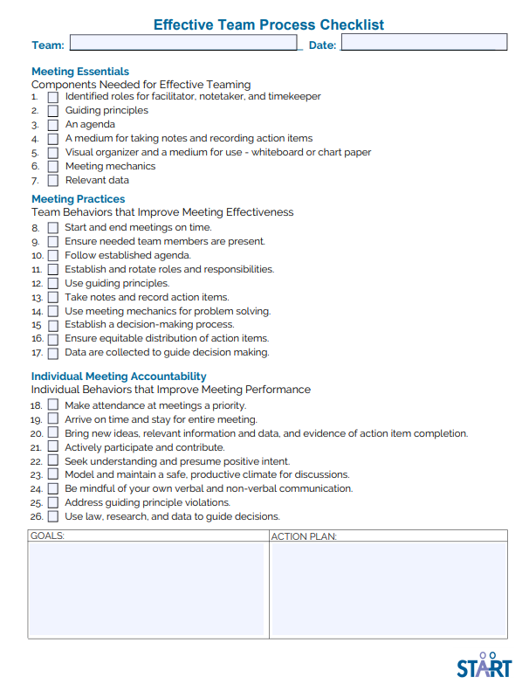
Effective Teaming & Problem Solving Assessment
Notes:
Tool you can choose to use with your teams.
One team goal and one individual goal
Polleverywhere 2 focus numbers 1- 26
Team: 1-17
Individual 18-26

Slide 16
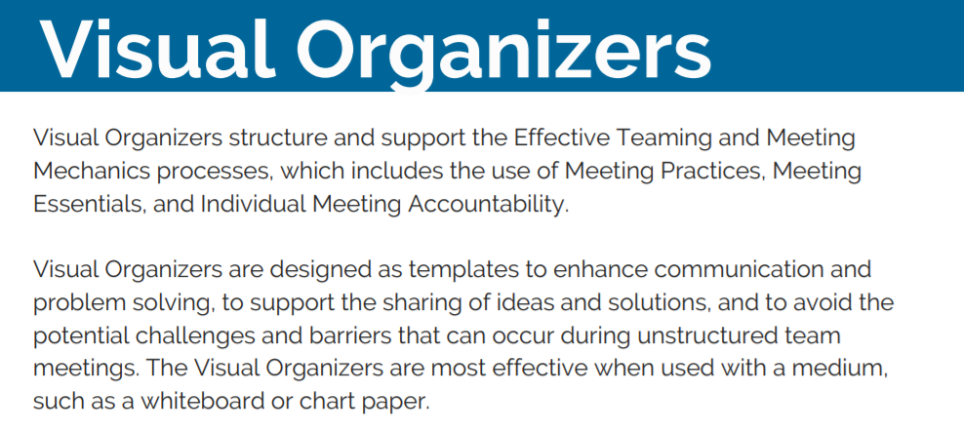
Visual Organizers
Notes:
https://www.gvsu.edu/autismcenter/effective-teaming-and-meeting-mechanics-60.htm

Slide 17
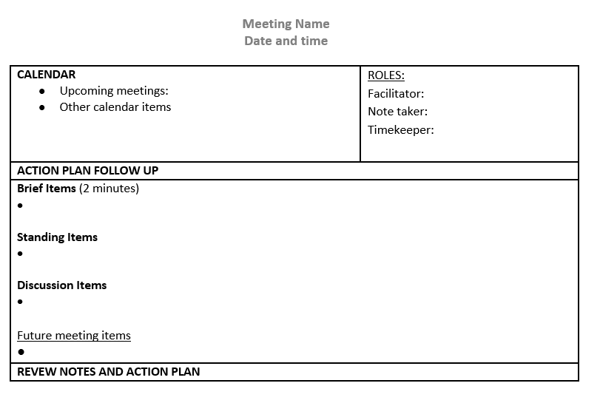
Meeting Plan
Notes:
Start on Time and End on time.
Members stay the duration of the meeting.
Rotate leadership roles – others? Meeting coordinator
We do not stop the meeting to update tardy members
Ground rules are established and a safe environment has been created to call each other out. Ex: obstacles prior to implementation variables
A structured agenda
Data drives decision-making
Multiple perspectives are considered
Everyone is accountable for the outcome – no more blaming the person who came up with the idea, the whole team can celebrate successes.
Interventions that are implemented are evidence based.
All team members walk away with notes to reference
Action plans are evenly distributed.

Slide 18
Meetings Supporting Tools and Visual Organizers
Meeting Topic | Supporting Tools/Visual Organizers
Weekly Team | Meeting Agenda
Behavior | Behavior Response Script
Academic Planning | Differentiated Output
Adult Support Needs | Paraprofessional Planning
Case Conference | Passport and Peers
Transition | Collaborative Transition
Notes:
Manual: you can use any of these visual organizers to structure your meetings… it’s when you get stuck that meeting mechanics/problem solving process needs to be used.

Slide 19
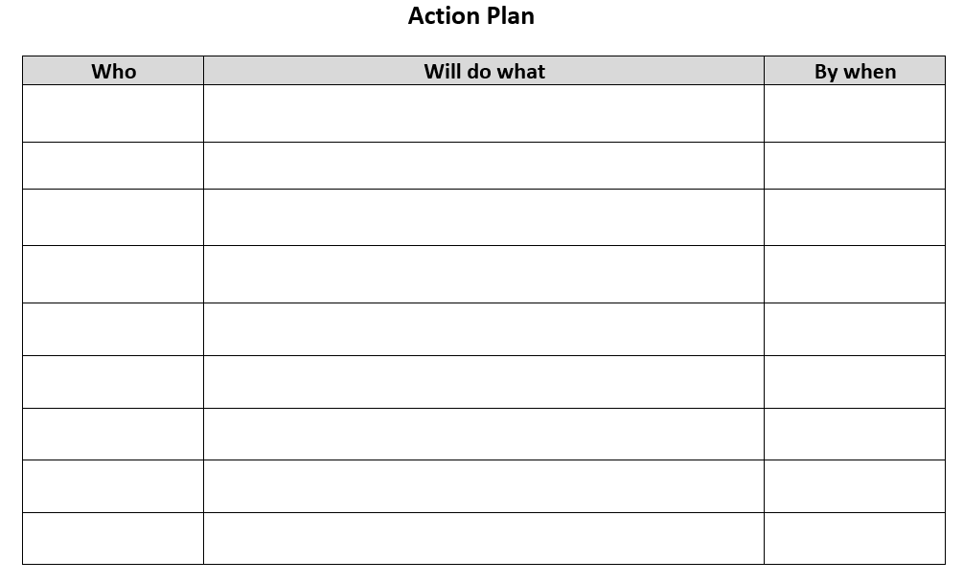
Action Plan

Slide 20
Meeting Mechanics Process
Meeting Mechanics Process
Notes:
Take a 15 minute break and then we will get into problem solving and the meeting mechanics process…

Slide 21
Steps of Meeting Mechanics Problem Solving
Data
Problem Identification
Problem Specification
Idea Generation
Brainstorm
Cluster and Prioritize
Implementation
Implementation Variables
Action Plan Development
Notes:
Time Keeper, Facilitator, Notetaker

Slide 22
Problem Identification
Notes:
(photo)
Flipchart…. If you have a genuine problem, you just might have an action plan when you leave here.
Problem Identification: do we have a problem worth working on… can it be resolved… discussion continues.
5 minutes to talk about a problem….

Slide 23
Problem Specification
Notes:
(photo)
Specify what your problem is .. When how often what does the data says? This might be the place where we decide do we need to collect more data before moving forward.. But usually you have a situation where you may choose to collect more data, but you need a plan beginning tomorrow. 5 minutes - go

Slide 24
Brainstorming
Notes:
(photo)
Talk about the adult behavior. Take a little more time with this.

Slide 25
Let’s try it!
Problem Identification
Problem Specification
Brainstorming/Idea Generation
YOU WILL NEED:
Facilitator
Timekeeper
Notetaker
Flipchart
Markers

Slide 26
Cluster & Prioritize
Notes:
(photo)

Slide 27
Implementation Variables
Notes:
This is the very first time that discussion about barriers can be addressed.

Slide 28
Action Plan Development
Notes:
Who will do what… action plan…

Slide 29
Leave with a plan…
Cluster and Prioritize
Implementation Variables
Action Plan Development

