Slide 1


Grand Valley State University
Campus Climate Assessment
Results of Report
September 23, 2011

Slide 2
Climate In Higher Education
Climate (Living, Working, Learning)
Community Members
Creation and Distribution of Knowledge
Barcelo, 2004; Bauer, 1998, Kuh & Whitt, 1998; Hurtado, 1998, 2005; Ingle, 2005; Milhem, 2005; Peterson, 1990; Rankin, 1994, 1998, 2003, 2005; Smith, 1999; Tierney, 1990; Worthington, 2008
Notes:
Climate on college campuses not only affects the creation of knowledge, but also has a significant impact on members of the academic community who, in turn, contribute to the creation of the campus environment.

Slide 3
Assessing Campus Climate
What is it?
Campus Climate is a construct
Definition?
Current attitudes, behaviors, and standards and practices of employees and students of an institution
How is it measured?
Personal Experiences
Perceptions
Institutional Efforts
Rankin & Reason, 2008

Slide 4
Campus Climate & Students
How students experience their campus environment influences both learning and developmental outcomes.¹
Discriminatory environments have a negative effect on student learning.²
Research supports the pedagogical value of a diverse student body and faculty on enhancing learning outcomes.³
¹ Pascarella & Terenzini, 1991, 2005
² Cabrera, Nora, Terenzini, Pascarella, & Hagedron, 1999; Feagin, Vera & Imani, 1996; Pascarella & Terenzini, 1991.
³ Hale, 2004; Harper & Quaye , 2004; Harper, & Hurtado, 2007; Hurtado, 2003.

Slide 5
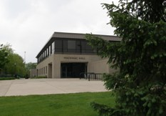

Project Objectives
Provide Grand Valley State University (GVSU) with information, analysis, and recommendations as they relate to campus climate.
This information will be used in conjunction with other data to provide GVSU with an inclusive view of campus.

Slide 6
Grand Valley State University
Vision Statement 2001-2015
Goal Two
Grand Valley provides a rich, inclusive learning and working environment that attracts, retains, and supports a diverse community.
Source: http://www.gvsu.edu/strategicplanning/

Slide 7
Strategic Goal #2
Objectives
Objective 2.5:
Annually, the university will increase its outreach efforts in order to enhance the diversity of its student body.
Objective 2.8:
By December 2010, the Office of Inclusion and Equity will conduct a rigorous climate study of faculty, staff, and student experiences to identify a current baseline of perceptions in areas of inclusion and equity.
Source: http://www.gvsu.edu/strategicplanning/

Slide 8
Overview of the Project
Phase I
Phase II
Phase III
Assessment Tool Development and Implementation
Data Analysis
Final Report and Presentation

Slide 9

Survey Instrument
Final instrument
  106 questions and additional space for respondents to provide commentary
  On-line or paper & pencil options
Sample = Population
  All students and employees of GVSU’s community received an invitation to participate from President Haas and members of the CSC forwarded subsequent invitations.
Results include information regarding:
  Respondents’ personal experiences at GVSU
  Respondents’ perceptions of climate at GVSU
  Respondents’ perceptions of institutional actions
  Respondents’ input into recommendations for change

Slide 10
Survey Assessment Limitations
Self-selection bias
Response rates
Social desirability
Caution in generalizing results for constituent groups with significantly lower response rates

Slide 11
Method Limitation
Data were not reported for groups of fewer than 10 individuals where identity could be compromised.
Instead, small groups were combined to eliminate possibility of identifying individuals.

Slide 12
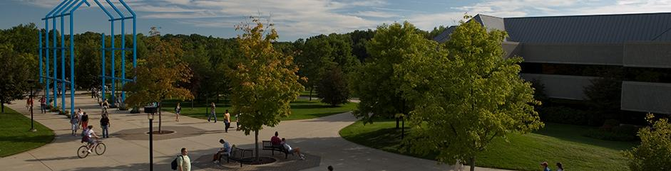
Results
Response Rates

Slide 13
Who are the respondents?
7,571 people responded to the call to participate (29% overall response rate).
6,110 respondents contributed remarks to one or more of the open-ended questions.

Slide 14
Student Response Rates
BA student/entered as 1st year student (24%, n=3208)
Non-degree seeking student (20%, n=30)
BA student/entered as transfer (19%, n=1146)
Graduate Student (25%, n=853)

Slide 15
Staff Response Rates
Clerical/Office/Technical (56%, n=289)
Executive/Administrator/Professional (60%, n=462)
Department of Public Safety (31%, n=11)
Maintenance/Grounds/Service (17%, n=26)

Slide 16
Faculty Response Rates
Associate Professor/Librarian (35%, n=18)
Assistant Professor/Librarian (37%, n=98)
Professor/Senior Librarian (21%, n=42)
Visiting Faculty (31%, n=35)

Slide 17
Faculty Response Rates
(Continued)
Instructor (46%, n=10)
Affiliate Instructor (28%, n=39)
Semester Adjunct Faculty (14%, n=67)

Slide 18
Student Response Rates by Selected Demographics
By Race
Students of Color
16% (n=926)
White Students
14% (n=5098)
By Gender
Women
16% (n=4,012)
Men
11% (n=1,966)

Slide 19
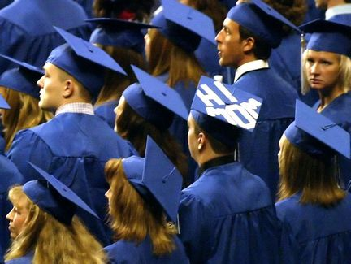
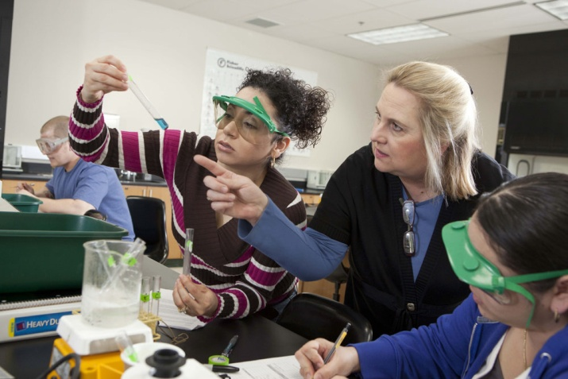
Results
Additional Demographic Characteristics

Slide 20
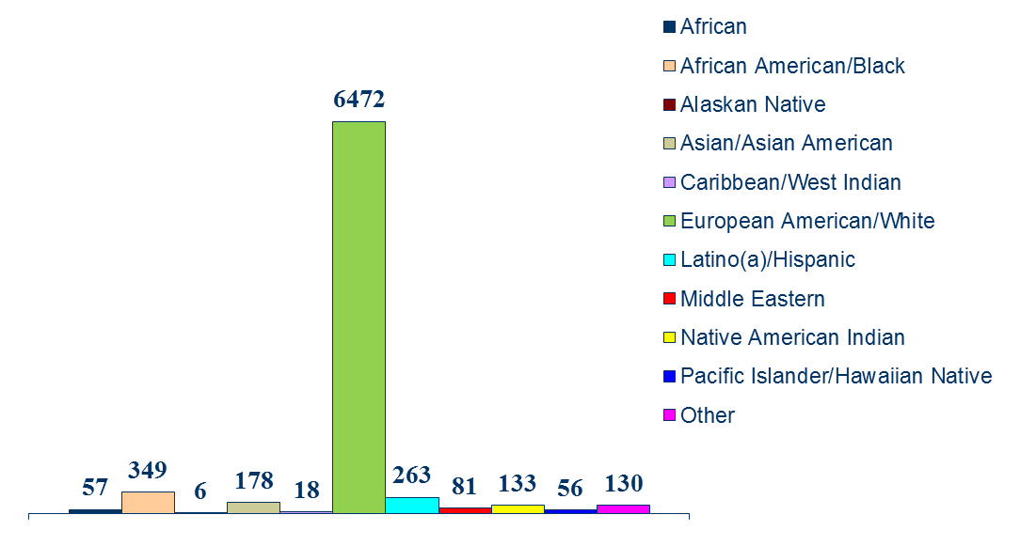
Respondents by Racial/Ethnic Identity (n)
(Duplicated Total)

Slide 21
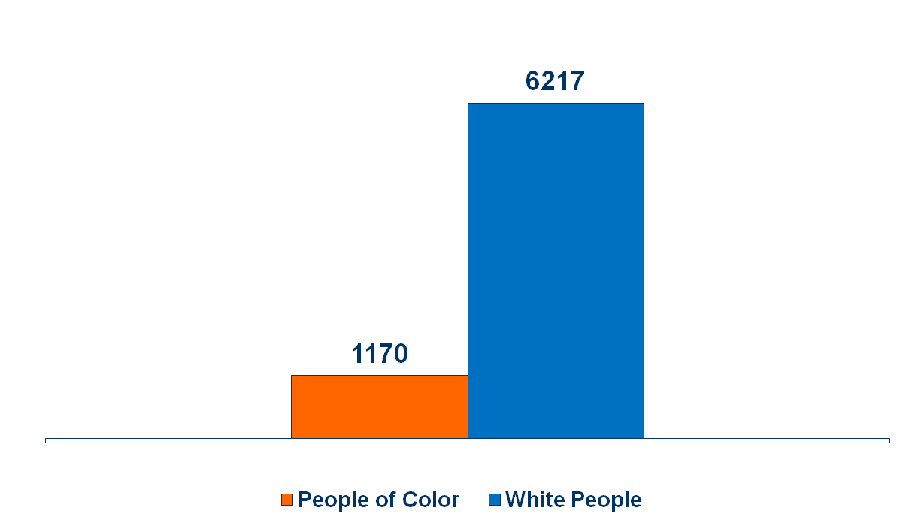
Respondents by Racial/Ethnic Identity (n)
(Unduplicated Total)

Slide 22
Respondents by Position Status and Gender Identity (n)
24 transgender respondents are not included in this review to protect anonymity

Slide 23
Respondents by Position Status and Sexual Identity (n)

Slide 24
Respondents with Conditions that Substantially Affect Major Life Activities by Position Status (n)

Slide 25
Respondents by
Spiritual Affiliation and Campus
 | n | %
Christian | 5,034 | 67
Other than Christian | 747 | 10
No affiliation | 1,586 | 21

Slide 26
Citizenship Status by Position
 | Students |  | Employees
 | n | % | n | %
U.S.-born citizen | 5703 | 94.9 | 1351 | 91.5
U.S. citizen – naturalized | 110 | 1.8 | 51 | 3.5
Dual citizenship | 46 | 0.8 | 10 | 0.7
Permanent resident (immigrant) | 56 | 0.9 | 49 | 3.3
International (F-1, J-1, or H1-B, or other visa) | 85 | 1.4 | 14 | 0.9

Slide 27
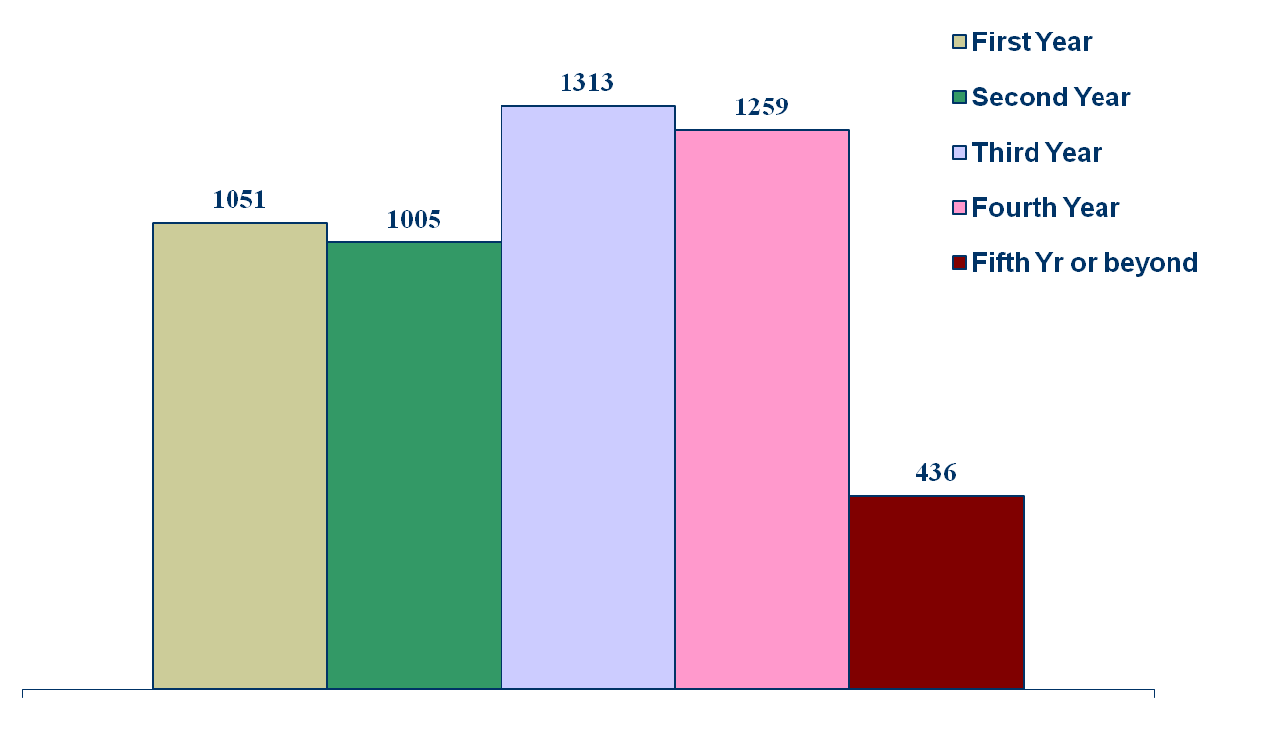
Students by Class Standing (n)

Slide 28
Students’ Residence
Residence | n | %
On-campus | 1731 | 28.6
Off-campus | 4263 | 70.5
Missing | 49 | 0.8

Slide 29
Students’ Participation in Organizations at GVSU
Organization | n | %
I do not participate in any organizations | 2474 | 40.9
Academic and Professional | 1227 | 20.3
Cultural | 341 | 5.6
Fraternities and Sororities | 510 | 8.4
Performing Arts | 342 | 5.7
Faith Based | 644 | 10.7
Service & Advocacy | 588 | 9.7
Special Interest | 395 | 6.5
Sports and Recreation | 1058 | 17.5
Student Government | 89 | 1.5
Media | 94 | 1.6
Honorary and Professional Societies | 356 | 5.9
Other | 7 | 0.1
Note: Respondents could chose more than one response

Slide 30
Respondents’ Political Views
 | Students |  | Employees
 | n | % | n | %
Far left | 119 | 2.0 | 50 | 3.4
Liberal | 1494 | 25.1 | 524 | 36.0
Moderate | 1644 | 27.6 | 464 | 31.9
Conservative | 1470 | 24.7 | 276 | 19.0
Far right | 44 | 0.7 | * | *

Slide 31
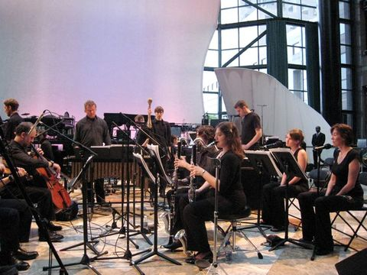
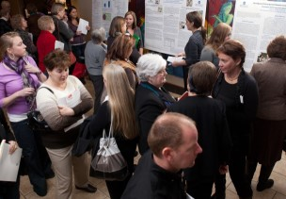
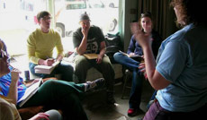
Findings

Slide 32
Overall Comfort Levels
Campus Climate
88%
Department/Work Unit Climate
76%
Classroom Climate
86%

Slide 33
Least Comfortable with Overall Campus Climate
People of Color
LGBQ

Slide 34
Least Comfortable with Climate in Department/Work Unit
People of Color
Women
LGBQ

Slide 35
Least Comfortable with Classroom Climate
Students/Faculty of Color
LGBQ Students/Faculty

Slide 36
Overall Satisfaction
84%
Employees who were “highly satisfied” or “satisfied” with their jobs at GVSU
61%
Employees who were “highly satisfied” or “satisfied” with the way their careers have progressed at GVSU

Slide 37
Levels of Satisfaction by
Demographic Groups
Satisfaction with Job
Satisfaction with Career Progression
LGBQ and People of Color least satisfied.
LGBQ and People of Color least satisfied

Slide 38



Challenges and Opportunities

Slide 39
Experiences with Harassment
11%
859 respondents indicated that they had personally experienced exclusionary, intimidating, offensive and/or hostile conduct that interfered with their ability to work or learn at GVSU

Slide 40
Form of Perceived Offensive, Hostile, or Intimidating Conduct
 | n | %
Deliberately ignored or excluded | 399 | 46.4
Intimidated/bullied | 355 | 41.3
Felt isolated or left out | 338 | 39.3
Stared at | 164 | 19.1
Target of derogatory remarks | 155 | 18.0
Felt isolated or left out when working in groups | 154 | 17.9
Note: Only answered by respondents who experienced harassment (n = 859).
Percentages do not sum to 100 due to multiple responses.

Slide 41
Personally Experienced Based on…(%)

Slide 42
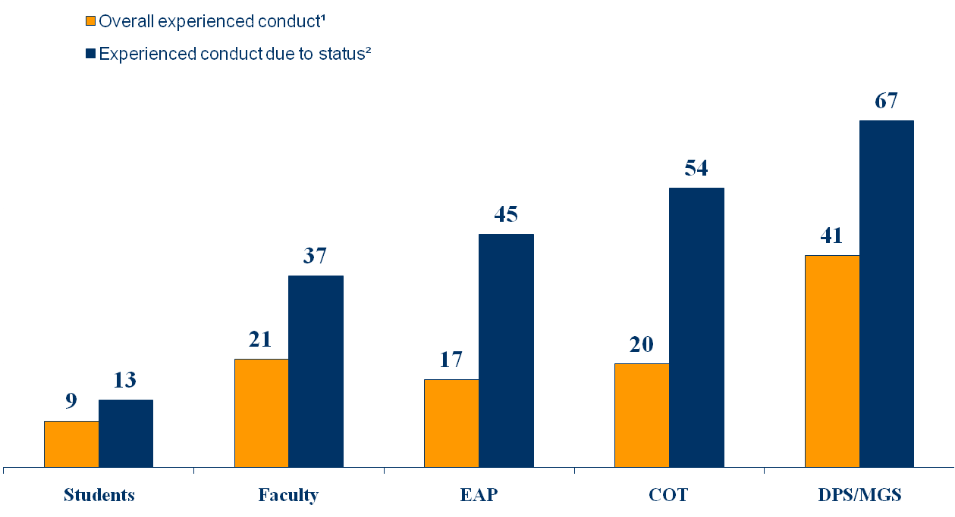
Overall Personal Experiences of Perceived Offensive, Hostile, or Intimidating Conduct Due to
University Status (by University Status) (%)
(n=560)¹
(n=73)²
(n=145)¹
(n=54)²
(n=78)¹
(n=35)²
(n=59)¹
(n=32)²
(n=15)¹
(n=10)²
¹ Percentages are based on total n split by group.
² Percentages are based on n split by group for those who believed they had personally experienced this conduct.

Slide 43
Overall Personal Experiences of Perceived Offensive, Hostile, or Intimidating Conduct
Due to Gender Identity (%)
¹
²
(n=580)¹
(n=161)²
(n=260)¹
(n=27)²
¹ Percentages are based on total n split by group.
² Percentages are based on n split by group for those who believed they had personally experienced this conduct.

Slide 44
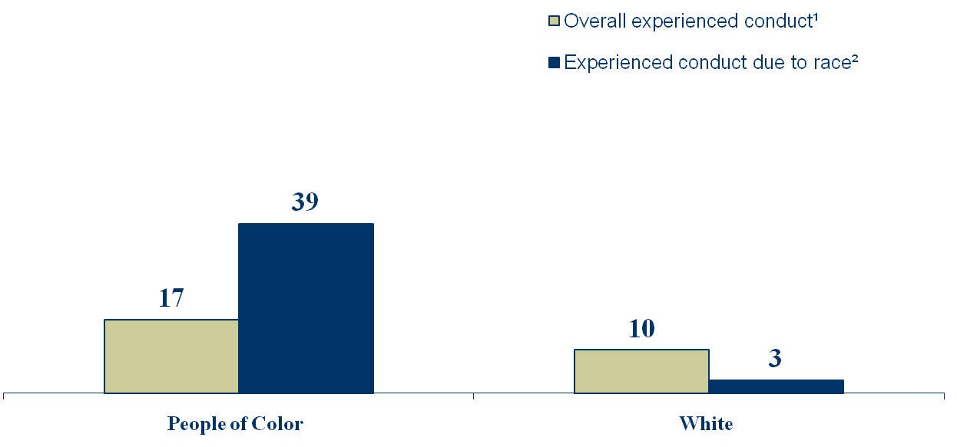
Overall Personal Experiences of Perceived Offensive, Hostile, or Intimidating Conduct
Due to Racial Identity (%)
(n=201)¹
(n=79)²
(n=619)¹
(n=19)²
¹ Percentages are based on total n split by group.
² Percentages are based on n split by group for those who believed they had personally experienced this conduct.

Slide 45
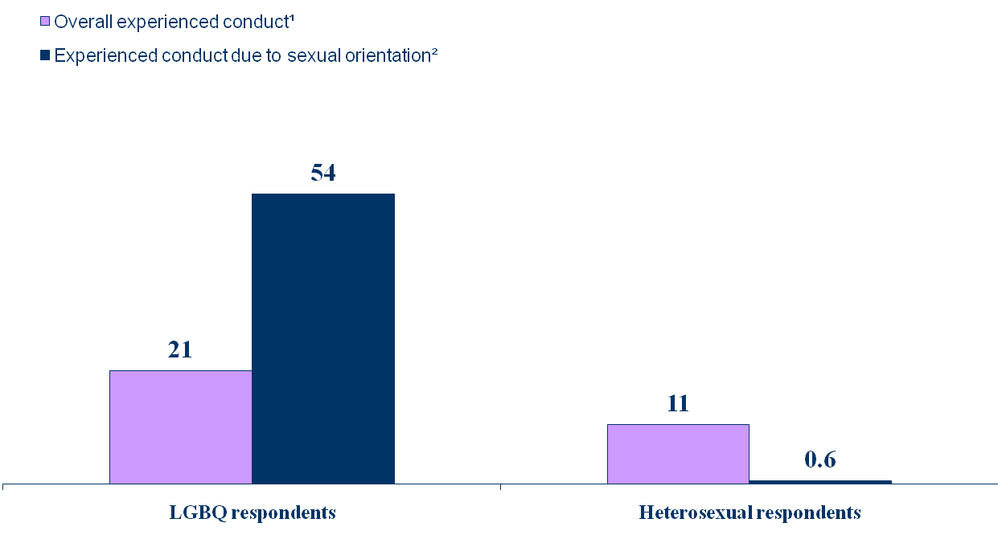
Overall Personal Experiences of Perceived Offensive, Hostile, or Intimidating Conduct
Due to Sexual Identity (%)
(n=90)¹
(n=49)²
(n=658)¹
(n=4)²
¹ Percentages are based on total n split by group.
² Percentages are based on n split by group for those who believed they had personally experienced this conduct.

Slide 46
Overall Personal Experiences of Perceived Offensive, Hostile, or Intimidating Conduct Due to Disability (%)
(n=63)¹
(n=12)²
(n=126)¹
(n=7)²
(n=41)¹
(n=8)²
¹ Percentages are based on total n split by group.
² Percentages are based on n split by group for those who believed they had personally experienced this conduct.

Slide 47
Location of Perceived Harassment
 | n | %
In a class | 322 | 37.5
In a meeting with a group of people | 194 | 22.6
Public space on campus | 154 | 17.9
While working at a campus job | 146 | 17.0
Campus housing | 124 | 14.4
Note: Only answered by respondents who experienced harassment (n = 859).
Percentages do not sum to 100 due to multiple responses.

Slide 48
Source of Perceived Conduct by
Position Status (n)

Slide 49
What did you do?¹
Personal responses:
Was angry (56%)
Told a friend (43%)
Told a family member (37%)
Felt embarrassed (37%)
Reporting responses:
Didn’t report it for fear complaint would not be taken seriously (17%)
Confronted the harasser at the time (16%)
Sought support from a faculty member (16%) or staff member (15%)
Made an official complaint to campus employee/official (11% )
¹ Only answered by respondents who experienced harassment (n = 859).
Respondents could mark more than one response

Slide 50
Sexual Assault at GVSU
2%
Experienced sexual assault while at GVSU (n = 154)

Slide 51
Respondents Who Believed They Were
Sexually Assaulted By Select Demographics
Position
Students (148)
Employees (6)
Sexual Orientation
LGBQQ (22)
Heterosexual (114)
Gender
Women (141)
Men (10)
Race
People of Color (31)
White People (119)
Transgender (3)

Slide 52
Respondents Who Believed They Were Sexually Assaulted
Where did it occur?
  Off-campus (n = 77)
Who were the offenders?
  Students (n = 59)
  Friend (n = 56)
  Acquaintance (n = 50)
What did you do¹?
  Told a friend (n = 88)
  Felt embarrassed (n = 83)
  Felt somehow responsible (n = 76)
¹Respondents could mark more than one response

Slide 53
Have you ever seriously considered leaving GVSU?

Slide 54
Respondents Who Seriously Considered Leaving GVSU
14% (n = 1,043) of all Respondents
Students (12%)
Faculty (23%)
Staff (14%)

Slide 55
Employee Respondents Who Seriously Considered Leaving GVSU
Gender Identity
Women (22%)
Men (18%)
Racial Identity
Employees of Color (26%)
White Employees (19%)
Sexual
Identity
LGBQ (28%)
Heterosexual (20%)

Slide 56
Student Respondents Who Seriously Considered Leaving GSVU
Gender
Women (12%)
Men (12%)
Race
Students of Color (18%)
White Students (11%)
Sexual Orientation
LGBQ (18%)
Heterosexual (11%)

Slide 57

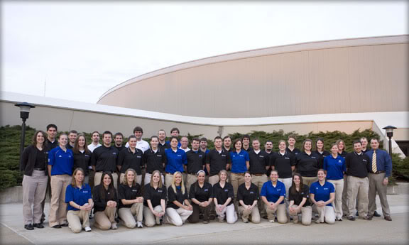
Perceptions

Slide 58
Respondents Who Observed or Were Personally Made Aware of Conduct That Created an Exclusionary, Intimidating, Offensive and/or Hostile Working or Learning Environment
 | % | n
Yes | 18.0 | 1,347

Slide 59
Form of Observed Exclusionary, Intimidating, Offensive, or Hostile Conduct
 | n | %
Derogatory remarks | 725 | 53.8
Someone being deliberately ignored or excluded | 437 | 32.4
Someone isolated or left out | 364 | 27.0
Intimidation/bullying | 324 | 24.1
Racial/ethnic profiling | 228 | 16.9
Assumption that someone was admitted/ hired/promoted based on his/her identity | 201 | 14.9
Someone isolated or left out when working in groups | 195 | 14.5
Derogatory written comments | 154 | 11.4
Derogatory/unsolicited e-mails | 141 | 10.5
Note: Only answered by respondents who observed harassment (n = 1,347).
Percentages do not sum to 100 due to multiple responses.

Slide 60
Observed Harassment Based on…(%)

Slide 61
Source of Observed Exclusionary, Intimidating, Offensive, or Hostile Conduct (%)
Source
Students (50%)
Faculty (20%)
Administrator (9%)
Note: Only answered by respondents who observed harassment (n = 1,347).
Percentages do not sum to 100 due to multiple responses.

Slide 62
Location of Observed Exclusionary, Intimidating, Offensive, or Hostile Conduct
In a public space on campus
34%
n = 455
In a Class
31%
n = 418
In a meeting with a group of people
16%
n = 218
Note: Only answered by respondents who observed harassment (n = 1,347).
Percentages do not sum to 100 due to multiple responses.

Slide 63
Perceived Discrimination
Hiring Practices
(20%, n = 298)
Employment Practices Up to and Including Dismissal (12%, n = 173)
Employment Practices Related to Promotion (21%, n = 314)

Slide 64
Perceived Discrimination
Race was the primary basis for discriminatory hiring.
Position was the primary basis for discriminatory-related employment practices and promotion.

Slide 65
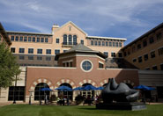
Work-Life Issues
The majority of employee respondents expressed positive attitudes about work-life issues.

Slide 66
Welcoming Workplace Climate
More than half of all employees thought the workplace climate was welcoming of “difference” based on all characteristics listed in survey except psychological condition.
Respondents of Color were least likely to believe the workplace climate was welcoming for employees based on gender and race.
Respondents of Color and LGBQ respondents were least likely to believe the workplace climate was welcoming based on sexual orientation.

Slide 67
Welcoming Classroom Climate
More than half of all student and faculty respondents felt that the classroom climate was welcoming for students based on “difference” across all dimensions.
Students/Faculty of Color were less likely than White students/faculty to indicate the classroom climate was welcoming based on race.
LGBQ students/faculty were less likely than heterosexual students/faculty to indicated the classroom climate was welcoming based on sexual orientation.

Slide 68
Student Perceptions of Campus Climate - Successes
The majority of students felt valued by faculty (78%) and other students (63%) in the classroom.
They also thought that GVSU employees (68%) and administrators (61%) were genuinely concerned with their welfare.
72% of all students believed the campus climate encourages free and open discussion of difficult topics.
75% of all students felt they have faculty who they perceive as role models and 56% felt they have staff as role models.

Slide 69
Student Perceptions of Campus Climate - Challenges
  31% of all students felt faculty pre-judge their abilities based on their identities/backgrounds.
  Students of Color, LGBQ students, and students with disabilities were more likely to feel faculty pre-judged their abilities based on their identities/background.
  Students of Color were more likely than White students to perceive tensions in classroom discussions.

Slide 70
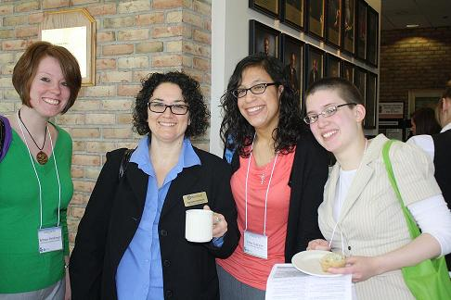
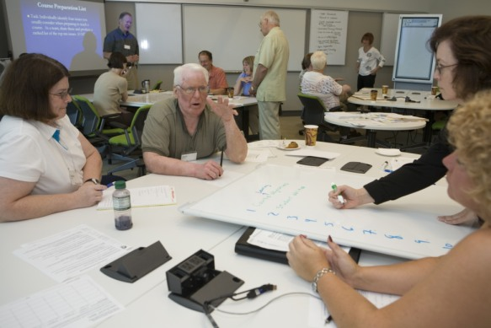
Institutional Actions

Slide 71

Inclusive Curriculum
More than half of all students and faculty felt the curriculum included materials, perspectives, and/or experiences of people based on 16 of 21 demographics characteristics except immigrant status, military/veteran status, parental status, physical characteristics, and disability status.

Slide 72
GVSU Commitment to Diversity/Inclusion 2005-2011
2005
61% (Students)
63% (Faculty)
2010
88% (Students)
67% (Staff
90% (Faculty)
94% (Staff)

Slide 73
Campus Initiatives That Would Positively Affect the Climate
Employees
More than half recommended:
  providing more effective mentorship for new faculty and staff
  providing clear and fair processes to resolve conflicts
  providing diversity education for staff, faculty, and students
  increasing the diversity of the faculty and staff, administration, and student body
  increasing funding to support campus climate change efforts

Slide 74
Campus Initiatives That Would Positively Affect the Climate
Students
More than half recommended:
  providing a person to address student complaints of classroom inequality
  providing diversity training for all students, staff, and faculty
  increasing the diversity of the faculty, staff and the student body
  increasing opportunities for cross-cultural dialogue among students, and between faculty, staff, and students
  incorporating issues of diversity and cross-cultural competence more effectively into the curriculum
  providing more effective faculty mentorship of students

Slide 75
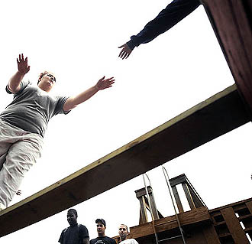
Summary
Strengths and Successes
Challenges and Opportunities

Slide 76
Context
Interpreting the Summary
Although colleges and universities attempt to foster welcoming and inclusive environments, they are not immune to negative societal attitudes and discriminatory behaviors.
As a microcosm of the larger social environment, college and university campuses reflect the pervasive prejudices of society.
Classism, Racism, Sexism, Genderism, Heterosexism, etc.
(Eliason, 1996; Hall & Sandler, 1984; Harper & Hurtado, 2007; Hart & Fellabaum, 2008; Malaney, Williams, & Gellar, 1997; Rankin, 2003; Rankin & Reason, 2008; Rankin, Weber, Blumenfeld, & Frazer, 2010; Smith, 2009; Worthington, Navarro, Loewy & Hart, 2008)

Slide 77
Overall Strengths & Successes
11% believed they had personally experienced harassment
18% had observed or personally been made aware of harassment.
88%
comfortable with the overall climate, 76% with dept/work unit climate, and 86% with climate in their classes.
84% of employee respondents were satisfied with their jobs at GVSU and 61% with how their careers have progressed.

Slide 78
Overall Challenges & Opportunities
11% of respondents (n = 859) believed they had personally experienced offensive, hostile, exclusionary, or intimidating conduct that interfered unreasonably with their ability to work or learn on campus.
18% of the participants (n = 1,347) had observed or personally been made aware of conduct on campus that created an offensive, hostile, exclusionary, or intimidating working or learning environment.

Slide 79
Other Strengths & Successes
All Respondents
The percentage of respondents who reported experiencing harassment at GVSU is lower than the percentage of respondents who report experiences of harassment in similar studies of postsecondary institutions.

Slide 80
Strengths & Successes
Students
A majority felt valued by faculty and other students in the classroom.
Employees
The majority of employees felt the workplace climate was welcoming based on gender, race, sexual orientation, and 15 other demographics characteristics.
A majority felt that employees and administrators were genuinely concerned with their welfare.

Slide 81
Other Challenges & Opportunities
Racial Tension
Respondents of Color (17%, n = 201) were more likely to report personally experiencing harassment when compared to their White counterparts (10%, n = 619).
Thirty-nine percent (n = 79) of Respondents of Color said the harassment was based on their race, compared with only three percent (n = 19) of White respondents.
Respondents of Color were less comfortable than White respondents with the overall climate, the climate in their departments/work units, and the climate in their classes.
62% of Students of Color and 78% of White students thought the classroom climate was welcoming based on race.
43% of Students/Faculty of Color and 27% of White students/faculty perceived racial/ethnic tensions in classroom discussions.
41% of Students of Color and 29% of White students felt faculty pre-judged their abilities based on their identities/backgrounds.
Employees of Color were also more likely than White employees to believe they had observed discriminatory hiring practices, discriminatory employment-related disciplinary actions, and discriminatory practices related to promotion at GVSU.

Slide 82
Challenges & Opportunities
Homophobia and Heterosexism
LGBQ respondents were 10% more likely than heterosexual respondents to experience harassment.
Gender Disparities
Gender was reported as the second highest basis (23%, n = 195) for personally experienced harassment.
Slightly higher rates of women (12%) versus men (10%) reported personal harassment, but substantially more women (28%) than men (10%) believed that the harassment was based on their gender.
Of all of the respondents who believed they had observed discriminatory employment practices, gender was the basis for discriminatory hiring (23%), employment-related disciplinary actions (14%), and discriminatory practices related to promotion (18%).
Of those respondents, 54% of LGBQ respondents indicated the basis was sexual orientation.
Sexual identity was the primary basis for observed harassment.
LGBQ respondents were less comfortable with the overall climate, the climate in their departments/work units, and the climate in their classes.
LGBQ employee and student respondents more likely to seriously consider leaving GVSU than their heterosexual counterparts.

Slide 83
Other Challenges & Opportunities
Harassment Due to University Position
Of all respondents (11%) who experienced harassment, university position (24%, n = 206) was indicated as the primary basis.
Staff respondents personally experienced harassment at substantially higher rates than faculty.
More staff members reported observing discriminatory hiring, and faculty reporting higher incidents of observing discriminatory practices related to promotion at GVSU.
Staff members were less satisfied with the way their careers have progressed than faculty members.

Slide 84

Next Steps

Slide 85

Process Forward
Fall 2011
    Share report results with community
      Community dialogue regarding the assessment results
        Inclusion & Equity Advisory Board
      Community feedback on recommended actions
      Full Report will be available in September at home page Inclusion/Diversity or www.gvsu.edu/mygvsu

Slide 86
Questions and
Discussion

