Slide 1
REGULATION
University faculty and instructional staff must be trained in fire drill procedures before each academic year
Fire Prevention Code, PA 207 of 1941, MCL 29.19a, Section a(5).
Presentation of the following information is GVSU’s effort to comply with Section a(5).

Slide 2
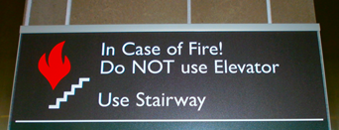
GVSU’s Responsibilities
The majority of GVSU academic buildings are constructed with:
Sprinkler systems
Smoke detection systems
Emergency exit signage
Emergency lighting
Fire rated enclosed stairwells
Fire rated doors
Pull station alarming
When an alarm sounds, University operations/classes in that building are suspended.
- EVERYONE MUST EXIT -

Slide 3
Faculty Preparation
Consider adding these statements to your syllabus:
Fire: Immediately Proceed to the nearest exit during a fire alarm. Do not use the elevator.
See http://www.gvsu.edu/emergency for additional emergency information.
Be aware that persons with disabilities have the primary responsibility to request assistance.

Slide 4
Faculty Responsibilities During an Evacuation / Fire Alarm
Interrupt class activity and advise students to evacuate the building.
Don’t assume it’s a false alarm!
Remind students to not use the elevators.
Follow exit signs

Slide 5
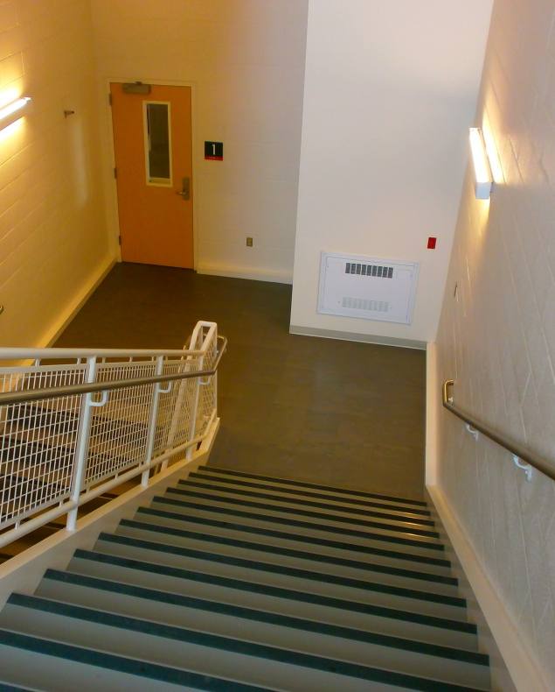
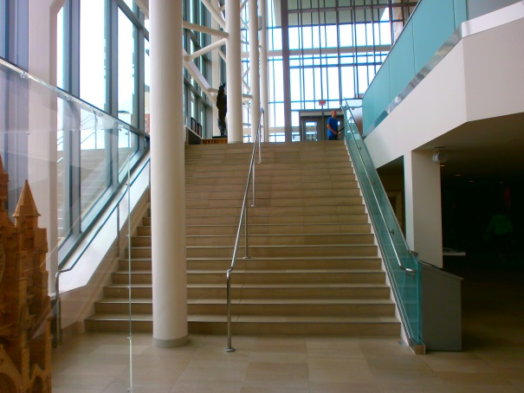
Evacuation of Persons With Disabilities
Do not use elevators!
Where possible, direct to nearest enclosed stairwell
Meet first responders and notify them of the location of anyone remaining in an enclosed stairwell
Faculty/Staff needing assistance should first direct students to evacuate and then go to an enclosed stairwell and call 911
ENCLOSED
NOT ENCLOSED

Slide 6
Emergency Information
www.gvsu.edu/emergency
Grand Valley Police Department Emergency Manager
Sergeant William O’Donnell
Phone: (616)-331-3255
Email: odonnewi@gvsu.edu

