Slide 1
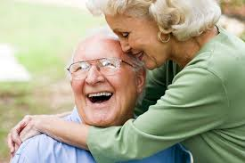
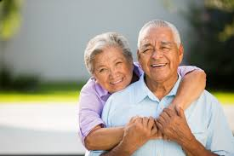
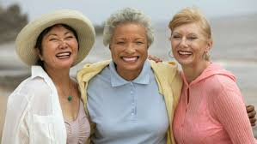
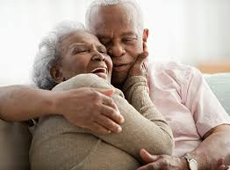
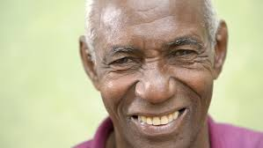
Lovers and friends: A millennial’s thoughts on love, intimacy, and relationships in later life
A keynote address
Grand Valley State University, 14th Annual Art & Science of Aging Conference
22 February 2019
Christina Pierpaoli Parker, MA & PhD candidate

Slide 2
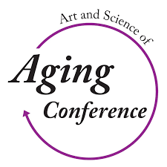
Special thanks to:
Dr. Priscilla Kimboko & Grand Valley State University
Art & Science of Aging Conference committee
Changing Aging & Dr. Bill Thomas
Psychology Today
University of Alabama
Mentors -Drs. Emlet, McCarthy, Scogin, Allen, & Crowther et al.
Notes:
And of course, to the older adults who continue to inspire me

Slide 3
And to Jack
Notes:
Last but not least, my husband Jack, family, and friends

Slide 4
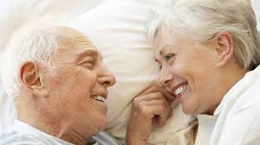
Objectives
1. Understand a bit more about my academic & clinical interests in aging and sexuality (not unusual to find that…odd)
2. Explain how connections between thoughts, feelings, and behaviors– and the stories you tell yourself– influence aging & sexual functioning
3. Discuss current scholarship on interpersonal, intergenerational, and volunteer relationships in later life and their health benefits
4. Contextualize late life sexual challenges and provide recommendations for OAs & providers

Slide 5
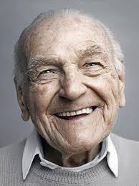
Overview
A millennial talks sex after 60 – how did she get here?
Relationships broadly defined
With self
With others
Aging & the relationship with the self
Successful aging, sexuality & CBT
Aging & relationships with others
Friendships, intergenerational, and volunteer relationships : The state of the psychological science
Aging, sexuality & intimacy
Overview
Epidemiology
Biopsychosocial context
Implications & recommendations
Questions & discussion

Slide 6
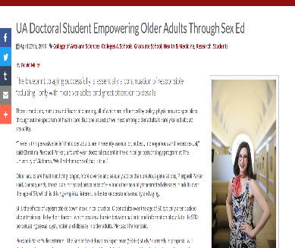
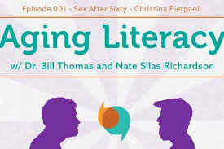
A millennial talks sex after 60- how did she get here?
Notes:
As an intergenerationally-oriented conference, we must also ask: “So, how exactly does at twenty-something get interested in aging, let alone sex and aging?” Fair question. I want to tell you a little bit about my journey for context and also highlight how we can leverage similar experiences to recruit more people into gerontologically- oriented vocations

Slide 7
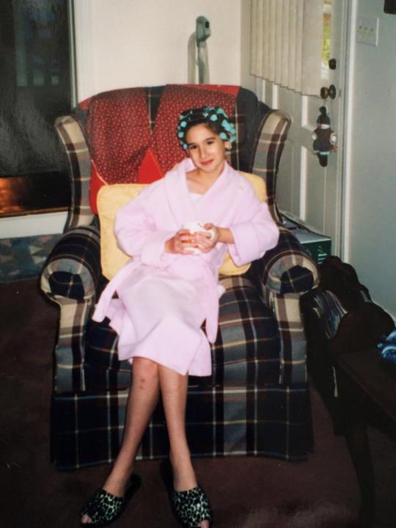
Notes:
The plan wasn’t to study aging. No – I was to be a lawyer. A lawyer until I realized that: (1) I didn’t have the moral fiber for lawyer-ing (and its inevitable politicking; sorry to any in the audience), and (2) that the market was already saturated with them
It’s clear to me, in retrospect, how non-academic factors largely cultivated my interest in aging– especially because gerontological coursework was woefully, blindingly– but not atypically– absent from my undergraduate psychology curriculum
I implicate my subjective age (how old you feel) in my strong and unmistakable attraction to the adult table. I am unapologetically old souled

Slide 8
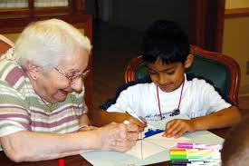
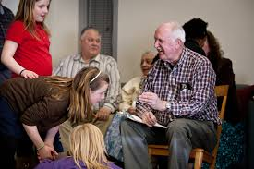
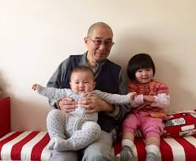
The contact hypothesis & intergenerational relationships
Contact hypothesis ¹
Allport, 1954: Under appropriate conditions, intergroup contact can effectively reduce prejudice, discrimination, and stereotyping between majority and minority group members
Notes:
In some ways, though, how old I feel reflects a deep allegiance to, solidarity with, and respect for older adults grounded in decades of positive, meaningful interactions with older adults
Allport’s contact hypothesis supports this, positing that, under appropriate conditions, interpersonal contact deconstructs stereotypes assigned to outgroups. It stands to reason, then, that having positive exposure to familial and non-familial older adults consistently predicts entering into gerontologically oriented vocations.
For me, this computers. My community, my parents, my grandparents, and mentors– all throughout development– have modeled the beauty, the complexity, and privilege of human aging
-this set sort of the “lens” through which I saw the world

Slide 9
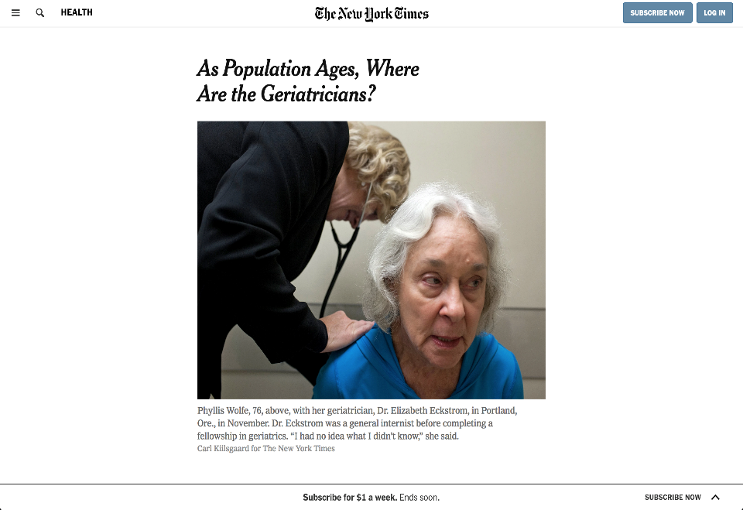
Notes:
Implications for developing programs and growing the gero community, particularly because consistent, positive exposure to older adults predicts entering gerontologically-oriented vocations and geriatrics is one of the few medical niches in US contracting even as need increases, with fewer and fewer residents pursuing it as a residency
Currently, the US has about 7,000 practicing geriatricians. To meet demands and opportunities, American Geriatrics Society estimates that medical schools would have to train at least 6,250 additional geriatricians between now and 2030 – 450 more annually than the current rate. How do we do that? Gerontologists must attempt to answer this question and I hope my journey provides some insight

Slide 10
Notes:
My intellectual interest in aging began in earnest during my undergraduate studies abroad in Urbino, a small, Italian town ensconced behind Renaissance-era walls and generously high hills. I noticed the many older adults who seemed to have little trouble walking up and down them daily—wondering how and why their fate differed so significantly from my grandparents’ (‘nonni’) whose struggles with advanced Alzheimer’s prevented them from even walking across the room. These observations kindled an already latent interest in understanding individual differences in aging and health processes as well as disentangling the biopsychosocial systems contributing to those differences.
When I returned to the States, I decided to declare my major in psychology and began volunteering on an interdisciplinary geriatric evaluation management team. The richness of this experience, combined with contact and old-soulness convinced me I wanted to be a part of a generation of scholars, clinicians, researchers, and advocates devoted to understanding a part of the human lifespan our own biology once precluded – particularly because we have nearly doubled the human lifespan in the 20th century

Slide 11
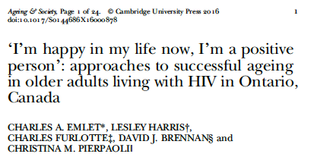
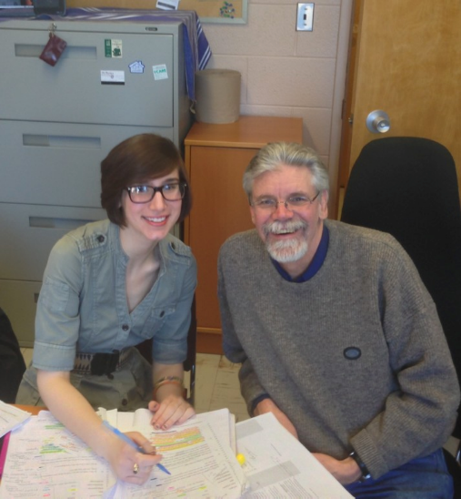
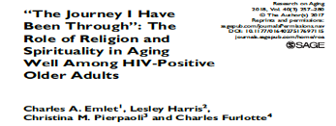
Me (left), my mentor Charles Emlet, PhD (right)
Notes:
As an undergraduate, I received a Killam Fellowship through the Fulbright program to study at the University of Toronto. There, I met Dr. Charles Emlet, a gerontologist researching the lived experiences of older adults aging successfully with HIV. As his mentee, I worked under his guidance to conduct semi-structured interviews with these adults and to hear their stories.
HIV as a chronic (vs. terminal disease) – an example of something we can study in ways we couldn’t before because our own biology precluded it. Got my interested in how and why older adults contracted HIV (“a young person’s disease”) and the “mechanics” of sexuality in later life. To understand how older adults get HIV, we need to understand sexual behavior and functioning.
Of course, for a host of reasons, few people doing the research. Other mentors like Barry McCarthy fostered these interests, which I then developed and leveraged to grow my research and professional platform (e.g. blog, podcast, this talk)

Slide 12
Intrapersonal (thoughts, feelings, behaviors, personal history, values)
Self
Other
Relationships
Notes:
Of course, work taught me a lot about sexual and intimate relationships but also about the relationship with self on which successful aging is predicted. Our relationship with self as a barometer for relationships (e.g. sexual, platonic, intergenerational) with othersr

Slide 13
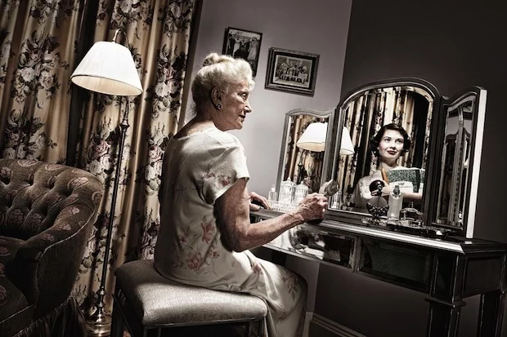
Relationship with the aging self

Slide 14
Strangers
Cose friends
intimates
Self
Acquaintances
Notes:
Many relationships in our life – but relationship with self establishes template/foundation for relationships with others. And as a health psychologist, I am always thinking about the individual – their experiences, their needs, their health behaviors
The individual as my primary level of analysis
Relationship with self as foundational– and certain basic conditions required to graduate onto other relationships
Intimate relationships – with family members, partners
Close friends – longtime friendships
Acquaintances – professional & mentorship relationships (perhaps where intergenerational relationships dwell)

Slide 15
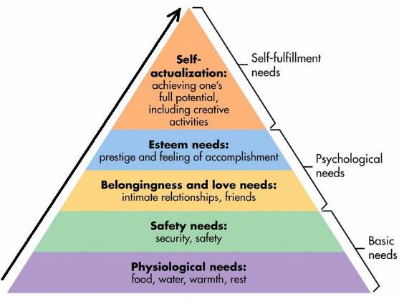
Strangers
Cose friends
intimates
Self
Acquaintances
Maslow, 1943
Notes:
The self as the most basic and fundamental relationship that first requires the most basic and fundamental things: homeostasis, food, water, sleep
Before we can even discuss other relationships in later life, we must discuss the relationship with the self and the basic needs fueling that relationship and others. Let’s start there. Models of successful aging useful in understanding how we can optimize aging process and health behaviors foundational to relationship with self

Slide 16
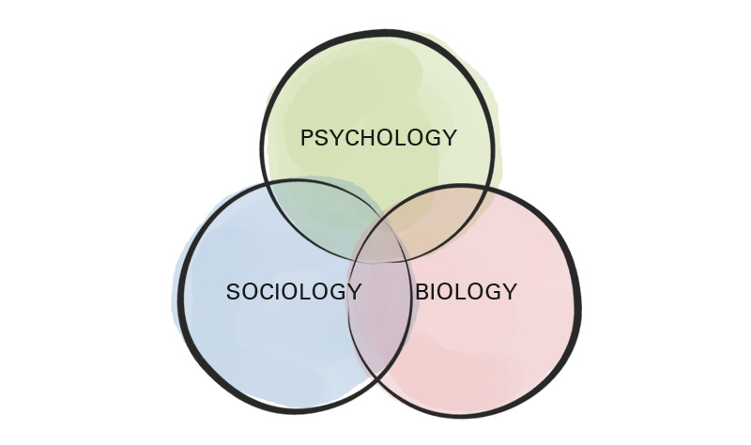
Engle, 1974
Notes:
These basic needs have biopsychosocial underpinnings

Slide 17
Aging as a continuum
Pathological
Normal
Successful
Low probability of pathology, high cognitive + physical capacity, life engagement
Lacking disease, but having many risk factors
High rates of disease + disability
Rowe & Kahn; 1987; 1997; 2002
Notes:
How these BPS intersect influence our aging process; aging as a continuum across combinations of the biopsychosocial factors
Over the last three decades– starting with Rowe & Kahn’s (1987) seminal article– modern gerontology has embraced a contiuum-based approach to evaluating aging, from successful, to normal, to pathological .Of course, some adults age pathologically, with high rates of disease and disability, most normally– lacking disease but having many risk factors– and many, successfully: having low probability of pathology, high cognitive and physical capacity, and active engagement with life
Considering individual difference variables (e.g. race, sex/gender, SES, personality) matters because it reveals the ratio of risk to protective factors used in determining how adults age. Over the last three decades— staring with Rowe & Kahn’s (1987) seminal article—modern gerontology has embraced a continuum-based approach to evaluating aging, ranging from successful, to normal, to pathological (Rowe & Kahn, 1997). Of course, adults vary: some age usually, lacking disease but having many risk factors; others pathologically with high rates of disease and disability; and many—increasingly— successfully: having low probability of pathology, high cognitive and physical capacity, and active engagement with life (Rowe & Kahn, 1997).

Slide 18
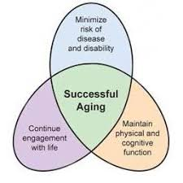
Successful aging
Psycho
Bio
Social
Notes:
While many have levied criticisms against successful aging– arguing that it neglects early developmental influences related to history and historical context, structural forces influencing later-life functioning, and well as long-term disease and disability processes, the SA model aimed to generate research on the biopsychosocial determinants of successful aging that would encourage people to make lifestyle choices maximizing their own likelihood of aging well and maintaining a high quality of life in old age (Kahn, 2002; pg. 726)
Successful aging compromised of physical, safety, and psychosocial needs

Slide 19
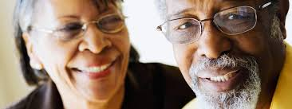
Sex & successful aging
Adults living longer and healthier lives, stimulating significant study of sexuality after 60. ⁵
Lindau et al. 2007
DeLamater et al. 2012
Brody et al., 2010
Contrary to ageist attitudes and beliefs, ² many adults remain sexual into later life, particularly if partnered and in good health ^{3,4}
Sex increasingly recognized as an indicator of successful aging & health, linked to ⁶:
Improved CVD health;
Improved QoL
Reduced depressive symptoms
Lower BMI
Notes:
1. (DeLamater, 2012)
2. Kaas 1981
3. Lindau et al.. 2007,
4. Karraker et al., 2011
5.. Ports et al., 2014

Slide 20
Inter-sex-tion
Disease & disability risk reduction
Maintained cognitive & physical functioning
Healthy sexuality & intimacy
Healthy aging
Life engagement
Notes:
Sexuality recognized as an increasingly important component of successful aging
The things that promote successful aging also promote safe, healthy, and satisfying sexuality –and provide foundations on which healthy relationships with self and other grow
Thus, promoting successful aging also promotes healthy sexuality, health sexuality also promotes successful aging

Slide 21
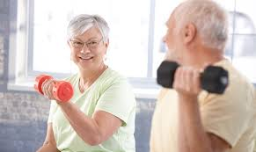
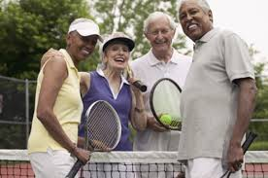
Sex as a “reward” for self-care & healthy living
Illness, medication, and surgery explain more variance in sexual dysfunction than aging alone ⁷
Thus, a commitment to self-care, health optimization & successful aging can promote sexual wellness, even in the face of disability and normal changes to the cardiovascular, endocrine, and nervous systems ⁸
What promotes health for the physical body– a whole-foods diet, adequate sleep, exercise, stress management, and social engagement– promotes health for the sexual body and brain, too ^{9,10}
Notes:
7. Nussbaum et al. 2005

Slide 22
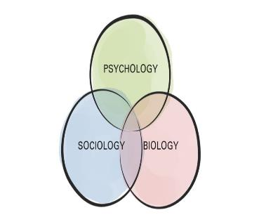
An trans-theoretical, integrative model of aging & sexual wellness
Strangers
Cose friends
intimates
Self
Acquaintances
Notes:
the self as the most basic relationship; the self has needs, these needs have biopsychosocial components, and these biopsychosocial components play into successful aging an sexuality alike; what is good for the aging self is good for the sexual self

Slide 23
Successful aging and healthy sexuality have large behavioral underpinnings ^{11,12} . Thoughts and feelings influence behaviors – as well as the stories we tell ourselves.
The relationship you have with yourself (+others, your health, sexuality etc) depends on the story you tell yourself about that person or thing
Notes:
In large part, the relationship you have with yourself depends on the story you tell yourself

Slide 24
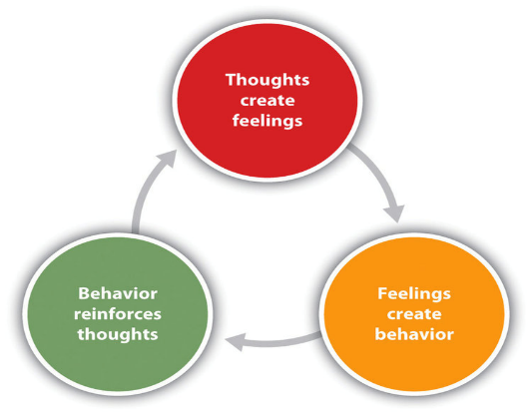
A cognitive-behavioral approach
Cognitive behavioral theorizing assumes that thoughts influence feelings and behaviors, and that thoughts, feelings, and behaviors have reciprocal and synergistic relationships
When we learn how to change unhelpful thoughts and behaviors, we can change feelings and attendant outcomes
Interrupt at cognitive level
Behavioral level
Notes:
Asking these questions because they influence our experience with disease
General overview of CBT – the idea that the way we process information influences how we feel and behave
In clinical psychology, CBT targets the reduction or elimination of dysfunctional thinking styles and behavioral patterns that maintain impairment

Slide 25
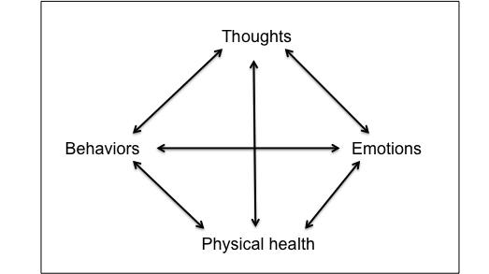
A cognitive-behavioral approach to healthy aging
“I will never lose weight. I am disgusting.”
Sad, defeated, hopeless
Emotional eating
Social withdrawal
Low physical activity
Weight gain, pain
Notes:
Given high rate of physical comorbidities and sexual dysfunction in later life, CBT model has been adapted to meet older adults’ unique needs

Slide 26
A cognitive-behavioral approach to healthy aging & sexuality
Context/ situation | Thought | Feeling | Behavior | Outcome
Sees body in underwear | “I am so old and ugly. Who would ever want to love or touch this?” | Sad, unattractive | Avoids physical touch & intimacy with partner | Pushes partner away; strains relationship
Partner loses erection during intercourse/experiences less firm erection | “I must be unattractive or a poor sexual partner. This is my fault.” | Guilty, embarrassed, shameful | Stops having intercourse | Partners begin avoiding sex; continue to see intercourse as performance and only form of sex
Has questions and concerns about vaginal discomfort during intercourse | “Good women shouldn’t do those things or ask their doctors questions like that. I should just keep my mouth shut and avoid the embarrassment” | Anxious, shameful, worried | Avoids asking and problem-solving with provider | Continues to experience painful, unpleasant sex. Pain worsens.
Internalized ageism (Levy, 2002; 2009)
Notes:
how might this play out in the context of aging, healthy, and sexuality?
-discuss role of internalized ageism: a form of in-group discrimination in which older adults marginalize and discriminate against other people, or themselves
Derived from Zusman’s (1966) Social Breakdown Syndrome, the Geriatric Sexuality Breakdown Syndrome (GSBS; Kaas, 1981) describes the psychosocial mechanisms through which adults internalize ageist messages impacting their sexuality. It assumes that sexual expression depends on several factors, including prevailing mores concerning sexual behavior, actual physical capacities, the individual’s past history of sexual response, and available partners. In later years, when relationships among these contributing factors change, so does sexual expression (Kaas, 1981). Because few healthy, sex positive models exist for older adults, many rely on ageist sociocultural cues about sexuality to orient their behavior (Kaas, 1981). These cues emerge from myths about the unnaturalness and amorality of late life sexuality, stemming from biological reductionist ideas about the fading procreate potential in later life coupled with visceral reaction to imaging parentialized/grandparentialized adults as asexual (Kaas, 1981). As with other modes of stereotyping, these cues color what older adults and their health providers perceive as “appropriate” within social parameters, fostering internalized ageism (Levy, 2009; Syme et al., 2018) stifling healthcare communication, and perpetuating sexual dysfunction (Weeks, 2002; Ports et al., 2014; Wimberly et al., 2006). A recent qualitative study of older adults, for example, revealed that many women experienced internalized ageism and endorsed sexist attitudes about their own sexuality (Syme et al., 2018).

Slide 27
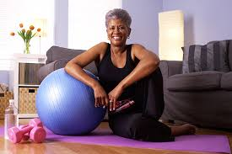
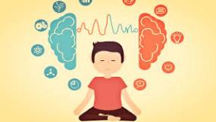
Functional, “whole-person”, cognitive-behavioral interventions for healthy aging & sexuality
Behavior
(things we do)
Cognition
(things we think)
Notes:
Here’s where those basic biopsychosocial needs come back

Slide 28
Back to basics
Notes:
Here’s where those basics come back

Slide 29
Basic behavioral interventions
Eating a whole foods diet
Overweight & obesity can cause diabetes, cardiovascular disease (CVD), and pain.
Diabetes & CVD are two known risk factors for erectile dysfunction.
Alcohol & tobacco use increase risk
Getting adequate sleep
Sleep takes out the brain’s trash, “resetting” us cognitively, emotionally, and physically
Too sleepy? Probably not having sex. More sleep = more energy to have sex
Engaging in exercise + movement
Cardiovascular training increases hippocampal density
Reduces pain, increases strength & stamina
Among women, yoga shown to increase blood flow to vaginal region, muscle tone, and reduce vaginal pain
Regulating mood & stress
High levels of negative affect can affect sexual functioning, including desire and arousal
Practicing mindfulness-based exercises, including deep breathing and progressive muscle relaxation, can help
Practicing assertive communication
Learning how to identify your (health/sexual) needs and communicate them clearly prevents & solves problems
Seeking information & knowledge
Knowledge about your health & sexuality empowers you to ask about your concern as well as understand your needs and options
Notes:
A commitment to health optimization and successful aging can also promote sexual wellness, even in the face of disability and normal changes to the cardiovascular, endocrine, and nervous systems (McCarthy & Pierpaoli, 2015). What promotes health for the physical body—a whole-foods diet, adequate sleep, exercise, adherence to medical recommendations, and stress management— promotes health for the sexual body and brain too (McCarthy & Pierpaoli, 2018; Ngandy et al., 2015).

Slide 30
Cognitive tools
Understand cognitive distortions
Increase awareness of unhelpful thoughts
Learn how to question, challenge, de-catastrophize & reframe
Examples: Are my thoughts accurate? Helpful? What could I say to myself that would be more accurate, positive, or helpful? What would I say to someone I love and respect?

Slide 31
Let’s practice
Context/ situation | Thought | Feeling | Behavior | Outcome
Sees body in underwear | “I am so old and ugly. Who would ever want to love or touch this.” | Sad, unattractive | Avoids physical touch & intimacy with partner | Pushes partner away; strains relationship
Context/ situation | Thought | Feeling | Behavior | Outcome
Sees body in underwear | “I am still worthy of love and affection even if I don’t look the way I’d like to right now. I can take steps to reach my physical goals” | Disappointed but motivated | Goes to the gym and walks on treadmill, kisses husband | Feels accomplished and connected; experiences intimacy
Notes:
Remember, changing thoughts or behavior can change feelings

Slide 32
Let’s practice
Context/ situation | Thought | Feeling | Behavior | Outcome
Has questions and concerns about vaginal discomfort during intercourse | “Good women shouldn’t do those things or ask their doctors questions like that. I should just keep my mouth shut and avoid the embarrassment” | Anxious, shameful, worried | Avoids asking and problem-solving with provider | Continues to experience painful, unpleasant sex. Pain worsens.
Context/ situation | Behavior | Thought | Feeling | Outcome
Has questions and concerns about vaginal discomfort during intercourse | Learns how to assertively and confidently discuss her concerns | “I know it feels uncomfortable to ask but sexuality is a health issue like anything else. A competent provider will honor and respect my questions without judgment” | Empowered, informed, confident, proud | Learns about using silicone (vs. water-based) lubricants; experiences painless intercourse
Notes:
Note that you can change

Slide 33
Let’s practice
Context/ situation | Thought | Feeling | Behavior | Outcome
Partner loses erection during intercourse/experiences less firm erection | “I must be unattractive or a poor sexual partner. This is my fault.” | Guilty, embarrassed, shameful | Stops having intercourse | Partners begin avoiding sex; continue to see intercourse as only “real” form of it
Context/ situation | Thought | Feeling | Behavior | Outcome
Partner loses erection during intercourse/experiences less firm erection | “Sometimes this happens, and there are all sorts of reasons for it that have nothing to do with me. What else is on the menu?” | Curious, hopeful, secure | Embraces an erotic, non-intercourse scenario | Arousal and pleasure that may nor may not flow to intercourse
Notes:
Note that you can change

Slide 34
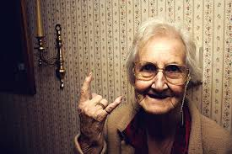
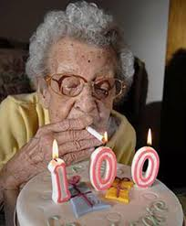
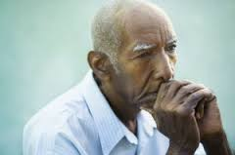
Summary
Successful aging, sexual functioning, and interpersonal relationships are all predicated on the health of & relationship to the self
Complex biopsychosocial factors underlie all of these constructs & their attendant health behaviors
Thoughts and feelings influences behaviors; all three have reciprocal & synergistic relationships
Cognitive-behavioral interventions can enhance the aging process & sexual functioning

Slide 35
Friendships & Intergenerational relationships

Slide 36
“A useless life is an early death.”
-Johann Wolfgang von Goethe
Notes:
Before I begin the presentation proper, I wanted to introduce this quote --- because I think it well encapsulates the theme of today’s presentation
-Johann Wolfgang van Goethe (Gu-ten): German writer and statesman

Slide 37
Relationships with others
Notes:
Recall that belongingness and life engagement represent important features of basic human need and successful aging, respectively

Slide 38
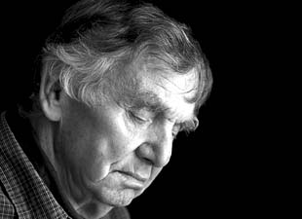
Conventional caregiving roles
(Gruenewald, Karlamangla, Greendale, Singer, & Seeman ,2007)
Commercially productive roles
(Herzog, Kahn, Morgan, Jackson & Antonucci, 1989)
Physical disability (Parmelee et al., 2007)
Notes:
However, challenges inherent to aging alter the nature, degree, and extent of an individual’s social engagement. Notwithstanding macro-level advances in medicine, public health, and culture that have significantly increased the quality and length of life, late adulthood represents a period of the life span largely divorced from conventional caregiving and commercially productive roles

Slide 39
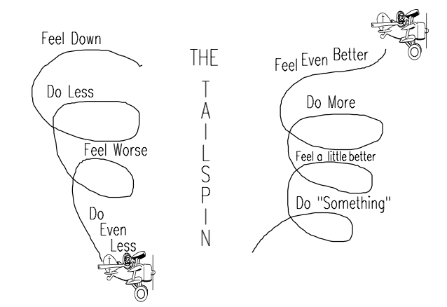
Behavioral activation (BA)
Clinical tool used to increase engagement in reinforcing, mood-boosting activities
When we feel sad, depressed, or lonely we sometimes avoid and isolate, which can worsen symptoms
Notes:
Predicated on activity theory & behavioral activation theories – that successful aging occurs when older adults stay active and maintain social interactions, and that behavioral activation maintains positive mood
Once you have made space, you can start getting busy in the way you’d like to!
BA = based on the idea that as individuals become depressed, they tend to engage in increasing avoidance and isolation, which serves to maintain or worsen symptoms

Slide 40
Downward Spiral
The downward spiral
Illustration on left shows that “giving in to the “slowed down” feeling that comes with negative mood (e.g. sadness, loneliness) can perpetuate a downward spiral
Do less → feel worse → do even less, etc.
Older adults particularly at risk as relationships and conventional social roles dwindle

Slide 41
Upward Spiral
The upward spiral
Illustration on right shows how a person can withdraw from a downward spiral
Engage in something meaningful→ feel a little better→ do more → feel even better
Notes:
We can induce upward spirals in providing socially meaningful opportunities for older adults

Slide 42
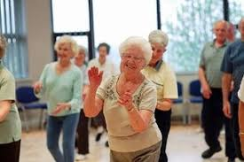
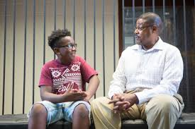
Perceived usefulness to others
We must remember that while opportunities for traditional role engagement decrease with age, older adults desire to remain active, useful, and generative ^{13,} ^{14,} ¹⁵
Activity, perceived usefulness, and generativity contribute to successful aging
Meaningful interpersonal relationships provide opportunities to cultivate such feelings
Notes:
A growing literature demonstrates that while opportunities for meaningful role engagement decrease, those decrements are not inherently preclusive to the desire to be and feel valued, useful, or generative in later life (Gruenewald et al., 2007; Erikson, 1968) and that feelings of usefulness may be protective against disability and premature mortality during this period (Kahana et al., 2013; Gruenewald et al., 2009; Glass, 1999)

Slide 43
Shifting the paradigm
Dependency-based gerontological theorizing
(older adults as consumers)
Contributory-based gerontological theorizing
(older adults as contributors & providers)
Notes:
This will require shifting the paradigm . To do this, we must embrace paradigm shifts toward older adults as contributors (vs. consumers) of social provision
Kahana et al. have argued that gerontological theorizing must move beyond a dependency-based paradigm of aging in which older adults are positioned as consumers of social provision and instead toward a contributory orientation in which they are competent providers of it (Kahana et al., 2007).
To do this, we must continue developing programs aimed at increasing perceived usefulness

Slide 44
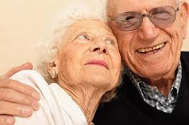
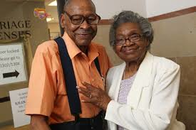
A growing, but nascent, literature:
Perceived usefulness to others in later life
Brown et al. (2003)
Providing instrumental support to friends + relatives was independently associated with reduced premature mortality beyond effects of receiving social support.
Gruenewald et al. (2007, 2009)
Found that older adults who reported feeling more vs. less useful to others were less likely to experience an increase in disability or to die over a 7-year follow-up period.
Pitkala et al., (2004)
Found prospective linkages between not feeling needed by others and greater risk of institutionalization and death in a sample of Finish older adults
Pierpaoli et al. (2015)
Feeling useful to others predicted active (vs. passive) coping with symptomatic OA knee pain
Notes:
The research on perceived usefulness is embryonic, but growing: the salubrious effects of receiving social support across the lifespan have been established (House et al., 1988) – but mounting evidence supports that the provision of support also yields health benefits (Brown et al., 2003; Krause et al., 1992)

Slide 45
Mechanisms & behavioral activation
Important to find volunteer opportunity that you can and want to do!
Perceived usefulness to others in later life
B
Volunteer
T
“Other people need me and appreciate my skills.”
F
Proud, energized,
happy
Reduced depression; fewer somatic symptoms (e.g. pain)
H
Upward spiral!
Notes:
Applied behavioral activation example
More research needed to understand mechanisms and causality. For example, feeling useful may preceded volunteerism, volunteerism may induce- we don’t know
But, doesn’t really matter because laws of behavioral activation stull at play

Slide 46
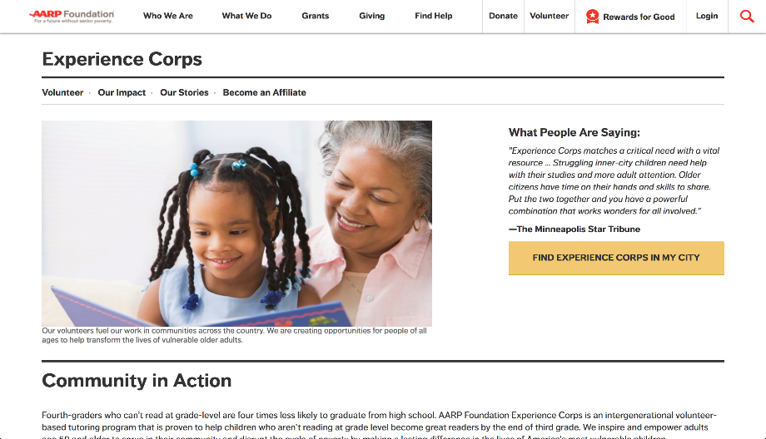
A case study of volunteering & intergenerational work: Experience Corps (EC)
https://www.aarp.org/experience-corps/
Notes:
AARP foundation experience corps: An intergenerational, volunteer-based tutoring program that engages adults 50 and older as literacy tutors for struggling students in public schools. The program empowers its volunteers to serve in their community and disrupt the cycle of poverty by making a lasting difference in the lives of vulnerable children

Slide 47
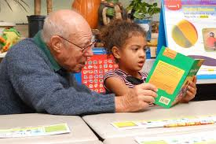
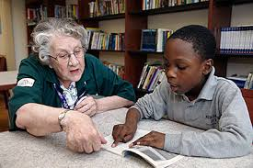
Experience Corps data
One year outcomes showed that EC volunteers increased physical strength, increase their social network, watched less TV, and showed less decline in walking speed ¹⁶
Trend toward improved cognitive functioning compared to waitlist controls ¹⁷
Improvements in depressive symptoms and functional limitations also noted after 2 years of service compared to matched comparison group ¹⁸
Notes:
https://academic-oup-com.libdata.lib.ua.edu/psychsocgerontology/article/65B/4/461/623052

Slide 48
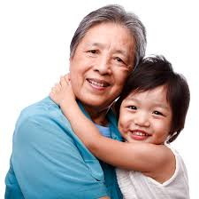
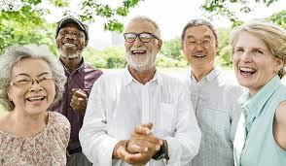
Implications
Volunteering as a valid RX from health providers
We need more research
Current literature provides compelling evidence that volunteering produces higher levels of well-being but program development cannot proceed without more specific information about what types of programs produce what kinds of effects– under what circumstances ¹⁶
Embracing social networking & tele-health models to enlarge reach & impact particularly for PWD ¹⁹
Notes:
https://academic-oup-com.libdata.lib.ua.edu/psychsocgerontology/article/65B/4/461/623052
Teleheleaht interventions for rural =dwelling and disabled older adults

Slide 49
A note on social media
Retirement, relocation, death, and disability may shrink size of, and access to, social networks
To compensate, many older adults have turned to social networking and, increasingly, online dating to satisfy needs for companionship, intimacy, and sexuality²⁰

Slide 50
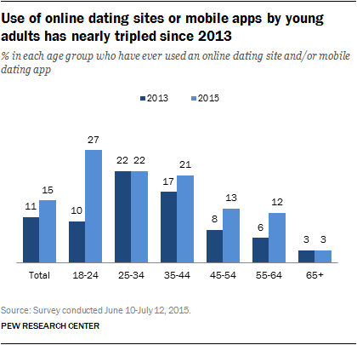
Data highlights
Reflecting this growth, as of 2014, 56% of people 65+ used Facebook ²¹
Since 2013, online dating rates among OAs aged 55-64 have nearly doubled from 6 percent to 12 percent, triggering the dawn of new dating sites with minimum age requirements.

Slide 51
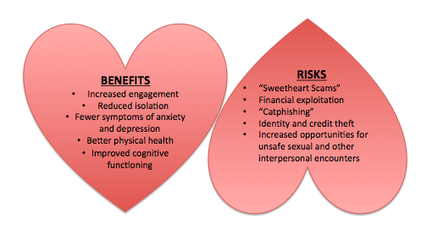
A geropsychologist’s love/hate relationship with social media
Harley & Fitzpatrick, 2009; Jung, Walden, Johnson, & Sundar, 2017; Hogeboom et al., 2010; Leiber, 2018
Notes:
Online social networking has benefits for older adults. Gerontological scholars have suggested older adults turn to the Internet to enhance social interaction (Harley & Fitzpatrick, 2009; Jung, Walden, Johnson, & Sundar, 2017) and, for many, it helps. Online engagement among older adults appears to increase perceived closeness to family and friends as well as reduce self-reported depression and stress (Hogeboom et al., 2010).
Online pursuit of romance and intimacy also has its costs. A climate of internet-facilitated dating in later life has introduced more opportunities for unsafe sex, sexually transmitted disease (STDs), and general exploitation among vulnerable older adults (Pierpaoli Parker, in progress). Non-exhaustive examples of this exploitation include financial scamming, identityand credit theft, and “sweetheart scams” or catphishing—the luring of someone into a relationship using a fictional persona for manipulative and exploitive purposes. The cost of online scamming alone exceeds $37 billion to older adults annually (Leiber 2018).
In the digital “golden” age, what role do psychologists have in managing these risks and benefits? How can psychologists respect older adults’ autonomy and promote their social and emotional wellbeing, while maintaining a commitment to do no harm?

Slide 52
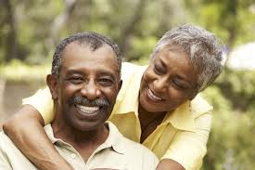
Summary
Social engagement contributes to successful aging
Notwithstanding changes to social networks with age, OAs maintain desire to stay active & engaged
Volunteer programs may confer health benefits to OAs but require more research to understand mechanisms and conditions
Embracing social media as a promising tool to facilitate engagement that requires ethical evaluation
For example, when and how should we go about reporting harm? Do we have a duty to consider capacity in deciding whether or not to introduce online engagement? Is that fair? How do we measure capacity to engage online?

Slide 53
Resources
Experience Corps
Silver Sneakers Program

Slide 54
Sexual & intimate relationships
Sexual & intimate relationships
Notes:
file:///Users/Christina_Pierpaoli/Desktop/united%20way.png

Slide 55
“In a nursing home, it doesn’t happen like ‘wham bam thank you ma’am.”
-Gayle Doll, director of Center on Aging at KSU, as quoted by the NYT
“Aging baby boomers are going to want to have sex, and they don’t want to play bingo.”
-Dr. Ann Christine Frankowski, associate director of the Center for Aging Studies at UMBC, as quoted by the NYT
Source: http://www.nytimes.com/2015/04/14/health/sex-dementia-and-a-husband-henry-rayhons-on-trial-at-age-78.html?partner=rss&emc=rss&smid=fb-nytimes&bicmst=1409232722000&bicmet=1419773522000&smtyp=aut&bicmp=AD&bicmlukp=WT.mc_id&_r=0
Notes:
Aging and sexuality is an important thing, per recent NYT article re: sex in the context of dementia

Slide 56
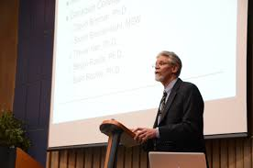
What other experts have to say:
“It is easier and significantly more comfortable for us to imagine older adults as asexual, heterosexual, or at best– monogamous. But science tells us that this just isn’t the case.” -Charles Emlet, Ph.D.
“The United States are much less pro-aging and pro-sex than other countries. The message sent to older adults is: ‘You’re not supposed to be sexual– sex is for the young, not you. For most people, it is embarrassing to think about people over 60 being sexual. But with aging, the many features of sex actually appear to improve ” – Barry McCarthy, Ph.D.

Slide 57
Sex & aging: An overview
Adults living longer and healthier lives, stimulating significant study of sexuality after 60.²²
Lindau et al. 2007
DeLamater et al. 2012
Brody et al., 2010
Contrary to ageist attitudes and beliefs, ²³ many adults remain sexual into later life, particularly if partnered and in good health ^{24, 25} though expression of that sexuality may change ²⁶
Notes:
1. (DeLamater, 2012)
2. Kaas 1981
3. Lindau et al.. 2007,
4. Karraker et al., 2011
5.. Ports et al., 2014

Slide 58
Notes:
Among the little research available on sex in later life, it appears that older adults are anything but retired from sex

Slide 59
Sex & aging: An overview
Seminal findings from National Social Life, Health, and Aging Project (NSHAP) reveal ²⁷:
Prevalence of sex declines
But OAs continue to engage in intercourse, oral sex, and masturbation into 8th and 9th decades of life
E.g.: 54% of oldest respondents reported having sex 2-3x monthly
Notes:
Sex increasingly recognized as an indicator of successful aging & health, linked to⁵:
Improved CVD health;
Improved QoL
Reduced depressive symptoms
Lower BMI

Slide 60
Sex & intimacy
Cross-cultural studies ²⁸ find that couples continue to seek & value intimacy throughout their 60s into their late adulthood
For some, aging represents an exciting, leisurely time to explore new dimensions of sexuality, modes of partnership, and forms of intimacy ²⁹
Many find that simple things– like hugging, kissing, touching, and simply spending time together– can feel more satisfying in later life than ever before ³⁰

Slide 61
The Fine Wine approach to sex and aging:
Sex not only appears to continue into the third act, but– like a a fine wine—it also appears to evolve in its complexity, flavor, and very constitution with age.

Slide 62
Socio-emotional selectivity theory may explain why
Notes:
As older adults’ time horizons decrease, their social goals shift from being knowledge-related to emotion-related. Thus, older adults become more selective about their social networks and place a higher value on emotional satisfaction, often spending more time with familiar individuals with whom they have rewarding relationships
-also hone social networks so that available social partners satisfy emotional needs
Other reasons:
We care less as time horizons decrease
We know about ourselves and our preferences
Our partners and their preferences
Less body image issues
Feeling like partners need each other

Slide 63
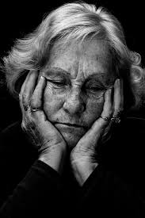
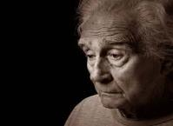
The rise of STDs in later life
OAs account for an increasing— and unprecedented—proportion of sexually transmitted diseases in the U.S. ^{31,32}
Between 2010 and 2014, the CDC³³ reports that adults 65+ saw:
A nearly 52% increase in chlamydia infections;
65% rise in syphilis; and
Most strikingly, adults over 50 account for:
17% of new HIV infections ³⁴
Roughly 50% of all existing HIV diagnosis in the U.S.
By 2020, rates will exceed 70% ³⁵
Notes:
Nowithstanding benefits, OAs account for an unprecedented proportion of sexually transmitted diseases in the United States
5. Ports et al., 2014
6. CDC, 2016
7. Emlet et al., 2017

Slide 64
Why? Epidemiological dynamics
Long-term survival with infection
(treatment advances)
Increased incidence of STIs among adults 50+
+
Notes:
The literature offers two explanations for these data. First, treatment advances, such as those in antiretroviral therapy (e.g. highly active antiretroviral therapy [HAART]), have transformed HIV from a terminal disease to a chronic condition that can be managed successfully (Kirk & Goetz, 2009; Porter et al., 2017), permitting seropositive adults to achieve life expectancies similar to those of their uninfected counterparts (Nightengale et al., 2015), inflating prevalence (CDC, 2017; Emlet et al., 2017). Second, the number of new infections (incidence) among older adults continues to increase.

Slide 65
Attitudes, knowledge, behavior
Ageism, ableism, stigma
Aging, disease
Engle, 1974
Notes:
These basic needs have biopsychosocial underpinnings

Slide 66
Biological
Aging itself leads to increased susceptibility to contracting sexually transmitted diseases¹⁰
Psychological
OAs engage in behaviors that increase their risk for infection ¹⁰
Sociocultural
Stereotypes and biases about aging and sexuality trickle down into clinical practice¹⁵
Systemic reductions in testosterone & estrogen
Reduced lubrication
Thinning anal & vaginal mucosae (tears)
Depressed immune responsiveness
Lowest rate of condom use among all age groups ¹¹
Underestimate risk & lack knowledge ¹²
Cohort differences related to recreational sex & drug use
Menopause & pro-erection medications ¹³
Shift patterns of divorce and dating ¹⁴
Physicians appear to underestimate prevalence of OA’s sexual concerns ¹⁶
Suboptimal sexual history taking & provider discomfort ¹⁷
Limited provider education¹⁸
Few men (38%) and even fewer women (22%) in a nationally-representative sample had discussed sex with a physician since age 50
Notes:
10. Gott 2005
11. National Survey of Health and Behavior, 2010
12. Syme et al., 2017
DeLamater, 2012
13. Fileborn et al., 2015
14. Sears-Roberts et al., 2011
15. Ports et al., 2014
16 Loeb et al., 2011
17. Ports et al., 2014
18. Gott et al., 2005
Recommendations and spikes in rates of late life infections notwithstanding, Lindau et al (2007) found that few men (38%) and even fewer women (22%) had discussed sex with a physician since age 50, consistent with findings describing an inverse relationships between increasing age and documented sexual history (Ports et al., 2014; Loeb et al., 2011).

Slide 67
Psychosexual education
Sex researchers & educators have long pointed to the positive contributions of sex education to healthy sexual attitudes and behaviors³⁶ , but comprehensive, evidence-based interventions tailored to older adults’ remain limited:
Hammond et al. (1971)/White & Catania (1982): Educating providers increased permissive attitudes toward aging & sexuality
Falvo & Norman (2004): OAs acquired & retained HIV/AIDS knowledge at 3- month intervention f/up
Loeb et al., (2010): Improved sexual history taking among residents receiving a brief educational intervention about late life sexuality
Illa et al. (2010): Secondary prevention intervention reduced sexual risk behaviors among HIV positive older adults
Bauer et al. (2013): Residential care nurses showed increased knowledge of and permissiveness toward late life sexuality after education program

Slide 68
Statement of problem
No study to date has designed, implemented, and evaluated a sex education program tailored to the needs of healthy older adults. Available models:
1
Place disproportionate emphasis on educating providers rather than older adults
2
Focus on improving sexual knowledge vs. sexual functioning and communication
3
Lack information from OAs’ lived experiences and expressed sexual health needs
Notes:
Existing literature highlights the need for further investigation. Unprecedented spikes in the prevalence of late-life STD/Is notwithstanding, no study to date has designed, implemented, and evaluated a sex education program tailored to the unique needs of older adults. Available studies— while encouraging— place disproportionate emphasis on educating providers rather than older adults themselves. Models in their current form therefore bypass a large and important feature of the problem, while also recapitulating narratives of older adults as passive, ineffective sexual agents. Other shortcomings of current studies include their focus on measuring descriptive versus inferential outcomes (e.g. sexual knowledge versus behavior), inexplicit HIV prevention education, and use of top-down rather than bottom-up approaches to educational content creation.

Slide 69
Senior Sex Education Experience (SEXEE)study
Aim 1
Develop a needs and evidence-based adult sex education pilot intervention
Aim 2
Implement intervention
Aim 3
Evaluate the feasibility and effectiveness of intervention for improving:
Sexual functioning (arousal, desire, satisfaction)
Sexual risk behavior
Sexual self-efficacy & communication
Sexual attitudes & knowledge

Slide 70
A three-pronged approach to study aims
Focus groups + semi-structured interviews with OAs + providers
Phase I
Program development+ implementation
Phase 2
Program Evaluation
Phase 3

Slide 71
Program evaluation & analyses
Post-intervention
Pre-intervention
More sexual knowledge
Fewer dysfunctional sexual attitudes
Less high risk behavior
Higher sexual self-efficacy & communication
Less sexual knowledge
More dysfunctional sexual attitudes
More high risk behavior
Lower sexual self-efficacy & communication
+ process measures (quality, feasibility, recommendations)
Notes:
Pre post measures on outcomes, with additional exploratory, inferential analyses (e.g. how certain health variables predict sexual functioning)
Adapted working alliance inventory to measure process?

Slide 72
Limitations + anticipated challenges
Lack of control group; heartening findings require cautious interpretation
Lack of randomization & self-selection bias. Qualitative differences in participants vs. non-participants
Social desirability/underreporting
Recruitment & attrition
Notes:
Recruitment = emphasize again good working relationships and connections with community in Tuscaloosa & Bham; idea of 12 per group as guidelines not necessarily hard and fast rule
Attrition= best efforts to reduce participant burden and increase convenience; will send reminders and use other media to keep participants engaged

Slide 73
Discussion + implications
Among the first evidence + needs-based psychosexual interventions tailored to older adults
Pilot in advance of a randomized control trial as part of a larger, subsequent research program
Aim to standardize + monetize protocol for application in medical settings using a stepped approach
Psychologists → personnel→ patients→ peers

Slide 74
In the meantime, providers and OAs alike must work together (and separately) to manage sexual challenges & risks with aging

Slide 75
Opportunities for providers
Recognize power & bias
Marry clinical competence with humility
Integrate assessment
Embrace interdisciplinary approaches & sex positivity

Slide 76
Recognize power & bias
A good first step starts with recognizing, inventorying, and challenging implicit or explicit biases about aging, sexuality, and disability
A second step, acknowledging the power they have to significantly enhance or subvert PWDs’ sexual quality of life (QoL) through discussing sexual functioning. ³⁷
patients appear more likely to report issues with sexual functioning if and when their healthcare provider prompts them ³⁸

Slide 77
Marry clinical competence with humility
Learn to see the individual as the expert of his or her own life, symptoms, strengths, and symptoms
While the practitioner indeed holds a body of knowledge that the patient does not, the individual also has understanding beyond the provider’s scope
Embrace postures of openness and “common humanity” ³⁹ to muster up good faith efforts to ask questions—humbly, curiously, kindly, and non-judgmentally— when youdo not know, albeit inside or outside the context of sexual wellness

Slide 78
Integrate assessment
Using standardized approaches to assessment (e.g. during comprehensive intakes and follow ups) can help to normalize and de-stigmatize sexual health as an acceptable part of holistic, whole-person, primary care among older PWD
Using assessments (e.g. ASKAS) may also help to scaffold training efforts for new or uncomfortable providers & facilitates evidence-based treatment planning
Notes:
ASKAS, PLISSIT model

Slide 79
Embrace interdisciplinary approaches & sex positivity
In isolation, most physicians lack the knowledge, comfort, or time to address sexual health issues. To meet the challenges of enhancing sexual wellness with aging, providers and PWD alike can use an interdisciplinary approach
Psychologists, physical therapists, urologists, gynecologists)
Providers may also advocate for the sexual citizenship of older PWD in these settings through creating “sex positive” spaces that include posters, educational pamphlets, fact sheets, condoms and other resources that explicitly and implicitly affirm their sexuality
Notes:
ASKAS, PLISSIT model

Slide 80
Opportunities for OAs
Understand & manage sexual risk
Maintain whole-person health
Develop psychosexual flexibility
Read up & speak up

Slide 81
Understand & manage sexual risk
For OAs especially, a good first step starts with understanding their vulnerability to sexual risk.
A second involves managing risks relative to potential harm, such as through gaining knowledge and/or changing behavior
Will differ for each person, depending on sex, gender, orientation, relationship status, disease status, values, preferences
Develop familiarity with available screening and treatment resources and leverage knowledge (e.g. Medicare part B reimbursements for yearly testing among at risk persons)
Notes:
Of course, these steps will differ for each person, depending on sex, gender, orientation, relationship status, values, preferences, and a catalogue of other individual differences too innumerable to list here (CITATION). For PWD in monogamous, long-term, committed relationships—for example—this may look like using silicone -based lubricants for lubrication and preventing secondary infections of anus or vagina (McBride et al., 2010;Yu & Rao, 2014). For single and dating PWD, like negotiating condom use, consent, and relationship expectations among one or many current partner— and for persons living with or at risk for STDs— undergoing routine testing and behavioral counseling.

Slide 82
Maintain whole-person health
What promotes health for the physical body—a whole-foods diet, adequate sleep, exercise, adherence to medical recommendations, and stress management— promotes health for the sexual body and brain too
Managing diabetes
Quitting smoking/reducing ETOH
CVD & resistance training
Regulating mood
Values work to integrate sexual self with spiritual self, particularly among LGBTQ+ OAs

Slide 83
Develop psychosexual flexibility
Perceiving sex only as intercourse and as an individual “orgasm” performance has especially harmful implications for older PWD whose changing cardiovascular, endocrine, and nervous systems can alter sexual response
Embracing the full range of non-intercourse based, asynchronous sexual scenarios—can relieve PWD of these sexual anxieties, increase sexual self-efficacy, and help to enlarge their sexual repertoires
Some of these scenarios may include mutual masturbation, oral sex, petting, erotic massage, “outercourse” and deep kissing
Notes:
Esther Perel, esteemed sex and couples therapist, said it best when she said that when it comes to sex and sexuality, “many instruments play in this orchestra—the lips, the tongue, the hands, the fingers”
Using masturbation & fantasy
We should note that cohort differences may color PWD attitudes toward masturbation and fantasy, which carry a myriad of historical myths associated with sin, illness, and immaturity (Coleman, 1999; Robinson, Bockting, Rosser, Miner, & Coleman, 2002). However, normalizing and encouraging masturbation can enhance sexual wellness and promote a realistic appreciation of its importance in safer sex for PWD (Robinson, Bockting, Rosser, Miner, & Coleman, 2002). Further , encouraging masturbation as a normal adjunct to partnered sex – or seeing it as an exercise of “sex” itself—can help older PWD to decrease anxiety, better understand their bodies, sexual needs, and preferences, as well broaden definitions of sexuality (Robinson, Bockting, Rosser, Miner, & Coleman, 2002; McCarthy & Pierpaoli, 2015).
Validating intimacy
Finally, intimacy represents a universal need across the lifespan, and as such, represents a critical area in promoting sexual wellness for older PWD. Cross-cultural studies of couples in five countries—Brazil, Germany, Japan, Spain, and the United States—for example, demonstrate that couples continue to seek and value intimacy throughout their 60s into their late adulthood (Heiman et al., 2011). For some, aging represents an exciting, leisurely time to explore new dimensions of their sexuality, modes of partnership, and forms of intimacy (Berdychevsky & Nimrod, 2015). Many find that simple things—like hugging, kissing, touching, and simply spending time together—can feel more satisfying in later life than ever before, (McCarthy & Pierpaoli, 2015) or more satisfying than sex itself. Consistent with socioemotional selectivity (Carstensen ,1992), these observations suggest that shrinking time horizons can motivate older PWD to cast aside sexual inhibitions and more mindfully savor their closest, and most intimate relationships. Older adults must therefore empower themselves, each other, and providers to accept intimate behaviors as legitimate, meaningful forms of sexual expression and wellness.
Note about different age friendly toys and products?

Slide 84
Read up & speak up
Few men (38%) and even fewer women (22%) in a nationally-representative sample had discussed sex with a physician since age 50, consistent with findings describing an inverse relationship between increase age and documented sexual history ⁴⁰
Healthcare providers may underestimate the prevalence of their older patients’ sexual concerns
Prevailing interpretations of these observations suggest that provider attitudes and beliefs about late life sex may stem from stereotypes of aging and sexuality, rather than from experiences with, or explicit education about, late-life sexuality

Slide 85
Summary
Oas consider sexuality and intimacy important parts of life, and remain sexual into their 8th and 9th decades
However, OAs account for an increasing and unprecedented proportion of STDs in later life, including HIV
The reasons for, and solutions to this have biopsychosocial features that OAs & health care providers alike can manage

Slide 86
Notes:
Conclusion & Implications for sex education curricula
While interventions for PWD should provide education about sexual health and risk behaviors—and empowerment to seek information (Ports et al., 2014)— we argue that successful curricula will also promote positive sexuality, psychosexual flexibility, and “whole-person” lifestyle intervention. Didactically and clinically, sex positive approaches to enhancing sexual wellness for PWD will include clear, humble communication, appropriate experimentation with intercourse and non-intercourse scenarios, affirming sensuality and intimacy, attaining sexual competence (e.g. ability to give and receive pleasure), setting sexual boundaries based on preferences, values, and safety (Robinson et al., 1994; Rosser and Bockting, 1994; Bockting and Forberg, 1998), and promoting healthy aging. Teaching dating (online, in-person), relationship, and communication skills will also help PWD to improve self-efficacy in negotiating safer sex and expressing sexual needs, questions, and concerns to partners and providers alike. The eventual development of peer-based sexual wellness programs (Pierpaoli Parker, 2018) may also improve ongoing PWD empowerment and sexual citizenship efforts. Above all, programs and providers will honor individual agency and differences in the pursuit of sexual wellness, emphasizing that one size does not fit all (Peterson, 2017).

Slide 87
Thank you!
+
Questions
Notes:
Feasibility
Sample size?
Recruitment?
Other measures? (E.g. internalized ageism?)
Cutoff scores appropriate?

