Slide 1
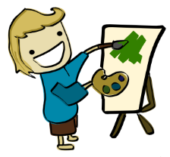
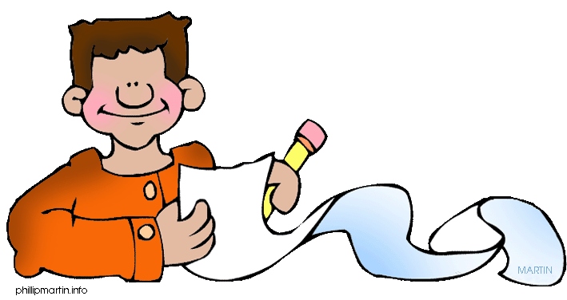
Paint, Write, Dance and for your Life
Loretta R. Konecki, Ph.D.
koneckil@gvsu.edu
Feb. 22, 2019
Art and Science of Aging Conference
Grand Valley State University

Slide 2
LEARNING OBJECTIVES/OUTCOMES
Upon completion of this workshop attendees will be able to:
Describe the role creativity has in supporting a quality of life in older adults.
Identify health and social benefits of creative activities for older adults.
Carry out possible creative activities with older adults.

Slide 3
ABSTRACT
Participating in creative activities such as drawing, painting, crocheting, writing poetry, writing life stories or novels, dancing, and making things have been found to promote higher levels of cognitive functioning, lower rates of limitations to daily physical functioning, and lower rates of hypertension.
This session will provide participants with an opportunity to do a few creative activities, as well as, hear a personal story of how creative activities have aided one retiree to maintain a positive quality of life.

Slide 4
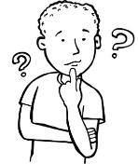
Retirement Considerations
Finances—Will I have sufficient money in retirement?
Housing—Where will I live in retirement?
Health—Will I be able to meet my medical needs?
Social—Will I interact with family and friends?
Emotional—Will I have a support network?
Giving—Can I make a difference?
Creative—Will I enjoy and participate in cultural and creative activities?
Life--Will I have a reason to get up in the morning?

Slide 5
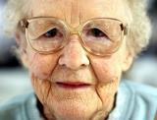
Why Cultural and Creative Activities for Elders?
“Evidence suggests that stimulating creativity in elders at all levels of functioning improves health outcomes…Fostering creative expression through cognitive exercise and imagination among those in later years may forestall dementias, improve quality of life for elders and their caregivers, and meet unmet personal and societal needs.”
Sierpina M. and Cole TR. Stimulating creativity in all elders: A continuum of interventions. Care Management Journals. 2004 Sep;5(3):175-181.

Slide 6
2005 White House Conference on Aging : Increase awareness of the positive physical and psychological impact that arts participation can have on older Americans.
Research suggests that active participation in the arts and learning promotes physical health, enhances a sense of well being among older Americans, improves quality of life for those who are ill, and reduces the risk factors that lead to the need for long-term care.
Even though there is an interest and participation in the arts by many older Americans, there is a general lack of awareness in the public, healthcare, and social services communities about the positive physical and psychological impacts of arts participation.

Slide 7
National Endowment for the Arts. (2015). The Summit on Creativity and Aging In America. A report from The Summit on Creativity and Aging in America in collaboration with the 2015 White House Conference on Aging held May 18th 2015 at the National Endowment for the Arts

Slide 8
Research Research Video Resultshttps://www.youtube.com/watch?v=inTDrDax9pQ
“…those who participate in such [creative] programs experience better overall health and quality of life.”
Cohen, G. D. (2006). Research on creativity and aging: The positive impact of the arts on health and illness, Generations, 30, 7-15.
“…results point to powerful positive intervention effects of these community-based are programs run by professional artists. They point to true health promotion and disease prevention effects. In that they also show stabilization and actual increase in community-based activities in general among those in the cultural programs, they reveal a positive impact on maintaining independence and on reducing dependency. This latter point demonstrates that these community based cultural programs for older adults appear to be reducing risk factors that drive the need for long-term care.”
Cohen, G. D. & The Center on Aging, Health & Humanities, The George Washington University, (2006). The Creativity and Aging Study: The Impact of Professionally Conducted Cultural Programs on Older Adults. Retrieved from https://hsre.himmefarb.gwu.edu/son_neafactpugs/2
Statistically significant findings regarding arts participants:
Better health
Fewer doctor visits
Less medication usage
Increased activities and social engagement
Hanna, G., & Perlstein, S. (2008). Creativity matters: Arts and aging in America. monograph, Americans for the Arts.

Slide 9
Creativity may help maintain Brain Health
https://brainhealth.nia.nih.gov

Slide 10
Research on Older Artists
…older artists are role models for successful aging. They stay engaged in community life, retain their social networks, and continue to work professionally. Moreover, artists find great meaning and purpose in life.”
Jeffri, J. (2015). Art cart: Saving the legacy. Organizing. Culture. Change, 3(1).
“…just when the last real chances of living and loving are fading. Here artistic creation serves old age as a substitute for what has been lost: …[these] stimulate the artist to reproduce objects to which his feelings can be directed. This ability to transfer the emotion invested in real objects to creations of the imagination is one of the best compensating mechanisms that art has to offer to someone who is growing old.”
Antonini , F. M. & Magnolfi, S., (2013) Creativity and aging. Institute of Gerontology and Geriatrics, University of Florence, Italy, Opening Lecture. Online: 28 December 2013.

Slide 11
Programs that Promote Creativity
Educational Programs promoting lifelong learning through arts—often in conjunction with higher education and arts organizations offered by OLLI, Grand Forum, Calvin College, Grand Rapids Art Museum, Meijer Gardens, GR Ballet, Opera, Symphony
Community Building Programs promoting social and civic engagement through participation in arts programs held in recreation centers, Gilda's Club, Senior Neighbors, Kent District Library
Healthcare Programs promoting art/music/movement-therapy at home, in healthcare and rehabilitation facilities and some hospitals.

Slide 12
Be Open to Creative Pursuits Creative Time Is Not Wasted Time
5 Tips to Help You Keep the Creative Spirit Healthy
Less television-Television is a time thief and stifles creativity. Avoid it as much as you can.
Make something -Make it a point to create things, whether it be through art, baking, sewing or restoring a classic motorbike. Whatever makes you eager to get out of bed works.
Look for new challenges-From trying the daily crossword to new hobbies, these activities keep the mind busy with positive thinking. Then ideas happen. Life gets interesting.
Stay healthy-Healthy body makes a healthy mind. So make sure you take care of yourself, including appropriate exercise.
Share your creative pursuits and results
Malcolm Dewey's Suggestions

Slide 13
Creative Activities Can Reduce Stress and Help Your Brain
Brain Health Video https://brainhealth.nia.nih.gov/engage-your-brain/discover-a-new-talent

Slide 14
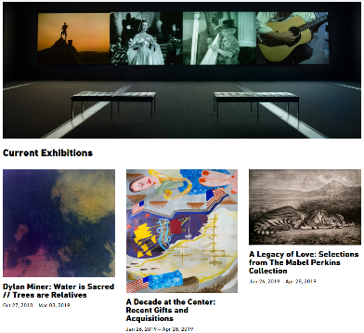
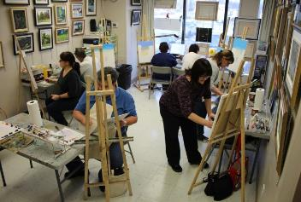
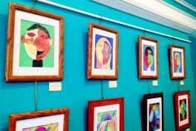
Group and Individual Art Activities Can Promote Creative Involvement
Visits to Art
Museums
Fairs
Studios
Classes in
Drawing
Painting
Sculpture
Ceramics
Zentangle
WATERCOLORS | AGE: 18/UP Learn techniques in watercolor and how to control it to create beautiful works of art. Step by step instruction is offered while implementing your own unique twist. Please see receipt for supply list. Location: Community Center Room 103Instructor: Deborah Bell We 4/10-5/22 10:00AM-12:00PM
R$106 NR$126
Grand Rapids Art Museum

Slide 15
Let’s Start a Guided Painting of Tulips Instructions for Painting a Tulip
Numerous lessons for guiding painting are available online in places such as Pinterest.
Draw a Tulip
This "How to Draw a Tulip” illustrates how well crayons and watercolor go together.
It’s also a great example of a wet-on-wet watercolor technique that can create lovely multi-colored flowers.
MATERIALS
Watercolor paper
Black marker
Crayons
Liquid watercolor paint
DIRECTIONS
Draw the tulips on watercolor paper with a pencil
Trace the drawing with the black marker or pen.
Add crayon lines in the flower and on leaves. The goal is to have enough contrast to see them, but that they don’t stand out too much either. Just some added texture. Use similar colors to the planned paint, but just a shade different. For example, yellow and pink in the flowers, and light green in the leaves
Paint with liquid watercolor paint.
To make the pretty multi-colored flowers, try what is called the “wet-on-wet” technique. Possibly paint the top half of one flower red and before it dries, paint the bottom half purple. Allow the overlapped color to just kind of seep into each other. It’s a great way to blend colors, and one of the things that watercolors do best.
https://www.pinterest.com/pin/127226758195970412/

Slide 16
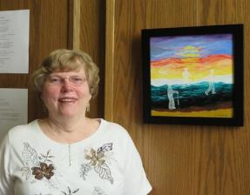
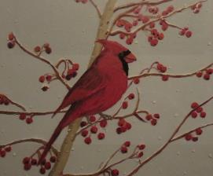
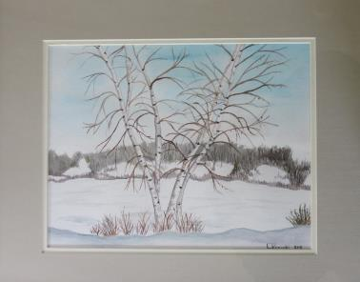
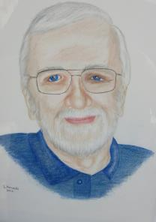
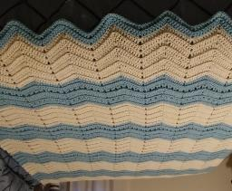
Some of My Arts and Craft Activities Elders Enjoy Participating in Art Too
Painting
Drawing
Crocheting
Quilting
Sewing
Art is a Form of Therapy

Slide 17
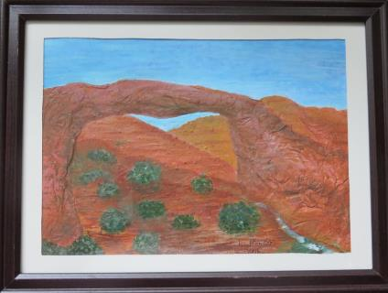
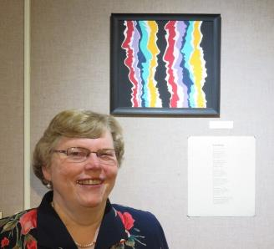
Paint & Write
Natural Bridges, By Loretta Konecki,, May 2016
What stories your layers can tell of
Minerals formed in the big bang,
Shells and sediment deposited in vast oceans,
Sands blown into desert dunes by howling storms,
Ooze teaming with one-celled life,
Hardening magma from volcanic eruptions,
Shifting tectonic plates forcing mesas into mountains,
Water recycling in rain, rushing streams, and lakes,
Evolving plants, animals, dinosaurs, and humans,
All leaving their remnants behind in rocks,
Imprints, petrified remains, and pictographs
Compressed into your colored layers.
You stimulate our imagination and understanding of history.
Your form was and still is shaped by
Turbulent water rushing to form rivers,
Winds sanding the sides of layered rock,
Freezing and thawing chipping away at stone,
Tiny roots pushing their way into cracks to form soil.
Throughout these constant changes
You have kept your link with the other side of the stream.
You remind us that, like you, we have been formed by earth’s history.
The iron that tints your red layers colors our blood,
The water that falls on your rocks provides turgidity to our cells,
The oxygen formed by plant photosynthesis is exchanged in our lungs,
You remind us that connections are crucial.
Physical links are important but not enough.
Our life roles link us with others as
Children, siblings, spouse, parents, relatives, colleagues, neighbors, friends and acquaintances.
Our beliefs link us with social action, religion, and politics.
Our education links us with knowledge, fiction and reality.
Our smiles, frowns and gestures link us with people we do not know.
Our soul links us through caring, empathy, sympathy, friendship, warmth, generosity and love.
We choose to make these linkages.
They transform us through our actions and reactions.
They imprint themselves on our thoughts and memories.
They make us who we are as natural bridges in the world.

Slide 18
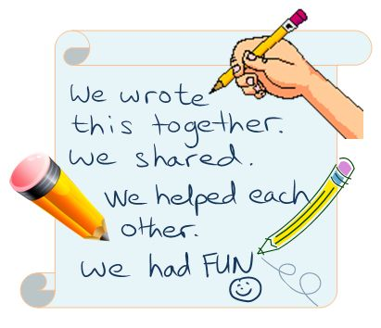
WRITE
Could Writing Improve Seniors' Health
https://www.interimhealthcare.com/education-center/news-media/news-desk/could-writing-about-life-improve-seniors-health/

Slide 19
Let’s Make a Book

Slide 20
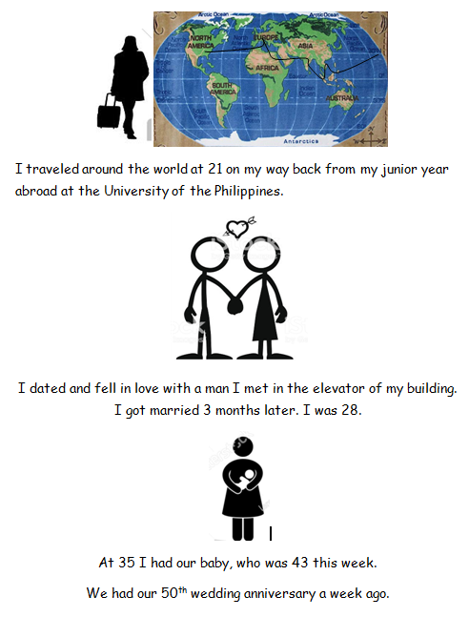
Write and Illustrate Your Story

Slide 21
Write a Guided Poem
On your paper, please write words that come to your mind in the following in order.
Line 1
Emotion of childhood
Activity of childhood
Line 2
Emotion of teen years
Descriptive Adjective
Activity of teen years
Line 3
Emotion of early adulthood
Event of early adulthood
Line 4
Description of your existence
MY LIFE
Happy swinging,
Lonely friendly dating,
Satisfying work,
Together, on my own.

Slide 22
Write the Next Paragraph in My Novel
It has been a horrendous few months. Leo, my husband of nearly 32 years, died of colon cancer on Easter morning after a long and difficult year. It was expected. He could not have chosen a worse day to die. I had plans for Easter and Leo knew it. So, after calling the funeral home, I continued with my plans for church and dinner at the club. After all, he was dead. What could I do but carry on?
Kaye, L. (2017). Flowers for Laurel
Stop! DON'T SHOOT!
I woke myself up with my screams and labored breathing. My dream had me running through the woods with a woman I didn't recognize. Men were chasing us. They were yelling, ‘Give it to us.’ I don't know what they wanted. I woke as shots were fired.
Kaye, L. (2019). Making a Difference
“Mom, guess what. Mike asked me out on a date tomorrow night before he flies back to Stanford and I go to U. of M. I don’t think it’s one of those friend things or hang out things. I think it’s a real date.
Kaye, L. (2018). Priscilla and Thomas.
I woke up to light flickering in my eyes. Where was I? This wasn’t my bed.
Kaye, L. (2018). Wait and See.
“Thomas, remember when Oko had his biology professor come over to the bar to meet me? Well, he’s been coming almost every day. We talk about brewing beer and making wine. It reminds me about all of the conversations I had with Dad George before I took over from him and became the manager and brew master here at the High Brow Brews and Music--Ann Arbor. I must admit that I enjoy our conversations while I’m behind the bar and Gary sits opposite me to keep me company.
Kaye, L. (2018). Carrie
I was more excited than usual about going to church with Joe Fiske and his parents. I couldn’t wait to tell my parents what a fantastic time Joe and I had at the country music concert in Lansing the night before. I was supposed to meet my parents at church and they would take me back to our farm from there.
Kaye, L. (2018). Finding Jean
If you want to read one of my novels, send me your email and I’ll send you a PDF.

Slide 23
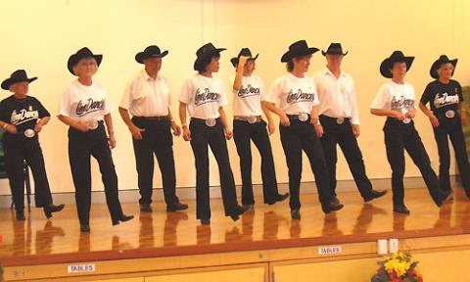
DANCE
Everyday Waltzes for Active Aging in Sparks! Arts for Wellness Toolkit, Singapore

Slide 24
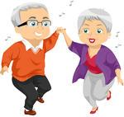
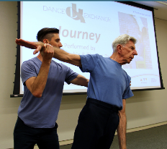
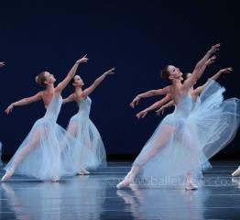
Group and Individual Dance Activities that Promote Creative Involvement
Dance Classes
Participating in Dances
Exercise should start with a warm up Warm Up Before Dancing
Attending Concerts
Ballet
Modern Dance
Ballroom Dance
Journey by Dance Exchange dancers

Slide 25
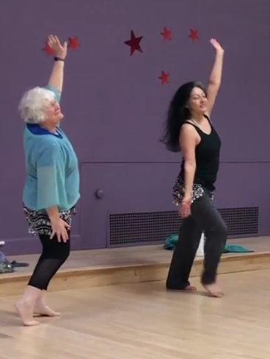
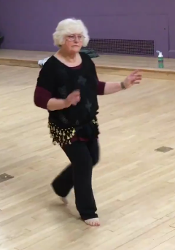
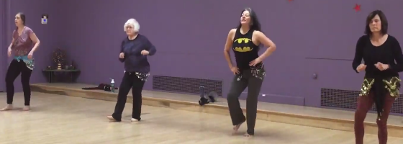
Priscilla Dancing
Intergenerational dancing is fun.
It provides you with exercise that can extend your health & enjoyment of life.
Priscilla says she isn’t good but is enjoying it.
Dancing with Laura Armenta
Year Old on Britton's Got Talent
https://www.youtube.com/watch?v=WU58NrR16nU

Slide 26
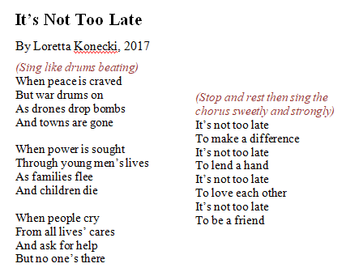
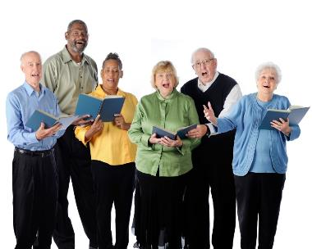
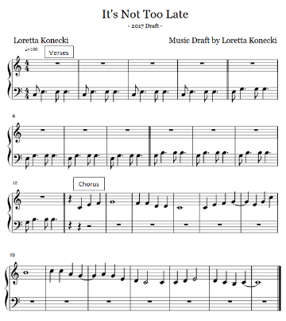
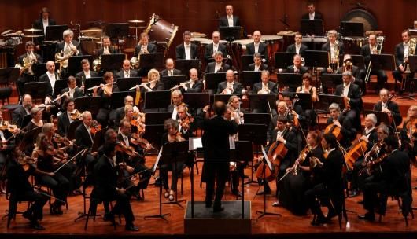
MUSIC
Senior Citizens Choir in New Zealand
Singing for the Brain

Slide 27
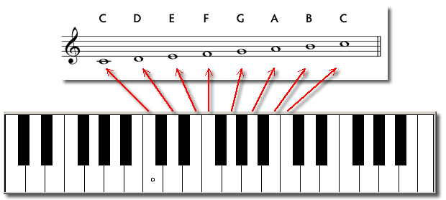
Group and Individual Music Activities that Promote Creative Involvement
Sing: Fix You
Learning new songs
Practicing songs
Singing in the shower
Learning to play an instrument
Practicing instruments
Learning how to write music
Writing songs or music
Singing in Choirs or Groups
Playing in Bands, Orchestras, or small groups
Attending Concerts
Listening to Music
Music Opportunities in Residential Settings:
Musical performances
Sing alongs
Sing alongs for dementia clients
Resident choirs or concerts
Places to practice music
Music instruction
Be Your Own Music Therapist: Create a Personal Power Playlist

Slide 28
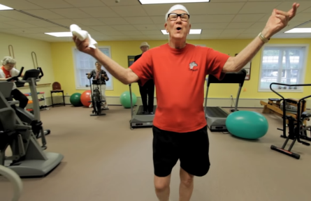
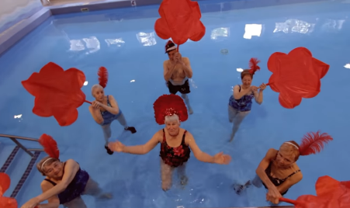
Clark Lip Dub
GVSU Lip Dub with Clark Home Residents in Grand Rapids
Can You Do It?

Slide 29
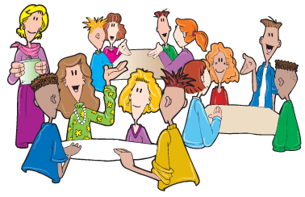
How can you promote cultural and creative activities?
Think—about creative activities can you foster with your clients or yourself?
Pair—with a person nearby
Share—your ideas with each other
Thank you

Slide 30
Research Bibliography…a beginning
Antonini , F. M. & Magnolfi, S., (2013) Creativity and aging. Institute of Gerontology and Geriatrics, University of Florence, Italy, Opening Lecture. Online: 28 December 2013
Cohen, G. D. (2006). Research on creativity and aging: The positive impact of the arts on health and illness, Generations, 30, 7-15.
Cohen, G. D. & The Center on Aging, Health & Humanities, The George Washington University, (2006). The Creativity and Aging Study: The Impact of Professionally Conducted Cultural Programs on Older Adults. Retrieved from https://hsre.himmefarb.gwu.edu/son_neafactpugs/2
Cohen, G. (2009) New theories and research findings on the positive influence of music and art on health with ageing, Arts & Health, 1:1, 48-62.
Fraser, K.D., O'Rourke, H.M., Wiens, H., Lai, J., Howell, C., & Brett-MacLean, P .(2015). A scoping review of research on the arts, aging, and quality of life, The Gerontologist, 55(4), 719-729.
Hanna, G.P., Noelker, L.S., & Bienvenu, B. (2015). The arts, health, and aging in America: 2005-2015, The Gerontologist, 55 (2), 271-277.
Hanna, G. & Perlstein, S. (2008). Creativity matters: Arts and aging in America. monograph, Americans for the Arts.
Jeffri, J. (2015). Art cart: Saving the legacy. Organizing. Culture. Change, 3(1).
Lindauer, M. S. (2009) Creativity in aging artists: Contributions from the humanities to the psychology of old age. Published online: 02 Nov 2009, 211-231
Mundell, K. (2015). Creativity and Aging. Maine Policy Review , 24(2),76 -79, https://digitalcommons.library.umaine.edu/mpr/vol24/iss2/18.
National Endowment for the Arts (2013). The Arts and Aging - Building the Science. https://www.arts.gov/publications/arts-and-aging-building-science.
National Endowment for the Arts. (2015). The Summit on Creativity and Aging In America. A report from The Summit on Creativity and Aging in America in collaboration with the 2015 White House Conference on Aging held May 18th 2015 at the National Endowment for the Arts
Rajan, K. B., & Rajan, R. S. (2017). Staying engaged: Health patterns of older Americans who participate in the arts. National Endowment for the Arts.
Sierpina, M. & Cole, T. R. (2004). Stimulating Creativity in All Elders: A Continuum of Interventions. Care Management Journals, 5 (3}, 175.
The Sparks! Art for Wellness Toolkit, (2018). Agency for Integrated Care and the National Arts Council. Singapore.

