Slide 1
Lisa Ellens
Advocacy Coordinator
Area Agency on Aging of Western Michigan
Marenta Klinger
Director of Masterpiece Living
Holland Home
Notes:
MARENTA:
Marenta’s Introduction – I graduated twice from GVSU - once with a bachelors in sociology/aging and adult life, and then again with a masters in health administration with a LTC focus. My background has been primarily in aging, long term care. Experience as an ombudsman in 25 local nursing homes. This allowed me to see both those who had ‘lived well’ and those who for one reason or another, had not. It was a stark contrast between the two. This experience has influenced my interest in successful aging research and what it means to live well – at ANY age! Serve on several aging related committees, including one with Lisa, which has only furthered my interest in the topic.
(Lisa’s introduction.)
We’re not here to personally tell you how to age successfully. This presentation is completely research base
What we CAN do, it present/provide some of the research, tools, and resources such as these books here that we utilize that have helped to shape the culture of our community to one in which people WANT to live well and can succeed in doing so.
So what does this look like? What does it mean to live well?

Slide 2
Notes:
MARENTA:
How many of you want to age successfully? Kind of a dumb question, right?
So if we all want to age successfully – we know exercise is good for us, we know getting enough sleep is good for us, we hear it on TV, read the articles in the paper… so why aren’t we doing them? Making them a part of our lifestyles and routines? We join the gym…
What does mindful (successful) aging look like to you?
Part of the World Health Organization defines Active Aging as “allows people to realize their potential for physical, social and mental well-being throughout the life course and to participate in society, while providing them with adequate protection, security and care when they need it…
Dictionary.com has all those numbered definitions and if you read long enough to get to number 13, it actually says aging = to grow!
being engaged in life, to the fullest extent possible
-potential
-growth
-active
-engaged
Now these are all words that could be used to describe a high school student as well. We are NEVER done growing, fulfilling our goals. As C.S. Lewis says there on the screen…
2

Slide 3
Increased Longevity
Traditional Aging in America
Culture of Youth + Ageism
The Research Story
Putting Research into Action
Ten Tips to Age Well
Notes:
MARENTA:
We have a lot to cover today –
The research story – how that research came to be
Putting research into action – bringing that research to life
Today, we’re going to share some of the resources (such as these books and others)
we’re going to look at the research done on successful aging
the findings that came out of that research
and ultimately how we can apply that research to our lives in order to live well = ten tips to age successfully which come out of LLDS.
3

Slide 4
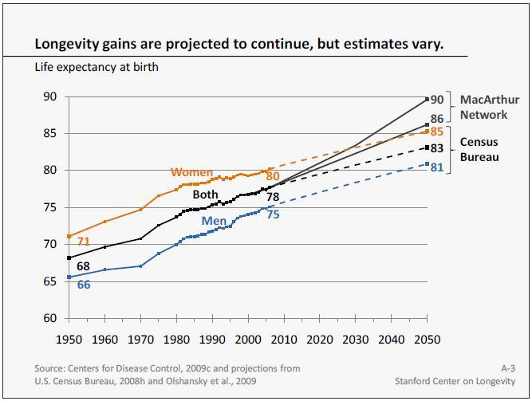
Notes:
LISA:
This isn’t new information for you. We know this. But it sets the foundation for the research that has been on successful aging -
Taking a step back to the late 1800’s, aging was not a pretty picture in the US. Aging was a new “problem” with a life-expectancy of 49 years old. People just didn’t live long. They weren’t equipped to do so.
Life expectancy at the end of the nineteenth century in the United States was still approximately age 49, but these discoveries, which provided safe water, infection-reduced surgery and childbirth, vaccines, and eventually, in 1928, penicillin, began to increase longevity dramatically. In fact, in the twentieth century alone, lifespan increased more than it had since the Bronze Age – it increased by 30 years!
As you can see…
Americans are living longer and healthier lives. According to the U.S. Census Bureau, a child born today can expect to live 78 years; by 2050 life expectancy at birth is projected to be 83; some estimate the number will be even higher. MF takes different factors into account, which you will hear about in the research findings.
At the same time that people are living longer, they are also enjoying lower rates of disability and poverty than previous generations.
Today, we live longer than our ancestors of any era. We’re able to travel anywhere on the globe and even into space! We produce and transport any commodity needed: food, cars, electronics, and clothes. We rarely die of infectious disease, and can replace hearts, kidneys, shoulders, knees, and hips. Yes, we have come a long way from our humble roots as a species.
4

Slide 5
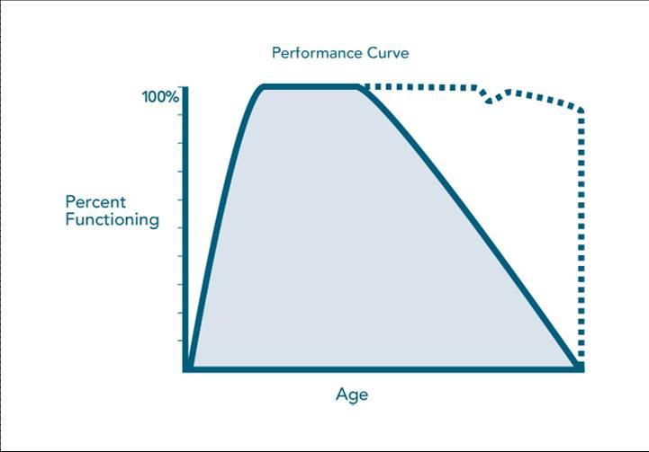
Notes:
LISA:
I’m sure many of you are familiar with this societal view of aging - the steady growth and increased potential until about age 30-35 and then a slow steady decline and death...
Traditionally, this is how we have viewed the aging process.
You all JUST said that you wished to age in a good way… so there has to be a better way than a slide with a painful ending… we will get to this in a moment.
5

Slide 6
Notes:
LISA:
6

Slide 7
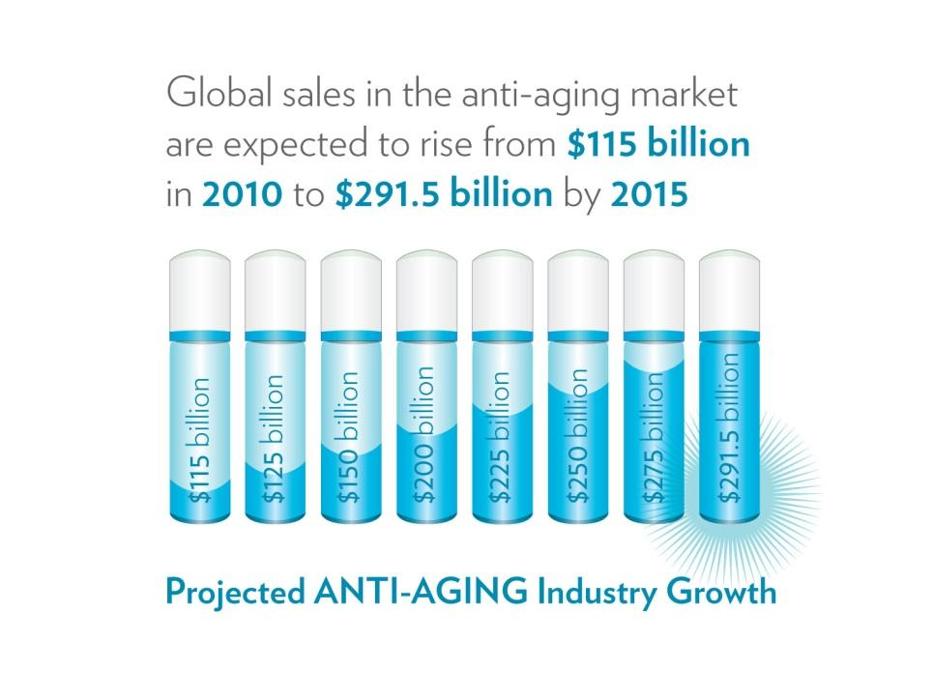
Notes:
LISA:
We are a society obsessed with youth. We think of older adults as broken versions of younger adults and attempt to lump them all together.
But it’s no wonder we have held these stereotypes of aging for so long with a society and culture that have for so long focused on youth.
GRAPH: Anti aging industry is expected to rise…
Unfortunately, despite what the research tells us, this is still the view of aging (as evidenced by the global sales #s). Growth and potential and then slow and steady decline. We are a productivity based culture and therefore equate being retired as not being valuable.
The AAI wanting to take away your wrinkles is like stripping away your experiences.
How do you experience/are you experiencing the aging process? How do you feel the culture responds to you as you age?
“Aging is not ‘lost youth,’ but a new stage of opportunity and strength. It’s a different stage of life, and if you are going to pretend it’s youth, you are going to miss it. You are going to miss the surprises, the possibilities, and the evolution that we are just beginning to know about because there are no role models, no guideposts, and no signs.”
~ Betty Friedan (writer, American activist)
So while our society still buys into this perception, we have to choose not to. Why have we chosen to only focus on the decline?? Sounds like a pretty sad story so far, doesn’t it?
7

Slide 8
Notes:
LISA:
8

Slide 9
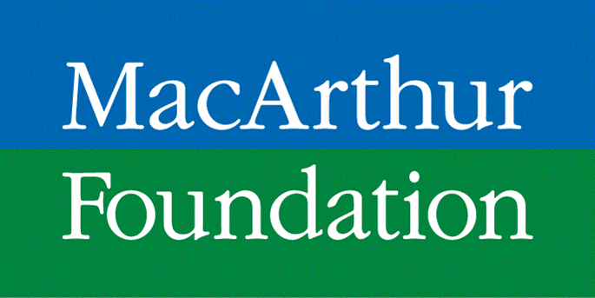
Notes:
MARENTA:
Why haven’t we studied what can go RIGHT with aging?
We’ve talked about how so much focus has been given to the stereotypical aging process, the decline, and all the negative things associated with it.
Thankfully, Jonas Salk, the discoverer of the polio vaccine, had an important question that challenged this view. He recognized that there were people who aged in a better way. Research up into the 80’s focused solely on all the things that can ‘go wrong’ with aging, but as a member of the MacArthur Foundation board, he challenged them to ask a new question: What can go RIGHT with aging?
Under the direction of Dr.’s Rowe and Kahn, they began a decade long study on those who stayed at high levels of performance for longer periods of time. What do those who are aging in a better way have in common??
The results of this research smashed the stereotypes of aging – In fact, it has been cited over 3100 times in other research and it began the transition towards looking at aging from a more positive perspective.
9

Slide 10
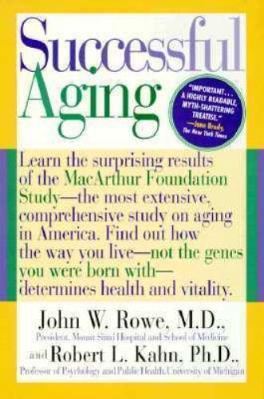
Putting the research into action
Lifestyle!
Notes:
MARENTA:
What they found through a year 10 study, culminated in the book Successful Aging, is there is a better way to age and that secret is lifestyle.
Quiz time: What percentage of the way we age is due to lifestyle style? Yes, 70%! We have the power to impact our successful aging journey.
Describe the GRAPH.
That decade long research study was all well and good on the pages of that book, but how could it be brought to the greater community? How could it be shared with others and be brought to life?
10

Slide 11
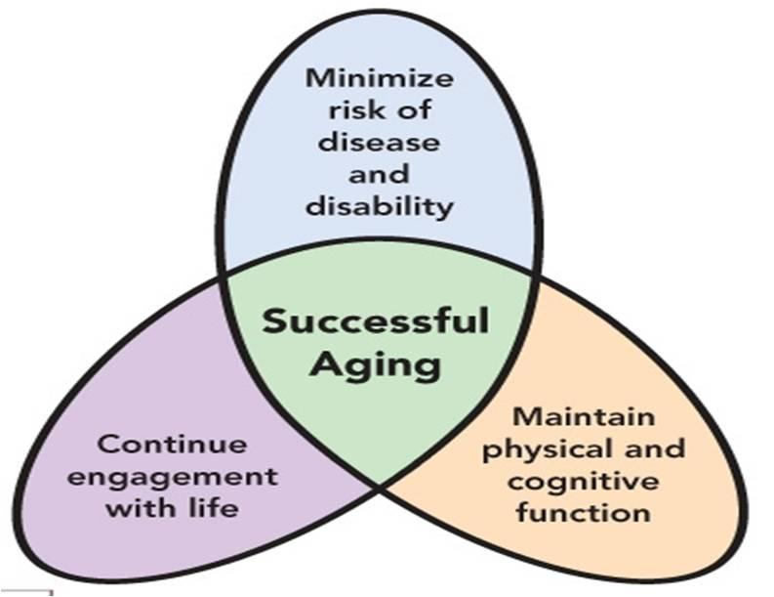
Notes:
MARENTA:
3 MAJOR OUTCOMES:
1. For so long we blamed our parents, our genes, for the way we were aging. These findings showed that genes don’t play as big of a part as we once thought. It’s our LIFESTYLE.
2. Whether you took the high road to aging (the dotted line) or the stereotypical aging path, was determined by your lifestyle – NOT by genes. 70% of the way we age is due to our lifestyle, the choices we make everyday. CHOICE comes into play.
3. Never too late to make a significant difference. You could even be down the path a way and start to make some minor lifestyle choices to… It’s never too late to improve your functional capacity.
Also 3 things in common with those that took the ‘higher road’. These characteristics define successful aging.
Maintain their physical and cognitive function:
They refuse to rust out. These older adults challenged themselves physically and intellectually as a matter of lifestyle. Rather than buy into the stereotype of aging as decline, these successful agers believe that by using their faculties they can at least maintain, and possibly expand, these abilities.
Minimize their risk of disease and disability:
They refuse to be victims, making great efforts to identify their risks for impairment, loss of independence, and even death and then doing all they can do to lower those risks. Reading, researching, and working with their physicians, they become educated seekers. Take Wayne for example. He has refused to let P’s define him or made that his identity. Has chosen to use P’s to make him a BETTER person!
3. Continued Engagement with Life:
These people were engaged. They refused to be placed on the bleachers of life. Traditionally, we have pasteurized our older adults. (like we do with horses!) Society meant well and believed this was a humane and caring thing. “Thanks for all you have done, now go retire.” The MA Foundation research shouted out that older adults must resist the isolation that is a destructive companion of growing old by remaining engaged! They had networks of friends and had meaning and purpose through something in their lives.
THIS is the formula for aging in a better way.
The path you take is up to you – it’s your choice!
11

Slide 12
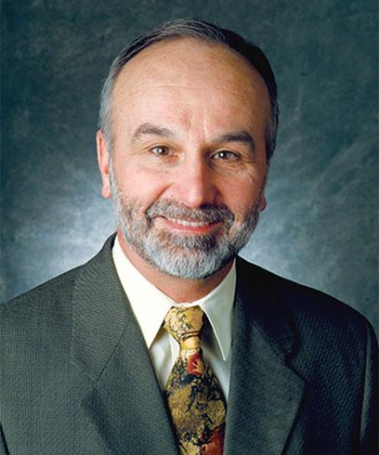
Notes:
MARENTA:
This is the book that helps us put the research into practice – the practical version
Dr. Roger’s aging like leaves metaphor (ended up inspiring the cover of this book): If Dr. Roger was going to write a prescription for aging in America, he might scribble, be leaflike. The directions, he says, go like this: “become more colorful with age, make more beauty than you can alone, and when your time comes, drop off the tree.” (seniorplanet.org article)
Dr. Roger spends a good portion of the first part of the book going through our human ancestry. We were once a society of hunter’s and gatherer’ although none of us were around to experience this ☺
12

Slide 13
Use it or Lose it
Keep Moving
Challenge Your Brain
Stay Connected
Lower your Risks
Never “Act Your Age”
Wherever You Are… Be There
Find Your Purpose
Have Children in Your Life
Laugh
Notes:
LISA:
These come from the second half of LLDS.
There are MANY lists like this out there (Billie Jean King recently published one as well), but they still boil down to being very similar.
Living as Hunter/Gatherer’s (even though our society has gone straight up, our human physiology is still quite the same. It has not advanced at the rate or level that society has):
The same characteristics that our ancestors who lived as hunter gatherer’s displayed are the same ones that our body’s crave today. Those are:
-Movement!!
-Quick Learning
-Strong social network
-All with a role
-Higher purpose
-Social compact
-Slower pace
-Food/Eating
-Close to nature
13

Slide 14
Notes:
LISA:
We sit to eat. We sit in our cars and drive to work. Many of us sit at work, peering into computer screens or talking on telephones. We spend long hours looking at screens: computers, iphones, televisions, GPS devices, games…
This applies to our physical bodies and our brains and we’re really not using either one.
Physical Bodies – remember the Apollo astronauts when they would come back from being in space? It was the first time astronauts went into space for any length of time. It happened at least twice where they would come back and have to be carried out on a stretcher. What was going on? This was the best of the best!
We know in space there is weightlessness. A flick of the finger would bring them across the room.The body doesn’t have to work at all. Muscle mass is lost, the bones lose calcium. The heart is a muscle – but in space, it takes a vacation.
On earth, we don’t have weightlessness, but we have created something VERY similar. And you are all doing it right now. Sitting. The body is at rest. Our muscles, our heart. They’re taking a break! This may be a cat in the picture, but it’s still very symbolic of our society today.
We can’t expect to use something if we don’t CONTINUE to use it and keep it up… it’s movement!!
14

Slide 15
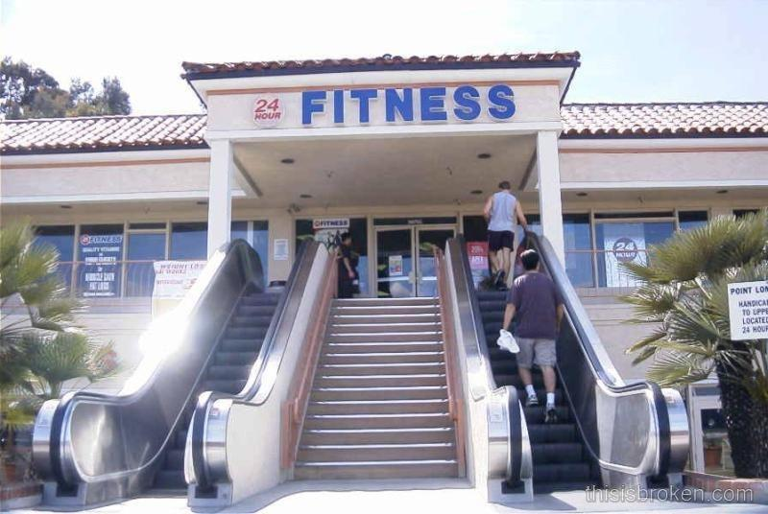
Notes:
LISA:
Our ancestors moved, when you were kids, you moved. Constantly. And you didn’t go to a gym to do it. Moving was their lifestyle.
You don’t have to be an Olympian to move. I absolutely hate running. Unfortunately. But that doesn’t mean that I shouldn’t be making an intentional effort to MOVE on a daily basis.
Dr. Landry writes in his book that movement is like Miracle-Gro for our brains.
Our sedentary lifestyle is killing us. The lifestyle choices we make to not move can be modified. Those choices, for the most part, are modifiable behaviors.
What if I told you you could decrease your likelihood of being afflicted with heart disease, dementia. Decrease your risk of developing cancer, diabetes, stroke. Decrease the likelihood of a fall, and if you did fall, a lower likelihood that you would break a bone.
What if I told you you could feel better, look better, have more energy to enjoy life. Sound good? What’s the catch right?
It’s movement. Simple as that. 30-45 minutes a day. That’s not a lot.
Keep moving! Just like our ancestors did. The risk of physical inactivity are so great. Incorporate movement into your lifestyle in order to live well.
15

Slide 16
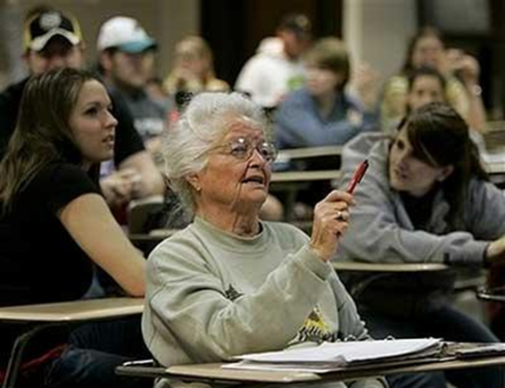
Nola Ochs, 95
Oldest person to be awarded an undergraduate degree.
Notes:
MARENTA:
Now Nola here knows that to the extent that you challenge the brain, it will respond!
She was the oldest person to get her bachelors degree at 95. If you can’t read it there it says I am not considering a master’s degree.
16

Slide 17
Nola Ochs, 98
Oldest person to be awarded Masters Degree.
Notes:
MARENTA:
And she got it. At age 98!
We are the architects of our brains.
We know now that our brains can continue to build new connections! Learning a new language, instrument. Even small things: eating with the opposite hand, putting pants on the opposite foot first (sit down), shaving – not with the opposite hand – start in a new place, put make up on, start somewhere else first! Healthy, getting out of your comfort zone, trying new things and learning new things.
Nun Study – had Alz brains in autopsy. But NO symptoms! Researchers were perplexed. Research shows that to the extent that we are physically active, blood to the brain challenging the brain by learning new things, we can – even if we have a gen predisposition to develop Alz. – can push the onset off! To later, and later, and later. To where these nuns it never showed up. did that. They died first!
A long-term study in Minnesota tracked the lifestyles and mental decline in a group of nuns. When they died, autopsies revealed some had Alzheimer’s brains – tangles of neurons, and the plaque of beta amyloid material surrounding these neurons. Yet, these nuns experienced no signs of Alzheimer’s. The investigators concluded that a lifestyle of regular physical and mental activity protected these nuns from the onset of the symptoms of dementia, even when the disease was anatomically present. What that tells is that cognitive stimulation improves memory and brain health and minimizes the progression of dementia.
What’s going on? These new connections develop ‘other roads’ in our brains. Those new pathways don’t stop developing just because we get older!
17

Slide 18
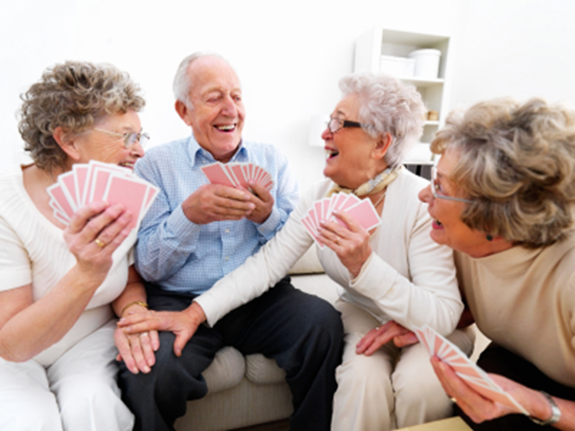
Notes:
MARENTA:
We know this is a good thing and made us feel good, but little did we know how good it was for our health.
LT studies: Those who are well connected are 2-5 times less likely to be heart disease, dementia, and cancer – all the big players. Studied in Scandinavia and Japan – same results. Being connected is a major stimulus to the immune system. And our immune system protects us from not only infectious disease, but these big players as well.
In Live Long Die Short, Dr. Landry states that social isolation has the risk equivalent of smoking a pack of cigarettes a day for your entire life.
This trend to become less connected as we age is a BIG threat. Especially with Facebook and Skype. While they are wonderful tools, nothing can replace the benefits of touch and face to face interaction. Stay connected!! Look how we evolved as humans! We were connected, had a role, had a purpose, be connected with people for a higher purpose – volunteering. Facilitate the interaction of older adults and children!
We have tens, even hundreds, of friends, but rarely touch their hands, or look into their eyes, or sit peacefully hearing their stories.
Dan Buettner, author of the Blue Zones, says “I also thing the trend toward isolation is a mistake. Drive down any American street at 9pm and you can see the greenish glow of the television or the computer in people’s window. We’ve become an increasingly isolated society. Fifteen years ago, the average American had three good friends. Now it’s down to two. We know that isolation shaves good years off of your life.” Don’t let that happen to you. Stay connected.
18

Slide 19
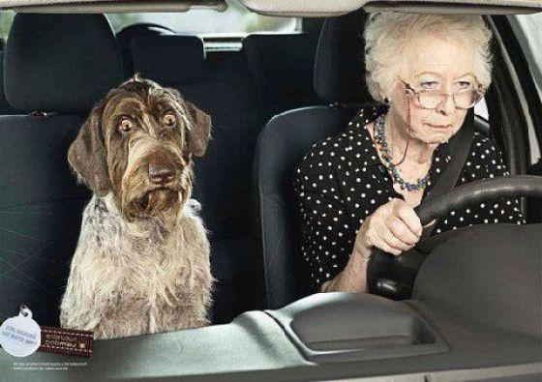
Notes:
LISA:
My risk for skin cancer (obviously): matter of identifying them, work with your dr., know them, know what you can do to prevent.
Don’t take the ostrich approach – don’t stick your head in the sand.
Buzzard effect – Dr. Landry says when we’re younger, those buzzards circle way up high, get older they get lower, start to pick at you. They are there! We can pretend they’re not and they’re not going to bother us, but they will!
Where are you going to be? What does your lifestyle look like?
Are you living the lifestyle that gives you the max resistance to take those hits? Those curve balls?
Doesn’t mean we have to stop eating chocolate and pie and all the things that make life worth living – but stay on track! It’s not all or none. Stay focused. Nutrition – giving the body the fuel it needs. Do you worry about what color your car is, what’s in the trunk? No! It’s about giving your car the right fuel so it runs!
***change picture***
There are other risks – don’t put yourself in this situation, but don’t let OTHERS put you at risk either!
Living with your children – in trying to eliminate all risks from your life, they actually put you at risk!
They expect your going to behave like the parent you always were. This phase in life – they will hold you back.
19

Slide 20
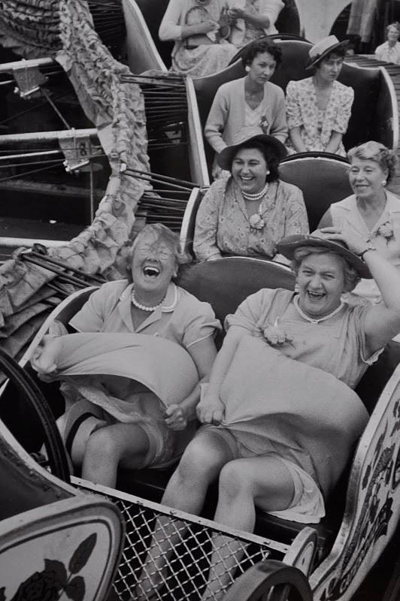
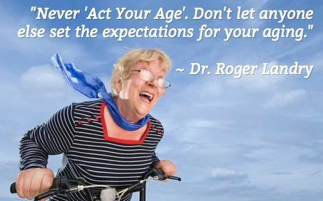
6. Never Act Your Age
Notes:
LISA:
Don’t consider that. This is why.
To act your age is to accept the still prevailing society’s stereotypical view on aging as decline only that we discussed. Age is just a number. It’s about what’s here and here. If we lower our expectations and anticipate less and accept this negative decline only story, there’s a good chance that this is exactly what you’re going to experience. We hear that aging is about attitude – and it is! You’re only as old as you feel!
Chuck Yeager (record setting test pilot) breaking the sound barrier 55, 60, 65 years old.
Grandma Moses – 78 when she started her painting career.
George Bush Sr. jumping out of a plane on his 90th birthday this year.
If you constantly act how you are ‘supposed to’ you’re cutting yourself short of your potential.
“Grandma’s” portrayal in children’s book – white hair, big glasses. That’s not your typical grandma today. Don’t act like that.
Live your life so your children ASK you to act your age! Get our of your comfort zone. (just don’t tell them I told you to do it). Anticipate More. Anticipating less is dangerous.

Slide 21
Notes:
MARENTA:
Stress – inherited from our ancestors as a way to survive – flight or fight.
Stress multiplies our risk.
We still have that today. The problem is, it’s meant to be short term – it’s a huge stimulus to our body, all hands on deck, shuts down a lot of the other functions in our body that we need for everyday.
We have the unique capability of being the only species that can stimulate this stress response with our thoughts.
As you sit here, I know what’s happening. If we had a microphone that could listen to your thoughts, what would we hear? I’m getting hungry, when’s she going to be done, I hope this is worth it, our chattering minds – we rip ourselves out of this moment, where is life is meant to be lived.
Go out to eat and see everyone sitting on their phones at the same table, not talking.
Parents who are so busy video taping everything they miss the actual event.
Artists – painting, what happens to time when you’re doing something you loved. You cannot be stressed if there is no element of time. Our ancestors – no element of time. Calm, joyful. Being in the present moment, stopping the chattering mind. Focused on the task at hand without the chattering mind. It’s attention w/o judgment, awareness without thought. Where is yours? Nature, walking? Running? Children? Craft? Music? We must find it! We must shut down that chattering mind. Break the moment even for a moment – mediation, prayer, focus on something – awareness w/out thought.
Stress starts early! Life may not be the party we hoped for, but while we’re here we may as well dance.
21

Slide 22
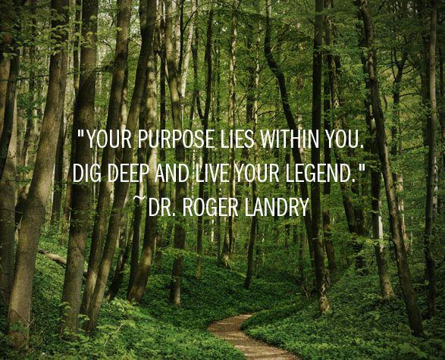
In Okinawa, this is the reason for waking up in the morning.
Notes:
MARENTA:
“Tell me what it is you plan to do with your one wild and precious life” – Mary Oliver, The Summer day
We NEED purpose. That’s who we are. Purpose usually involves other living things: people, plants, animals…
I don’t want to miss what good things are going on in other cultures around the world. The Blue Zones was a book written by Dan Buettner, a National Geographic Explorer, about the areas of the world where people live the longest.
(Ikaria, Greece; Sardinia, Italy; Okinawa, Japan; Nicoya, Costa Rica; Loma Linda, CA)
A significant part of the Okinawan culture is their strong role in their community and their deep understanding of their purpose and value. In fact, they have a word, that we cannot translate directly, because we don’t have a word for it in English – Ikigai refers to the reason for waking up in the morning. What gets you out of bed in the morning? How is that related to your meaning/purpose?
We hope to help transform the United States into a place where each and every older adult can wake up with a strong sense of their ikigai….
Ee-kee-guy
Roles are very important in Okinawa. (page 87 of Blue Zones). A sudden loss of a person’s traditional role can have a measurable effect on mortality. It is seen especially among teachers and policemen who die very soon after they quit working. Police and teachers have very clear senses of purpose and relatively high status. Once they retire, the lose both of those qualities and they tend to decline rapidly. Conversely, those who feel needed remain functioning longer.
Identifying what’s possible and what’s happening around the world, gives us great hope for the future of aging in America…
(A Piedmont Gardens resident told me that the literal translation is Iki = live; gai = worth.)
22

Slide 23
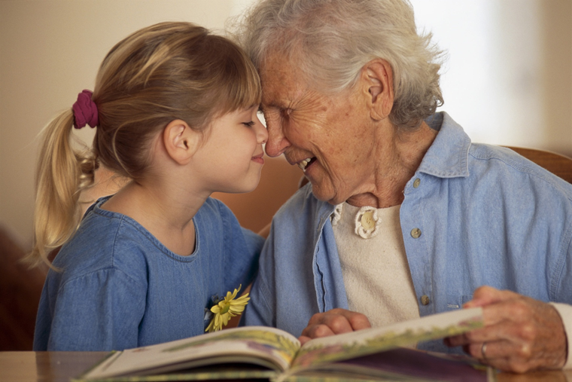
Notes:
LISA:
Need purpose, need children in our lives.
As the grandchildren go away, we loose that contact. Disengaged from children.
We know this is a problem, at HH and similar places, so we facilitate intergenerational events. We as a society have to initiate that.
SA is not getting just your AARP card.
It’s more than that. The interaction with kids makes it come full circle, it’s just as important for them as it is for you. We’re all in it together.
23

Slide 24
Notes:
LISA:
And Laugh.
We HAVE to laugh.
Have you heard the story of Norman Cousins? Wrote a book: Anatomy of an Illness, he was diagnosed with a terminal disease – he was feeling badly. He checked himself out of the hospital, rented a movie projector, this was back in the 70s, some candid camera episodes, Marks brothers movies, brought it back to the hospital and laughed and laughed. He laughed himself into remission for 30 years! And he died of another condition!
We didn’t know what was going on then, but we know now that laughter, much like social connections is a huge stimulus to the immune system. We can measure the immune system now so we know so much more. Protects you and draws ppl to you so that connection is there – so the immune system is just bursting with social connection AND laughter.
Most of you think right now you have a nice very neutral expression on your face. What I see is this. Remember gravity? This a not a welcome to people. This is grouchy. This does not say, come! I want to know you! We LOOK grouchy most of the time! Pay attention to that! Laugh and smile. I just want to make sure there are no barriers to being all that you can be.
So those are the 10 tips.
24

Slide 25
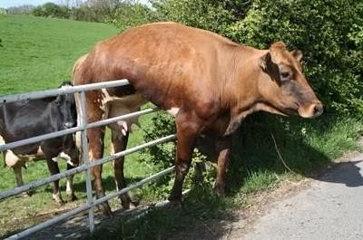
Notes:
LISA:
Don’t be on the fence!
I’ve told you that most of the way we age is due to lifestyle.
I’ve told you were that lifestyle comes from
I’ve told you ten different ways in which that lifestyle can look like.
Please don’t be on the fence!
25

Slide 26
YOUR CHOICE!
Notes:
LISA:
Begin NOW. Be thinking about what you can be doing to age in a better way. To live well.
Because it IS your choice. Which path you take is your choice. Please don’t let anyone else write your story. No stereotypes, no diminished expectations, no expecting less.
26

Slide 27
Notes:
MARENTA:
George Eliot, MAE, had it right:
Never too late.
You’re never going to win the lottery if you don’t buy a ticket. It requires you to do something. It is, by definition, lifestyle. YOUR lifestyle. Not someone else's. As we age, becoming connected, active, fulfilled is less common. Be around people and places that help you to continue to GROW.
What did you learn today? What are your take aways? What are you going to do differently as a result of what you learned today?
Living well can happen at ANY age. Remember one of the biggest findings from the research in SA: that it’s never too late to start making positive changes!
I wish you great success in your lifes continuing adventures as you work to age well!
27

