Slide 1
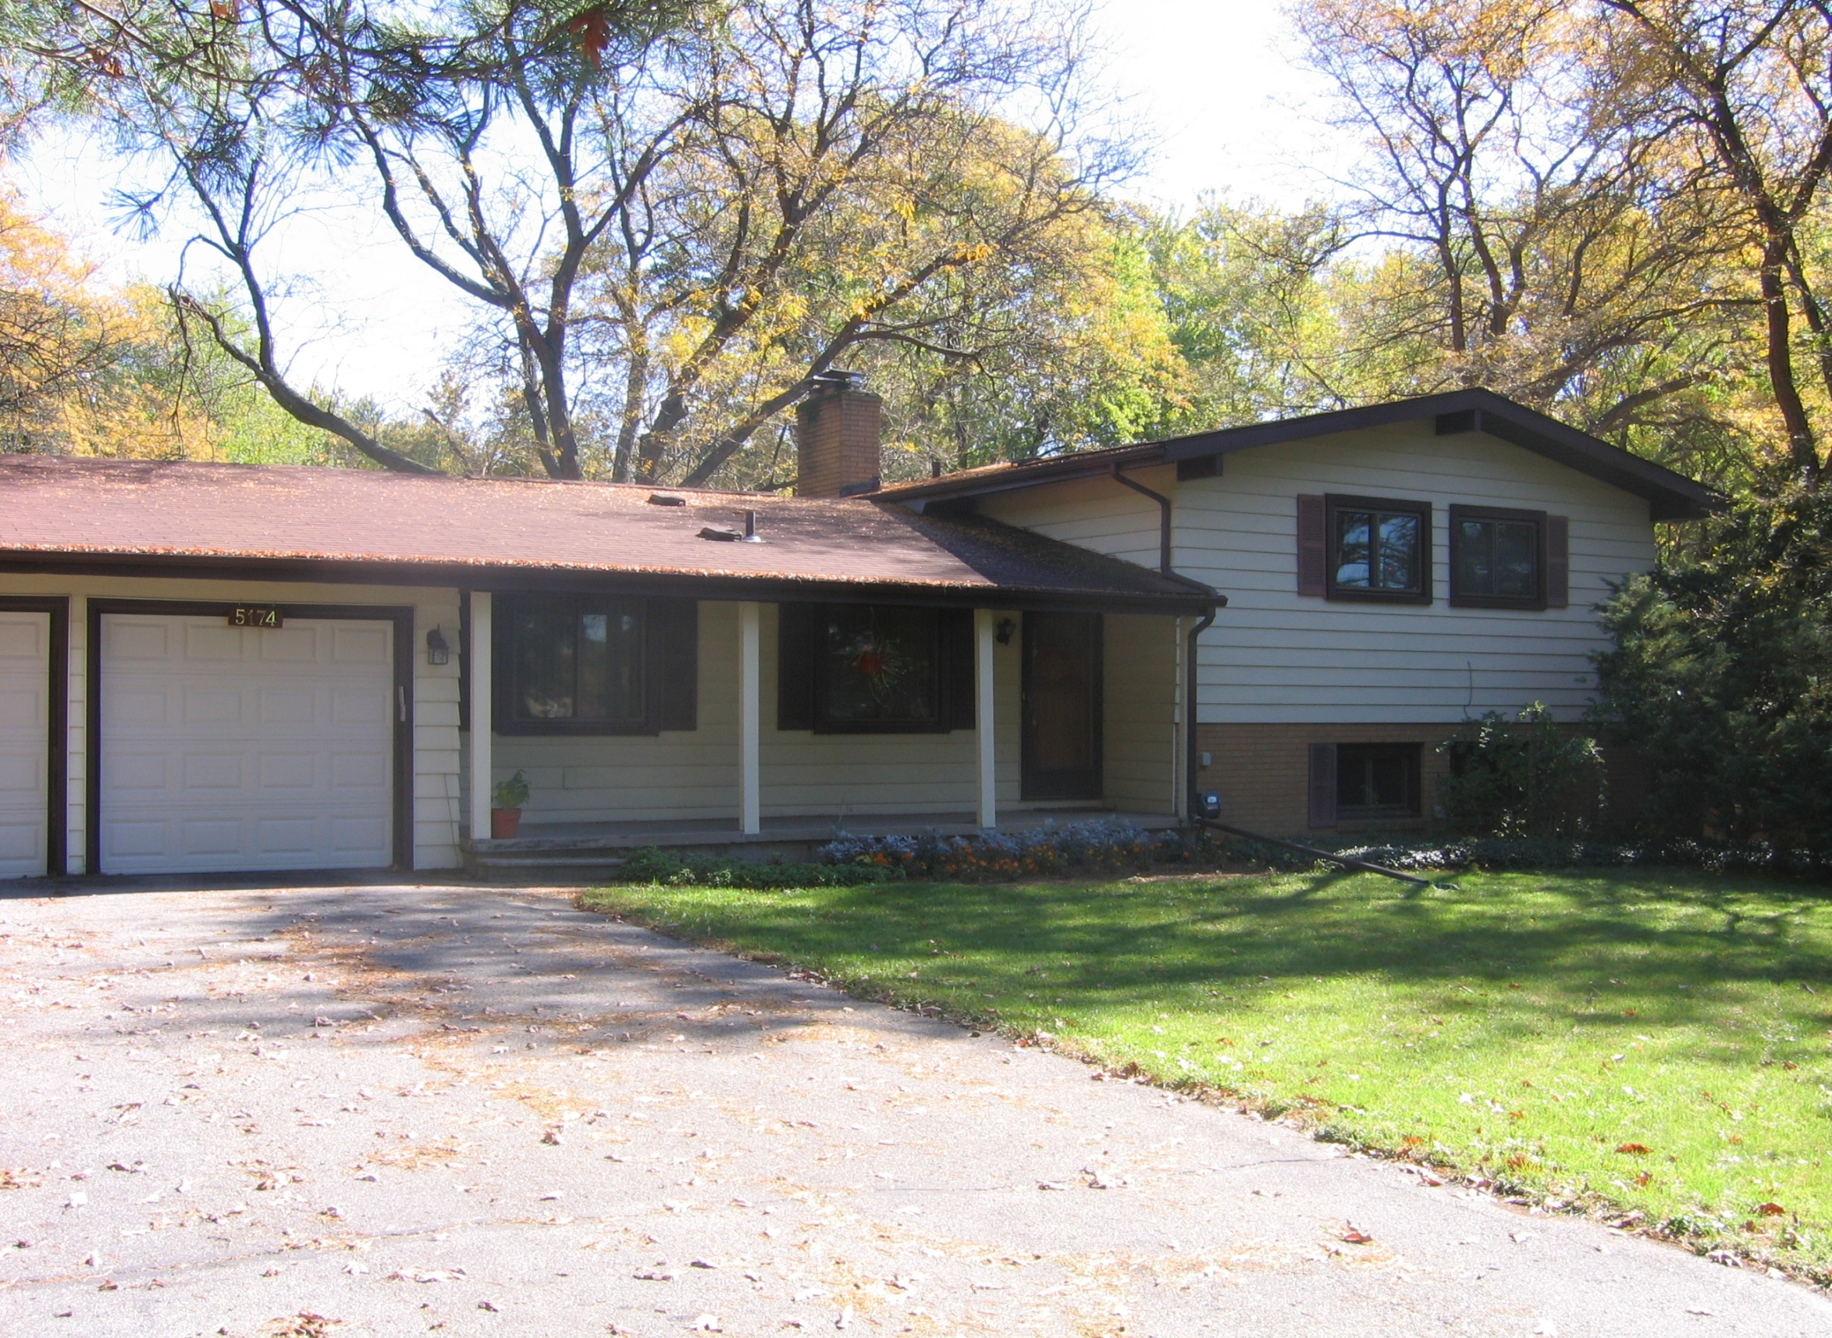

HomeFit
Debra Lindstrom Hazel, PhD, OTRL
Karen Kafantaris, AARP Michigan
Notes:
AARP Staff/Volunteer introduces self and OT and AARP

Slide 2
Purposes of HomeFit
  To begin thinking about what YOU can you do in your current home to allow you to safely remain in that home as long as you choose.
Notes:
We have 3 objectives for this program.
#1
Each of the things we talk about will cost money – some more than others. However, when you consider that independent living costs 4,000/month, assisted living costs 3,000 per month and a nursing home costs 8000/month – and those are conservative numbers – I think you will see that making these changes is much more economical. And you end up staying where you would rather be.

Slide 3
  To determine what is important to YOU
    Activities such as
      Cooking
      Yard work
      Laundry
    Leisure activities such as
      Woodworking
      Using computer
      Making crafts

Slide 4
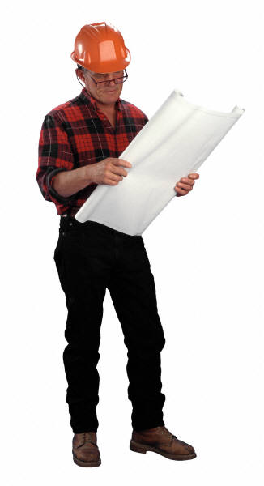
  3. To identify consultants needed
    Certified Aging in Place Specialist (CAPS)
    Occupational Therapist (OT)
    Remodeler
    Architect
    Landscape Architect
    Builder
Notes:
CAPS—certified aging in place specialist is a professional trained to help someone remain in their home safely, independently and comfortably. This training is conducted by the National Association of Home Builders Remodelers.
Occupational Therapist is a person trained in helping people live life to the fullest, and that often means figuring out how to stay in their own home as they age.
Remodeler—someone to remodel your home
Architect—professional to consult if you have structural questions about whether or not the changes you’d like to could safely be made on your home
Landscape architect is a specialist involved in planning, design and sometimes direction of a landscape, garden, or distinct space (such as changing steps to a zero-step entrance).

Slide 5
Overview
  Safe and easy to use
      Entrances
      Bathrooms
      Living Areas
Notes:
How can you make your home as safe and as easy as possible for you for
Entrances, bathrooms and living areas?
You are making an investment in your own future. The $ you spend to be able to stay in your own home today can save you tens of thousands of dollars a year if you can safely stay there instead of paying for assistive living or even more expensive for a nursing home Add costs for Lansing

Slide 6
Worksheet
Areas that
  work as they are
  can be changed with minor cost
  can be changed with major cost
Simple devices that can assist you
Reference for your personal use
Notes:
Opportunity to assess your home’s current accessibility.
By completing the worksheet you can figure out what works just as it is right now?
What can easily be changed and you can do soon with minimal cost?
What can be changed but you will need to plan and budget for it?
What devices might help you if you can’t make the structural changes you’d like?
Save time and $ if you have all this information to share with a consultant.

Slide 7
Terms
Universal Design and Visitability
  Zero Step/No Step
Livability
  Design for a Lifetime
Notes:
Here are some terms that you might hear when you are learning about aging in place:
Universal design is an approach to
designing products and environments to be
appropriate for all people, including those
with physical, cognitive, or sensory
impairments.
Visitability: refers to homes that include a few basic features that make them accessible to people regardless of their physical abilities: at least one no-step entrance, wide doorways and at least a ½ bath on the main floor.
Zero step/no step refer to the entrance and location of all of the critical areas (bathroom and living/bedroom, laundry, etc.)
Livability: universally designed, easy to use features, low maintenance, environmentally friends and energy efficient. Livable homes also have spaces that can be adapted to allow people to age comfortably without moving or encumbering excessive disruption or expense. Livable homes are designed for a lifetime which is another term that is sometimes used.

Slide 8
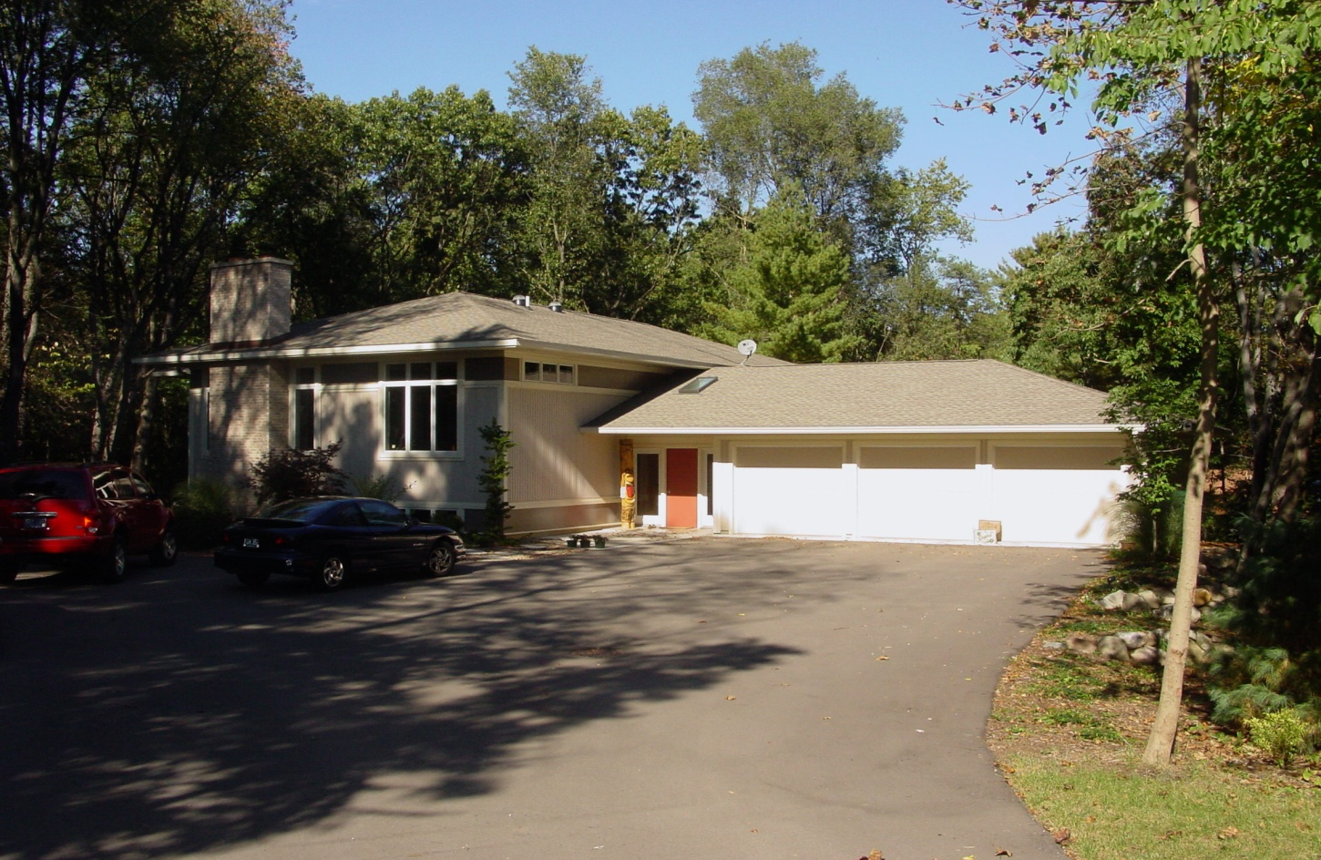
Entrances
Notes:
Introduce the OT
We all have to get into our homes. If we have trouble temporarily with steps, that can limit our ability to even get into our own homes. This home has a no-step entrance, but you can see it does not look industrial or commercial. Here is a close up of the entrance.
No step entrances work for everyone. If anyone is temporarily using crutches or a walker after a knee replacement, it is much easier to get into and out of the home. This type of entrance also works for parents with baby strollers and delivering large appliances.

Slide 9
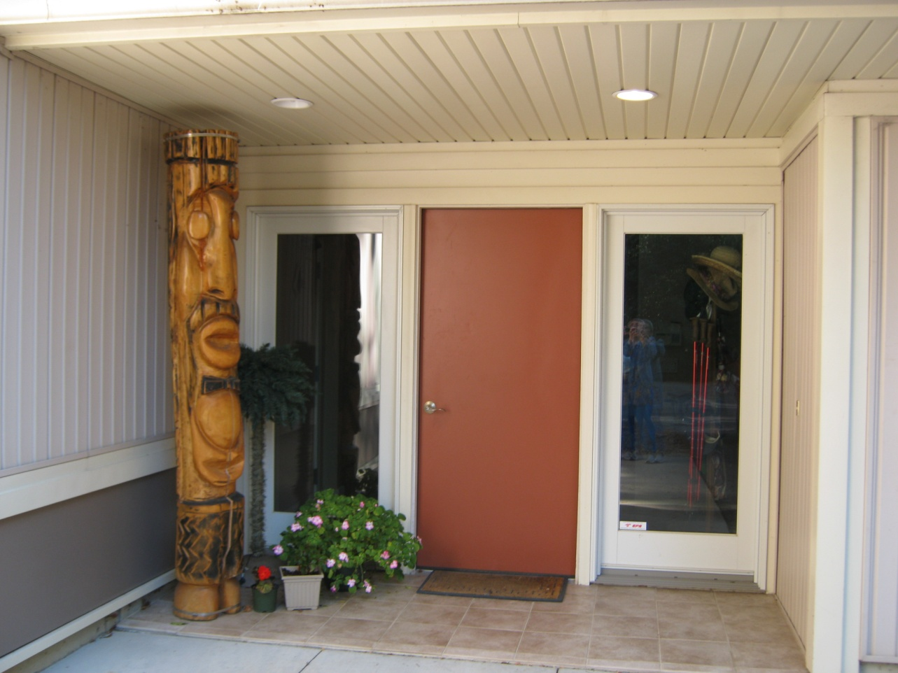
Close Up Of No-Step Entrance

Slide 10
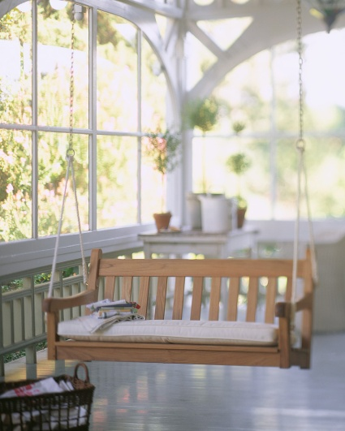
Worksheet/Entrances
Steps
Threshold Height
Door
Porches
Lighting
Hand rails
Notes:
Please take out your worksheet and look at the first section on entrances. At the end we will ask you to fill this out, but right now just use it as a reference for notes. You have a “clean” one in your packet, so the one on the clipboard might be a good place to write notes to yourself.
Things to know about your entrances so you can create a no-step entrance if you do not have one.
Think about each of the entrances to your home, front, back, side or deck.
How many steps are there? How wide is the door? Do you have a storm door and an entrance door? What is the threshold height? Porch size—can someone in a wheelchair or using a walker maneuver around?
Lighting—critical for safety at night
Are there hand rails on both sides?
Are the house #s easily viewed from street both in daylight and at night

Slide 11
Alternative for Steps
  No-step/Zero-Step
  Ramp
  Mechanical Outdoor Lift
Notes:
These are 3 alternatives for getting into your home

Slide 12
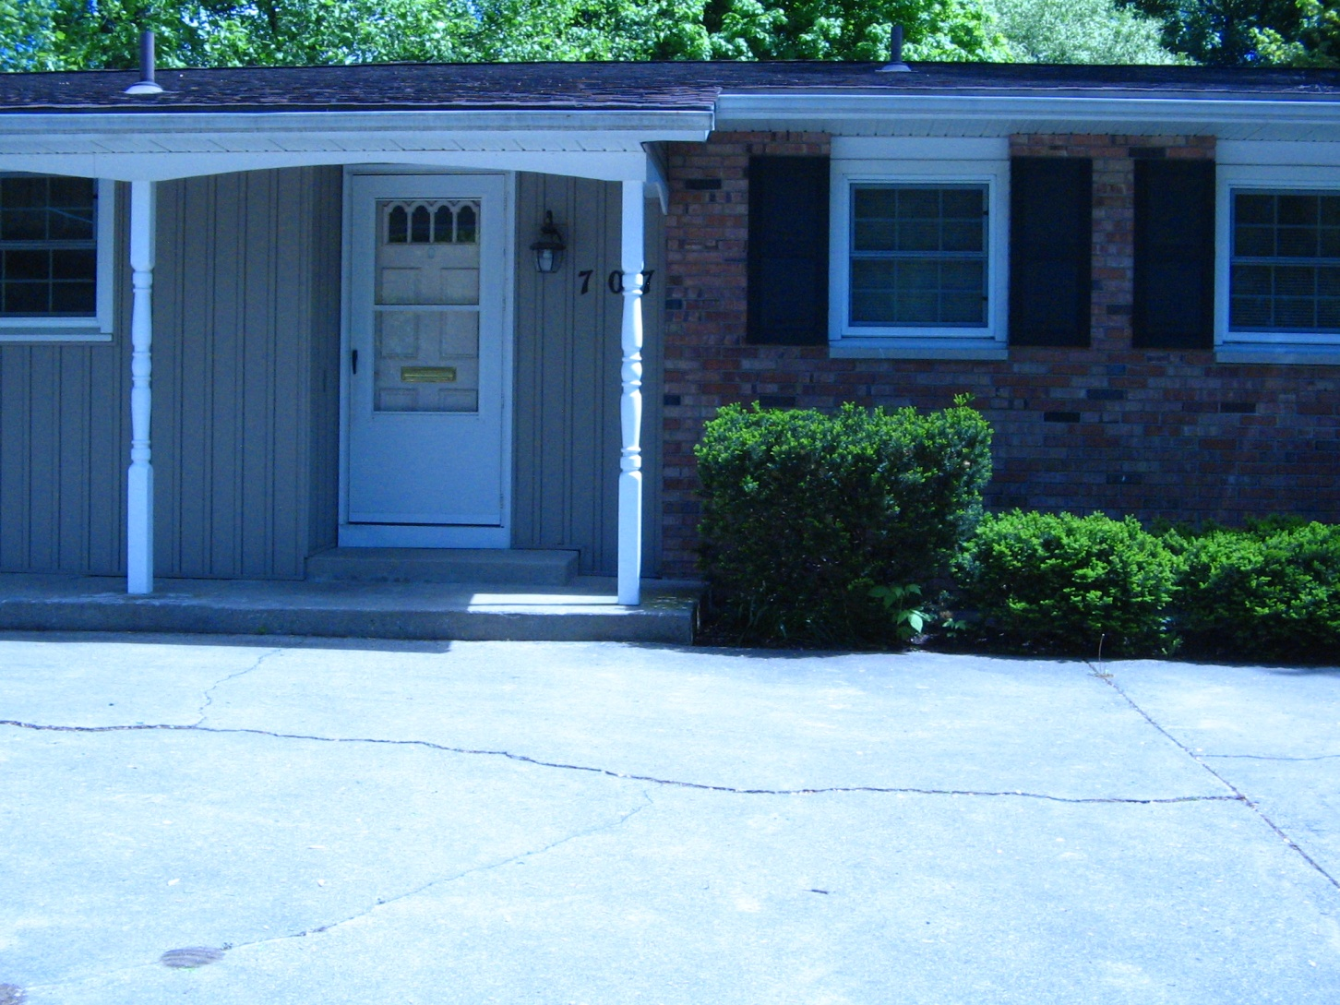
Potential for No-Step Entrance with landscaping…. BEFORE…..
Notes:
This home lends itself to a no-step entrance if you landscape the driveway area to gradually slope up to the door. This can be done only if there are not any basement windows in the front area that you would cover if you change the landscaping this way. If there are windows in this area, there is a problem for exiting the basement as well as potential moisture problems.
For this landscaping to allow safe access, you need to make the slope gradual enough for safety, which means 1 foot of slope for every inch of rise. There are 10 inches of rise for this home, so the slope must be at least 10 feet long. Be sure this does not interfere with the driveway and garage entrance. This access could be made from the front straight on or from the right of the house where the bushes are located.
Also, can you read the house number in this picture? Do you think a friend could read it from the street at night?

Slide 13
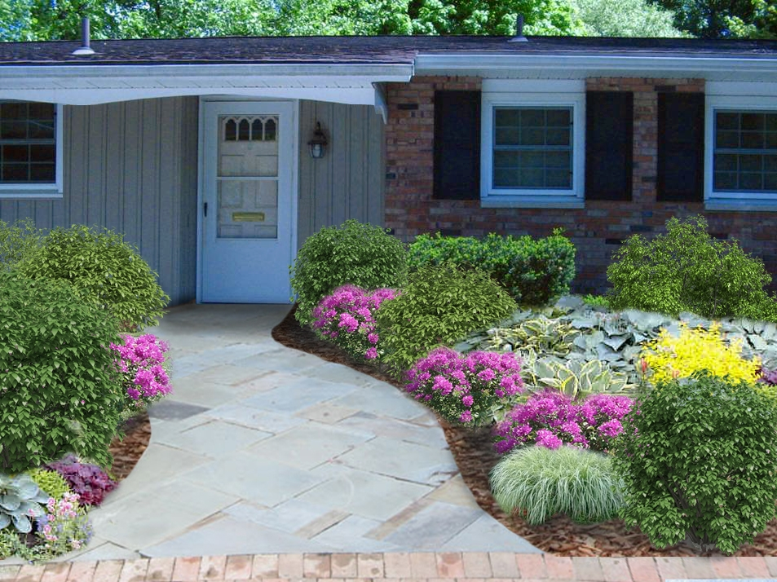
No-Step Entrance Created With Landscaping

Slide 14
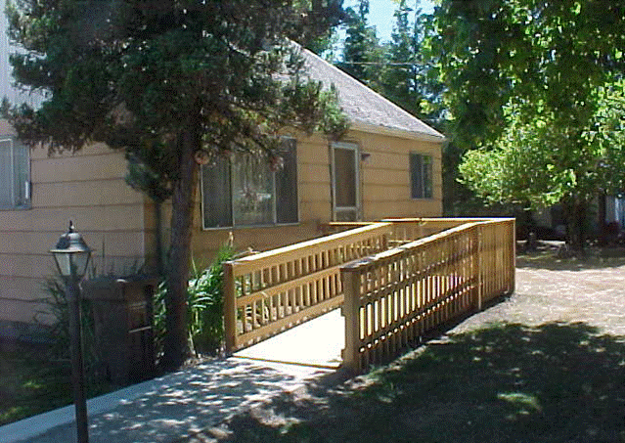
Ramp for 8” Height
Notes:
This entrance is now accessible by the ramp and it has a porch or landing large enough for someone in a wheelchair to manage opening the door if the opening is on the right side of the door.

Slide 15
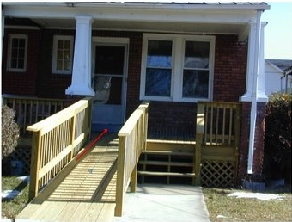
Ramps/Handrails/Porch/Lighting
Notes:
This home owner solved the problem of how to put in handrails on both sides for the ramp without changing the whole porch configuration. They put the ramp on the left with double hand rails and that right hand rail also serves as a hand rail so anyone walking down the steps also has the benefit of 2 handrails.
Lighting needs to be reasonable for your home and neighborhood. Consider motion detectors, but problems can occur with wind or animals around at night. Decide what works best for your particular home.
Be sure that your street numbers are easily seen at night without exterior lighting and during the day from the street.
Handrails
Important for everyday use; important for winter with ice and snow; important for use for anyone with mobility limitations needing to go in and out of your home. This might be you, your family or friends.
Porch
Determine whether or not the porch meets the needs for someone coming up to your door, opening the door and maneuvering into the home. Sometimes people need to get rid of their storm door that opens outward or at least need to change the direction it opens. On the previous slide you can see that the storm door open on the left, and there is maneuvering room for a wheelchair or walker to get into the home. Our inside doors usually open into the home, but the storm doors usually open to the outside.

Slide 16
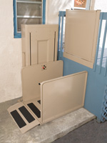
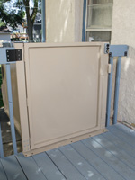
Outdoor Mechanical Lifts
Notes:
This is a vertical lift for a deck that has call/send controls, manual hand-crank for lowering in an emergency (no power), a removable “stay-dry” platform canopy and a cold weather package.

Slide 17
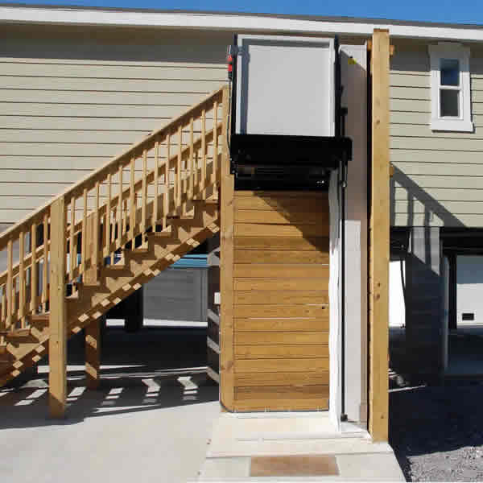
Vertical
Platform
Lift
Tall Tower
Notes:
This is a tall tower vertical platform lift that is listed on-line for less than $5,000. This lift is at the entrance position on the 2nd floor. This type of lift may be the only way to get into the second floor of this building. Check the local requirements for whether or not this type of lift must have a cover for weather.

Slide 18
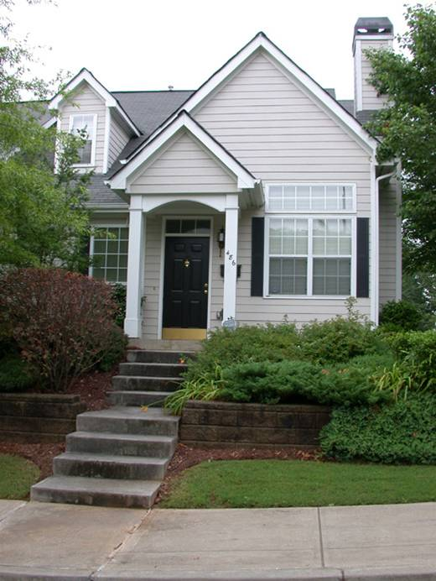
Are Entrance Modifications Always Practical?
Not always.
Not if the site is steep
AND has no back approach
AND has insufficient yard to allow a reasonable slope from the street to the house
Notes:
Sometimes when you look at a home, you have to determine whether or not it is practical to create a no-step entrance because of the particular landscaping and size of the yard. If you cannot landscape for a inclined walkway to the house, there is no space for a ramp and there is no back entrance that would allow a lift, you may feel “stuck.” In this type of a situation an architect would help you know what is structurally possible to do to the home, a remodeler could help with what is practical to do and an occupational therapist can help you explore whether or not there are other adaptations or techniques that you can safely use to navigate the entrance to get in and out.

Slide 19
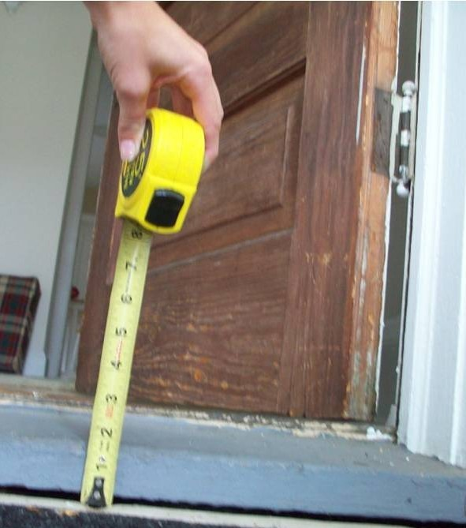
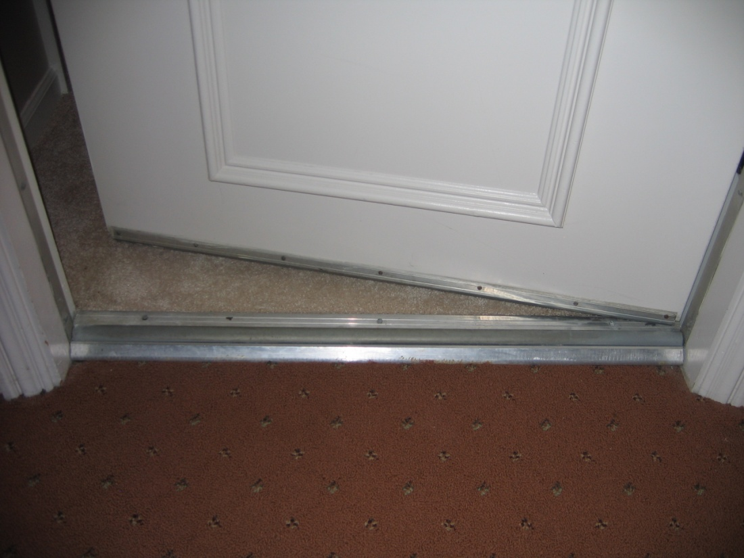
Door Thresholds
Notes:
If the height of the door threshold is more than ¾” it is very difficult for an older person to easily navigate over the threshold in a wheelchair. This particular threshold on the left is about 1 ¾” which would make it very hard to get in and out safely and easily.
If a threshold is beveled it is much easier to navigate in and out.

Slide 20
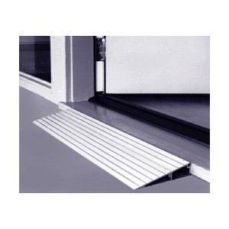
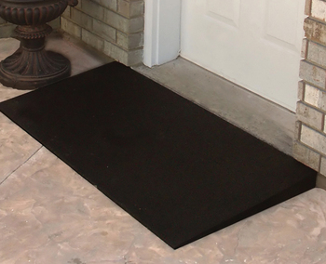
Threshold Ramps
Notes:
Portable threshold ramps can make it much easier to get in and out of the house. These portable aluminum ramps are available for thresholds up to 6 ¼” high. These higher ramps weigh about 20# and are 34” wide. And about 33” long. The only problem noted in the reviews was that the ramps do not secure easily to concrete so they are not as stable as the reviewers would like. These 6” ramps were under $150 on line.
The rubber threshold ramp is much heavier, 40# for a 2.5” rise, 24” long and 48”wide. This has a capacity of 850#. The cost of this ramp on-line is less than $200. Demonstrate on the model door
You may consider this as a somewhat inexpensive fix if your only issue is the threshold height (not steps).
http://www.spinlife.com/critpath/match.cfm?categoryID=88

Slide 21
Typical Home
Front door
  35” wide
  33” opening
Bathroom doors
  27” wide
  26” opening
Bedroom doors
  30” wide
  29” opening
Notes:
Standard walkers and wheelchairs can usually get through the front door if the opening is 33” and the door width at least 35”. Opening space depends on the space behind the door. If there is a wall there is less opening since the door cannot be opened fully.
A standard wheelchair need about 30” to get through a door. A standard walker without wheels needs about 29” to get through a doorway.
In a ranch style home with similar sized doors, a person can take their walker into the bathroom by turning it to the side to get it through the door jams and then using it to walk into the bathroom. It is not possible to get a wheelchair into the bathroom in most homes that have 27 “ doors. A person is able to wheel the standard wheelchair through a bedroom door if they lifted their hands from the wheelrims as they went through the door. Wider doors for the bathroom and bedrooms would make maneuverability much easier.
Add picture

Slide 22
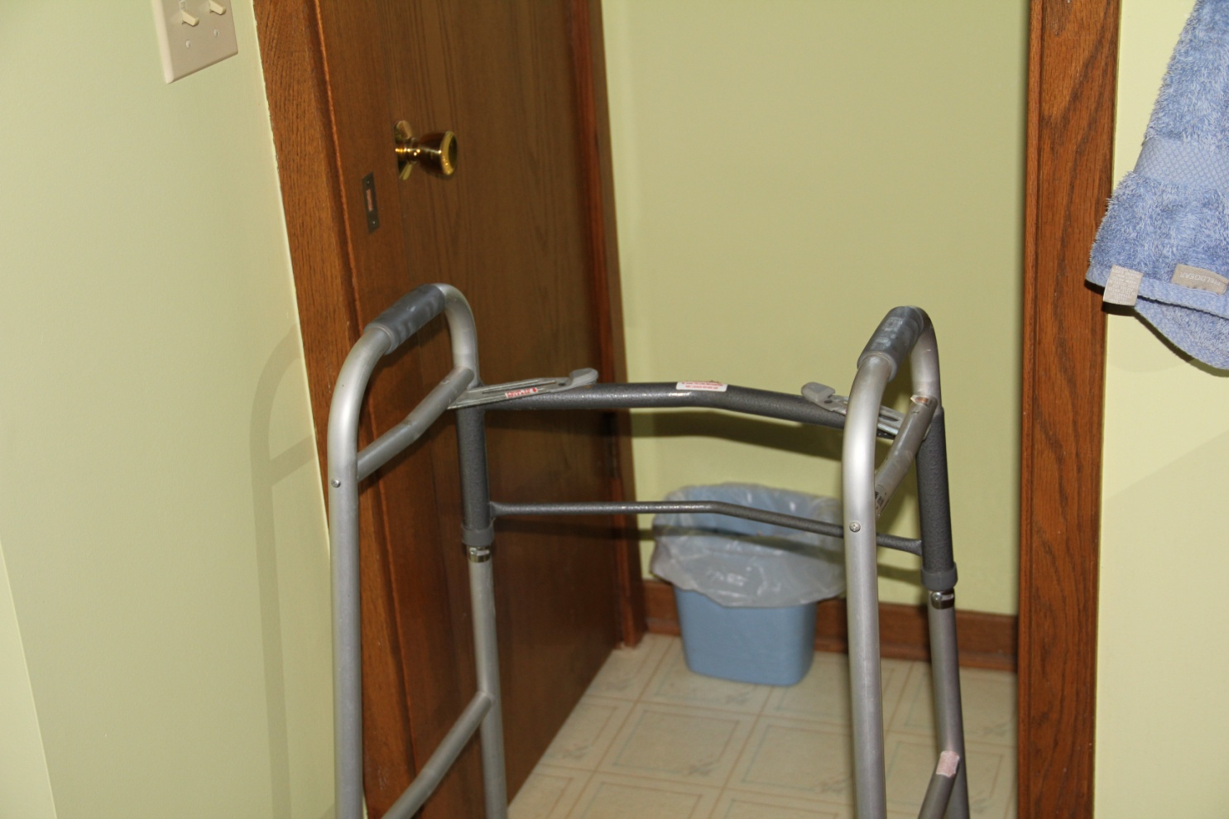
24 Inch Door - Walker

Slide 23
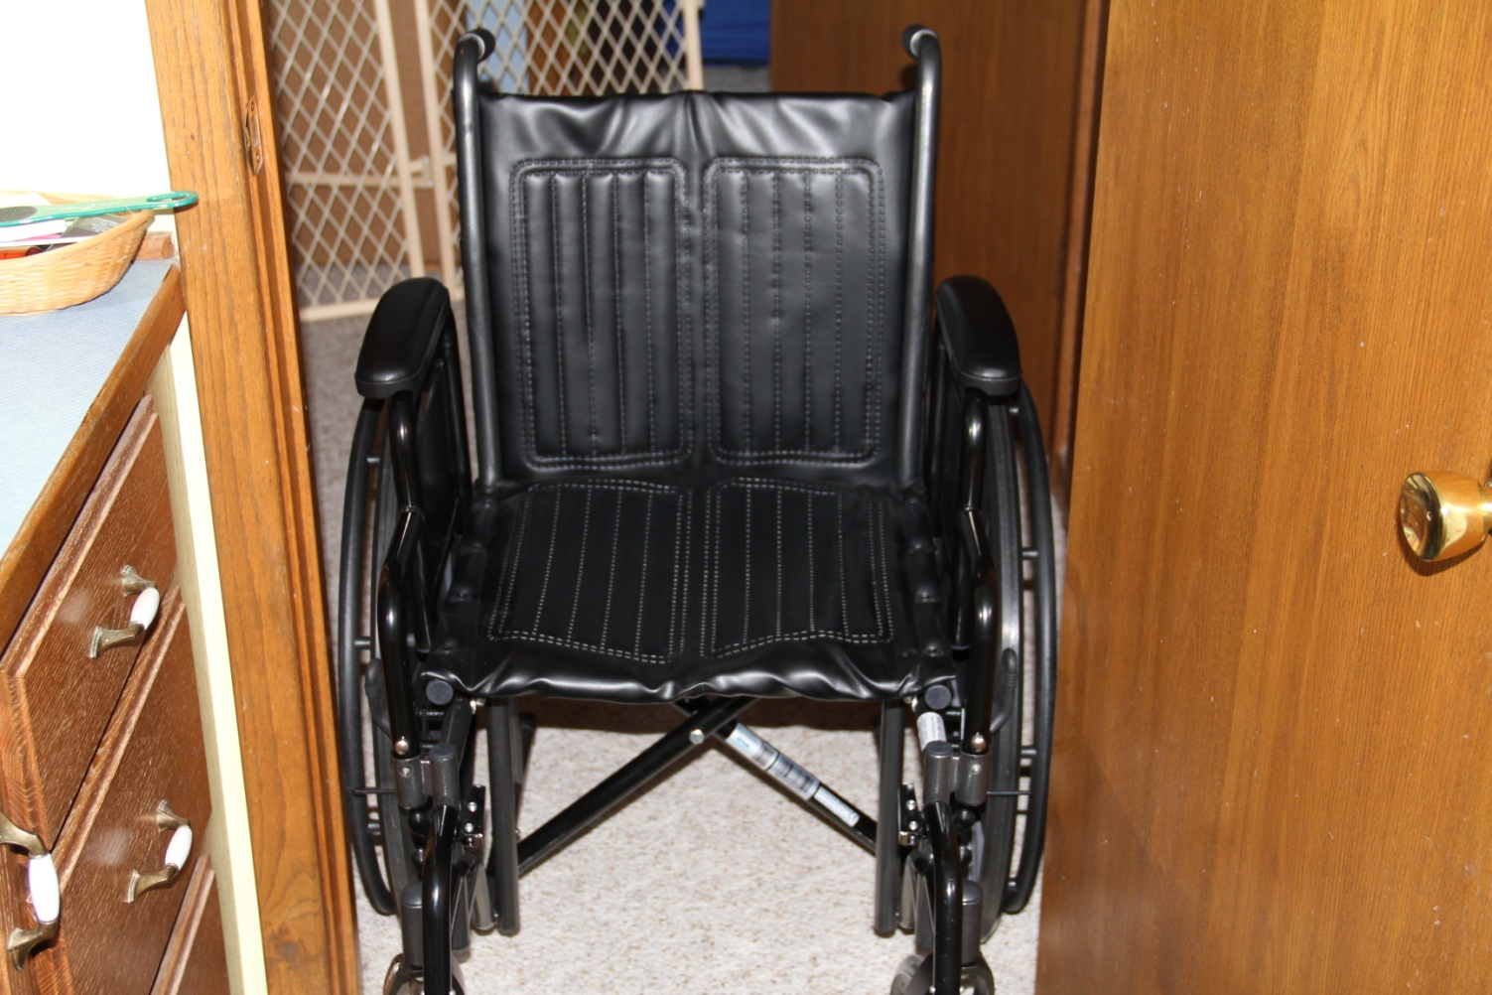
27 Inch Door - Wheelchair

Slide 24
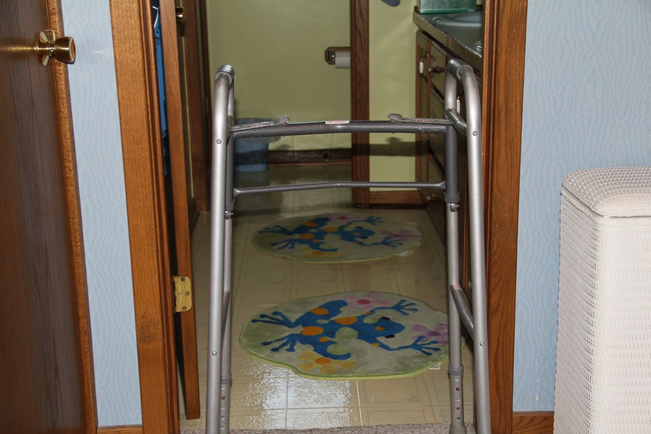
27 Inch Door Walker

Slide 25
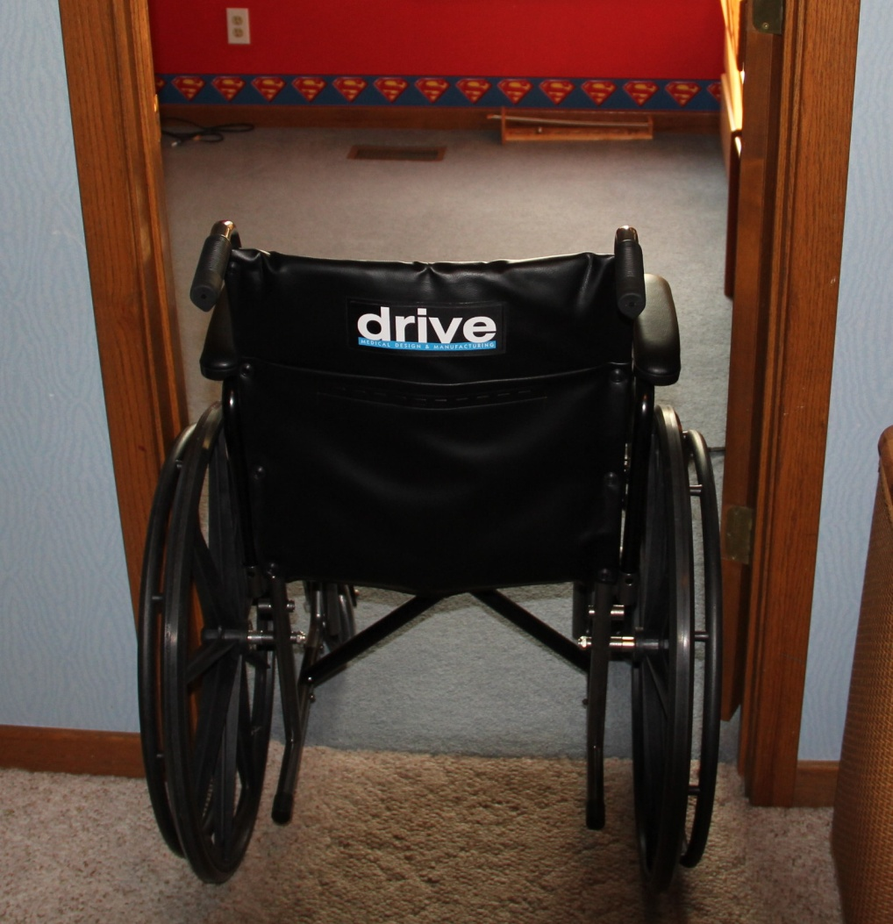
30 Inch Door - Wheelchair

Slide 26
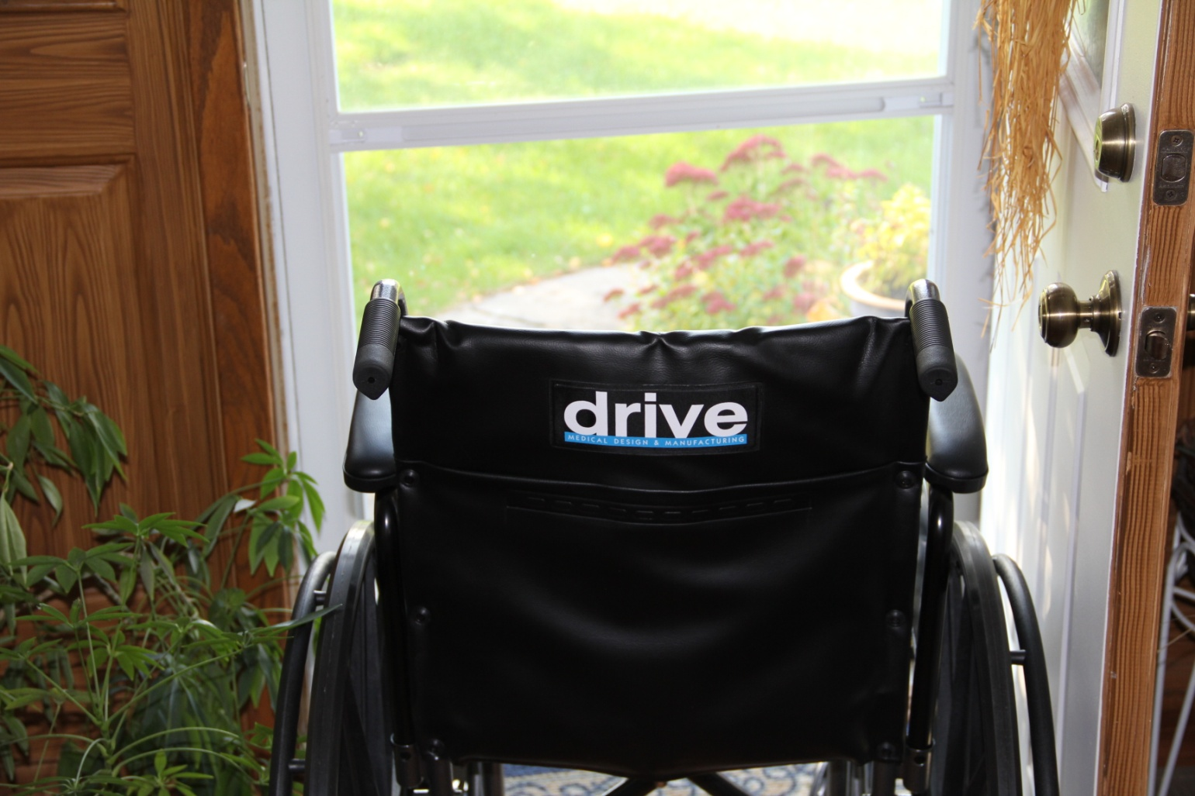
36 Inch Door - Wheelchair

Slide 27
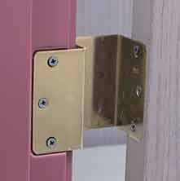
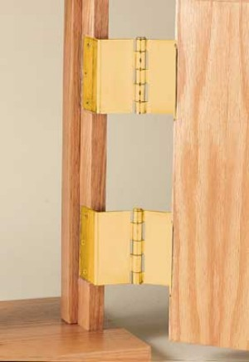
Swing-Clear Hinges
Notes:
These hinges actually make the door opening as wide as possible by swinging the door completely clear of the opening. It doesn’t make it any wider, but just maximizes the space of the opening. Demonstrate with the model

Slide 28
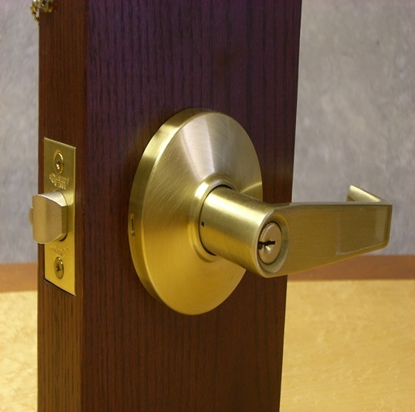
Lever Handles
Notes:
Lever handles can make life much easier on the outside as well as inside doors. With this style you do not need to grasp the round handle, which can sometimes be difficult if you have any hand strength limitations such as arthritis and it can be easier even if your strong hands are full because you can unlatch the door with your elbow if needed. Demonstrate on the model door

Slide 29
Stairways
  Handrails on both sides of stairways
  Is the stairway well lit?
  Do the stairs have a non-slip surface?
Notes:
Now look at your worksheet again for the stairways section. Falls on stairs can cause significant injuries.

Slide 30
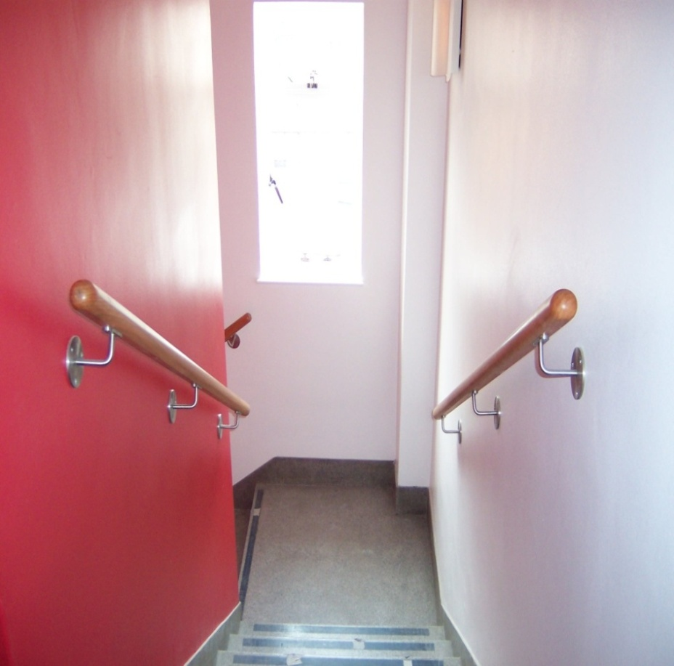
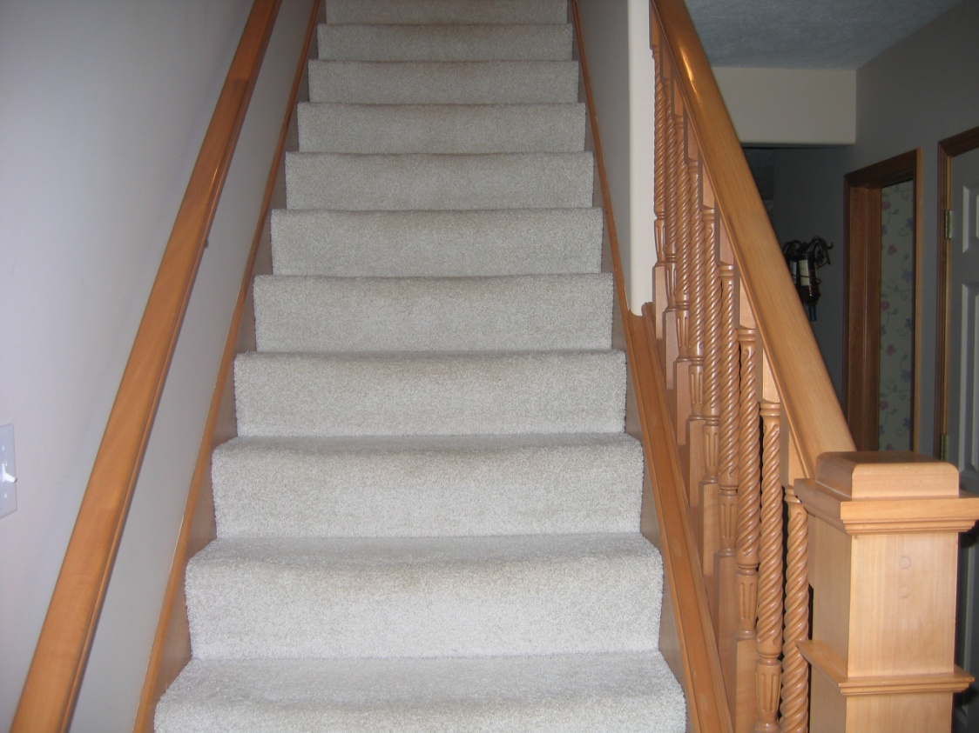
Stairways
Notes:
Stairways need to be well lit and have railings on both sides. Look at the steps in your home to see if they are as safe as possible. Adding non-slip strips can be very helpful on bare wood stairs. Railings on both sides can allow someone to use their cane effectively going both up and down.

Slide 31
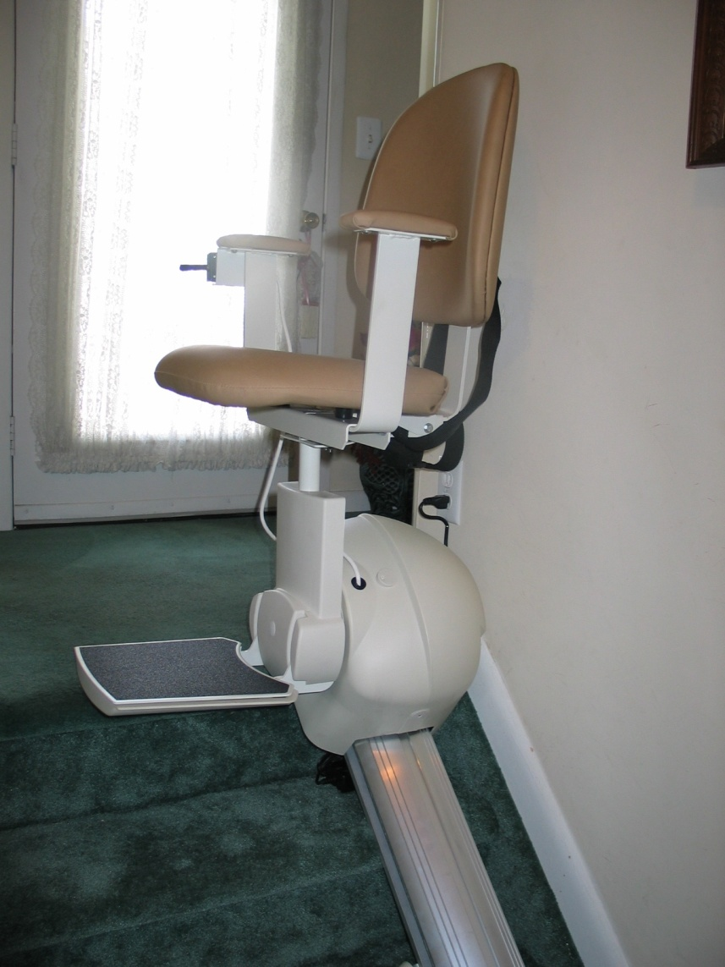
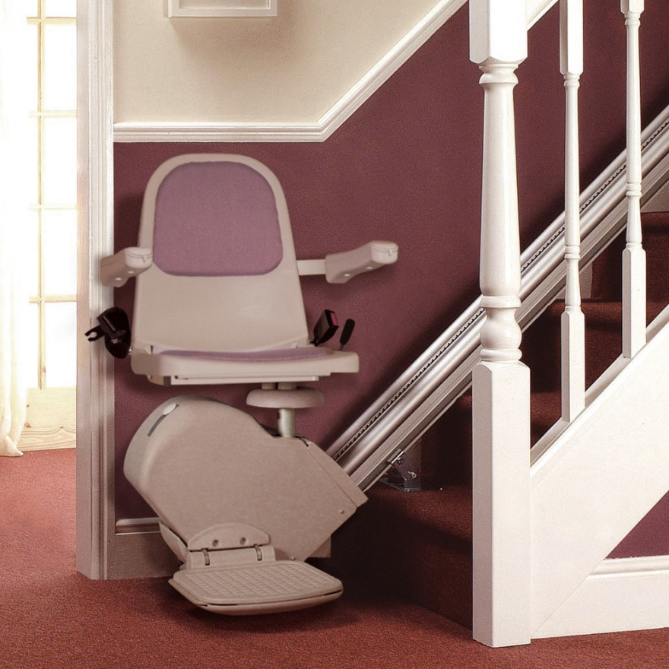
Stair Lifts
Notes:
If you are considering stair-glide
The cost is dependent on whether or not the stairway is Straight, Curved, and if there a landing—if there is, how big is it?
The cost goes up significantly when it has to be custom-made for your particular stairway.
Straight 16’ glides can be found for about $4,000 plus installation
Custom made glides start at about $10,000

Slide 32
Bathrooms
Tub/Shower Combination
Shower
Grab Bars
Tub Bench
Shower Seat
Comfort Height Toilet
Maneuvering space for a wheelchair
Sink style
Notes:
Now again look at your worksheet for the area on bathrooms. Think about the specifics of each of your bathrooms. This is an area that we all need to use and your safety is very important in the bathroom. You need to think about how much space you have to get a wheelchair or walker into the bathroom and then how to get it to the toilet, shower and sink and then how to safely use those areas.
If you remember from the slide on size of doors, the bathroom doors in the house built in the 1970s had a width of 27”, but the opening without swing clear hinges was 26”. Often people are not able to get their wheelchairs into the bathroom and even have to turn their walker to get it through the door so they can walk in safely. The slide lists things to consider for the bathroom, so think about what the problems might be in your current bathroom and then consider how some of these solutions might work for you.

Slide 33
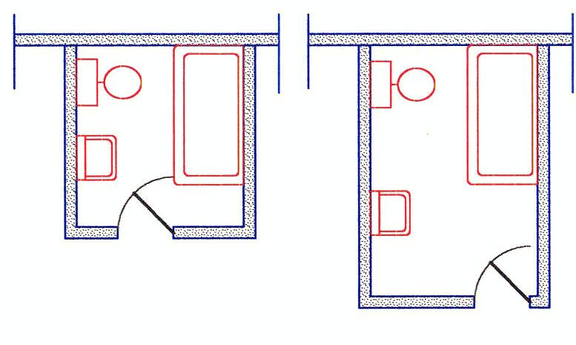
Can you get maneuvering space in traditional bathroom?
Notes:
This is an architect’s drawing of a very common bathroom style in the US. The bathroom on the left is a much smaller bathroom than the one on the right, but the fixtures are arranged in a similar fashion; there is much more maneuvering space in the bathroom on the right. We are going to talk about one idea of how make these bathrooms more accessible. One way would be to remove the tub/shower combination and replace it with a pre-fab walk in shower.

Slide 34
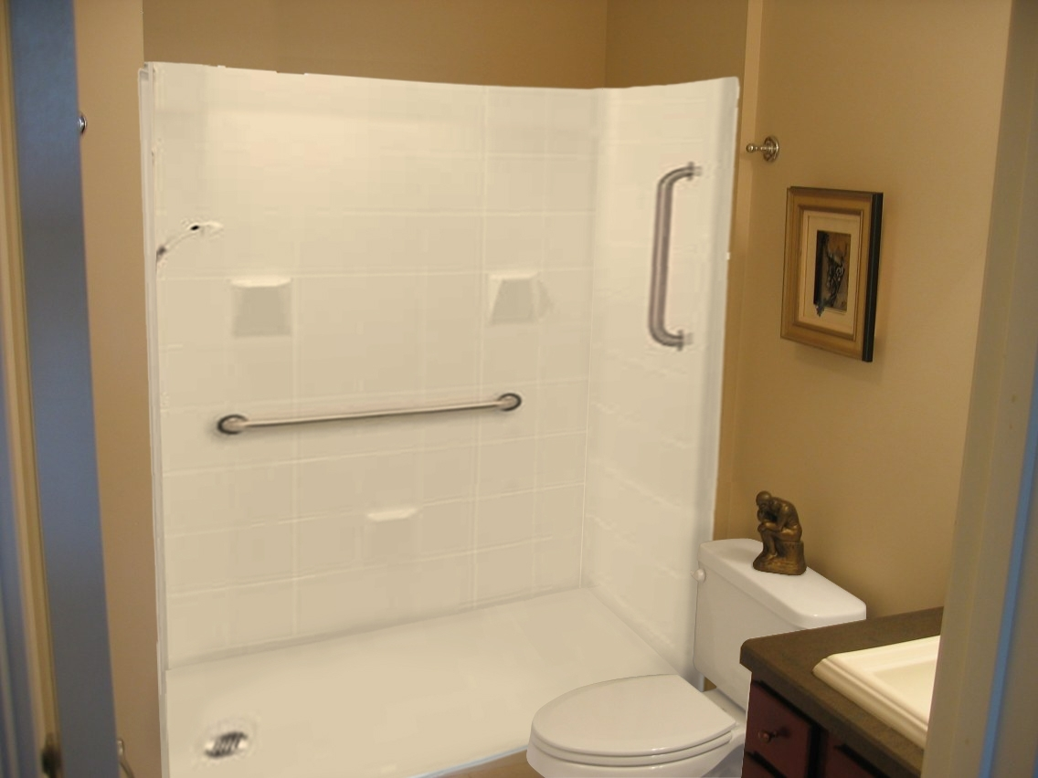
Notes:
This is a picture of pre-fab shower insert available on-line for less than $1,500 not including shipping, handling and installation. This insert uses the same drain as your tub drain and fits into the space where your tub/shower was located. This unit is a 60” bathtub replacement shower designed to utilize the bathroom framing around 5’ tubs. Grab bars can be added to these walls, but you may want to consult with an occupational therapist for the best placement for your specific needs if you have any limitations.
The question for these flat to the ground inserts is always about keeping the water in the shower area. Your shower curtain will close off the area, but you may need to have someone dry the floor after the shower if someone is walking out of the shower and may otherwise slip on the wet floor. You might explore a non-slip mat that is nearly flush with the floor for safety. This is also a conversation you might to have with an occupational therapist about how to safely create a shower area for your specific situation.
http://accessible-shower-design.com/#a2

Slide 35
Can you get maneuvering space in traditional bathroom?
Notes:
Another option that would give you more maneuvering room than the pre-fab insert would be to remove the tub and place a tile floor in the area where the tub was formerly located so that a wheelchair could use that space for maneuvering to the toilet when you were not involved with showering. In the next slide you will see drawings of the bathroom on the left remodeled to allow for wheelchair access to the toilet. See if you can identify the changes from this slide to the next for accessibility.

Slide 36
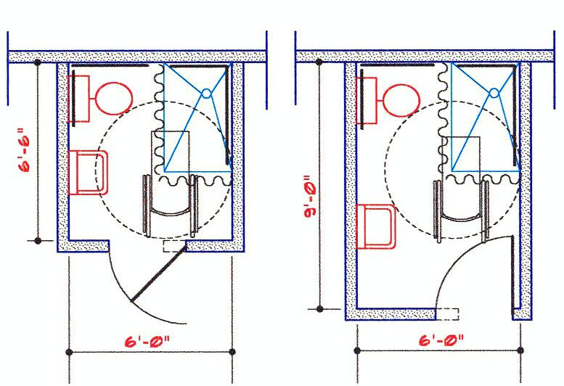
Floor Level Drain With Shower Curtain
Shower area becomes part of maneuvering space
Notes:
So you can see the door on the left was widened, changed to open out of the bathroom, and the tub/shower combination was replaced with a roll in shower area. The squiggly line is the shower curtain that can surround the shower area when needed. The wheelchair now has enough turning radius that someone could get to the toilet from the wheelchair when the shower is not in use.
In the diagram on the right the door is also widened, but even with the wheelchair use the door direction does not need to be changed. Without the tub in the way the space is there to easily maneuver to the toilet.

Slide 37
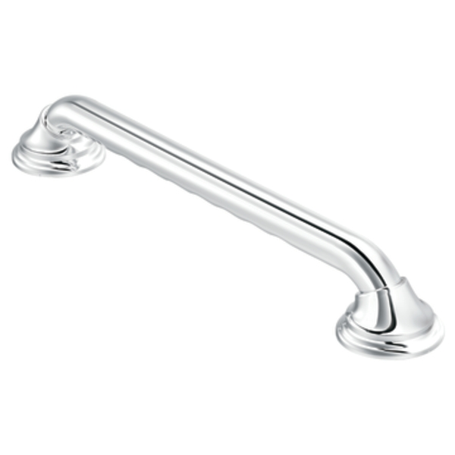
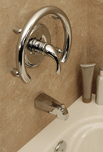
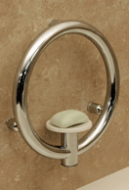
Grab Bars
Notes:
Research has indicated that grab bars are safest when they are horizontal to the floor rather than vertical or at a diagonal.
Invisigrab bars less than $250.00
http://www.sagebathrooms.com/Invisia-Collection/
Moen Home Care Grab Bars < $100
http://www.moen.com/home-care-by-moen/chrome-36-grab-bar/_/R-CSI:R8736D3GCH

Slide 38
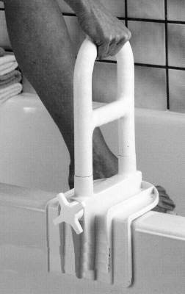
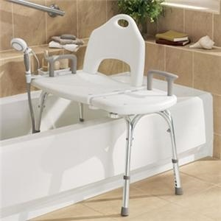
Low Cost Safety Devices

Slide 39
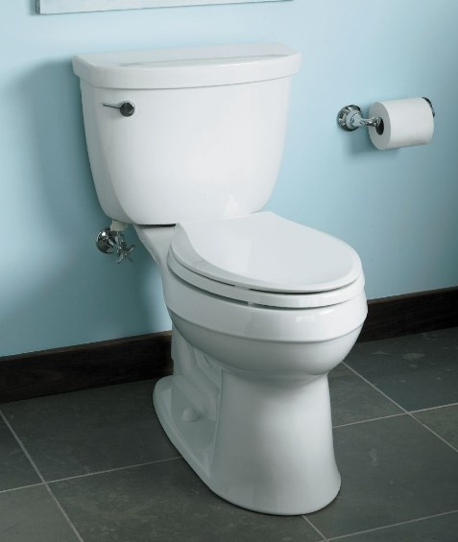
Comfort height toilet
Notes:
One solution for a easier toilet is the comfort height toilet.
There are many styles and features for the comfort height toilet. It is designed to be the height of most chairs so that people do not have to sit down so low and can stand up easier.
http://www.sinksfaucetsandmore.com/index.asp?PageAction=VIEWPROD&ProdID=3512 $359

Slide 40
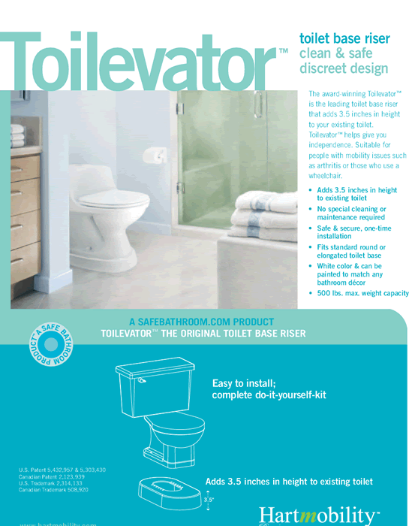
Toilevator
A toilet base riser that adds 3.5” in height to your existing toilet.
Notes:
Another solution is to get a toilevator which is an insert you add underneath your current toilet to raise the height to a more comfortable height. These usually cost less than $100.
http://www.acessinc.com/assistive_toilevator.htm

Slide 41
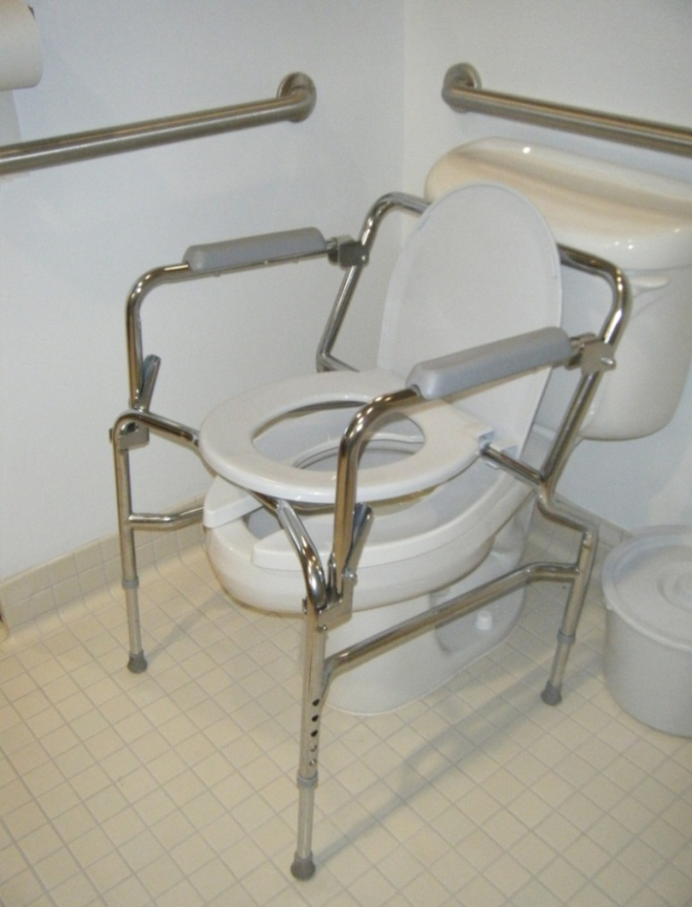
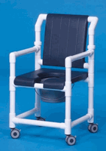
Inexpensive alternatives
Notes:
The commode chair is the least expensive option and often used by people for temporary situations or when remodeling is not an option. This device sits right on top of the toilet, raises the height of the toilet, and provides arm support without needing any structural changes at all. These are often available for under $50.
Another option might be a shower chair and commode combination. This may fit over toilets, depending on the toilet, but it would also allow you to roll someone into the shower for bathing. This model is less than $400.
http://www.showercommodechairsplus.com/deluxe-shower-commode-chairs.html

Slide 42
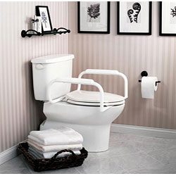
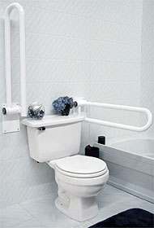
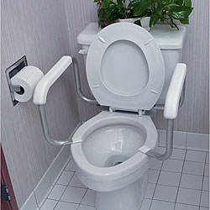
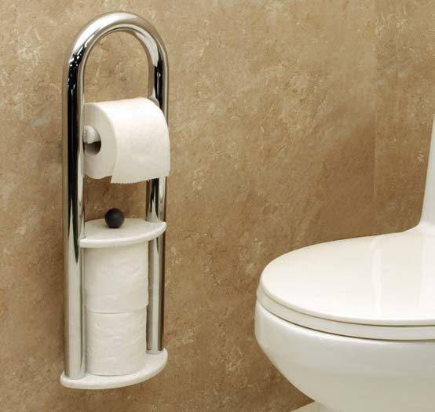
Support Devices for the toilet
Notes:
There are a variety of devices you can add onto or near your toilet instead of using grab bars. The most common are the bars that connect directly to the toilet. Look for devices that can securely attach to the toilet and will hold the weight of a person as needed.
The 2 devices on the left are the least expensive. They attach right to your toilet. These 2 may also help someone with some minor balance difficulties on a higher toilet to feel secure.
The device on the top right can attach right to the wall or on a stand attached to the floor. The bars swing up when they are not needed
The device on the lower right is a grab bar that is attractively designed around a toilet paper holder. No one knows it is a grab bar.
http://www.overstock.com/Health-Beauty/Mabis-Toilet-Safety-Arm-Supports-Pack-of-2/4121468/product.html $32
http://www.thefind.com/office/browse-toilet-hinged-arm-support <$300
http://www.overstock.com/Health-Beauty/Moen-Toilet-Safety-Rails/4665410/product.html?rcmndsrc=2 $30
http://www.overstock.com/Health-Beauty/Standers-Security-Pole-and-Curve-Grab-Bar/2330236/product.html?rcmndsrc=2 $139

Slide 43
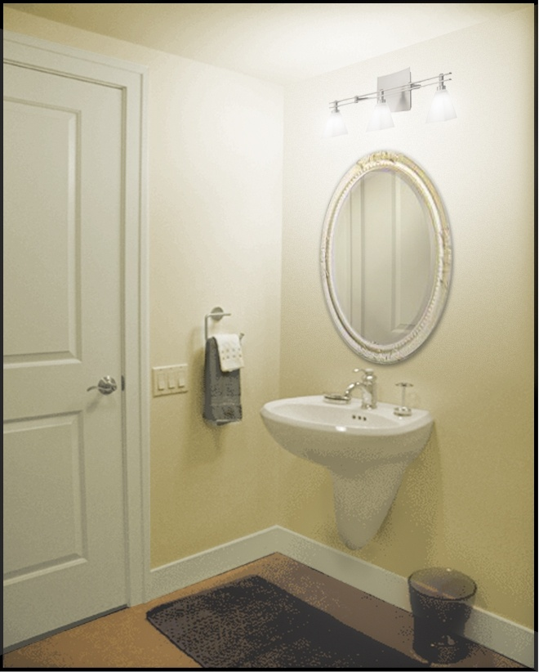
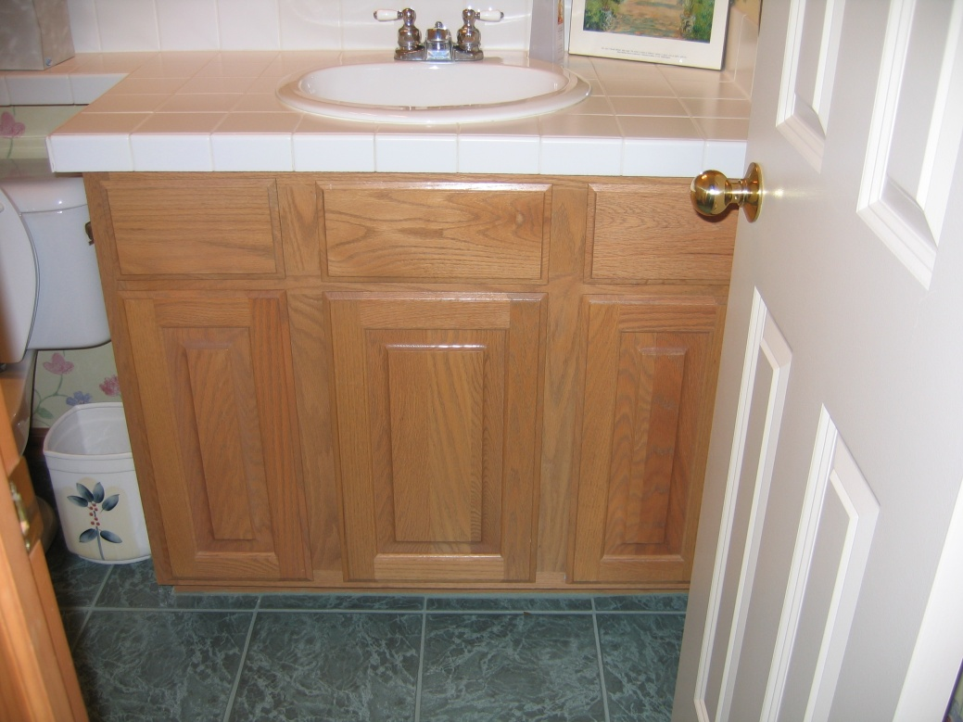
Could you fit a wheelchair under either of these sinks?
Notes:
Access to the bathroom can be difficult with the traditional vanities as pictured on the left. For this vanity you could take out the cupboard doors and remove enough of the items and bottom of the cupboard and a portion of the base to allow someone’s legs to fit under the sink in the vanity cupboard area.
The sink on the right is wall mounted and that might be an option, but you need to be aware that wall mounted sinks should not be used as supports for leaning or getting up out of a wheelchair.

Slide 44
Kitchens
Countertops
Cupboards
Cooking
Refrigerator /freezer
Eating area
Dishwasher
Notes:
Please look at the kitchen questions on your worksheet now. We will go through each of these areas individually.
Think about how safe and easy it is for you to do the things you want and need to do in the kitchen. Your desire and need to cook may change at different points in your life.

Slide 45
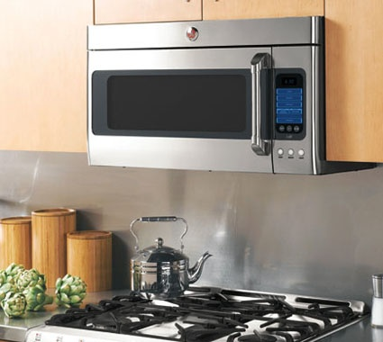
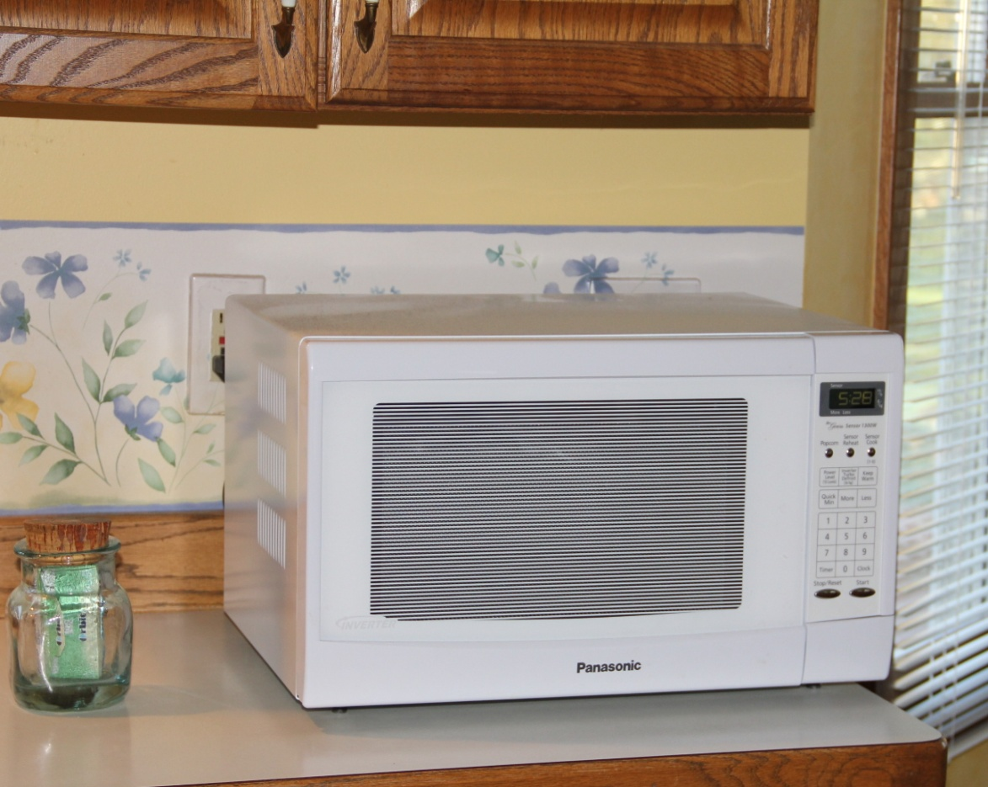
Over the stove vs. countertop microwave
Notes:
Although having our microwave right above the stove-top seems to be a good use of space, this can become difficult for us if we have any arm limitations for getting our arms up to the microwave and then lifting dishes up and down. A more convenient location is actually right on the countertop so we can easily maneuver the dishes at a more manageable height.

Slide 46

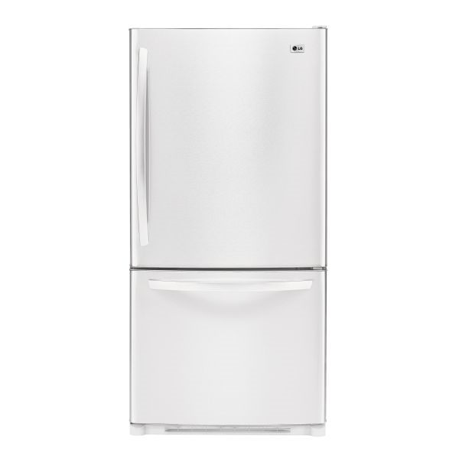
What type of refrigerator is easier for you to use?
Notes:
There are many different styles of refrigerators, but we each need to think about where we can store the things that we use the most so we can easily reach and manage those things.
Some styles work better for some people than others. If you want to get to both refrigerator and freezer items often and you have enough space, the side-by-side refrigerator/freezer may be a great option for you—everything you use frequently can be at waist height. If you don’t use the freezer much, the model with the freezer on the bottom allows more accessible refrigerator space. You have things from mid-thigh up so you don’t have to bend down to get things from the bottom shelf crisper.

Slide 47


Pull out counter top increases accessibility
Notes:
Sometimes we need to sit while we prepare food. This can be difficult if we don’t have a convenient place to do this in the kitchen. A simple solution to this problem is to change a drawer into a pull-out cutting board where you have space to fit your legs under the pull-out while you sit and prepare food.
Store the items that you use most often in easy to access areas. This may mean that you have some things stored on your counter-top.

Slide 48

Stove Controls
Notes:
The location of the stove controls is often best at the front so that you don’t have to worry about burning yourself if you have to reach across hot burners to reach them. That is only safe if you do not have young children around who might turn the controls on and get hurt.
Are you safe getting things in and out of your oven? You can always wear the heavy duty oven mitts and the “handy dandy” oven rack puller to make this style of oven safe if you don’t have a wall oven.

Slide 49

Oven Rack Puller
Notes:
Are you safe getting things in and out of your oven? You can always wear the heavy duty oven mitts and the “handy dandy” oven rack puller to make this style of oven safe if you don’t have a wall oven.

Slide 50

Place table next to kitchen counter
Notes:
Sometimes we may need to temporarily set up a table near our counter work space. This set up was used after a woman had a knee replacement since she could not easily carry things across the room with her walker during her early recovery time. The table could easily be taken down when she had her Book Club, but made things easier and safer for her for the few weeks she needed a close eating area.

Slide 51


Is this dishwasher style more accessible?
Notes:
There are different styles of dish washers available now that eliminate some of the bending if you are just doing a small load. These drawer systems would allow you to access the dishwasher without bending to reach the lower rack of a traditional dish washer. Some people find these styles energy efficient for them as well since they can run smaller loads when there are just 1 or 2 people eating on a regular basis, but they do have the extra capability when they have company and someone else is there to help with the lower level drawer.

Slide 52



Laundry
Notes:
Many homes have the laundry facilities in the basement. If you were not able to use the stairs, what problems would you encounter doing laundry? What are your options? Move your laundry facilities to the mail floor, put in a stair lift, or have someone else do your laundry for you.
The two styles on the left are closet size combination washer/dryers and have some nice benefits.
The style on the right is a raised front loading machines that is a more expensive model, is much bigger and energy efficient but it may be difficult to find space for the size washer and dryer on your main floor. You would also need a matching dryer which is the same size.
Think about whether or not there is a space in your current home for a washer/dryer on your main floor. Is there a closet that you could use for a space-saving combination like on the left on the screen? Is there a place to insulate part of your garage to locate it there? Can you change part of your kitchen to allow you to move it there? Some of your options might be to replace some cupboards or a pantry or a breakfast nook.

Slide 53
Leisure Activities
What do you like to do in your free time?
  Woodworking
  Computers
  Sewing/Quilting
  Other
What problems might you encounter continuing to enjoy you leisure activities?
  Accessing the area (basement/garage/2nd floor bedroom)
  Accessing/using the tools, equipment, space
Notes:
The AARP research has found that we are happiest when we are engaged in activities that are meaningful to us. What are things you like to do and find meaningful? What can you do now so that you will still be able to enjoy doing those activities in the future.

Slide 54

Electrical Outlets and Switches
Outlet height
  Traditional height
  Raised in areas of most use
Switches height and type
  Maximum height of 48”
  Use of rocker style switches
  At bottom and top of indoor stairs
Notes:
How high are most of your electrical outlets, light switches and thermostats? You may want to consider one change to make is to move outlets and switches to be 3-4’ from the floor. It can make things much easier for you to plug and unplug appliances, turn on light switches and manage the thermostat. The rocker style switch shown on the slide can make turning lights on and off very easy. There are big safety benefits for having a switch at both the top and bottom of a staircase.

Slide 55
Lighting in the Home
Adequate lighting is needed
  Hallways
  Stairways
  Entrances
  Living areas
  Bedrooms
  Bathrooms
Notes:
Being able to see well enough is critical for your safety. Being “green” is the rage right now, but being safe is more important than saving a few cents or kilowatt hours. Good lighting can prevent a fall, so think about making sure all of the areas listed on the slide are well lit as a preventative measure to keep you from falling and breaking a hip. There are so many problems that start with a hip fracture, so doing everything possible to prevent this is well worth the cost.
Another safety concern is tripping on throw rugs. Although they can make it warmer in the winter and softer while doing dishes and clean off shoes, rugs can be significant safety issues and often are the cause of falls.

Slide 56



Night Lights
Notes:
We have to worry about lighting especially at night to prevent falls when we get up to go to the bathroom. Consider placing these inexpensive lights in the bedroom, the hallways and the bathroom. The first picture is an LED night light that is movement sensitive, the 2nd night light is light sensitive, and the last night light is an led light that is light sensitive. All these were purchased at local stores.

Slide 57


Windows
Notes:
The purpose of this slide is to help you think about the importance of windows and your ability to open and close them if needed. Whatever type of window you have, the window needs to open and close easily enough that you can use them for temperature control or escape if needed. Often people do not think about how important it is to open and close a window in terms of safety.

Slide 58




Emergency Communication
Notes:
Having a way to contact someone in an emergency is an important. This might be a cordless phone that you carry with you, a cell phone that you have in your pockets when you take out the garbage or a emergency alert system such as a lifeline to make easy contact with someone if you need help. Here are several options. Cordless phones now come multiple phones and charging stations so you can carry one around while another is charging. There are very simple cell phones without contracts that have large numbers and easy ways to contact who you need only when you need them.

