Slide 1
Building Better Balance is as Easy as 1..2..3!
Presented by:
Lisa Spangler, COTA
Jill Banka, PTA
Kara Hansen, BS

Slide 2
Program Development
Education of Wellness, Nursing and Activities Staff
Working together as a Team to identify those Residents in need

Slide 3
Education of Residents and Families
Introduction of Therapy Staff

Slide 4
Discuss Therapy Options
Physical Therapy
The goal is to reduce pain and improve or restore mobility.
Increase strength, balance, and coordination
Assessing and treat pain
Modalities
Manual therapy and joint mobilization
Gait training and safety education on use of walker or cane if needed
Promotion of health and wellness
Individualized exercise programs

Slide 5
Occupational Therapy
The goal is to increase independence and safety with every day activities.
Compensatory strategies with everyday living skills.
Energy conservation
Use of adaptive equipment
Modifications based upon cognitive level
Contracture management
Low Vision
Home evaluations and education on home modifications
Individualized exercise programs

Slide 6
Education on Falls
25% of hospital admissions and 40% of nursing home admissions are due to falls.
50% of the elderly who are discharged home for fall related hip fractures will experience another fall within 6 months.
87% of all fractures in the elderly are a result from a fall.
1 out of 5 people with hip fractures die within 1 year of injury.
25% of people who are on their own before a hip fracture remain in the nursing home for at least one year.

Slide 7
Cost of Falls
The average health care cost of a fall injury is $19,440 which includes hospital, nursing home, emergency room, and home health care.
Many Falls are Preventable
Cost Effective options vs. Cost of a Fall

Slide 8
It takes a Team to be Successful
Wellness
Nursing
Therapy
Administration

Slide 9
Screenings
Tinetti vs. Others

Slide 10
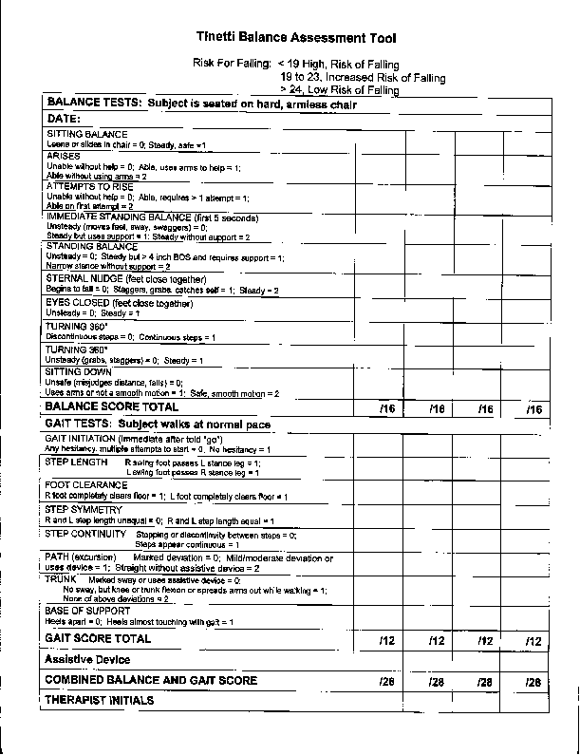

Slide 11
Now What?
Recommend Physical Therapy Services to build Strength and improve Balance enough to enter a Balance Exercise Class
OR
Determine the Appropriate Level of Balance Class to begin based on the Tinnetti Balance Assessment Score…1, 2 or 3

Slide 12
Benefits of Physical Therapy-Score below 19
Assess direct and indirect causes of imbalance
Increase Strength
Refer to proper Level of Balance Class

Slide 13
Level 1- Score of 0-19
Standing Two Foot Balance
Standing Two Foot Theraband Balance
Sit to Stand
Heel Raises
Squats
Boxing Stance
Side Stepping
Back Kicks
Front Steps
Back Steps

Slide 14
Level 2- Score of 20-23
1 Leg Stance
Front Toe Taps
Heel Raises
Front Leg Kicks
Leg Raises
Side Kicks
Sit to Stand
Heel to Toe Walk
Boxing Stance
Front Lunges

Slide 15
Level 2 Cont..
Side Lunges
Squats
Hokey Pokey

Slide 16
Level 3- score of 24-28
Focused on improving Balance without holding on for support
Increased number of Strengthening Exercises
Utilize Balance Pods and other methods of challenging Balance
Obstacle Courses, Stepping over or through items
Increased Speed of Exercises to challenge Balance

Slide 17
Questions?

Slide 18
References
Centers for Disease control and Prevention: www.cdc.gov/homeandrecreationsafety/falls/fallcost.html
Aging Care. www.agingcare.com/Articles/Falls-in-elderly-people-133953.html
Aging Care. Www.agingcare.com/Articles/Exercise-benefits-for-the-Elderly-95383.html.
Hall, C., (2009). OT Toolkit.
Barnett, A., Smith, B., Lord, S.R., Williams, M, Baumand, A. (2003) Community-based group exercise improves balance and reduces falls in at-risk older people: a randomized controlled trial. Age Aging, Jul, 32(4); 407-14.
Hass, R., Malone, S., Lausenberger, E., Keating, J.L., Sims, J., Motley, E., Jolly, B., Morgan, P. & Haines, T. (2012) Clinical Decision Making in Exercise Prescription for Fall Prevention. Physical Therapy. 92(5), pp. 666-679.
Shubert, T.E. (2011) Evidence-Based Exercise Prescription for Balance and Falls Prevention: a current review of the literature. Journal of Geriatric Physical Therapy. 34(3), pp. 100-108.

