Slide 1
Purposeful and Meaningful Leisure and Recreation for Senior Adults
Dawn De Vries, DHA, MPA, CTRS
Email: devridaw@gvsu.edu
2014 Art & Science of Aging Conference

Slide 2
Session Objectives
Participants will be able to:
Define what purposeful and meaningful activity is.
State how engagement in purposeful and meaningful leisure and education contributes to aging well.
Identify how to discover purposeful and meaningful leisure and recreation to an individual.
Explain 3 techniques for motivating and engaging individuals to participate in meaningful and purposeful leisure.

Slide 3
Why do people want to be involved in activities
(work and leisure)?
Notes:
Brainstorm activity – write down response on flip chart.

Slide 4
ACTIVITY IS A BASIC HUMAN NEED expressed in work and leisure.
Life would be pretty boring and meaningless without it.

Slide 5

1,440 minutes in a day

Slide 7
Does it involve…
A sensory experience?
Solace?
Being active?
Cognitive stimulation?
Emotional health?
Self-Respect?
Seasonal or special activities?
Being inside or outside?
Being out in the community?
Cultural or ethnic traditions?
Religion?
Relationships?
People of all ages?

Slide 8
Purposeful and Meaningful Leisure
DOES NOT MEAN . . .
DOES MEAN . . .
Work or task focused
You always have to be “accomplishing” something
Just participating
Being active
Involvement in what you value
Feeling of using your time wisely
Engagement and interaction
Satisfaction and enjoyment

Slide 9
So, what is purposeful and meaningful leisure to you?

Slide 10
Hopkins & Smith (1978) said:
“Activity is the bridge between one’s inner reality and the external world. It is through our activities that we are connected with life and other human beings. Through activities… we learn about the world, test our knowledge, practice skills, express feelings, experience pleasure, take care of our survival, develop competence, and achieve mastery over our destinies”

Slide 11
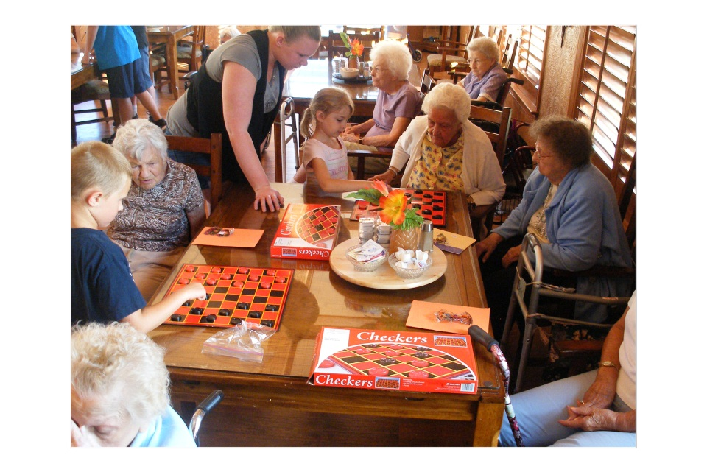
Meaningful Leisure
Being Me
Finding Balance
Providing Enjoyment
Contribute
Provide sense of freedom
Connect us to others
Challenges

Slide 12
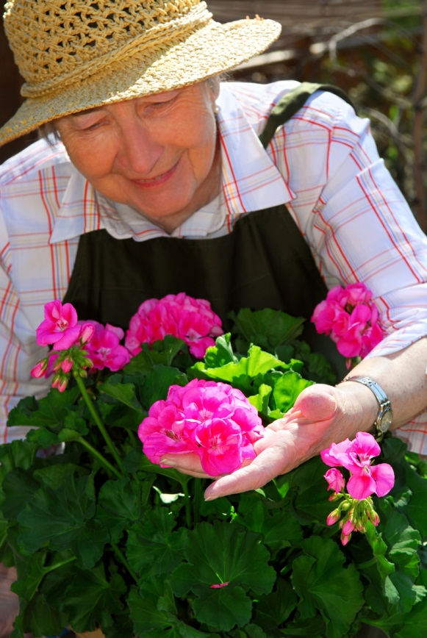
Being Me
What does it mean?
Considerations
  May need adaptations
  What activities are most important to me?

Slide 13
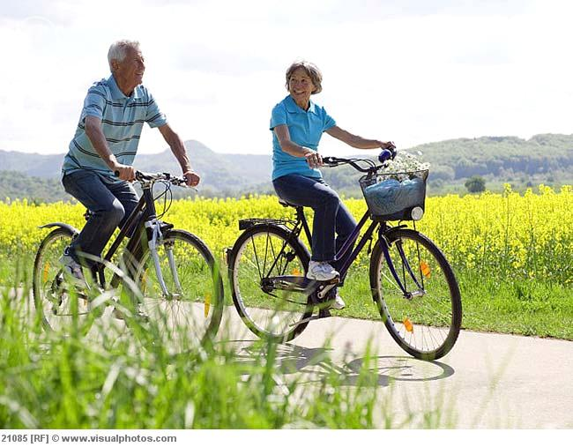
Balance
Between relaxation and keeping busy
Considerations:
  Know your abilities
  Accept what you do is best you do at that time
  Take breaks

Slide 14
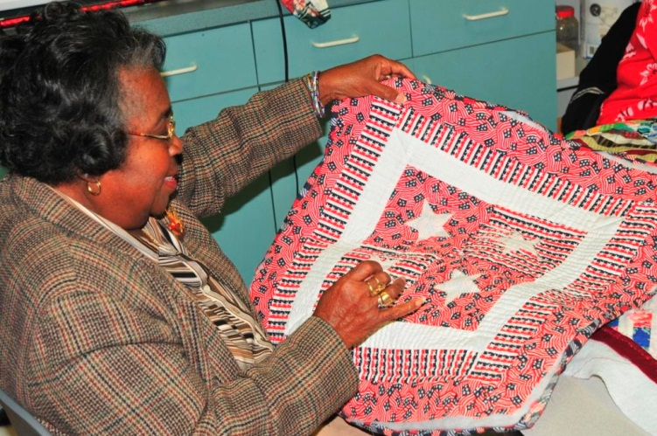
Enjoyment
Have fun and laugh
Be happy!
Considerations:
  Have fun!
  Remember to laugh
  Young at heart
  Fresh perspective

Slide 15

Contribute
What does it mean?
Considerations:
  Recognize value
  Volunteer
  Advocate
  Spending time with others

Slide 16
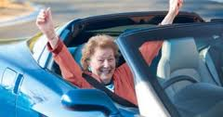

Freedom
Escape stress of daily tasks and responsibilities
Considerations:
  Outdoors
  Arts and music

Slide 17

Connection
What is it?
Considerations:
  Social groups
  Quality relationships
  Tremendous emotional benefits

Slide 18
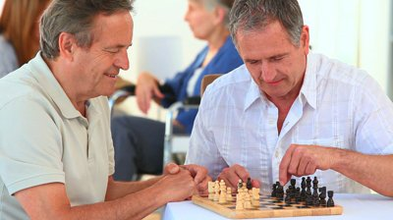
Challenge
Grow, learn, develop
Considerations:
  Try something new
  Learn a new skill or take up a new hobby
  Involve others
  Experience nature

Slide 19
What are the benefits of engagement and involvement in purposeful and meaningful leisure?

Slide 20
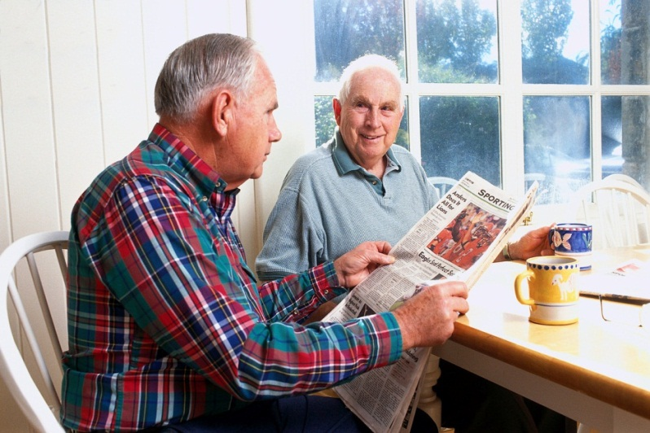
Benefits of Involvement
Give meaning to life
Continue past roles and leisure interests
Reduce boredom
Provide meaningful interaction
Provide structure and routine
Minimize depression, anxiety and isolation
Maintain function and abilities
Notes:
Compare/check off what the group came up with under why involve residents in activities.
Explain some of points such as:
continuation of past roles and interests (artist, teacher)
provide structure/routine
minimize depression by providing meaning, socialization, out of room involvement, active lifestyle
maintain function – ROM even through doing craft – help residents to continue to do tasks for themselves
decrease behaviors by engaging resident, distraction, meaning, boredom

Slide 21
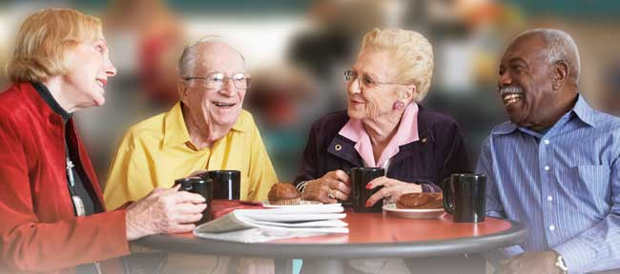
Benefits Con’t.
Provide sensory stimulation
Maintain quality of life
Increase appetite and ability to sleep
Decrease challenging behaviors
Build on strengths and abilities at a time of many losses
Enhance self-esteem

Slide 22
Discovery
Past and present interests and skills
Religious and cultural background
Abilities
Past and present roles
Personality
Experiences: achievements, disappointments, concerns, passions, favorites

Slide 23
Factors that may Interfere with Engagement
Passive
Depression
Lack of purpose/ apathy
Anxiety
Communication challenges
Confusion
Movement patterns
Feeling of dependence
Anger
Loneliness
Wandering
Short attention span
Sensory losses
Cognitive loss
Embarrassment

Slide 24
Principles to Follow for Motivating
Know the person you are trying to motivate.
Provide a reason for the activity.
Keep things short and simple.
Be creative.
Be adaptable and flexible. You may need to change things as you go along.
Minimize distractions and confusion.
Provide environmental cues.
Allow the person to take the lead when possible.
Have all supplies on hand.
Watch for signs of frustration.
Focus on abilities and strengths.
Provide ample time for response and task completion.

Slide 25
Motivating Techniques
Find the best time of day for that individual.
Follow regular but flexible routine.
Be enthusiastic.
Talk with person before trying to get them to do something.
“Can you help me?”
Create success.
Use personal interests and past roles.
Be realistic.
Be encouraging.
Peer invitations.
Children and youth.

