Slide 1


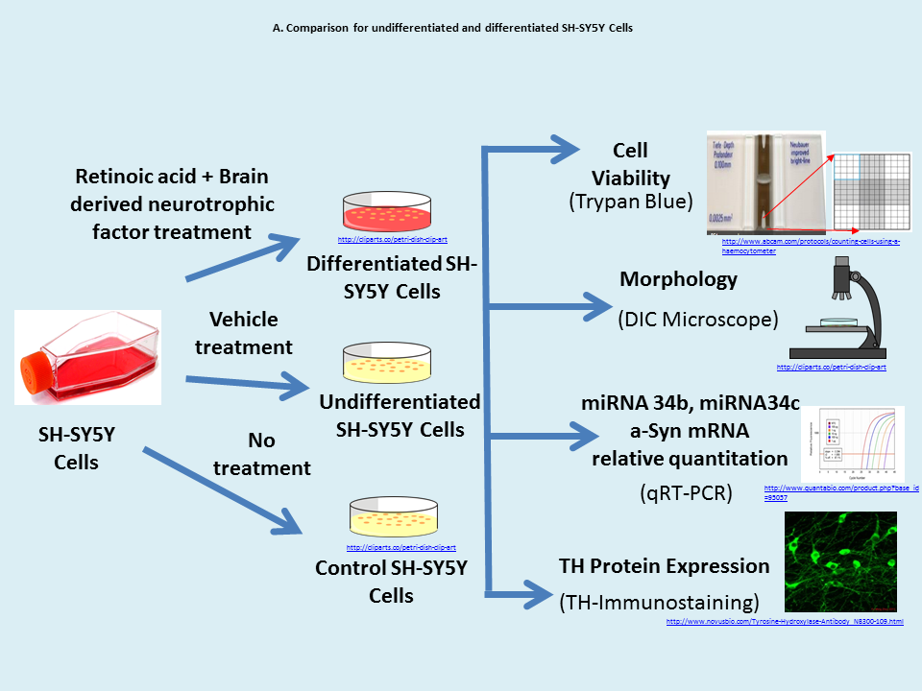
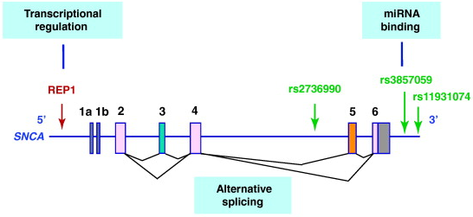
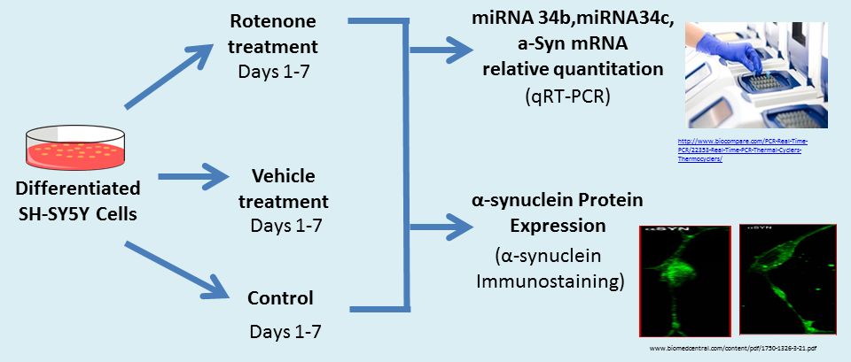
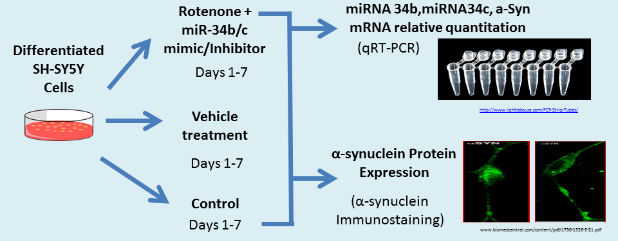
MicroRNA expression studies in rotenone-induced cellular model for Parkinson’s disease
Sapana Shinde, Aaron Ripley, Dr. Sok Kean Khoo
Department of Cell and Molecular Biology, College of Liberal Arts and Sciences, Grand Valley State University
Objective
Introduction
To study expression of microRNAs, miR-34b and miR-34c, in association with alpha-synuclein aggregation in a rotenone induced cellular model of Parkinson’s disease.
Parkinson’s Disease
Parkinson’s disease (PD) is characterized by loss of dopaminergic (DA) neurons along with aggregation of alpha synuclein protein (a-Syn) known as Lewy neurites or Lewy bodies. Although the specific cause of PD is unknown, genetic and environmental factors are shown to play important roles. Rotenone, an inhibitor of mitochondrial complex I of the electron transport chain¹, is commonly used in vitro to reproduce PD phenotypes. Cells cultured with rotenone showed ~30-50% reduction of mitochondrial complex I and induced misfolding and aggregation of a-Syn, which mimic the phenotypic changes that are observed in PD brain tissue ².
Alpha Synuclein (a-Syn)
a-Syn is a highly conserved protein that is abundant especially in the presynaptic terminals of neurons. a-Syn gene was first mapped for PD in 1996. Missense mutations and multiplication of a-Syn can lead to PD pathogenesis. Over-expression of a-Syn has been reported to associate with familial and sporadic PD³. Recent reports suggest post-transcriptional regulation of a-Syn mRNA by microRNAs (miRNAs) at its 3’ untranslatable region (UTR).
MicroRNAs (miRNAs)
miRNAs are small, conserved RNAs (18-22 bp) that mediate post-transcriptional gene regulations and are involved in important biological processes such as cell development, differentiation, proliferation, and apoptosis. A recent study showed miR-34b/c target the 3’ UTR of a-Syn and inhibition of miRNA-34b/c expression showed increased a-Syn level and aggregation in SH-SY5Y cells⁴. Here, we proposed to use rotenone to create a cell model that mimic early-stage PD² to elucidate the relation between miRNA-34b/c expression and a-Syn aggregation.
A. Comparison for undifferentiated and differentiated SH-SY5Y Cells
B. Treatment of differentiated cells with Rotenone
Venda LL et. al. Trends in Neuroscience (2010)
C. Treatment with miR-34b/c Mimic and Inhibitor
Acknowledgements
This project is funded by the Presidential Research Grant Award and Special Project Graduate Assistantship from GVSU Office of Graduate Studies. We also thank GVSU Department of Cell and Molecular Biology for their support.
References
1. Todd B. Sherer et. al. (2002) An In Vitro Model of Parkinson’s Disease: Linking Mitochondrial Impairment to Altered -Synuclein Metabolism and Oxidative Damage. The Journal of Neuroscience, 22(16):7006–7015.
2. Kathleen M. Borland et. al. (2008) Chronic, low-dose rotenone reproduces Lewy neurites found in early stages of Parkinson's disease, reduces mitochondrial movement and slowly kills differentiated SH-SY5Y neural cells. Molecular Neurodegeneration, 3:21: 5021-5030.
3. Lara L. Venda et. al. (2010) α-Synuclein and dopamine at the crossroads of Parkinson's disease. Trends Neuroscience, 33(12):559-68.
4. Savan Kabaria et. al. (2015) Inhibition of miR-34b and miR-34c enhances α-synuclein expression in Parkinson’s disease. FEBS letters, 589(3):319–325.

