Slide 1

Driver Awareness:
15-Passenger Van Safety
Alex Rautio, Facilities Services, OSH Intern
Updated October 2014

Slide 2

Starting Out
Objectives:
Safety steps you should take before any trip
with a 15-Passenger Van
Wearing Seatbelts
Tire Maintenance
Adjusting mirrors

Slide 3
Your Driving Condition
Drivers may not text, talk on the phone, or use MP3 Players
Alcohol or Illegal drugs are strictly forbidden.
Keep in mind, some medicine may cause drowsiness, such as Benadryl
Make sure drivers are fully rested.
Driving through the night is not recommended
Rotate drivers every two hours for long distance trips
Ask someone else to drive if you are feeling fatigued or ill
Do not read maps or adjust a GPS while driving, have a passenger help you navigate.
If driving through the night, it is suggested that you take a break or rotate drivers every two hours. Don’t hesitate to switch drivers if you are feeling tired.

Slide 4

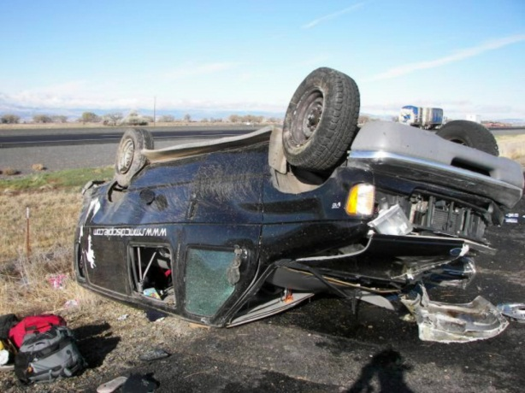
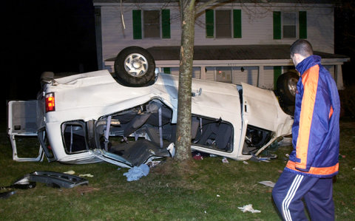
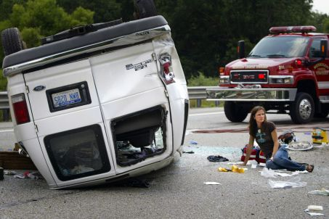
Seatbelts
BUCKLE UP – Wear your seatbelt at all times.
According to the National Highway Traffic Safety Association, about 80% of those killed in a roll over accident were not wearing their seatbelt.

Slide 5

Pre-Trip Inspection
Check that the following parts of the van are working:
Lights
Windows (scrape snow/ice off)
Mirrors
Tires
Windshield wipers
Fuel level
Familiarize yourself with controls
Window wipers, lights and turn signals.

Slide 6
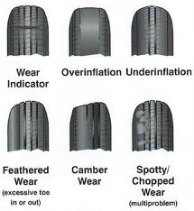
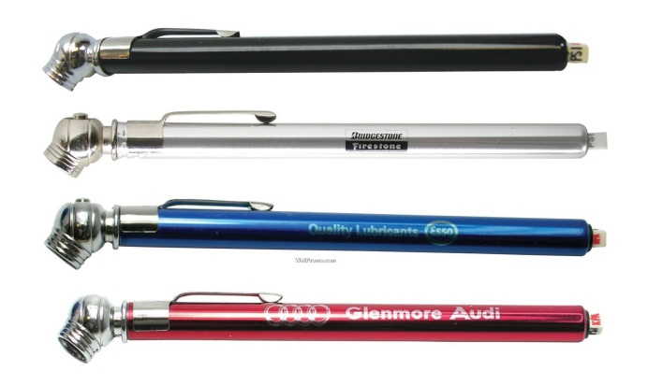
Tires
Do a visual inspection each day.
Check before driving the vehicle.
Be sure there is no aging, cracking, punctures, or rotting rubber.
Tire pressure should be ok when rented through Enterprise.
Low tire pressure is a major cause of rollovers
If tires appear low, you may need a tire gauge.
Tire pressure gauges are cheap at most hardware stores.
The correct P.S.I. is located on the federal certification label (normally on doorjamb or in owner’s manual).
National Highway Traffic Safety Administration estimates that 74% of passenger vans have mis-inflated tires

Slide 7
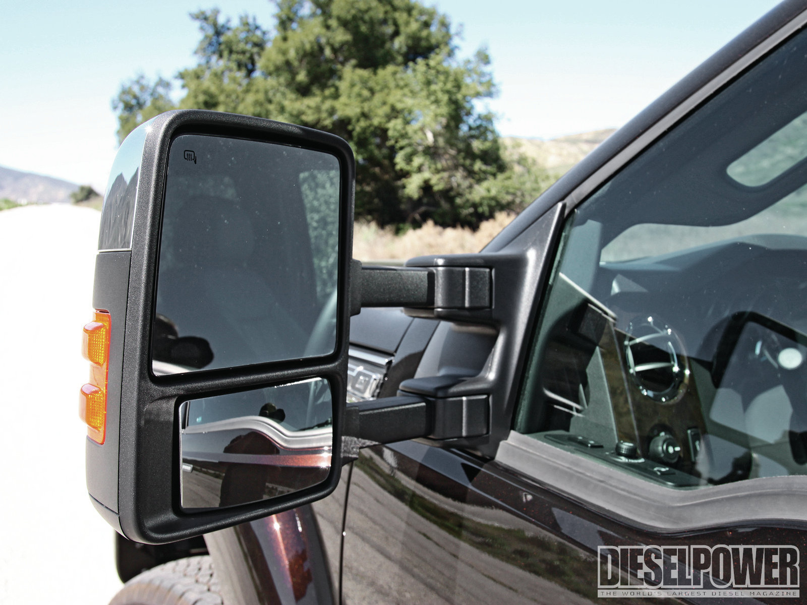
Adjust Your Mirrors
Use mirrors to maximize the view of the area around the vehicle.
Top mirror is used for driving; bottom is used for towing trailers or parking.
Turn mirrors until you can barley see the edge of the van.
Mirrors only give you a clearer view, they do NOT eliminate blind spots.
Use a spotter when backing up if necessary.
Always check mirrors when changing or merging lanes.

Slide 8

Van Characteristics
Objectives:
Characteristics of 15 passenger van
How center of gravity affects driving
How passenger number and placement affect driving stability
*All of these objectives apply to 12 passenger vans and handicapped accessible vans as well.
You may be a good driver, but this is different than driving a normal car.

Slide 9
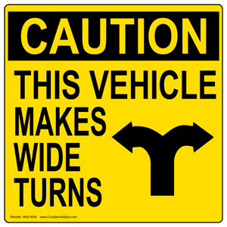
The Van
Driving a 15 passenger van is different than driving a normal van.
It is higher, wider and longer.
Compensate for the differences by modifying your driving behavior.
Use spotters when backing up.
Vans require more space when stopping.
Take turns and lane changes slowly.
Always observe posted speed limits.

Slide 10
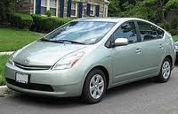
Center of Gravity Is Higher
A vehicle with a high center of gravity is unstable
Center of Gravity always changes with weight and position
More weight creates a higher center of gravity
Never allow more than 15 passengers in a van
Normal Car: Typically bumper level
15-Passenger Van: Typically the bottom of the window/windshield level

Slide 11
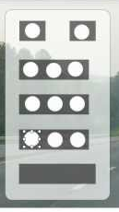
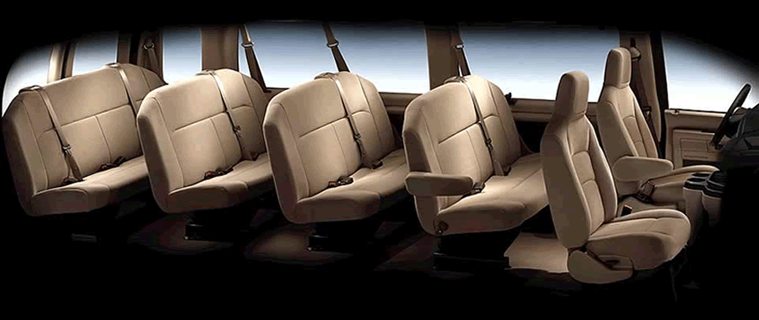
Van handling
15 passenger vans handle differently when loaded and unloaded.
More passengers makes the van more unstable
A fully loaded van is 3 times more likely to roll over than one with less passengers.
Distributing passengers and cargo can lower the center of gravity
Van handling: https://www.youtube.com/watch?v=dBPKt4Pctsg
Van loading: http://www.youtube.com/watch?v=5LrsZPQL-rg

Slide 12
In Case of a GVSU vehicle accident
Remain at the scene. Only move the vehicle if it poses a safety hazard. Call an ambulance if someone is injured.
Report accident to authorities. Report any incidents involving injury or damage to the nearest police department.
Gather Accident Information. Obtain the names/addresses of the other drivers and any person injured. Obtain license plate numbers of anyone involved. Take pictures of the accident if possible.
Obtain names, phone numbers and addresses of any witnesses.
Contact risk Management at GVSU. Contact Michael Doxy as soon as possible at 616-331-2257 or Jackie Adams at 616-331-2257.

Slide 13
Which of these steps must be performed before starting out on a trip? Select all that apply.
A pre-trip inspection
Mapping out route to destination
Adjust the mirrors
Become familiar with controls
Buckle up

Slide 14
The best way to determine the correct tire pressure for your particular vehicle is to check the number shown on the doorjamb sticker. True or False

Slide 15
A walk around inspection of the van should occur how often?
Before every trip
Once a week
Twice a week
At least once a month

Slide 16
Even with the van’s mirrors correctly adjusted, it is impossible to eliminate blind spots.
True or False

Slide 17
According to the National Highway Traffic Safety Administration, What percentage of these who die in a 15-Passenger Van rollover are not buckled up?
20%
40%
80%
60%

Slide 18
When fully loaded with passengers, a van’s center of gravity is higher due to the extra weight.
True or False

Slide 19
Vans are most stable when…
Passengers are seated as far back as possible.
Passengers are spread evenly throughout the van.
Passengers are seated as close to the front as possible.

Slide 20
A high center of gravity tends to make a vehicle ______ as a vehicle with a low center of gravity.
More stable
Less stable
Equally stable

Slide 21
Compared to other types of vehicle accidents, rollover crashes are more likely to result in fatalities.
True or False

