Slide 1
GVSU Anthropology
Internship Workshop
Fall 2016
Tara Hefferan, Ph.D.
224 Lake Michigan Hall
hefferta@gvsu.edu; 331-8924

Slide 2
Today’s Plan
Intro to Internships
Internship Options
Steps to Follow

Slide 3
GVSU Anthropology & Internships
What are internships?
Supervised, structured career experiences
Classroom training into workplace
Defined learning goals, supervision, evaluation

Slide 4
Why Internships?
Anthropologists must articulate and demonstrate skills competency
Anthropologists hired for their skill-sets (Ellick and Watkins 2011)

Slide 5
What skills do anthros possess?
Research design
Data gathering and analysis
Record searching
Transcription
Grant writing
Program evaluation
Diversity training
Cultural competence
Public speaking and presentation
Report writing
Team-based research
GIS mapping
Holistic approach
Critical thinking

Slide 6
What internships are available?
Bethany Refugee Svcs
Cultural Education/JCO
Refugee Employment

Slide 7
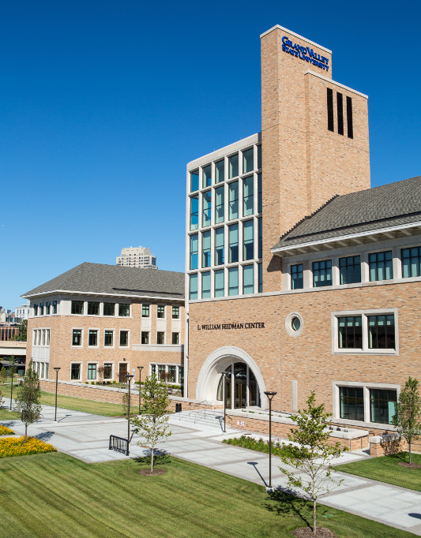
What internships are available?
Degage Ministries
Resource Specialist
Open Door Women’s Shelter
Participatory Action Research?

Slide 8
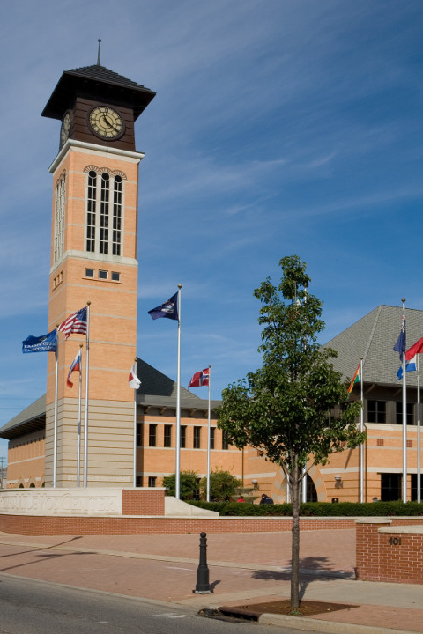
What internships are available?
Fulton St Farmer’s Market

Slide 9
What internships are available?
Other open placements
GRPM
West Michigan Environmental Action Committee
Latin Americans United for Progress
Exodus Place

Slide 10
What internships are available?
GVSU Career Center
Laker Jobs
Other online search tools
Idealist
Indeed
USAJobs

Slide 11
What are the steps to follow?
Define interests and internship goals
Meet with GVSU Anthropology Internship Coordinator Tara Hefferan
Search for an internship
Vet potential internship sites
Establish faculty mentor
Arrange a meeting between the faculty mentor and site supervisor
Complete a Work Plan
Obtain permission & register for ANT 490

Slide 12
(From Nolan 2003:74)

Slide 13
Source: Delgado nd:

Slide 14
Source: Delgado nd: 16

Slide 15
Delgado nd:17

Slide 17
What responsibilities do interns have?
Work with faculty mentor & site supervisor during internship period
Carry out all duties in Work Plan
Complete academic requirements
Academic journal
Work log
Any assigned readings, papers, etc.
At end of semester, submit internship portfolio
Academic journal; work log; other assignments
Internship report “Dear intern”
Reflection essay
Updated resume/CV

Slide 18
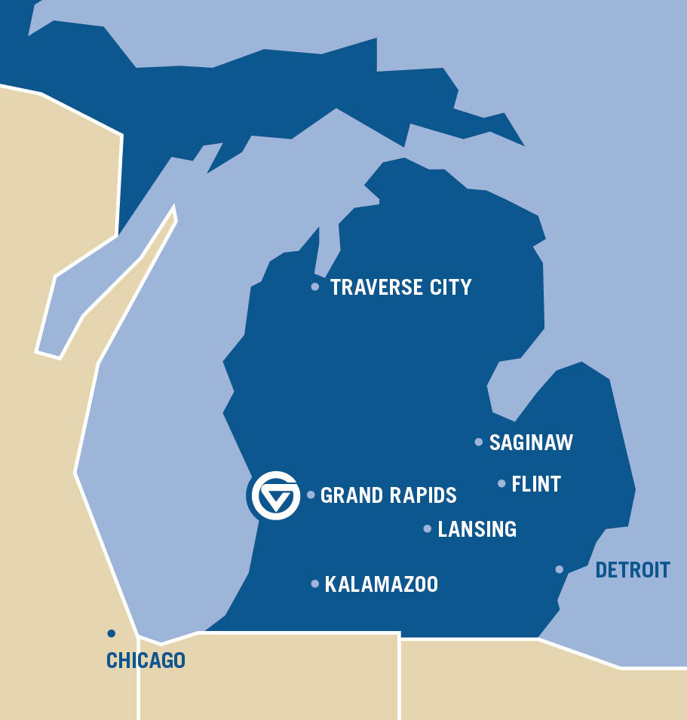
Next steps
Self-assess interests and goals
Peruse today’s internship packet for more details and internship options
Plan your schedule: when will you intern?
Bethany? Or other Spring 2017 internship, meet with Dr. Hefferan in the next couple weeks.

Slide 19
Works Cited
Delgado, Guillermo. n.d. Internship Handbook. Anthropology Internship Program. UCSC.
Ellick, Carol J. and Joe E. Watkins. The Anthropology Graduates Guide: From Student to a Career. Left Coast Press.
Nolan, Riall. 2003. Anthropology in Practice: Building a Career Outside the Academy. Boulder, CO: Lynne Reinner Publishers.

